Slide 1
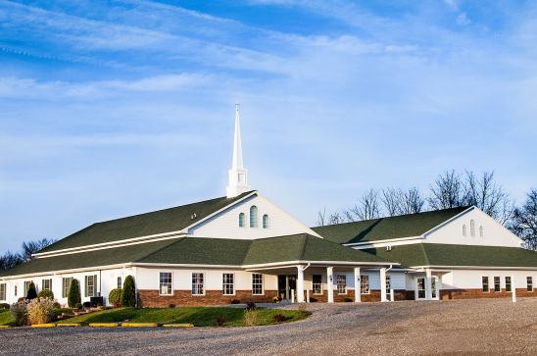
The Doctrine of the Church (continued / application)
The History, Growth, and Character of the Various New Testament Churches

Slide 2
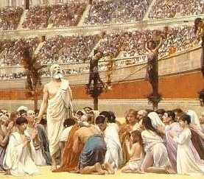
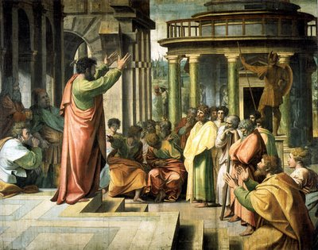
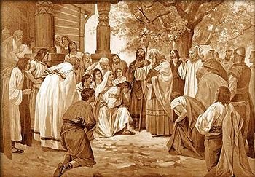
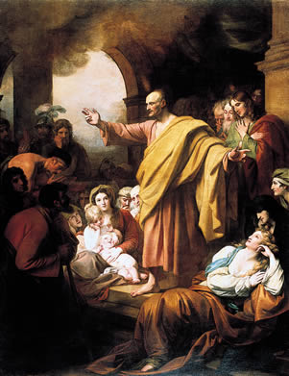
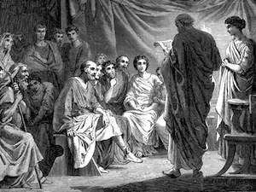
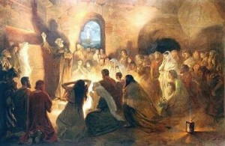
The History, Growth, and Character of the Various New Testament Churches.

Slide 3
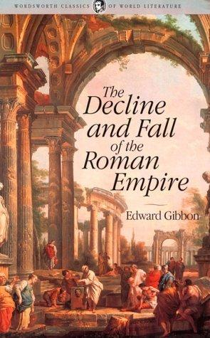

Slide 4
The classic history of ancient Rome is given by Gibbon in Decline and Fall of the Roman Empire, written in the eighteenth century by a scholar who was distinctly antagonistic to Christianity. But even Gibbon named four distinct reasons why Christianity grew so rapidly in the ancient world:

Slide 5
1. The inflexible zeal and enthusiasm of the Christians.
They took the teachings of Jesus at their face value. They refused to compromise with any pagan religion or secular code. ‘They were absolutely happy, always getting into trouble.’
2. The Christian doctrine of the future life.
Even among the most brilliant of the Greek and Roman writers, ignorance, hesitancy, and professed insincerity about immorality are found. The Christian gospel gave people hope of eternal life with God.

Slide 6
3. The miraculous power ascribed to the early Church.
‘With great power gave the apostles witness’. Marvelous miracles were wrought by the disciples to demonstrate the truth of their assertion. Some of these are recorded in the New Testament, but there were many more.
4. The pure, austere morals of the Christians.
They would not compromise with pagan immoralities. They abandoned sins when they became Christians, lived exemplary lives and exhibited a standard of virtue unknown to the ancient world. The virtuous way of life was beyond the understanding of men. They had been used to ‘mystery’ religions imported from the Orient, and were dependent upon secret rites for their appeal. But the ancient Christians exhibited what the apostle calls, ‘the mystery of Godliness.’ The first Christian aim in those days was to be Christlike in life.

Slide 7
The virtuous way of life was beyond the understanding of men. They had been used to ‘mystery’ religions imported from the Orient, and were dependent upon secret rites for their appeal. But the ancient Christians exhibited what the apostle calls, ‘the mystery of Godliness.’ The first Christian aim in those days was to be Christlike in life.

Slide 8
Today there is a vast difference in the spiritual character of the various members of the average local church.
In every local assembly there may be ‘tares’ and ‘wheat’ growing together, that is, both saved and unsaved members.
The apostolic Church was perhaps the nearest approach to the true Church.

Slide 9
The early Christians were:

Slide 10
1. United (Acts 2:44; 4:32; Eph. 4:1-7)

Slide 11
(Acts 2:44-46 ) “And all that believed were together, and had all things common; And sold their possessions and goods, and parted them to all men, as every man had need. And they, continuing daily with one accord in the temple, and breaking bread from house to house, did eat their meat with gladness and singleness of heart, Praising God, and having favour with all the people. And the Lord added to the church daily such as should be saved.”
(Acts 4:32-33) “And the multitude of them that believed were of one heart and of one soul: neither said any of them that ought of the things which he possessed was his own; but they had all things common. And with great power gave the apostles witness of the resurrection of the Lord Jesus.”

Slide 12
(Ephesians 4:1-7)
“I therefore, the prisoner of the Lord, beseech you that ye walk worthy of the vocation wherewith ye are called, With all lowliness and meekness, with longsuffering, forbearing one another in love; Endeavouring to keep the unity of the Spirit in the bond of peace. There is one body, and one Spirit, even as ye are called in one hope of your calling; One Lord, one faith, one baptism, One God and Father of all, who is above all, and through all, and in you all. But unto every one of us is given grace according to the measure of the gift of Christ”

Slide 13
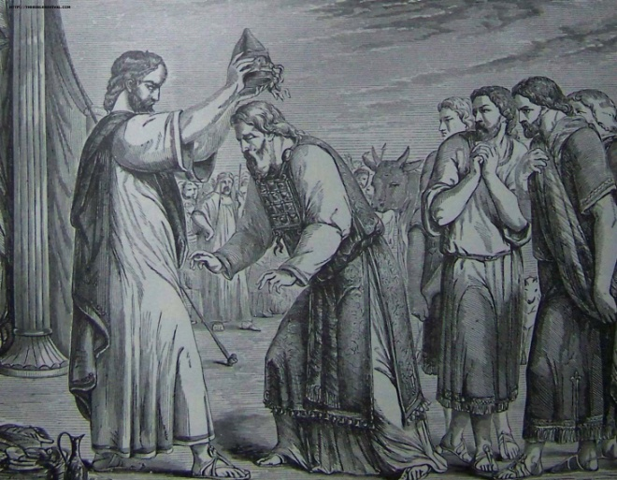
(Proverbs 6:16-18) “These six things doth the LORD hate: yea, seven are an abomination unto him: A proud look, a lying tongue, and hands that shed innocent blood, An heart that deviseth wicked imaginations, feet that be swift in running to mischief, A false witness that speaketh lies, and he that soweth discord among brethren.”
(Psalm 133:1) “Behold, how good and how pleasant it is for brethren to dwell together in unity!”

Slide 14
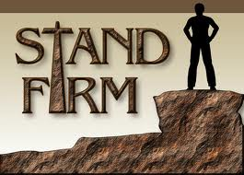
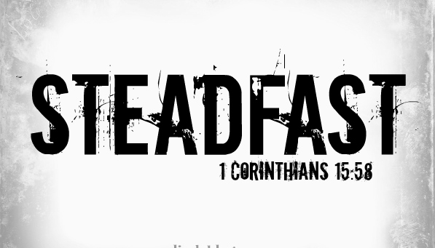
2. Steadfast

Slide 15
(Acts 2:41-42) “Then they that gladly received his word were baptized: and the same day there were added unto them about three thousand souls. And they continued stedfastly in…

Slide 16
Steadfast in doctrine.
No turning aside from facts to fables, no heaping up teachers with itching ears, no wavering like the waves of the sea, tossing about from doubt in despair! They were steadfast in their belief in God’s Word – I Thess. 2:13
Steadfast in fellowship.
If the members had stopped to criticize, no doubt they would have found faults in each other and their church, but they remained steadfast in fellowship. They were quick to see their own failures, but slow to criticize others’ faults – Phil. 2:1

Slide 17
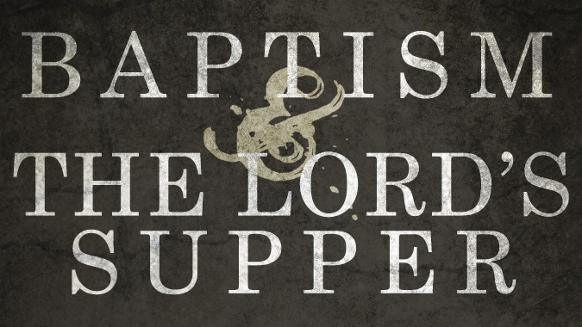
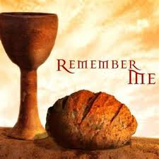
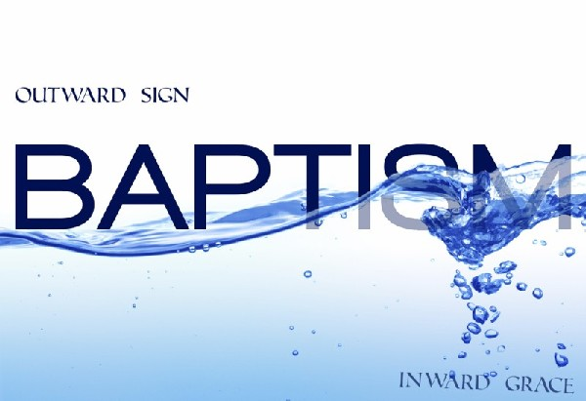
Steadfast in observing the ordinances.
Christ was the substance of sermons and the center of worship – Col. 1:18
The institution of the Lord’s Supper and of Baptism represented the work of grace in the hearts of the early believers - Rom. 6:3-4; 1 Cor. 11:23-26

Slide 18
Steadfast in prayer.
They prayed ‘in one accord’ and received such a wonderful answer that they continued steadfast in prayer.
The true Church is composed of praying Christians - Acts 1:3-4, 12-14

Slide 19
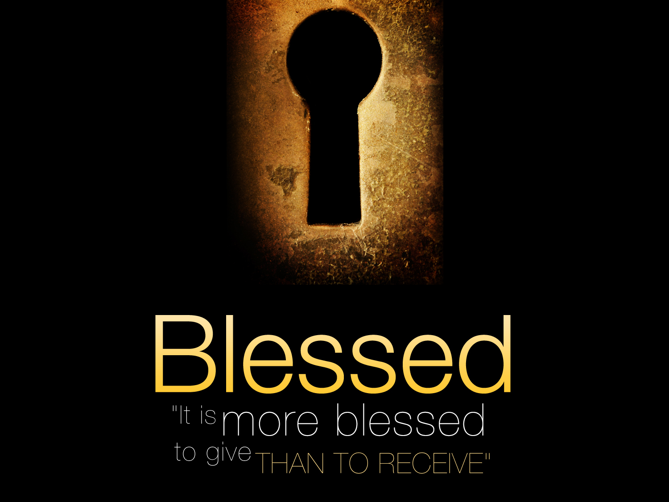
3. Charitable (Acts 2:45; 4:34-35; Eph. 4:28-32)

Slide 21
They ‘sold their possessions and goods, and parted them to all men, as every man had need.’
The members gave spontaneously.
Their love for each other was so great that they sold out their businesses and disposed of their lands, laying the money at the disciples’ feet.
Their charity was a wonderful testimony of the love of Christ.
Those who looked on the sacrificial giving of the early church commented - ‘See how they love one another.’

Slide 22
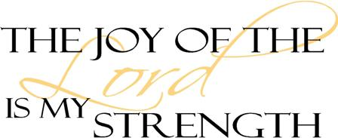
4. Joyful (Acts 2:46-47; Eph. 5:18-21)

Slide 23
They continued daily with one accord in the temple with gladness and singleness of heart.
It was this singleness of heart that made them happy.
They were not divided between Christ and the world, but being wholly the Lord’s, they rejoiced in the Lord.
Their communion with Christ was not clouded with the things of this world.
They rejoiced in God because they were so glad to be saved this filled them with great joy.

Slide 24
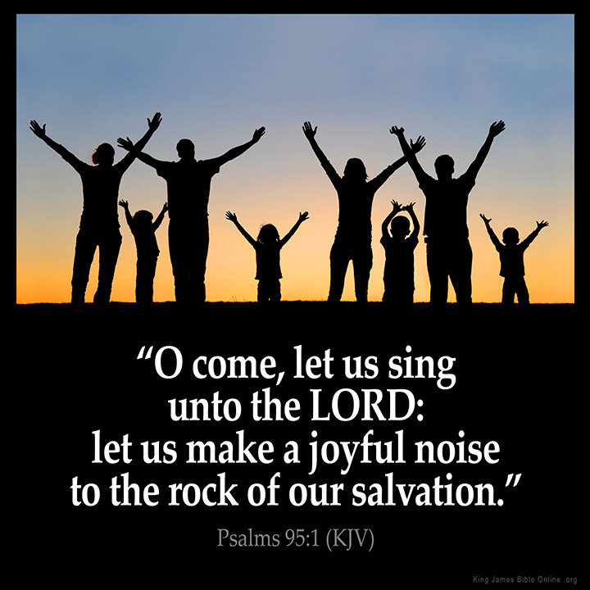
Don’t ever get over being saved

Slide 25
5. Favor with men
(Acts 2:47)
“Praising God, and having favour with all the people. And the Lord added to the church daily such as should be saved.”

Slide 26
It is a most remarkable thing that in spite of opposition and persecution from the people and the rulers, the early Church was exceedingly popular.
Far more than the average church today. The sincerity and joy of these first Christians could not fail to impress the people of the world who were looking for life and happiness.
These men believed in the reality of what they saw, and when they realized that the members of the church were united, steadfast, charitable, joyful, and downright earnest in their faith, they were greatly moved.

Slide 27
(Acts 5:13-14)
“And of the rest durst no man join himself to them: but the people magnified them. And believers were the more added to the Lord, multitudes both of men and women.”

Slide 28
6. Successful (Acts 2:41, 47; 5:14; 6:7; 13:44; 16:5; 18:8)

Slide 29
Never was a church so richly blessed with the power of God. The church grew by leaps and bounds. For the first two centuries the Church ran along the ground like wild-fire, and out of nothing assumed such vast proportions that the whole world was ‘turned upside down.’

