Slide 1
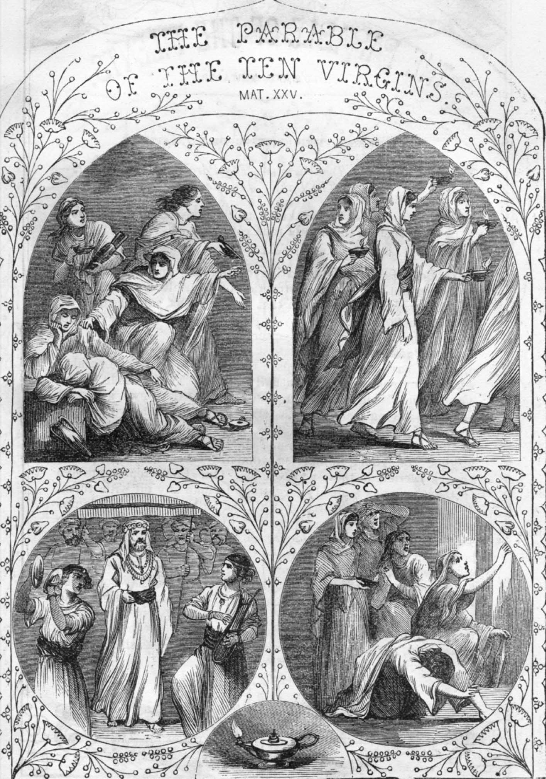
A Prophetic Parable
The wise and foolish virgins
(Matthew 25:1-13)

Slide 3
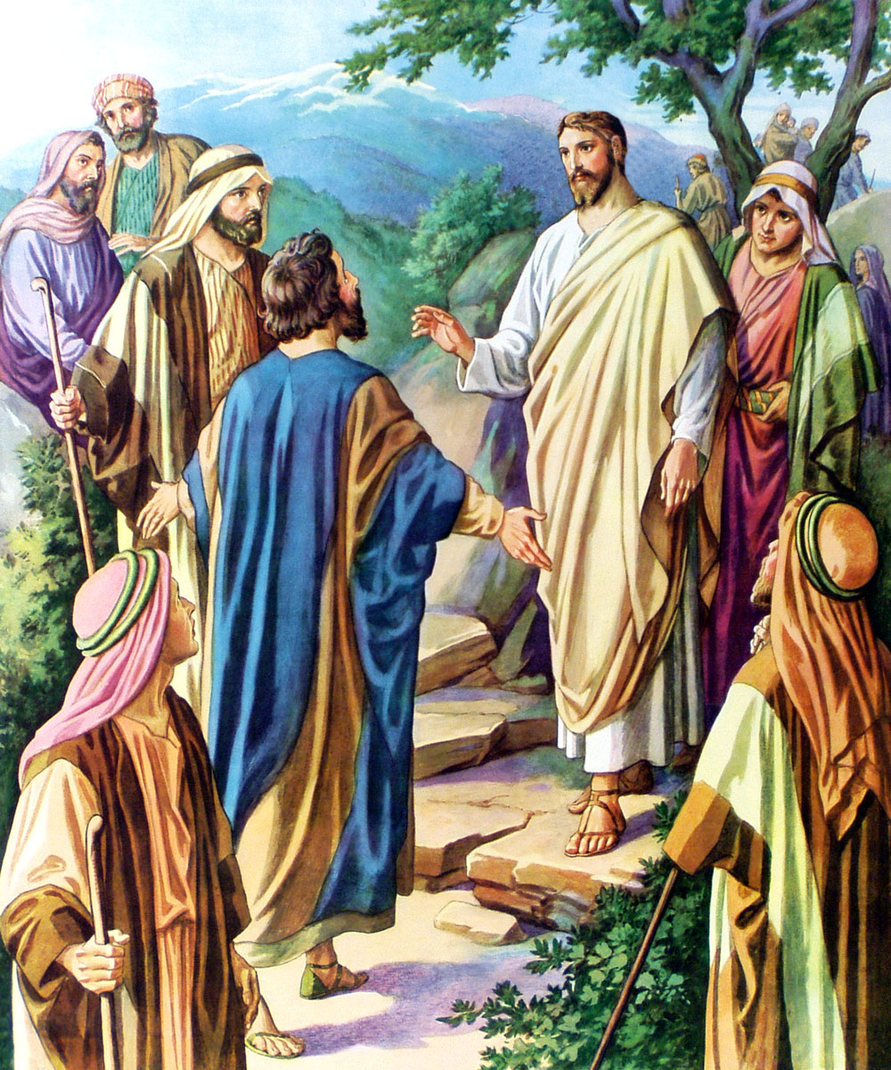
Jesus teaching His disciples what would be the signs of His coming and the end of the world.
Matthew 24:1-39

Slide 4
Jesus exhorting His disciples to always be watching and ready for His return.
Matthew 24:40-44

Slide 5
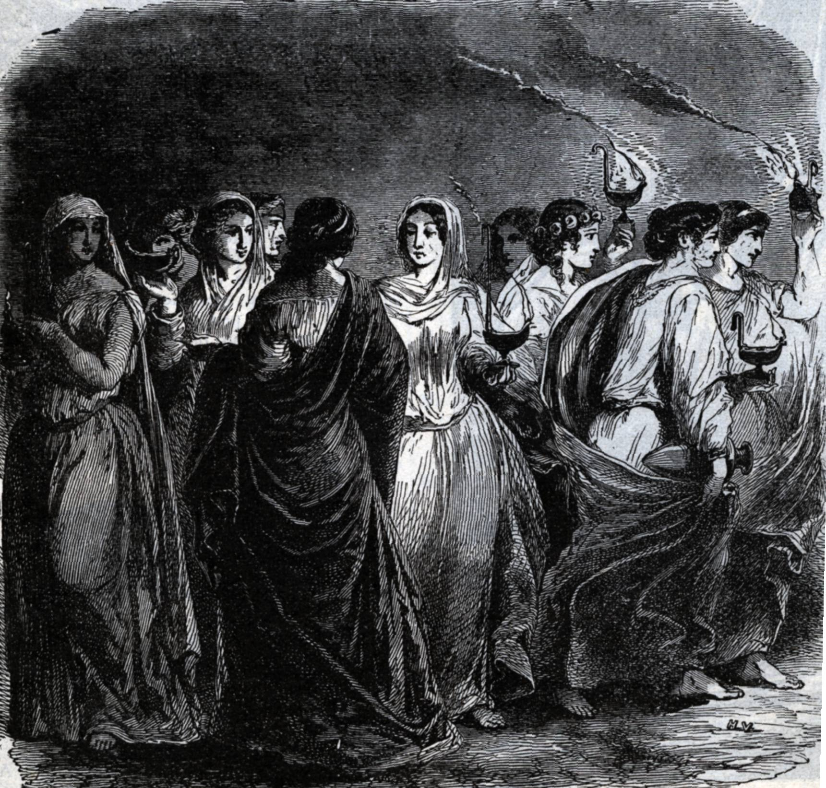
Jesus teaching on the parable of the ten virgins
Matthew 25:1-13

Slide 6
Matthew 25 “A Dividing Work”
Parable of the 10 virgins - The prepared from the unprepared – vs. 1-13
Parable of the Faithful and the Unfaithful servant – One reward the other punished - vs. 14-30
The Judgment of the Nations (Sheep from the goats) – One saved the other lost – vs. 31-36

Slide 7
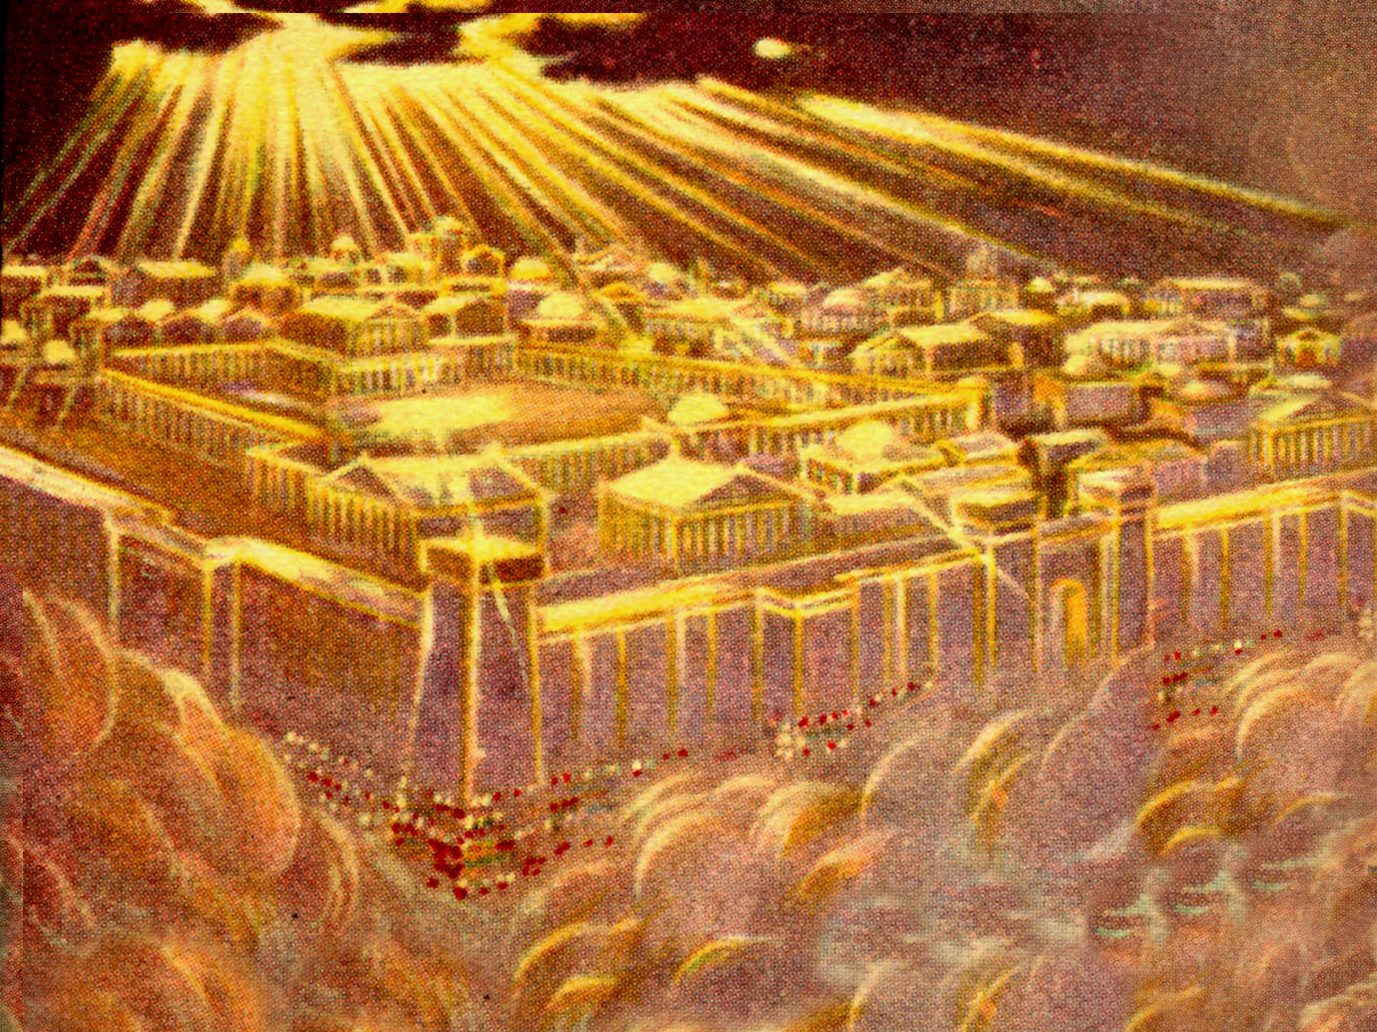
Kingdom of heaven

Slide 8
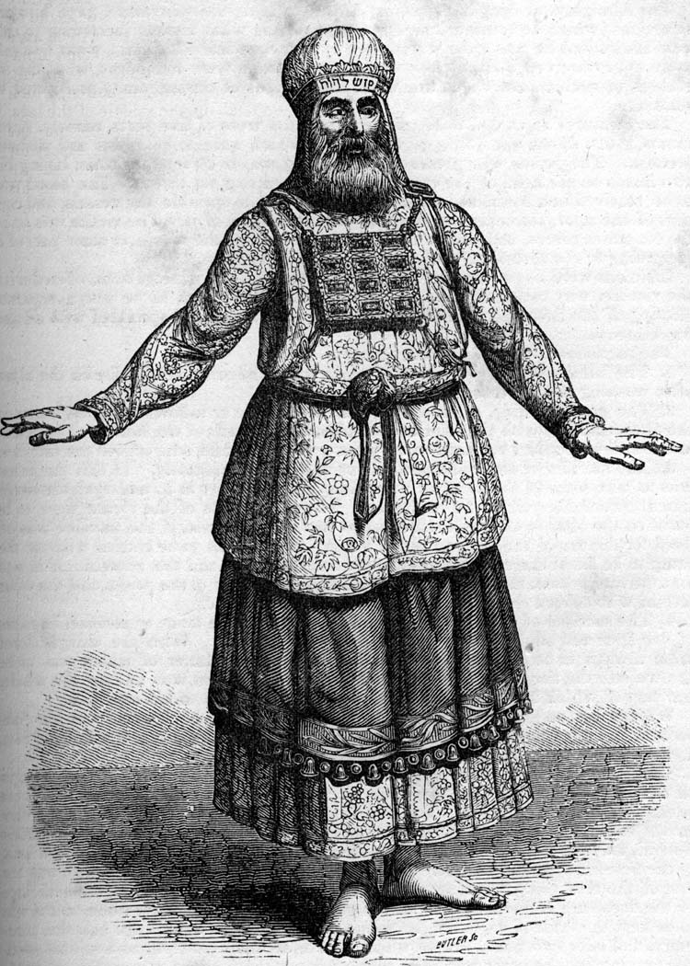

Slide 9
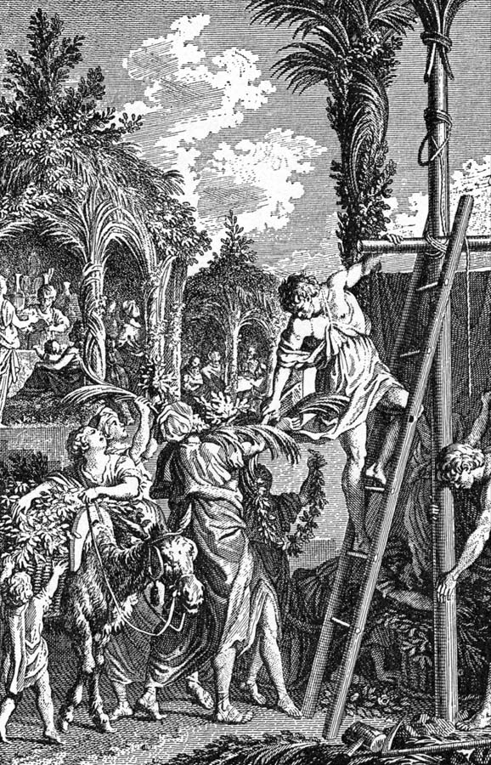

Slide 10
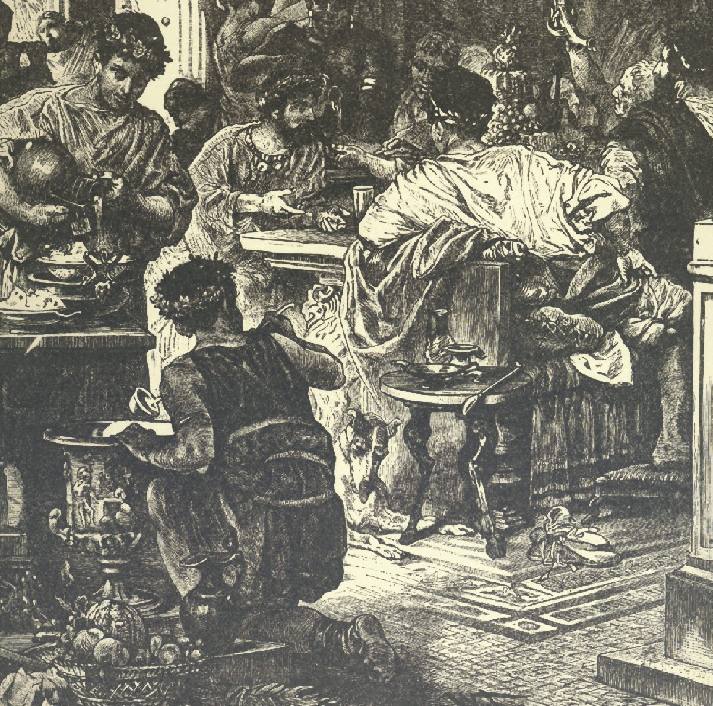

Slide 11
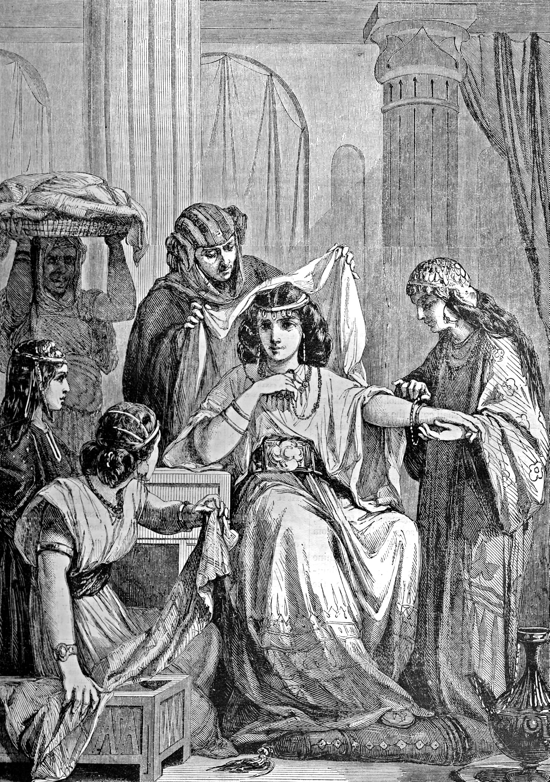

Slide 12
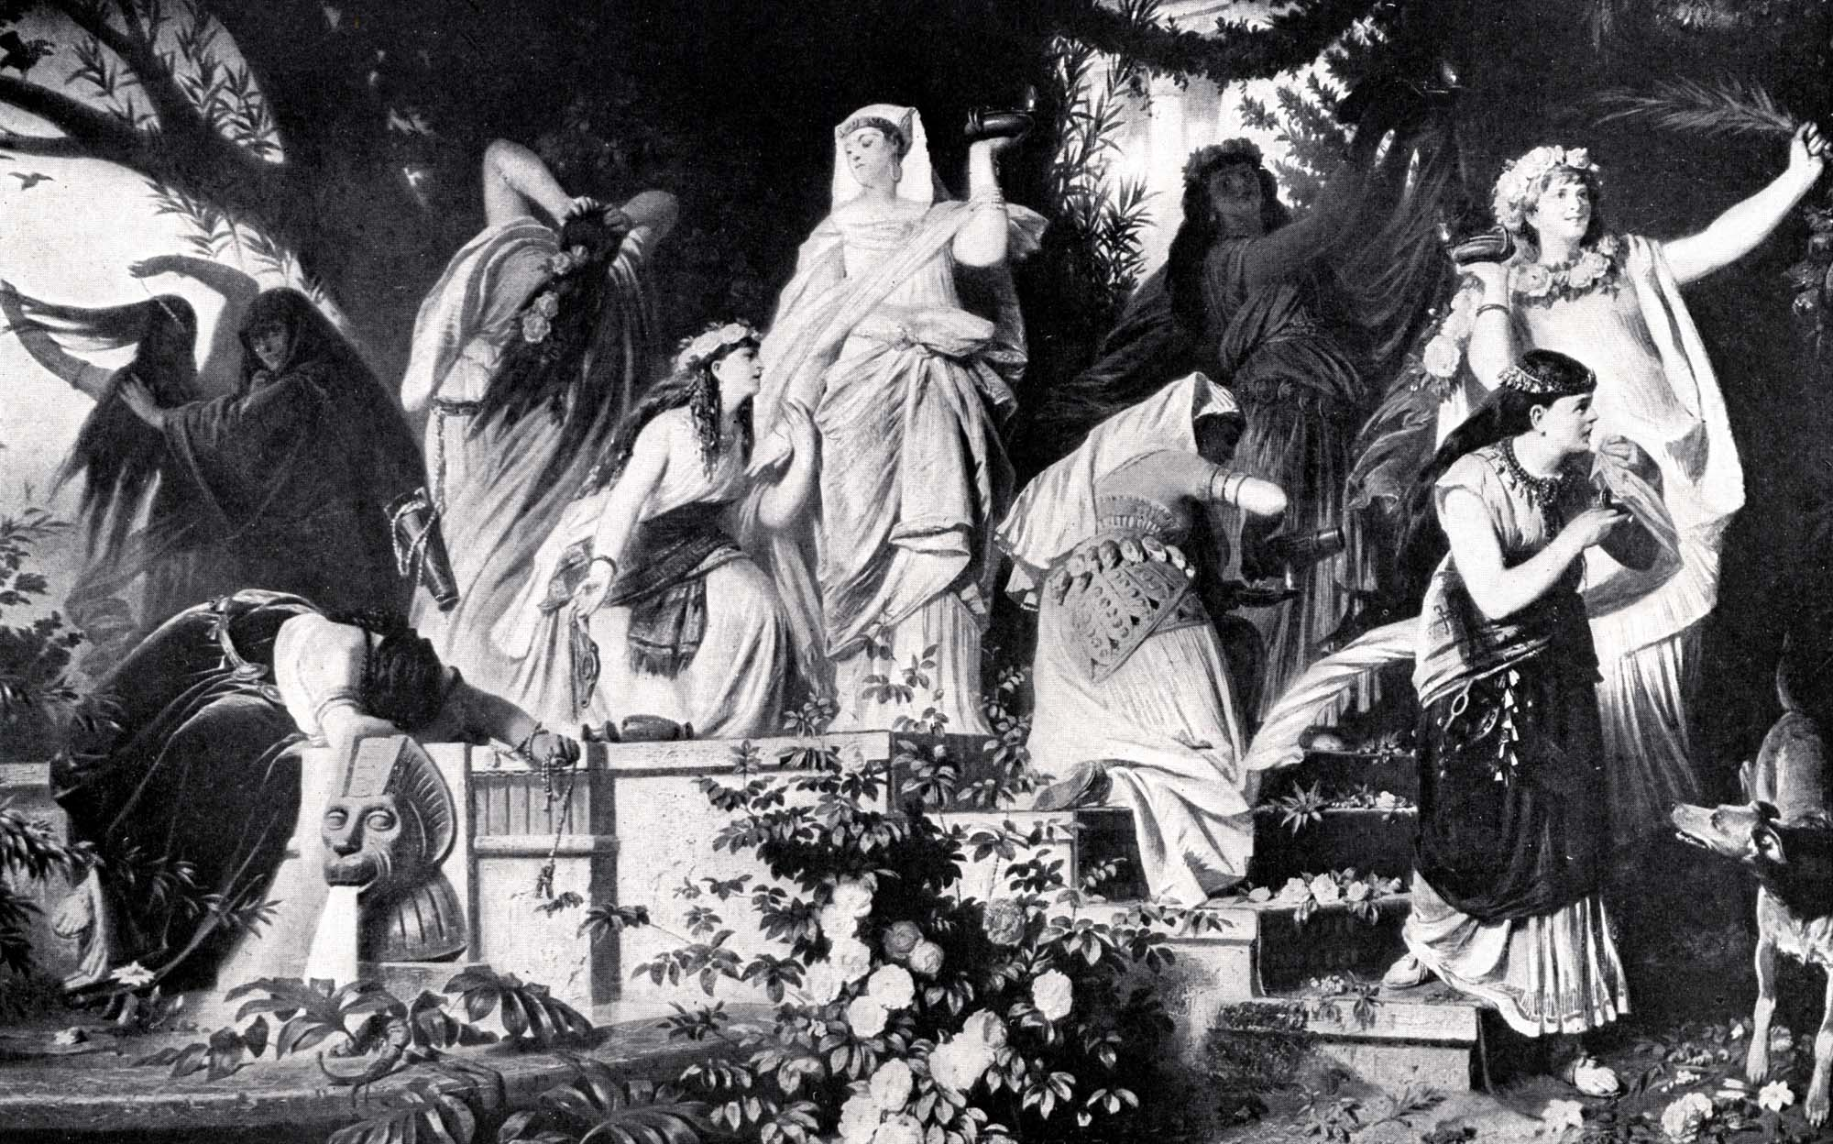
Ten Virgins

Slide 13
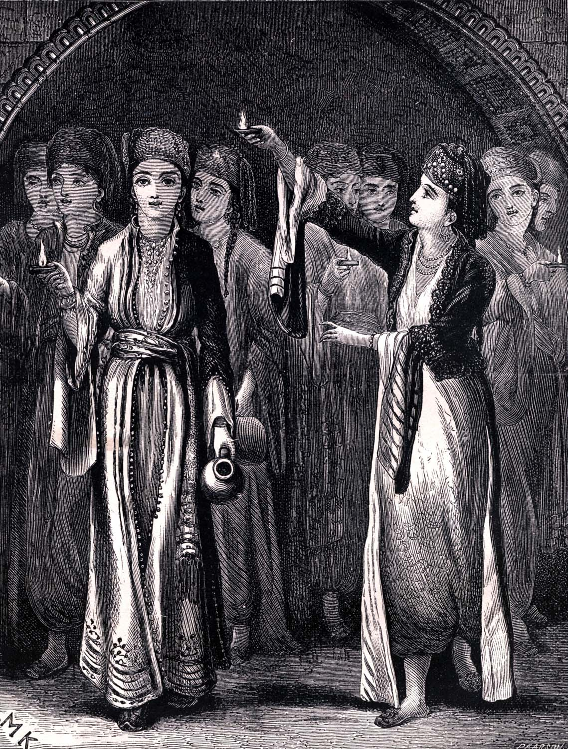
Five wise

Slide 14
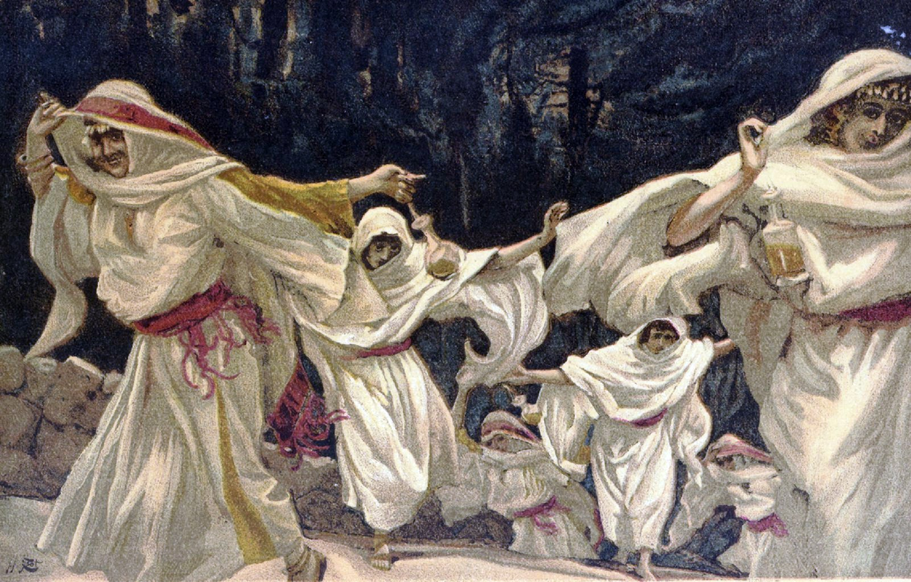
Five foolish

Slide 15
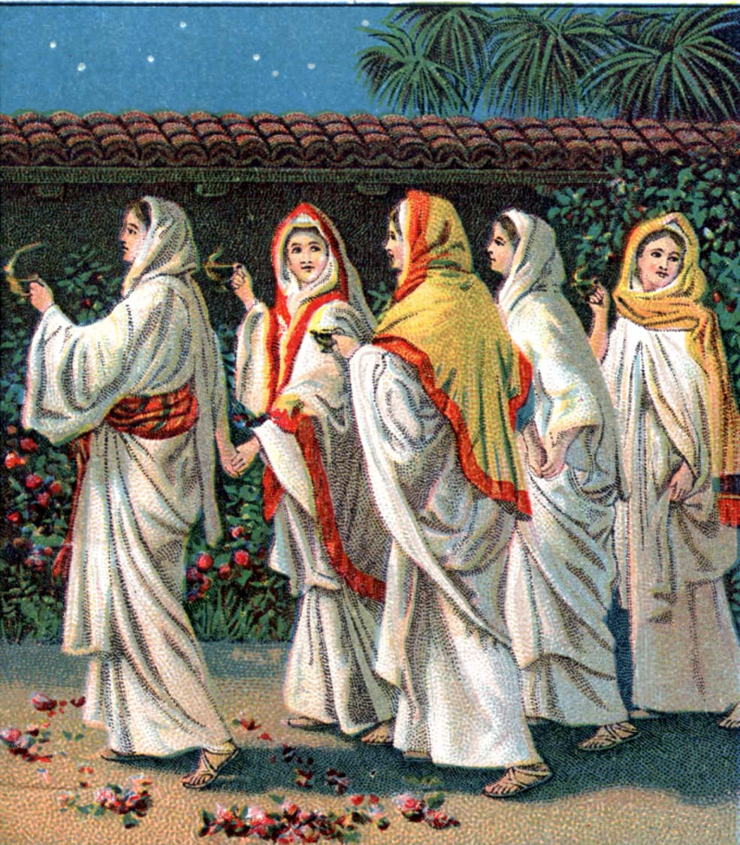

Slide 16
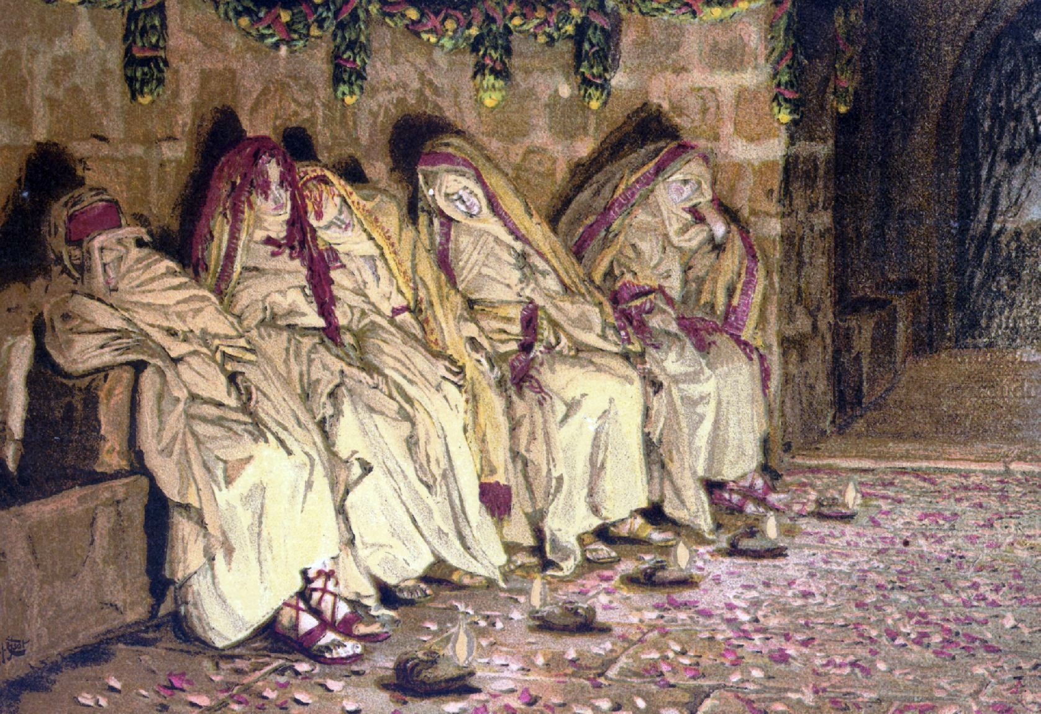

Slide 17
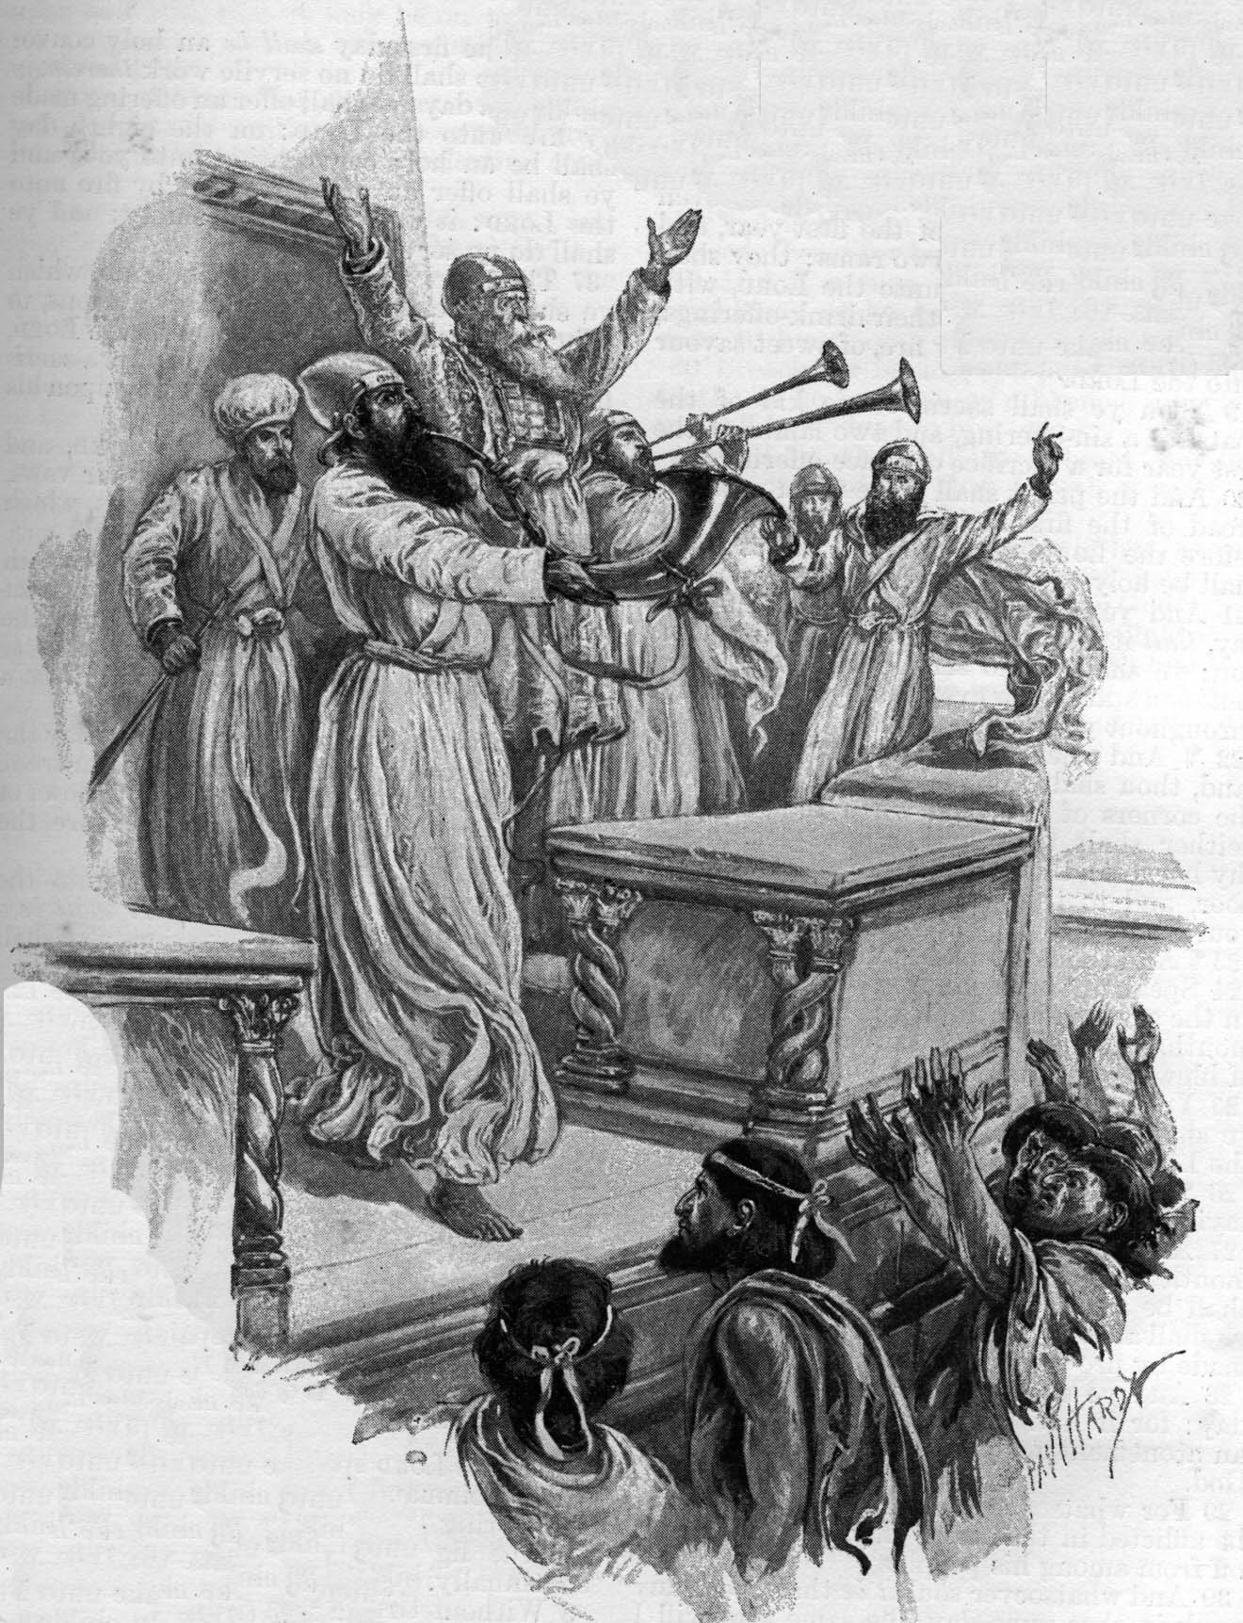

Slide 18
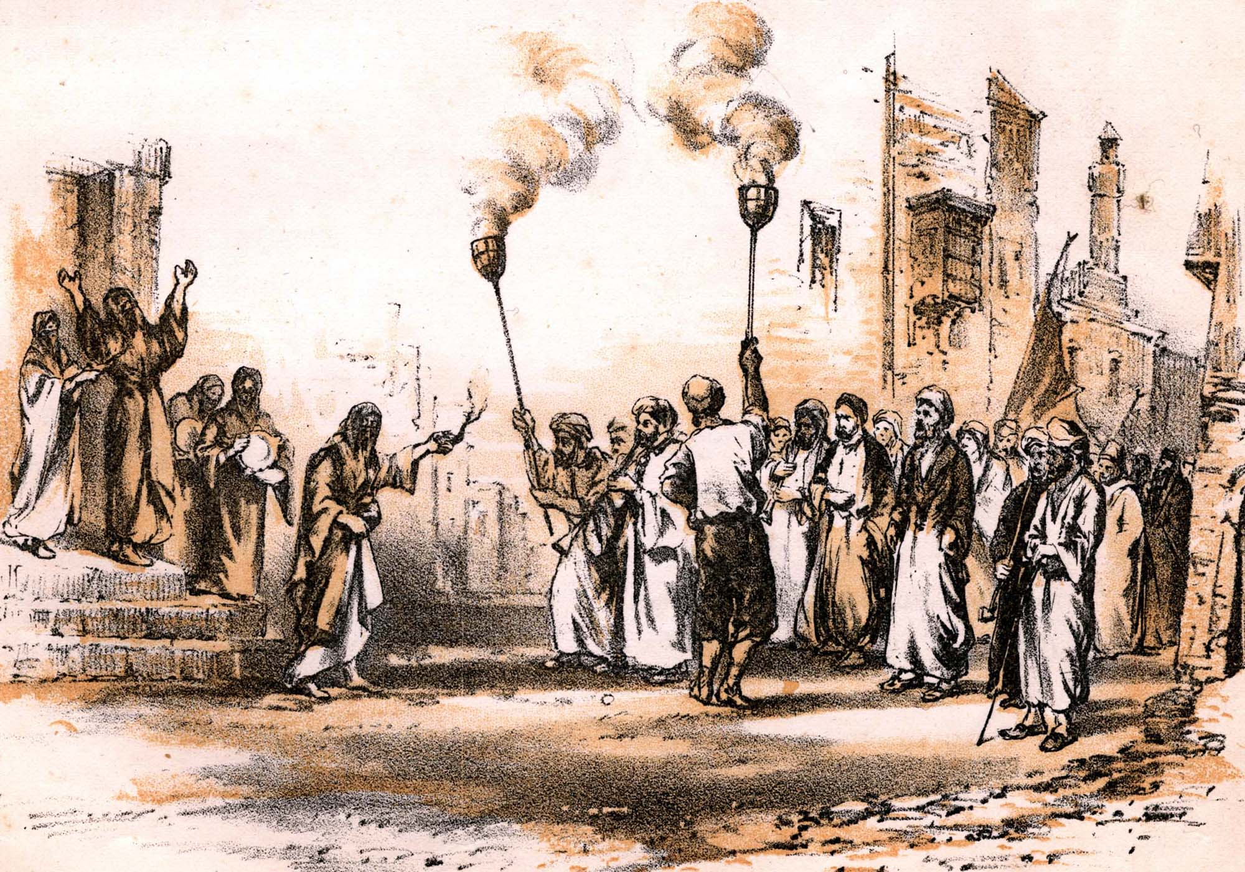

Slide 19
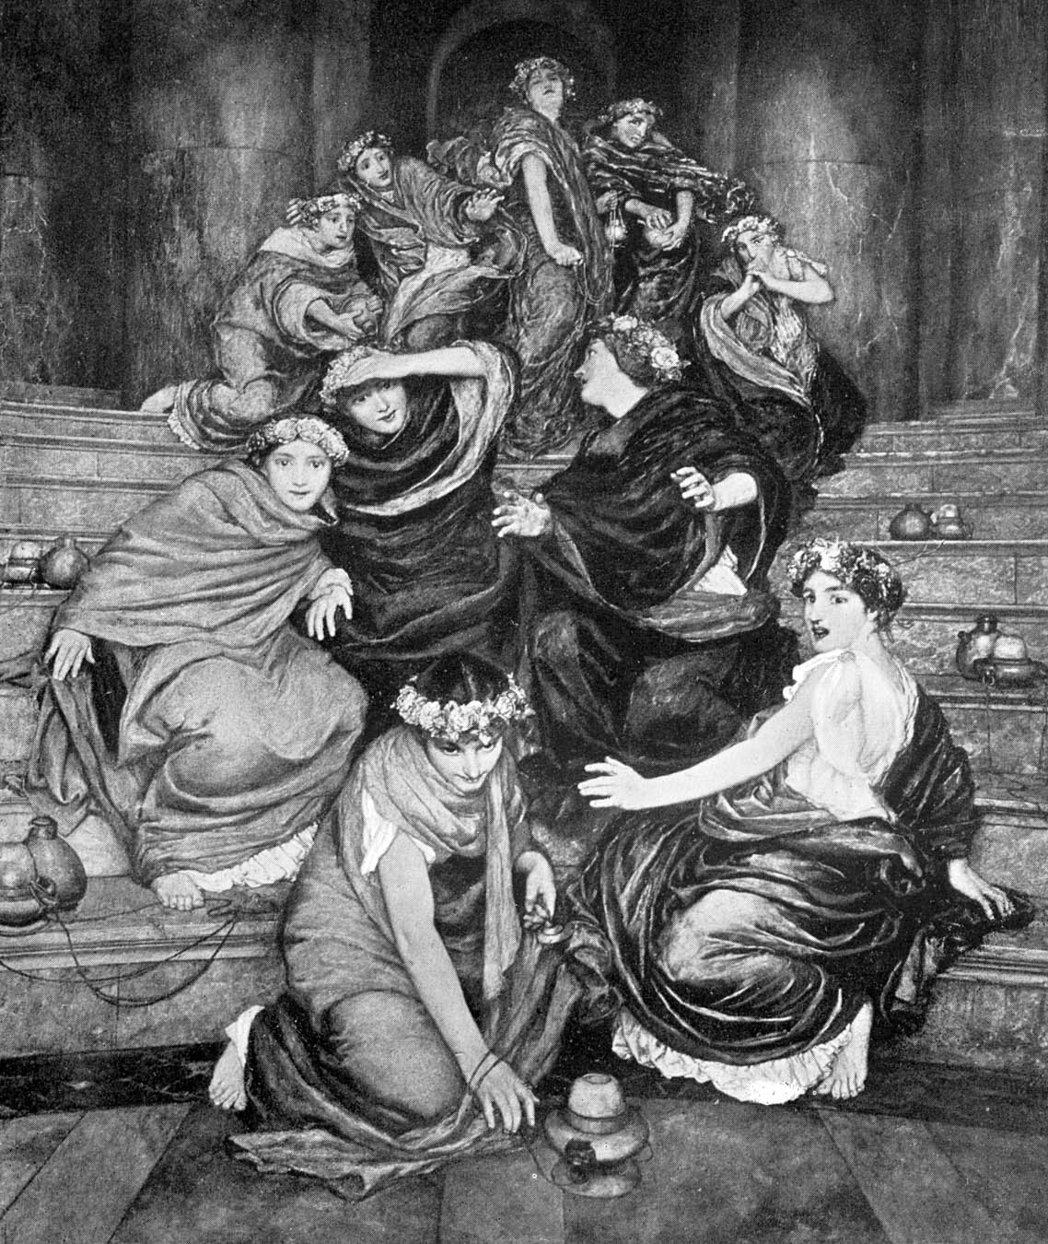
Virgins sleeping

Slide 20
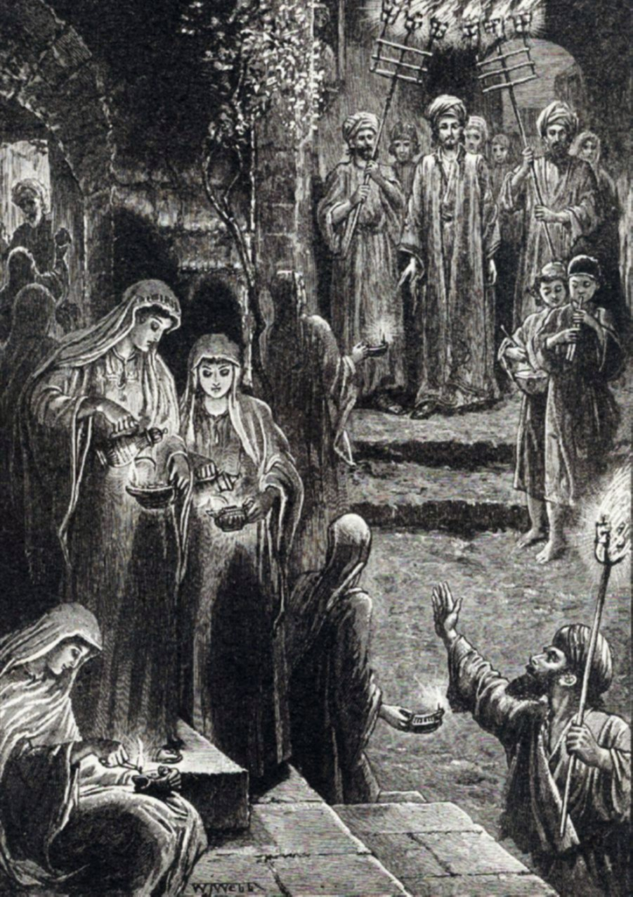

Slide 21
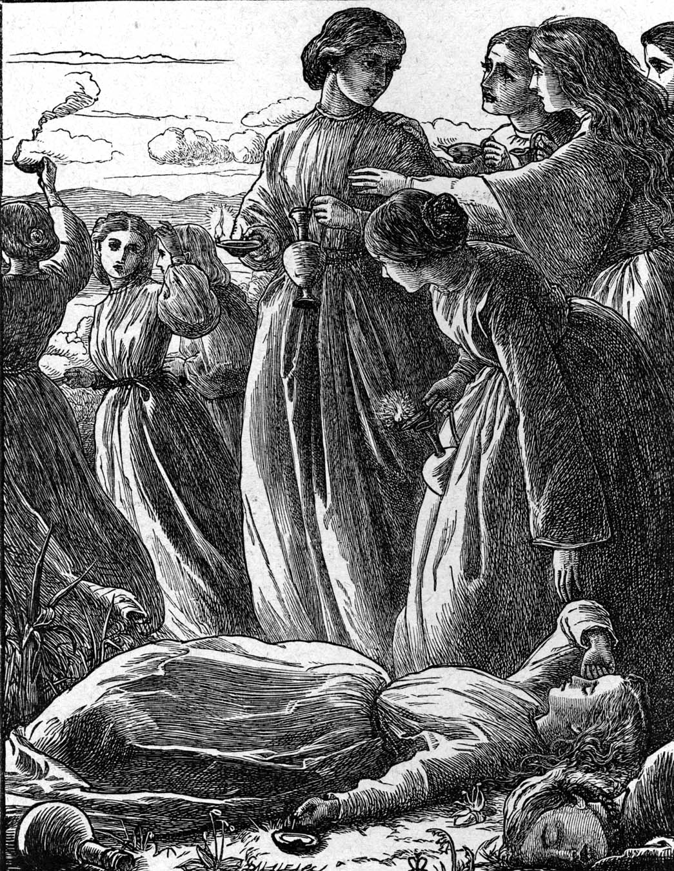

Slide 22
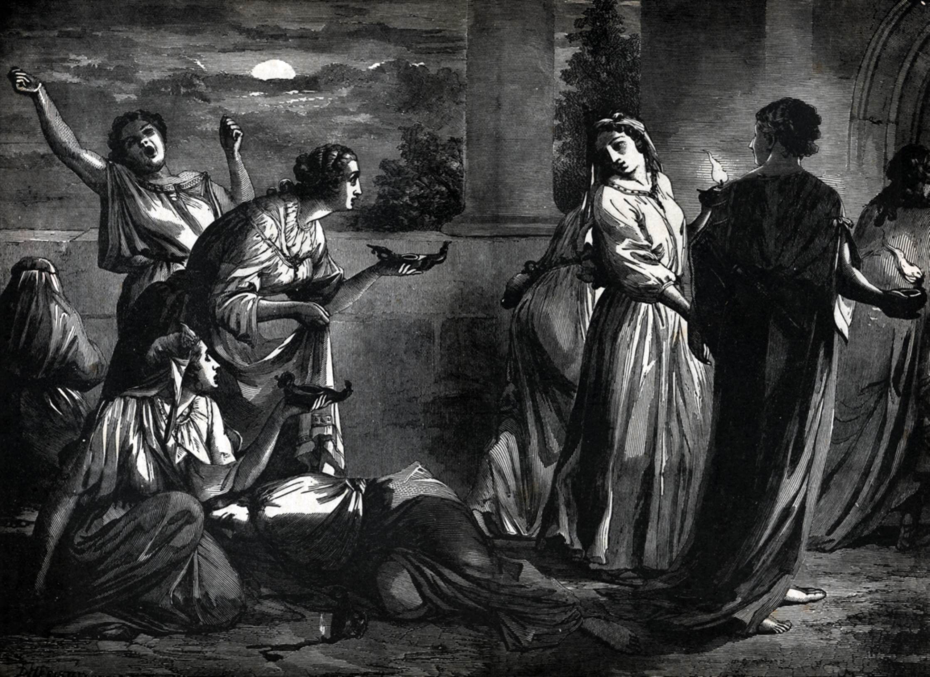

Slide 23
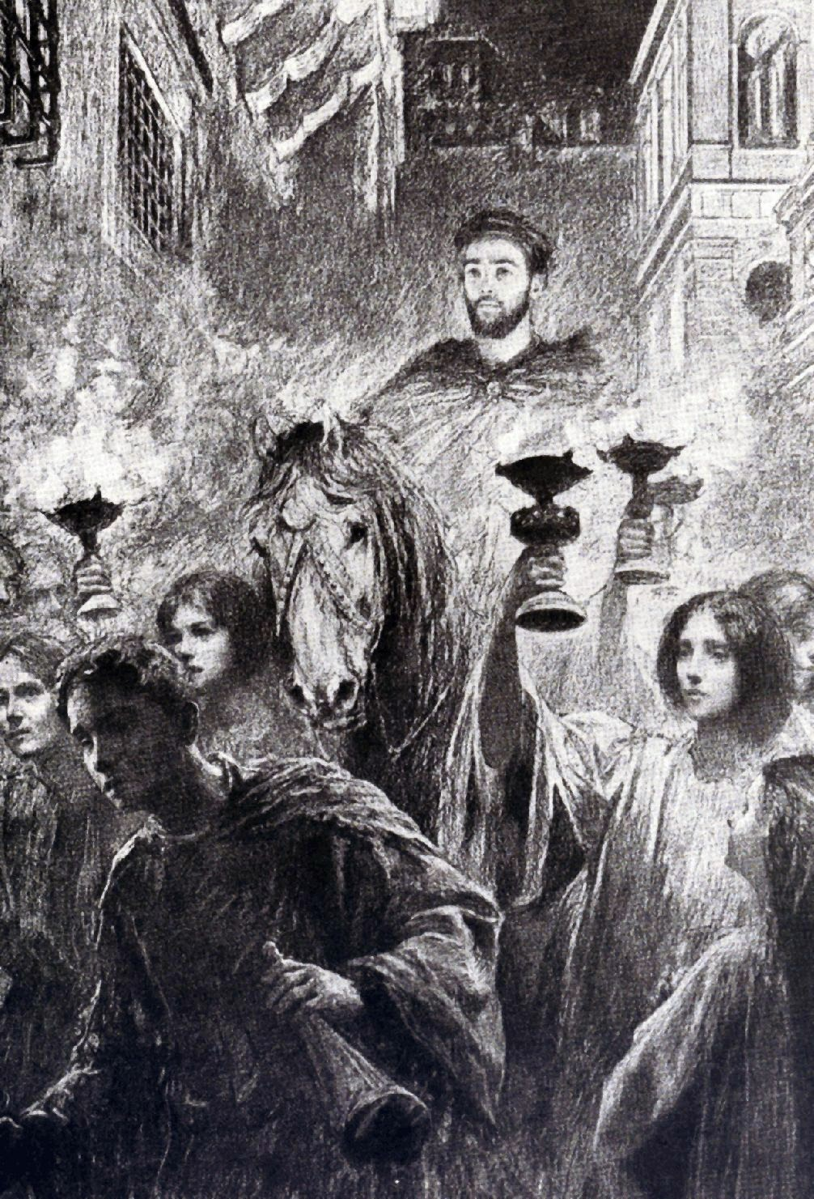

Slide 24
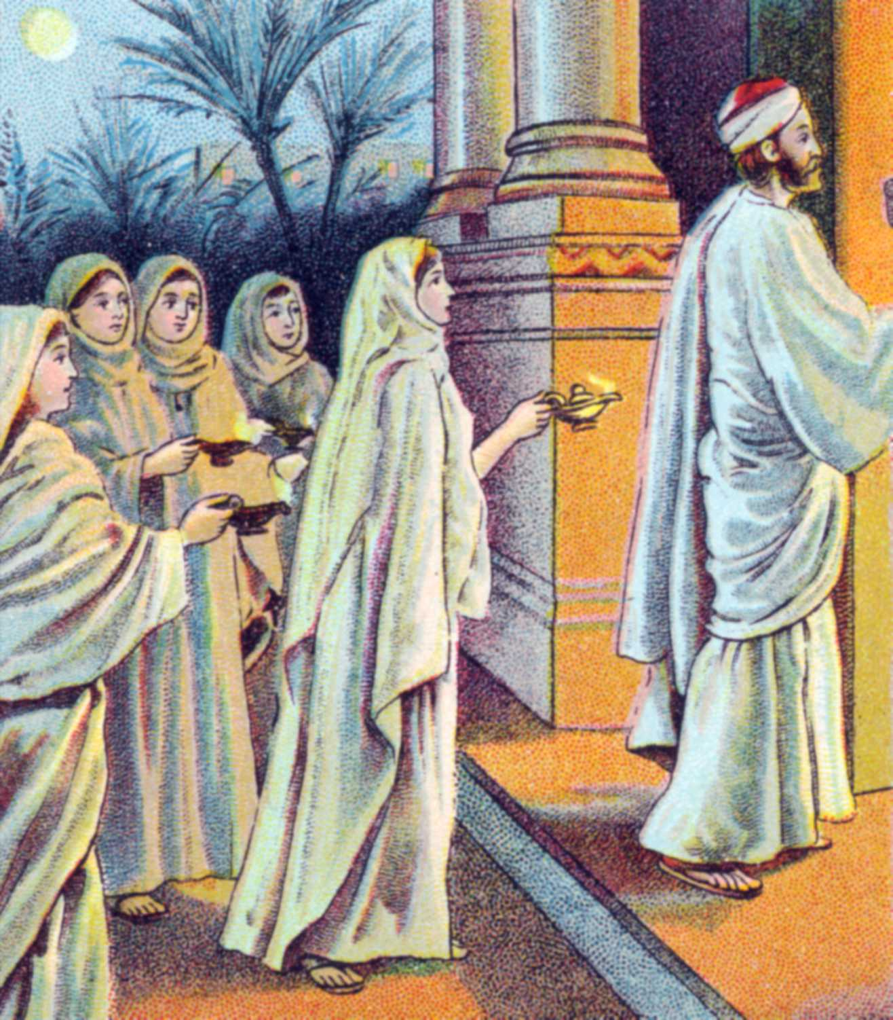

Slide 25
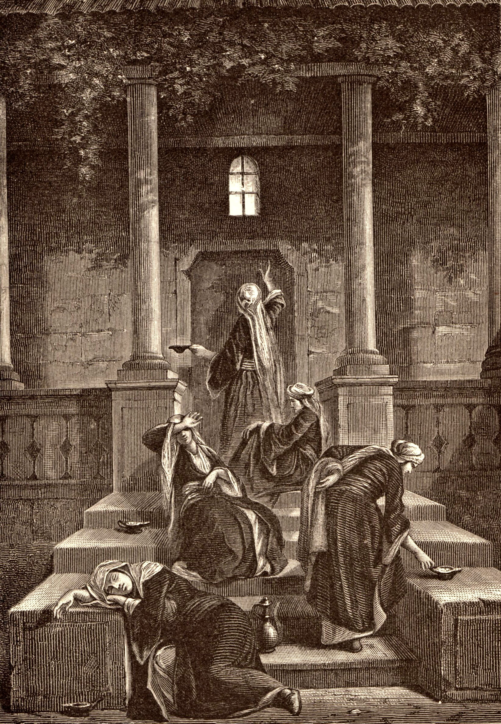

Slide 26
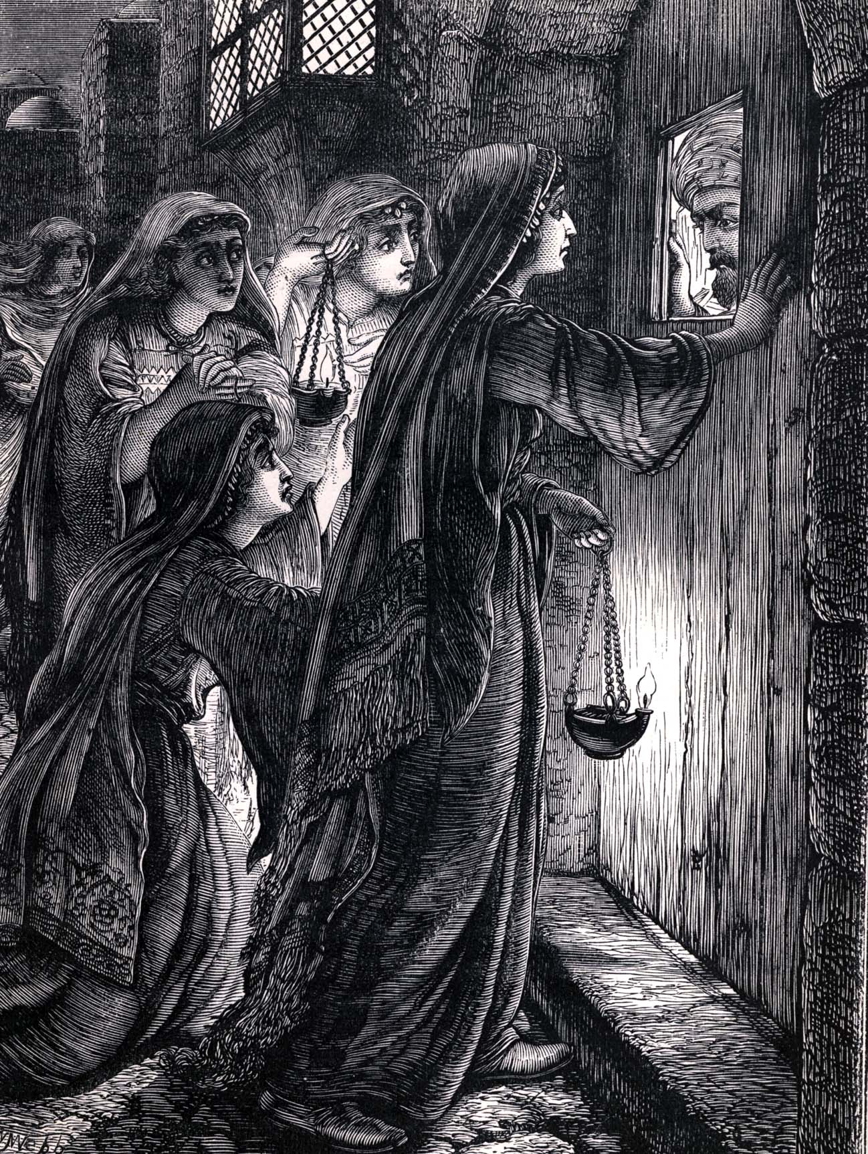

Slide 27
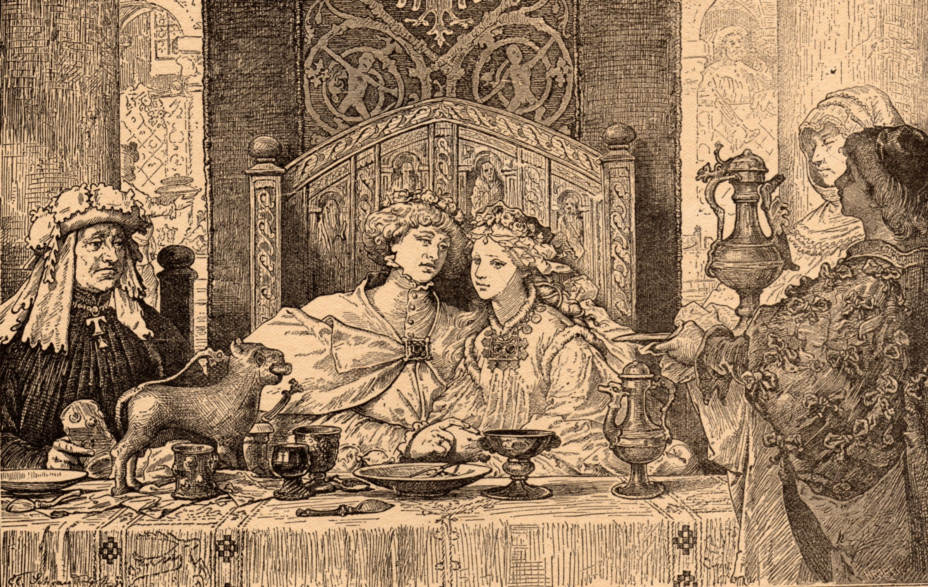

Slide 28
The Interpretation of the Parable
Jesus is the bridegroom – (Isaiah 62:5; Matthew 9:15; John 3:29)
Believers are the bride of Christ – (Romans 7:4; Ephesians 5:30; II Corinthians 11:2)
The return of Christ is pictured as a great wedding – (Revelation 19:7-9)
The Virgins – Professing believers

Slide 29
Foolish Virgins – False believers / hypocrites (those unprepared for the Lord’s return) – Matthew 24:36-44, 50-51
Wise Virgins – True believers - II Corinthians 5:21, 11:2; Ephesians 5:26-27
Lamps represent our lives and testimony – Matthew 6:15-16
Oil represents the Holy Spirit – I John 2:20; Romans 8:9-16

Slide 30
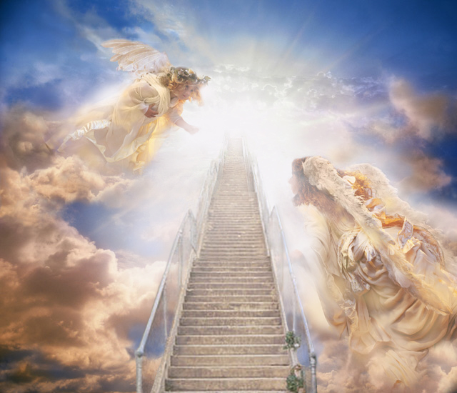
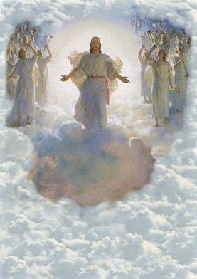
“For the Lord Himself shall descend from heaven with a shout, with the voice of the archangel, and the trump of God…”

Slide 31
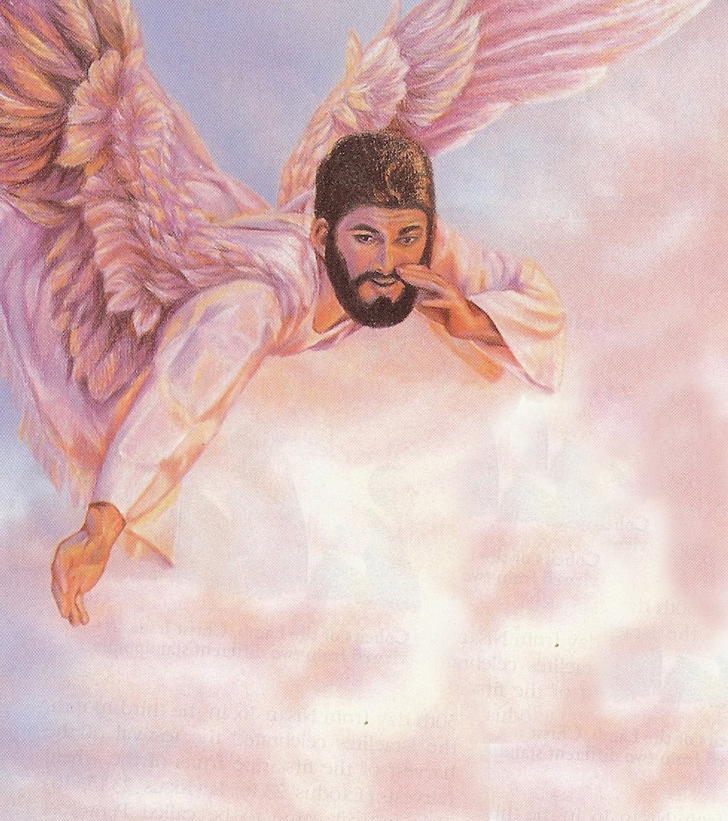
“Come up hither.”

Slide 32
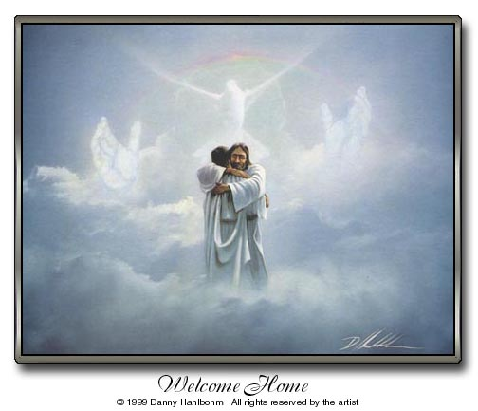
“…meet the Lord in the air: and so shall we ever be with the Lord. Wherefore comfort one another with these words.”

Slide 34
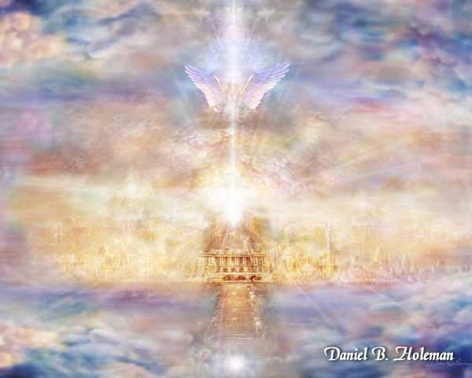
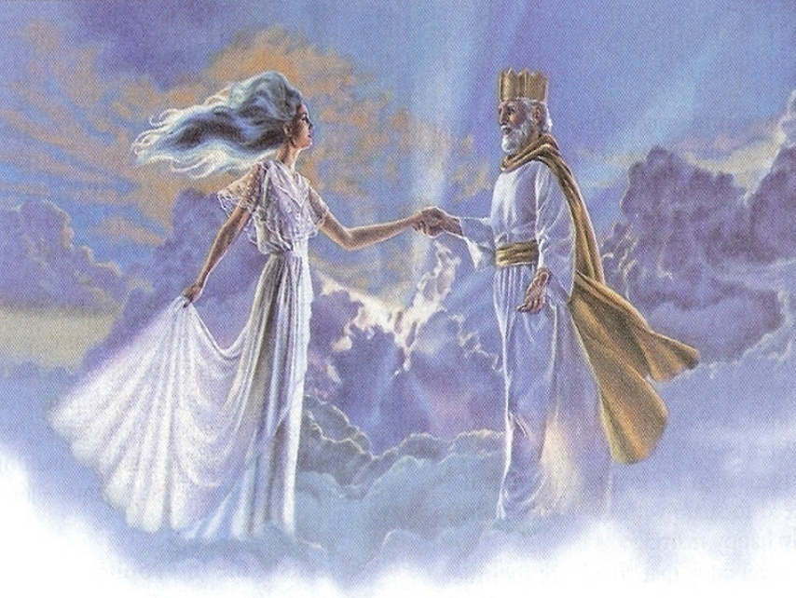
“For He hath prepared for them a city…whose builder and maker is God.” (Hebrews 11:10, 16)

Slide 35
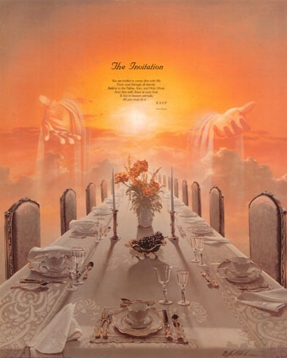
“Blessed are they which are called unto the marriage supper of he Lamb.” “Whosoever will may come.”

Slide 36
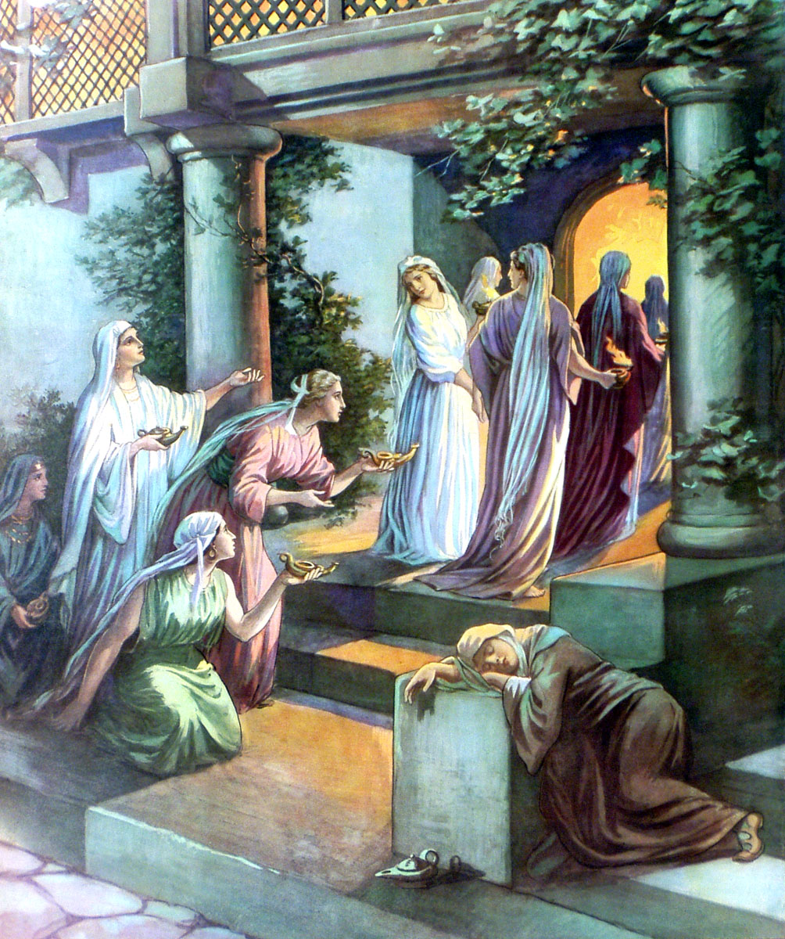

Slide 37
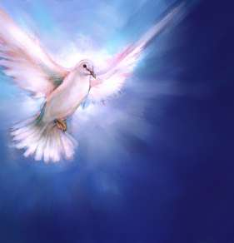
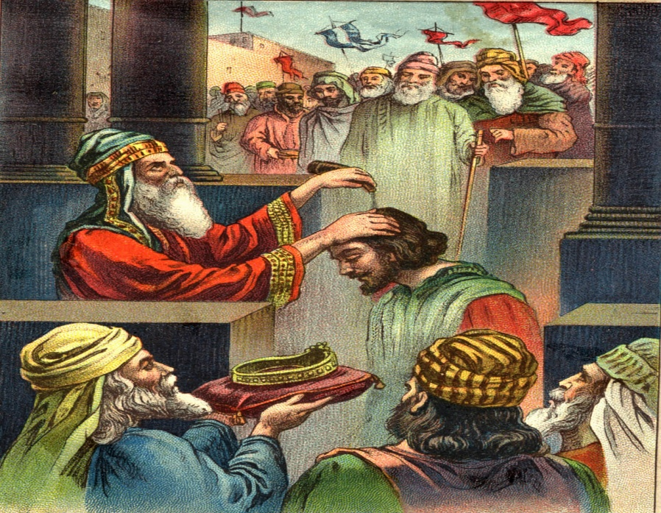
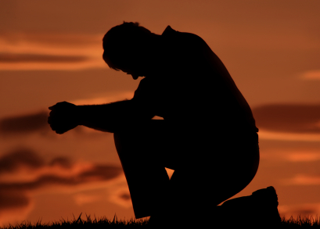
“The anointing which ye have received of Him abideth in you.”

Slide 38
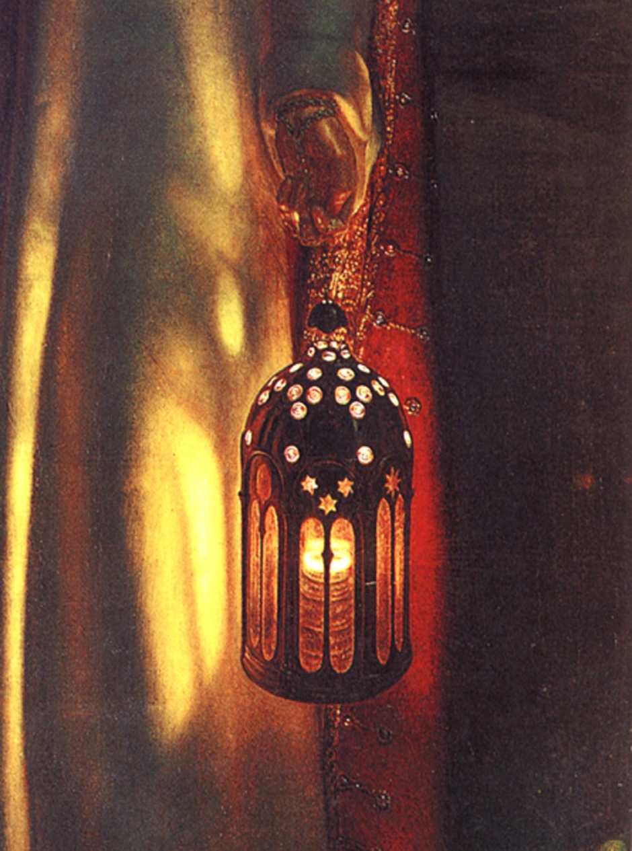
“Let your light so shine before men, that they may see your good works, and glorify your father which is in heaven.”

Slide 40
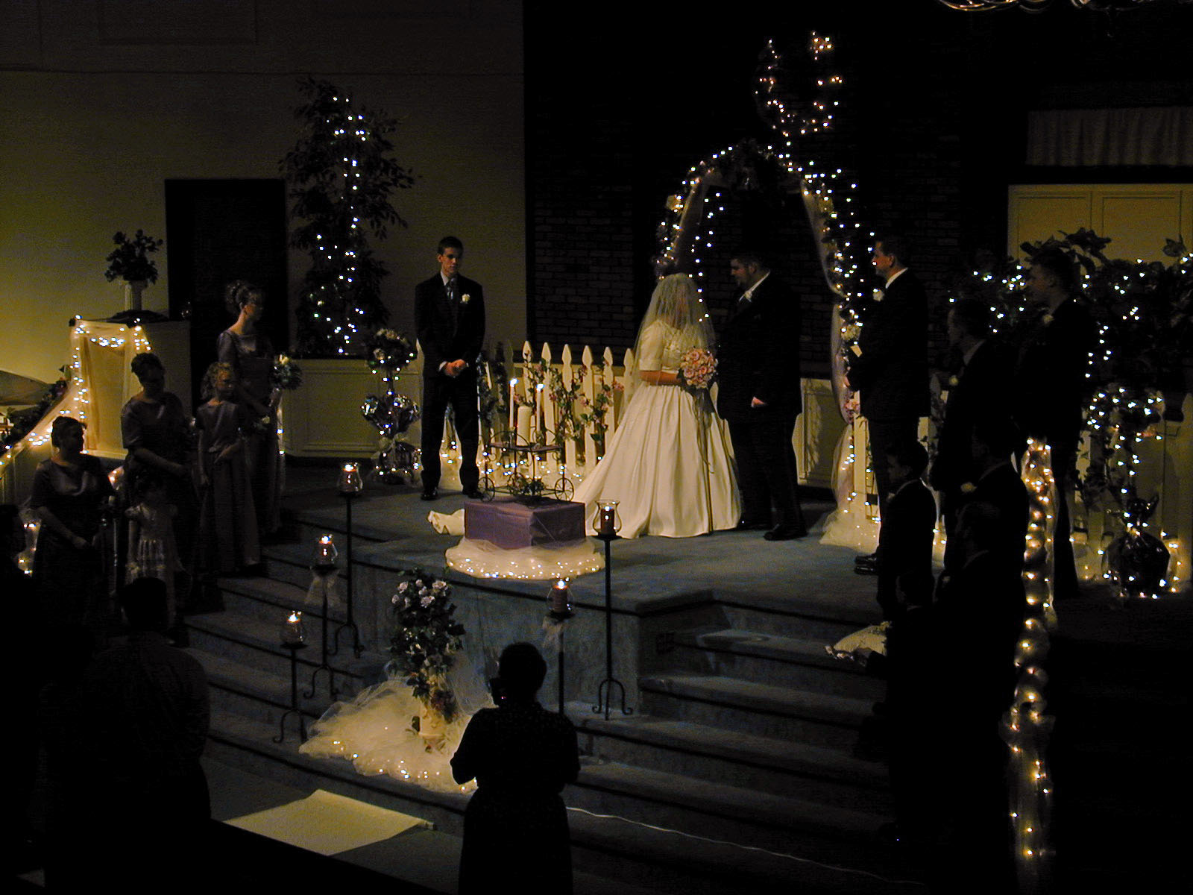
Christ’s relationship with the believer

Slide 41
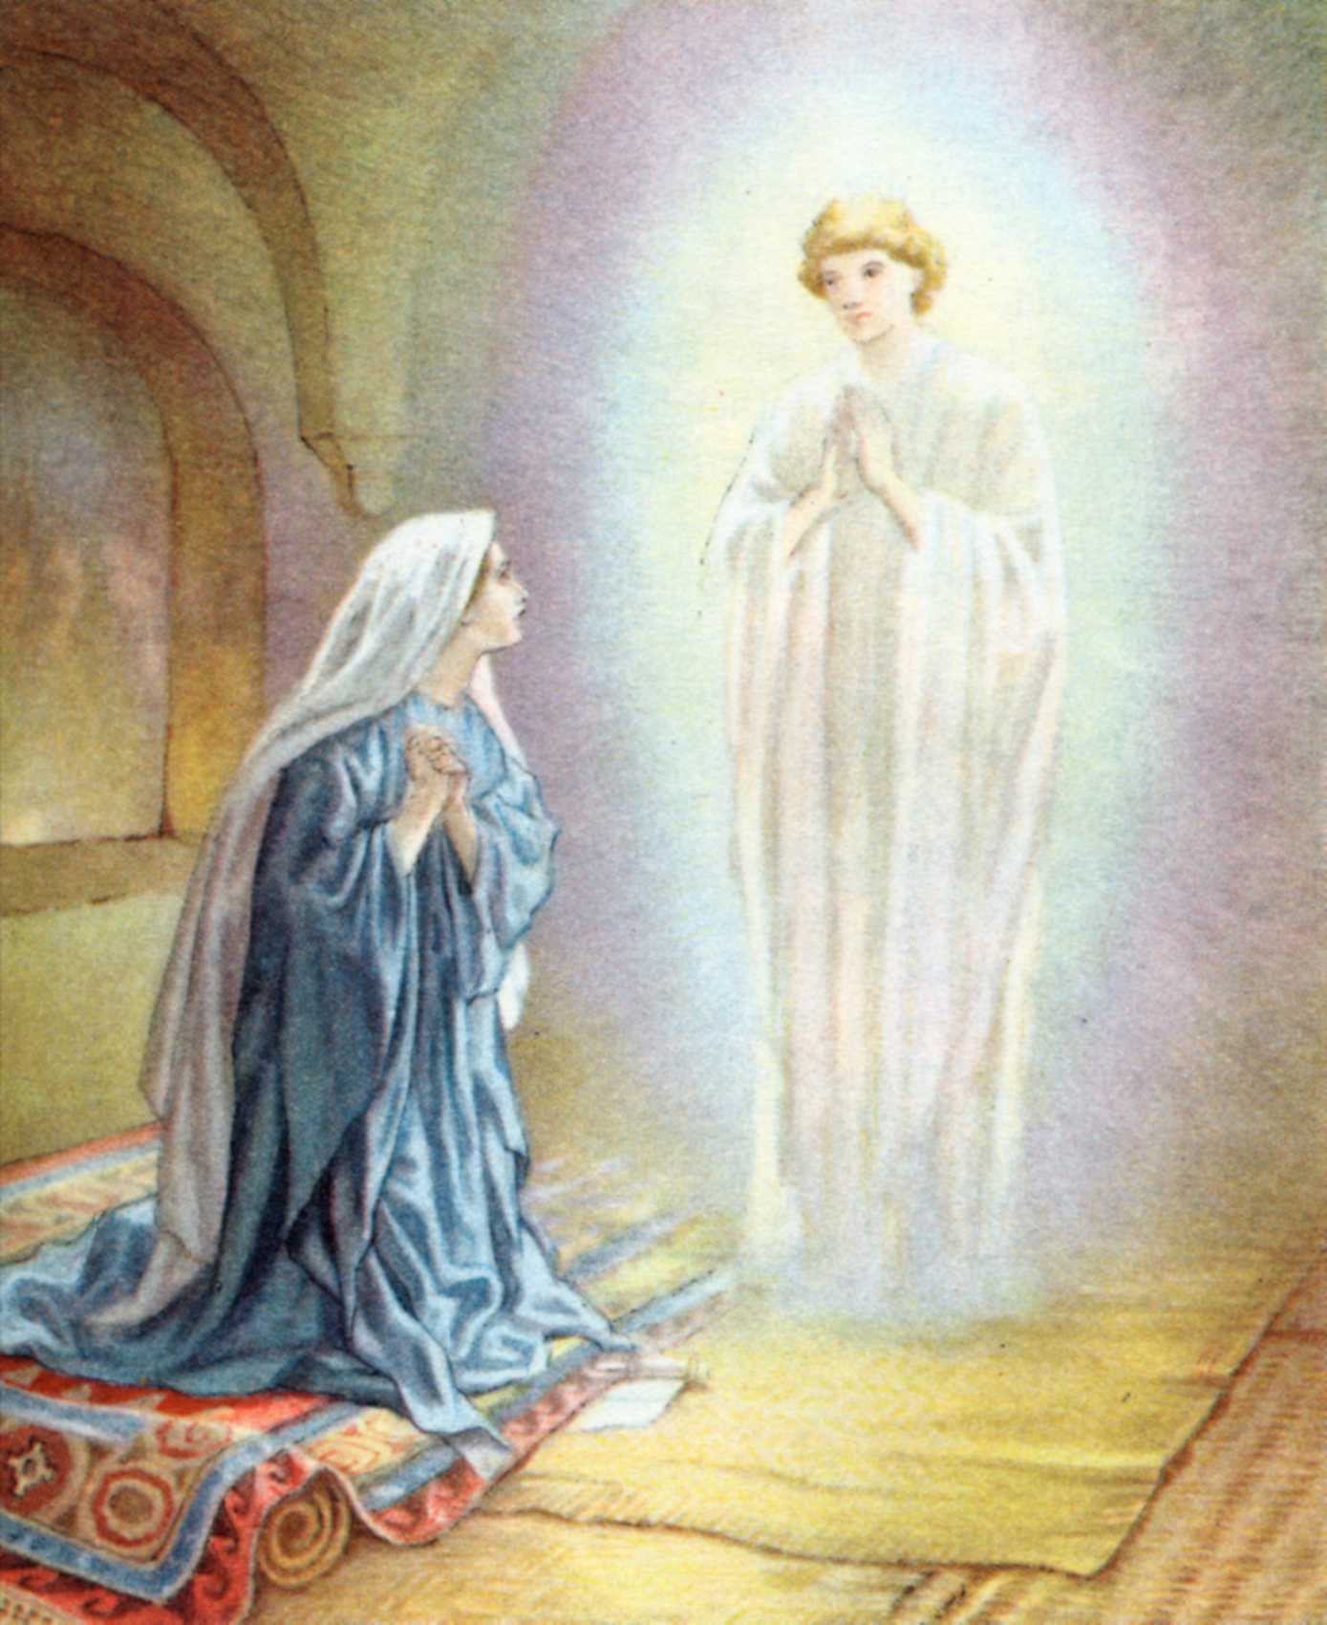
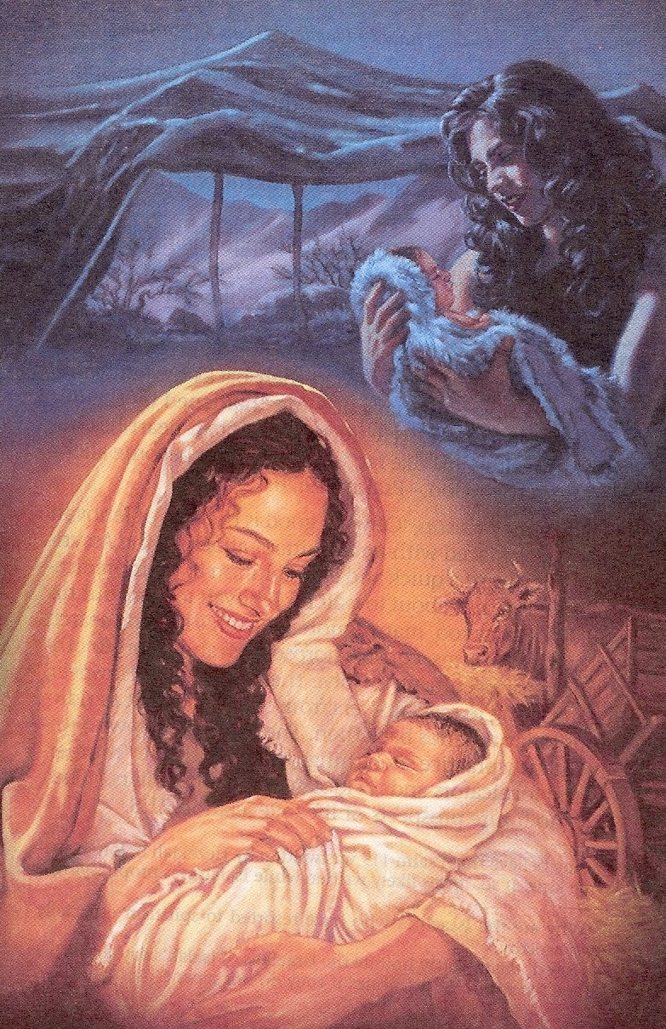
“Thou shalt call His name Jesus.”

Slide 42
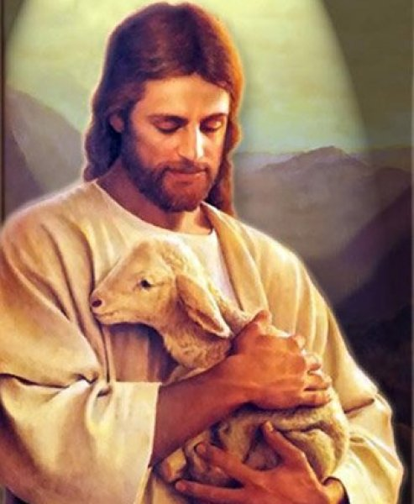
“For the son of man is come to seek and to save that which was lost.”

Slide 43
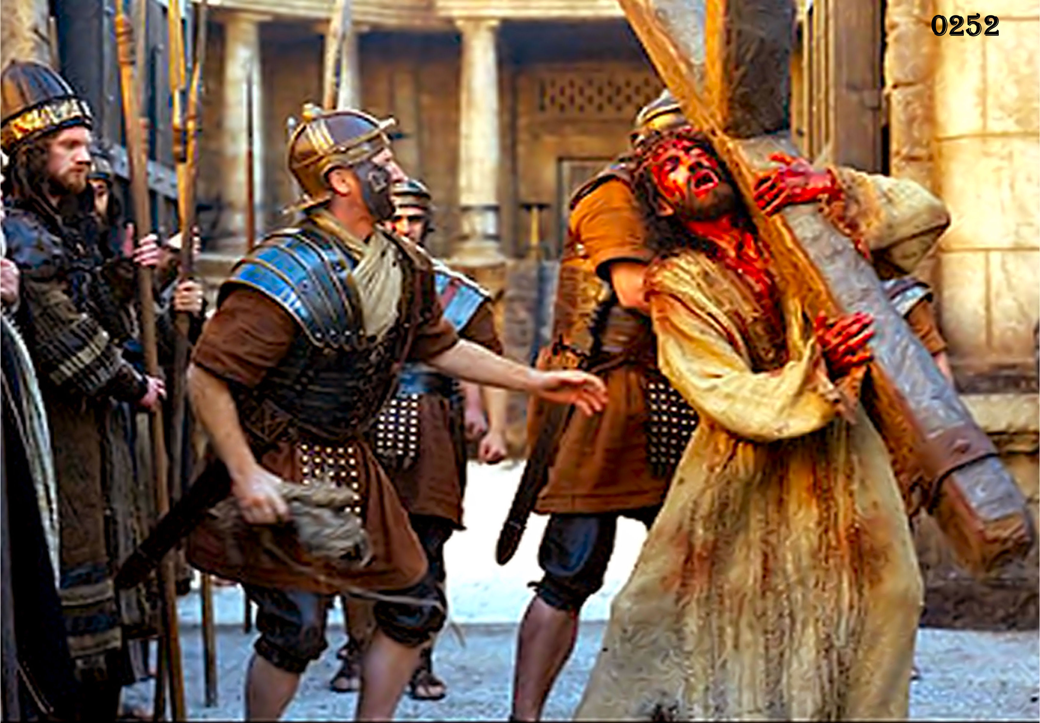

Slide 44
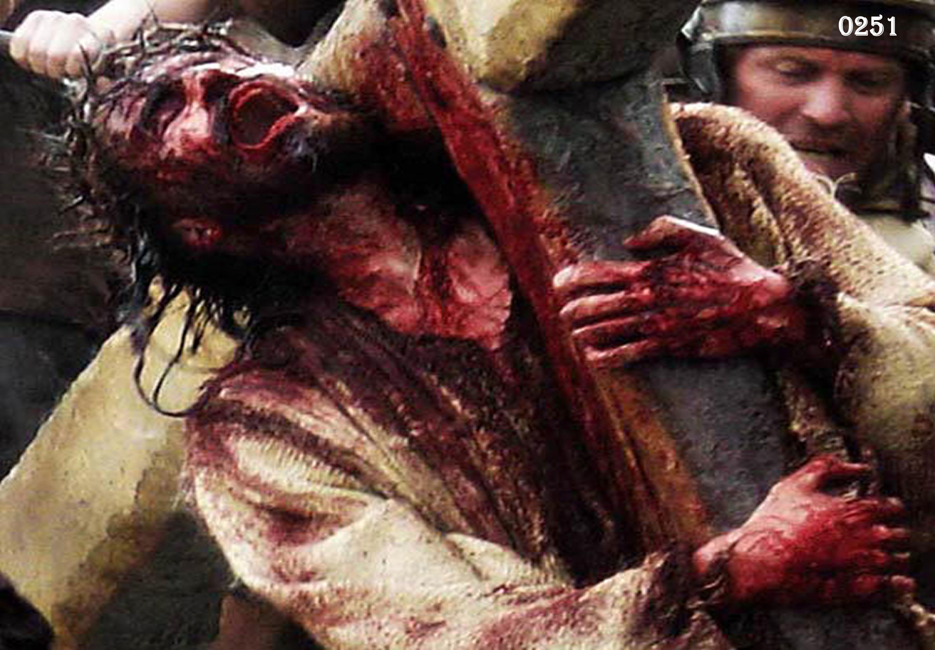

Slide 45
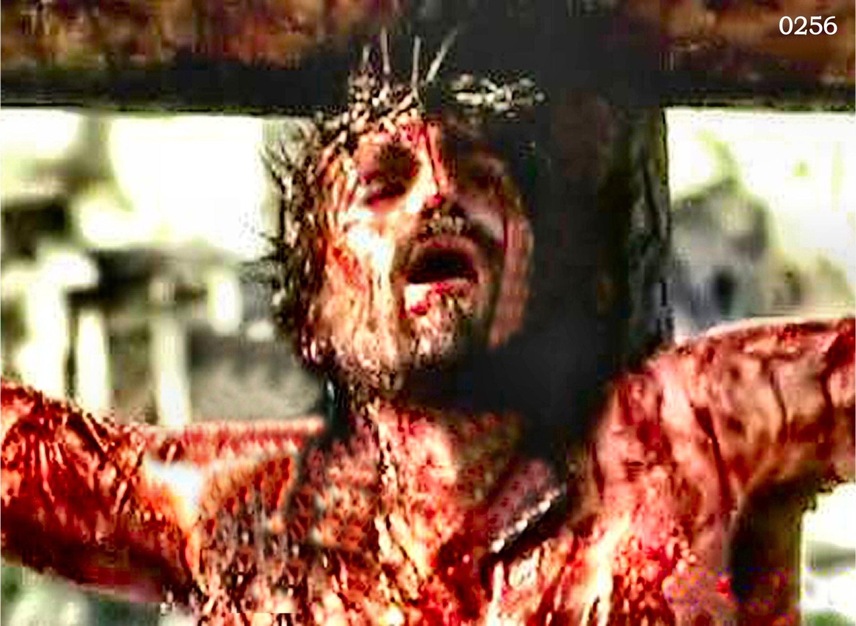

Slide 46
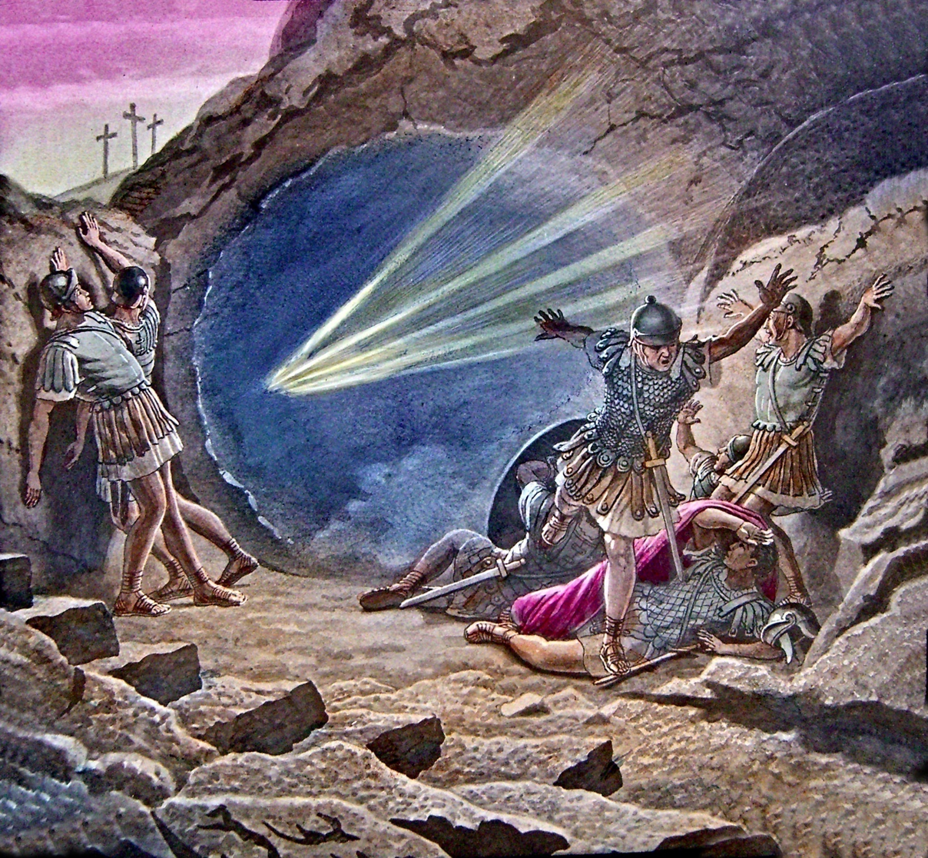

Slide 47
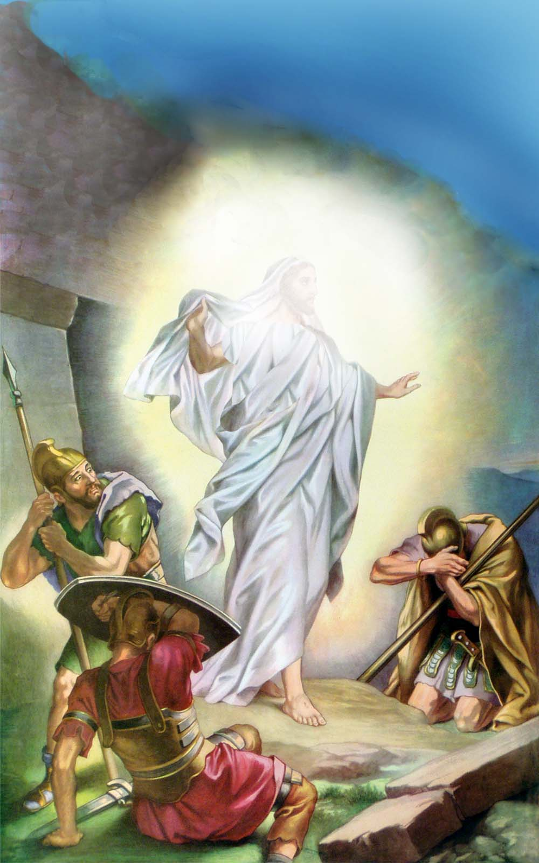

Slide 48
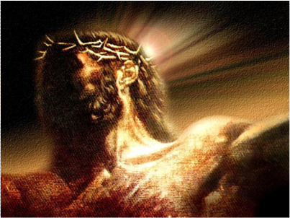
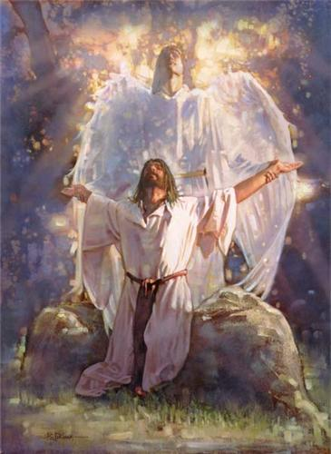

Slide 49
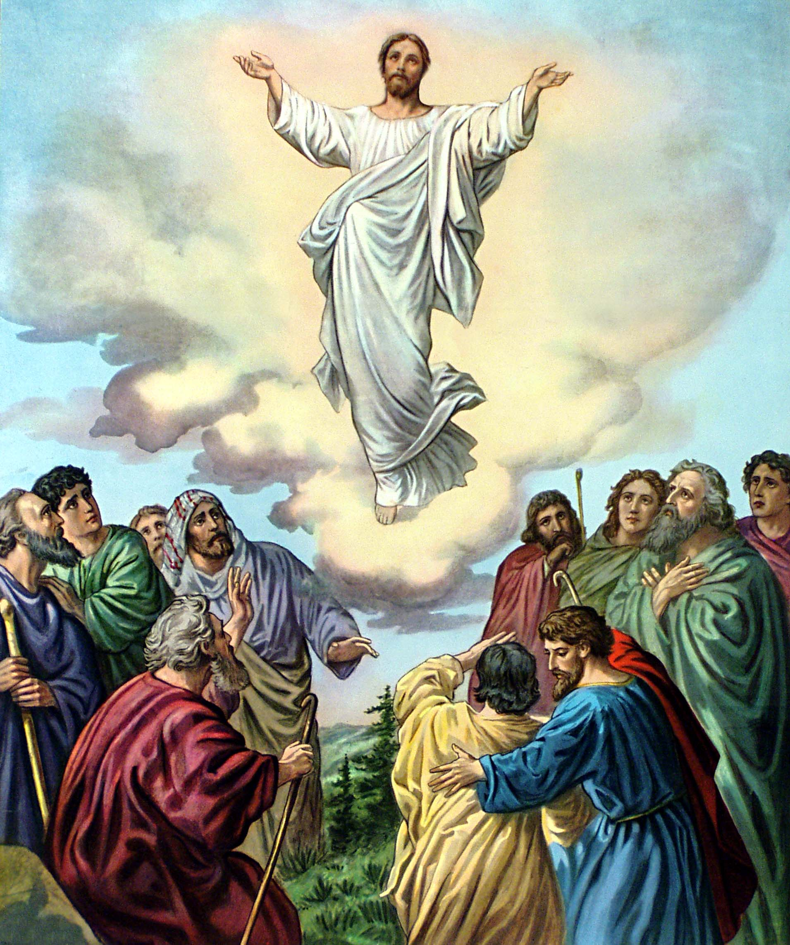

Slide 50
“In my father’s house are many mansions: if it were not so, I would have told you. I go to prepare a place for you. And if I go and prepare a place for you, I will come again, and receive you unto myself; that were I am, there ye may be also.” (John 14:2-3)

Slide 51
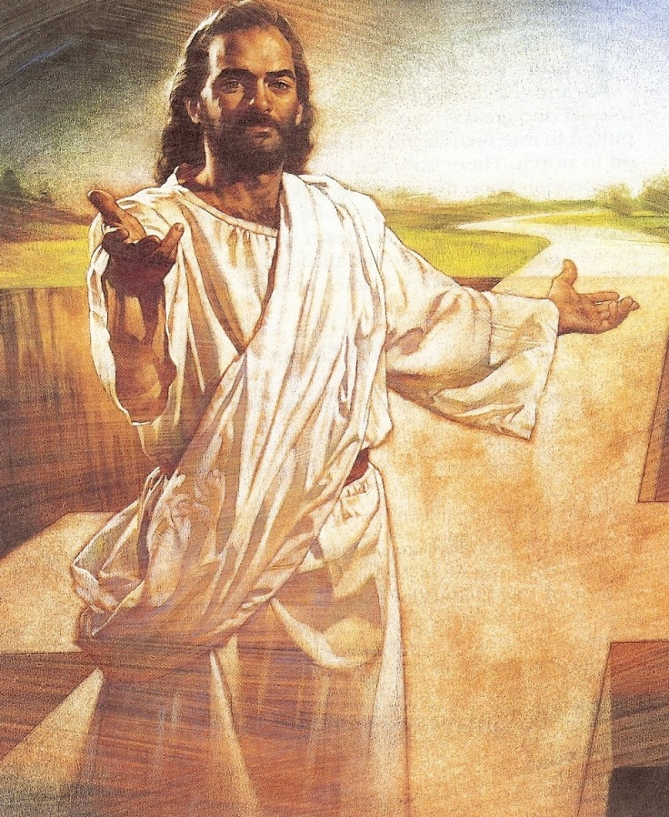
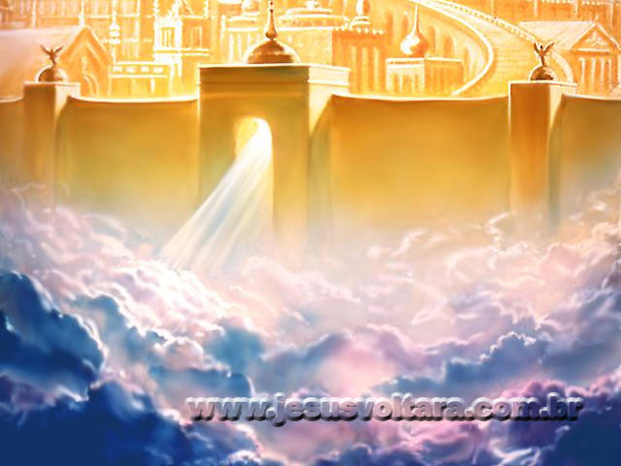

Slide 56
“Behold the tabernacle of God is with men, and he will dwell with them, and they shall be his people…And God shall wipe away all tears from their eyes…”

Slide 57
Matthew 7:14

Slide 58
“And in hell he lift up his eyes being in torments…I am tormented in this flame.”

Slide 61
“Behold the Lamb of God, which taketh away the sins of the world.”

Slide 62
“The Lion of the tribe of Juda, hath prevailed…and He cried with a loud voice as when a Lion roareth.”

Slide 63
“Watch therefore, for ye know neither the day nor the hour wherein the Son of man cometh.”

