Slide 1
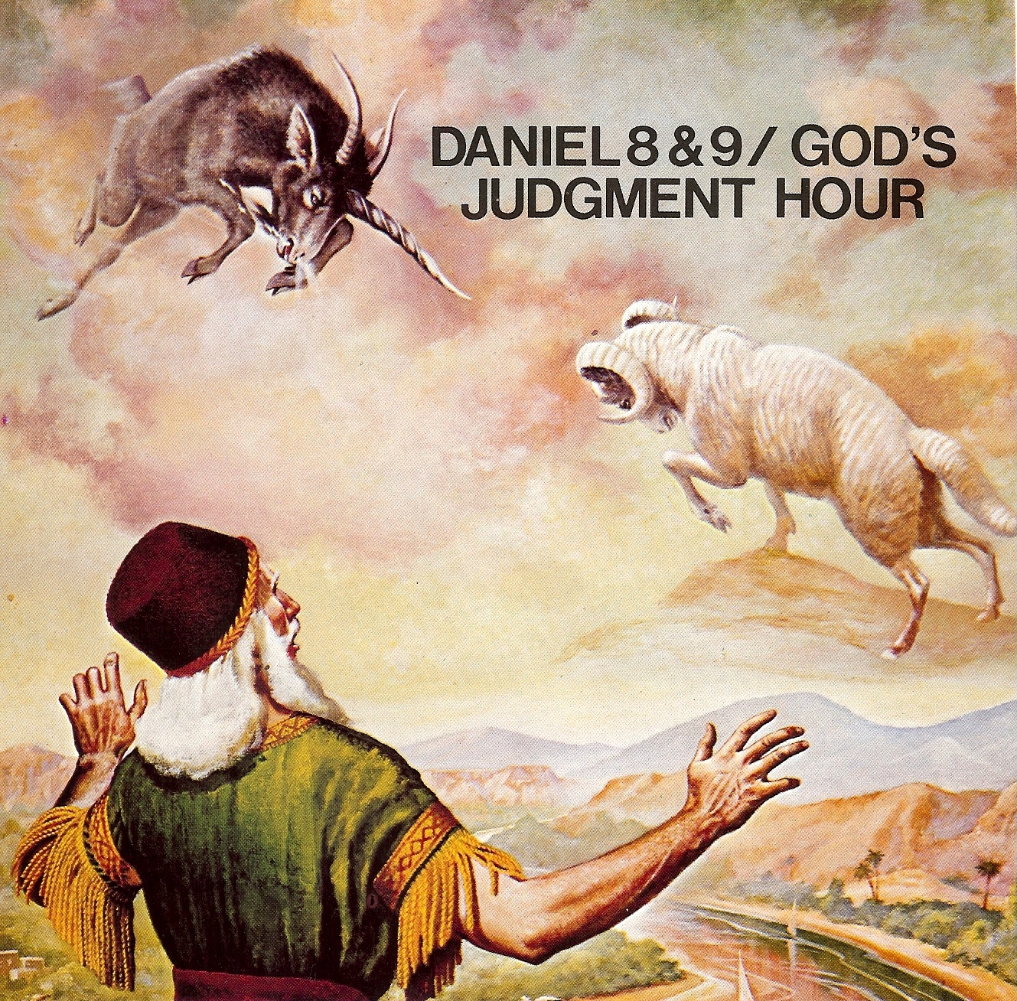
Daniel’s vision of the Ram, the Goat, and the Little Horn Daniel 8:1-27

Slide 2
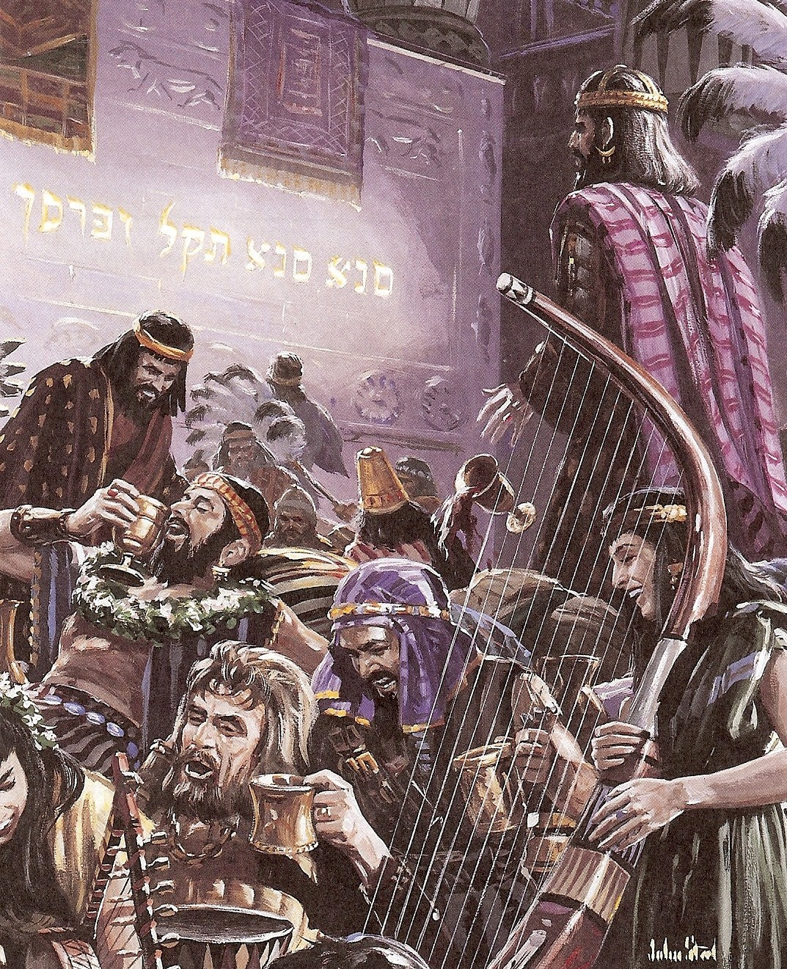

Slide 3
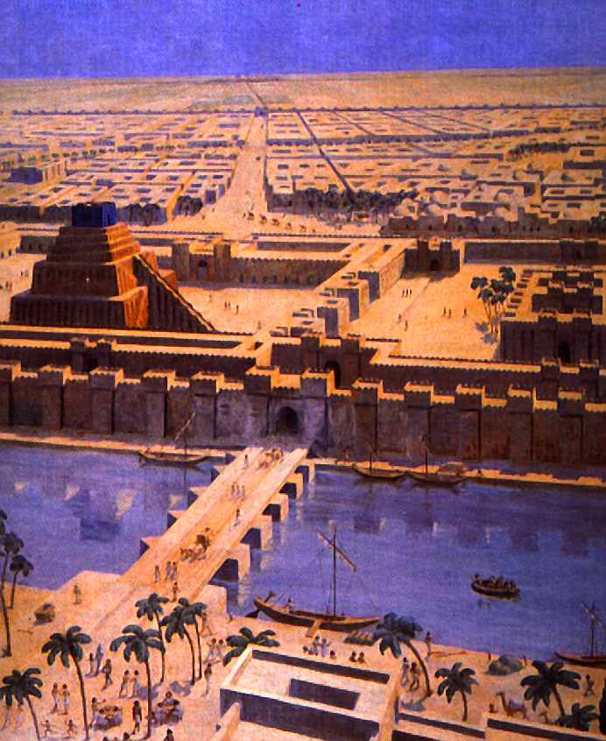
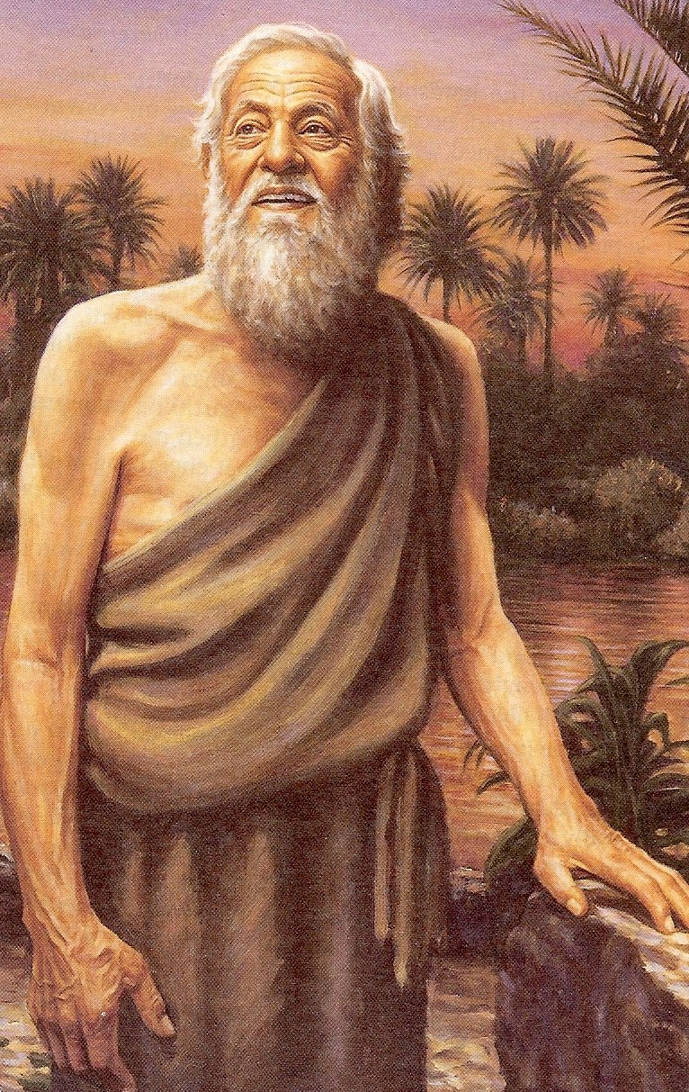

Slide 4
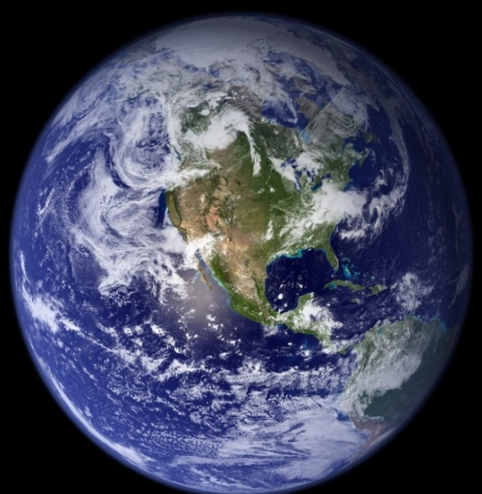

Slide 9
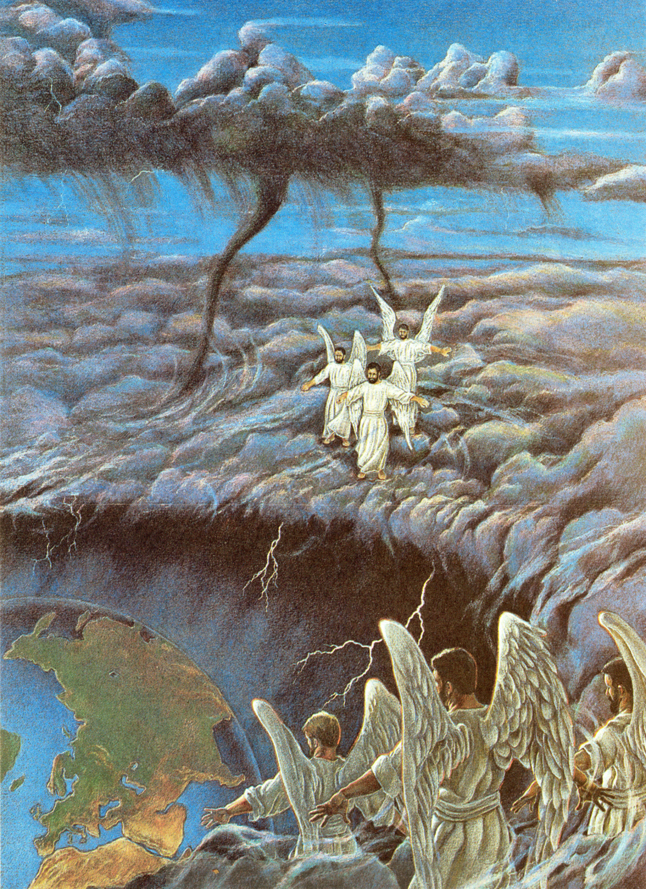

Slide 12
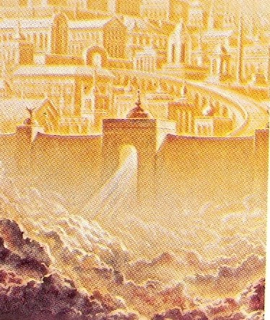

Slide 13
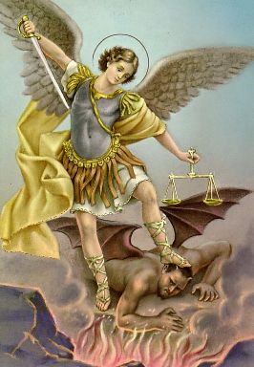
(Revelation 12:7-9)

Slide 14
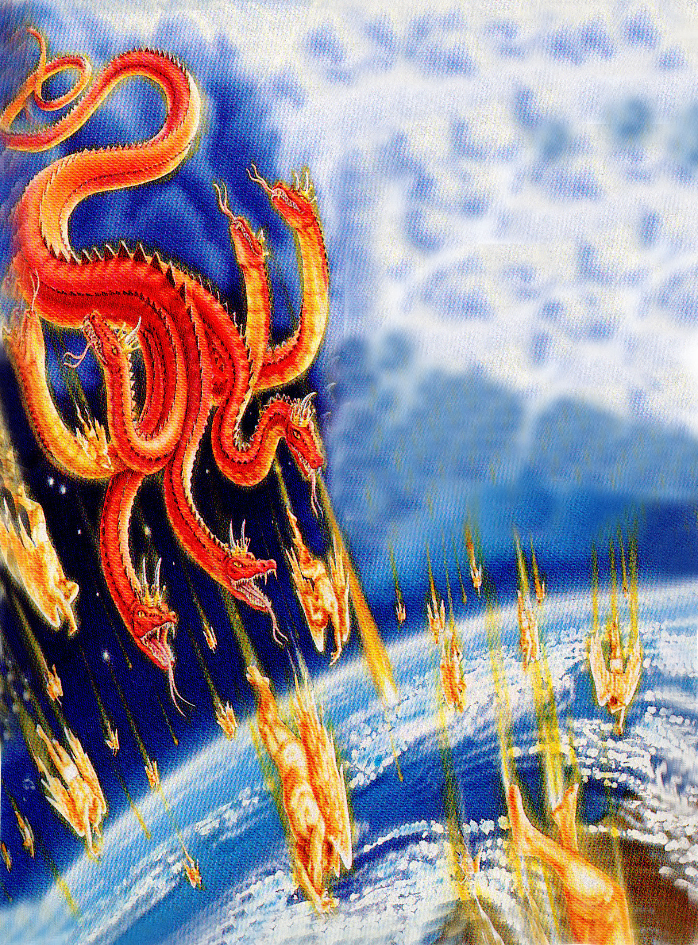

Slide 15
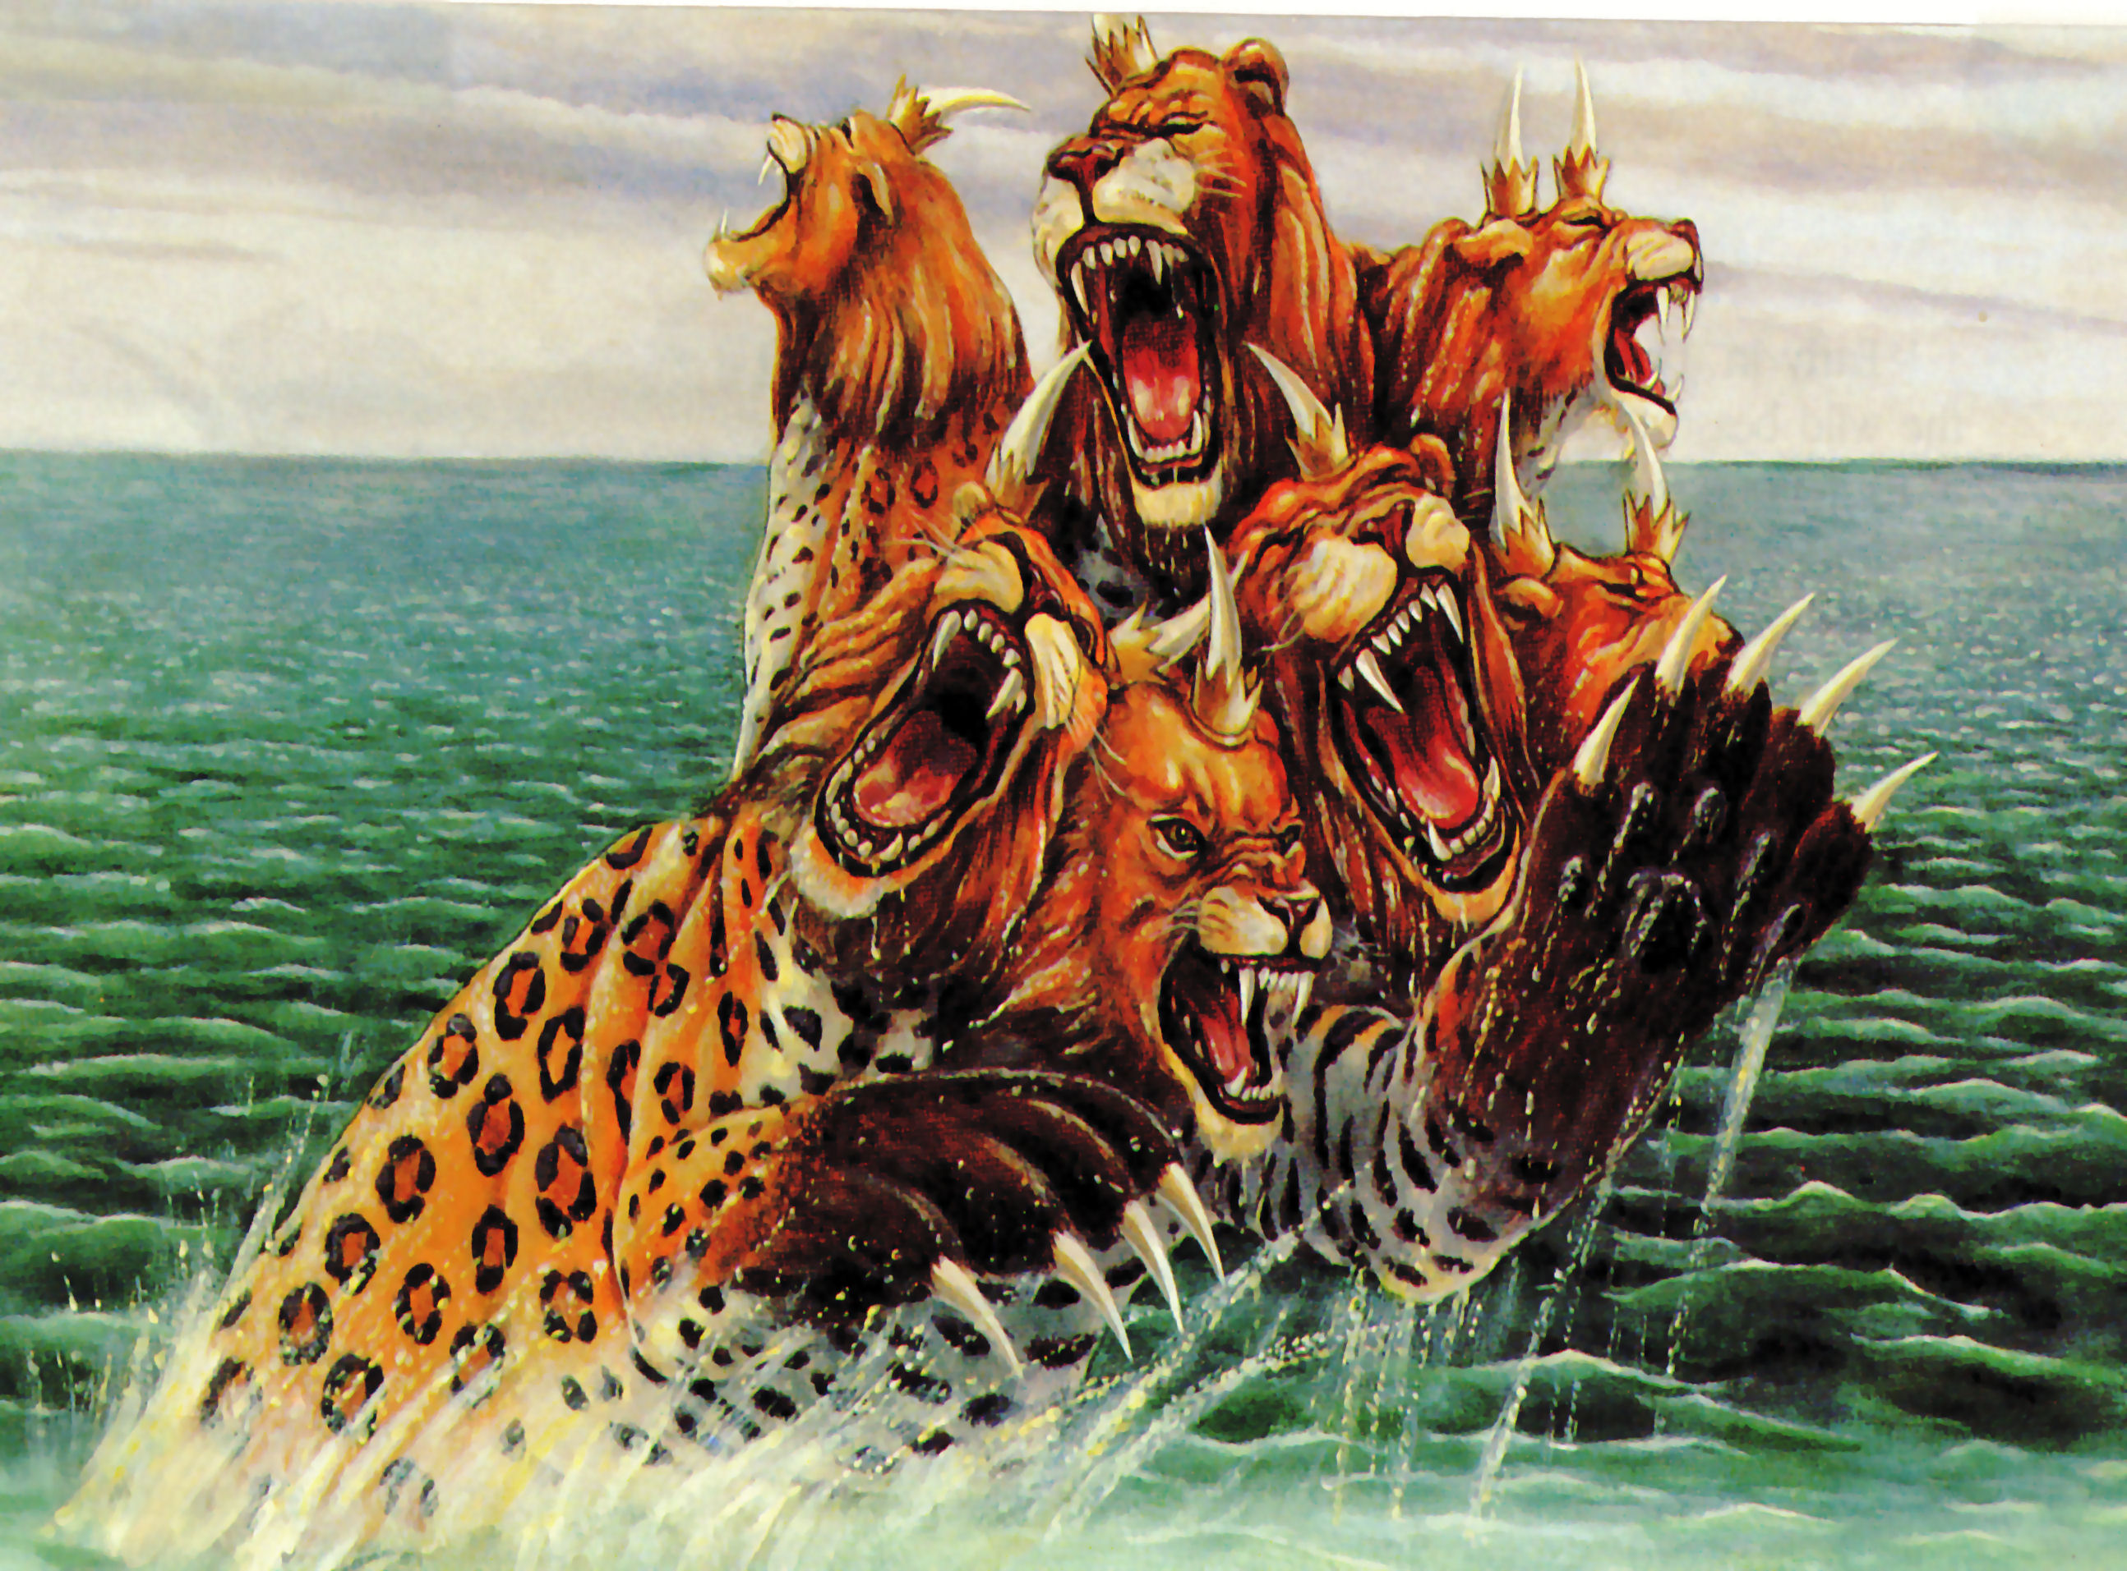

Slide 16
“By peace he shall destroy many.”

Slide 17
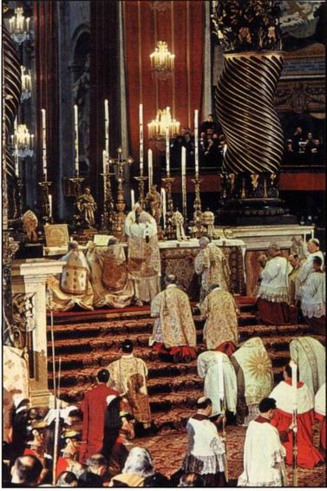
“He waxed exceeding great…”

Slide 18
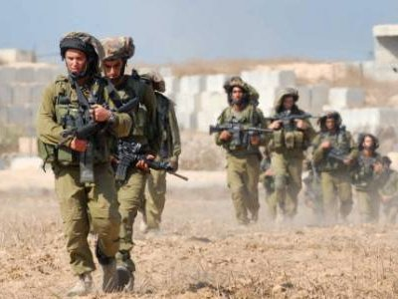
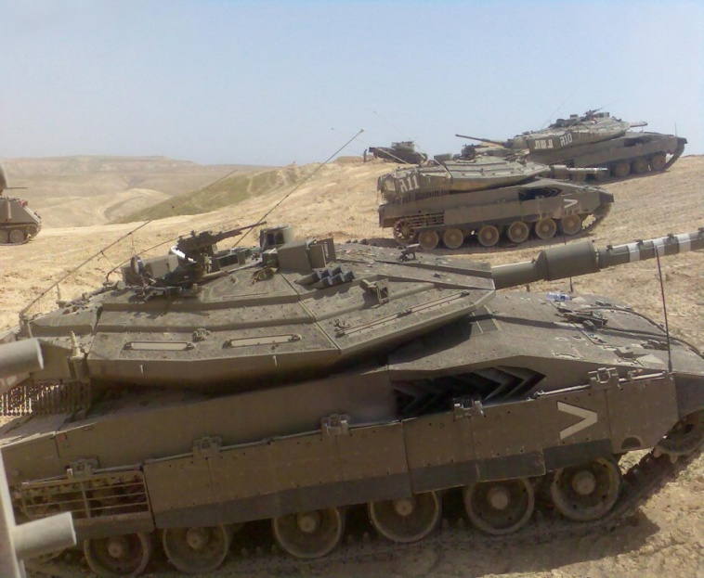
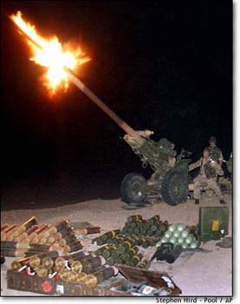
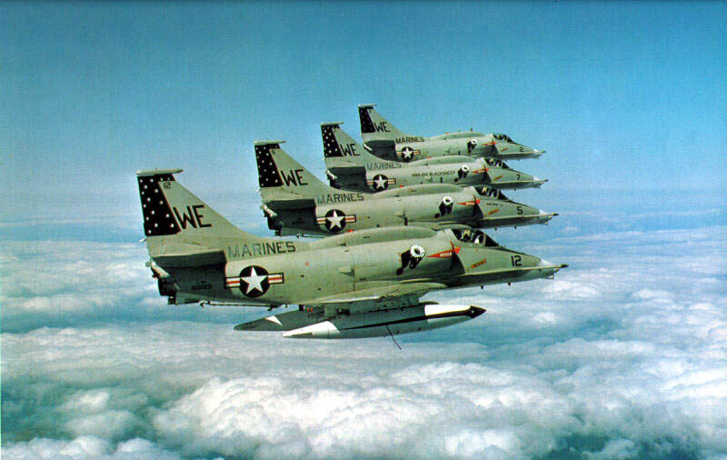
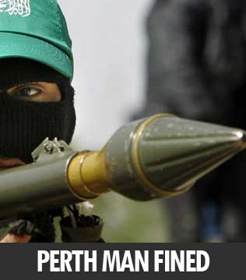
“And a host (army) was given him against (to oppose) the daily sacrifice…”

Slide 19
“By him the daily sacrifice was taken away…”

Slide 20
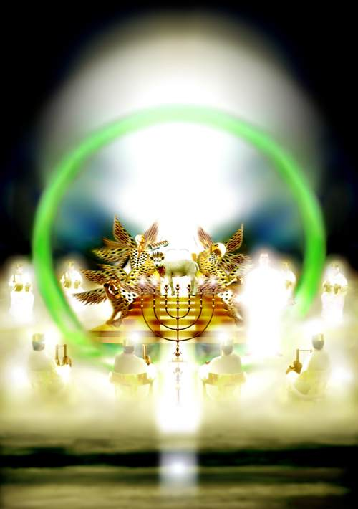
He exalted himself as high as the Prince of the Host

Slide 21
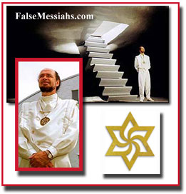
“A king of fierce countenance, and understanding dark sentences, shall stand up.”

Slide 22
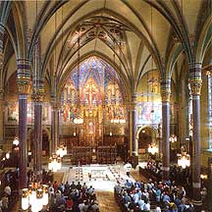
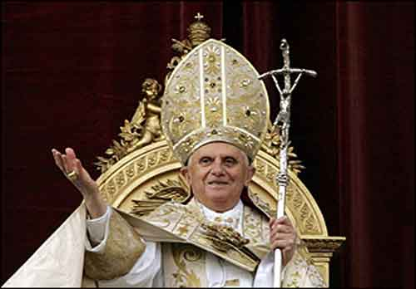
“He magnified himself…”

Slide 23
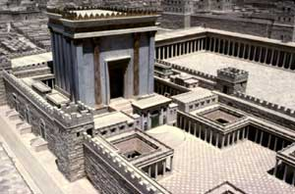
“His power shall be mighty, but not by his own power.”

Slide 24
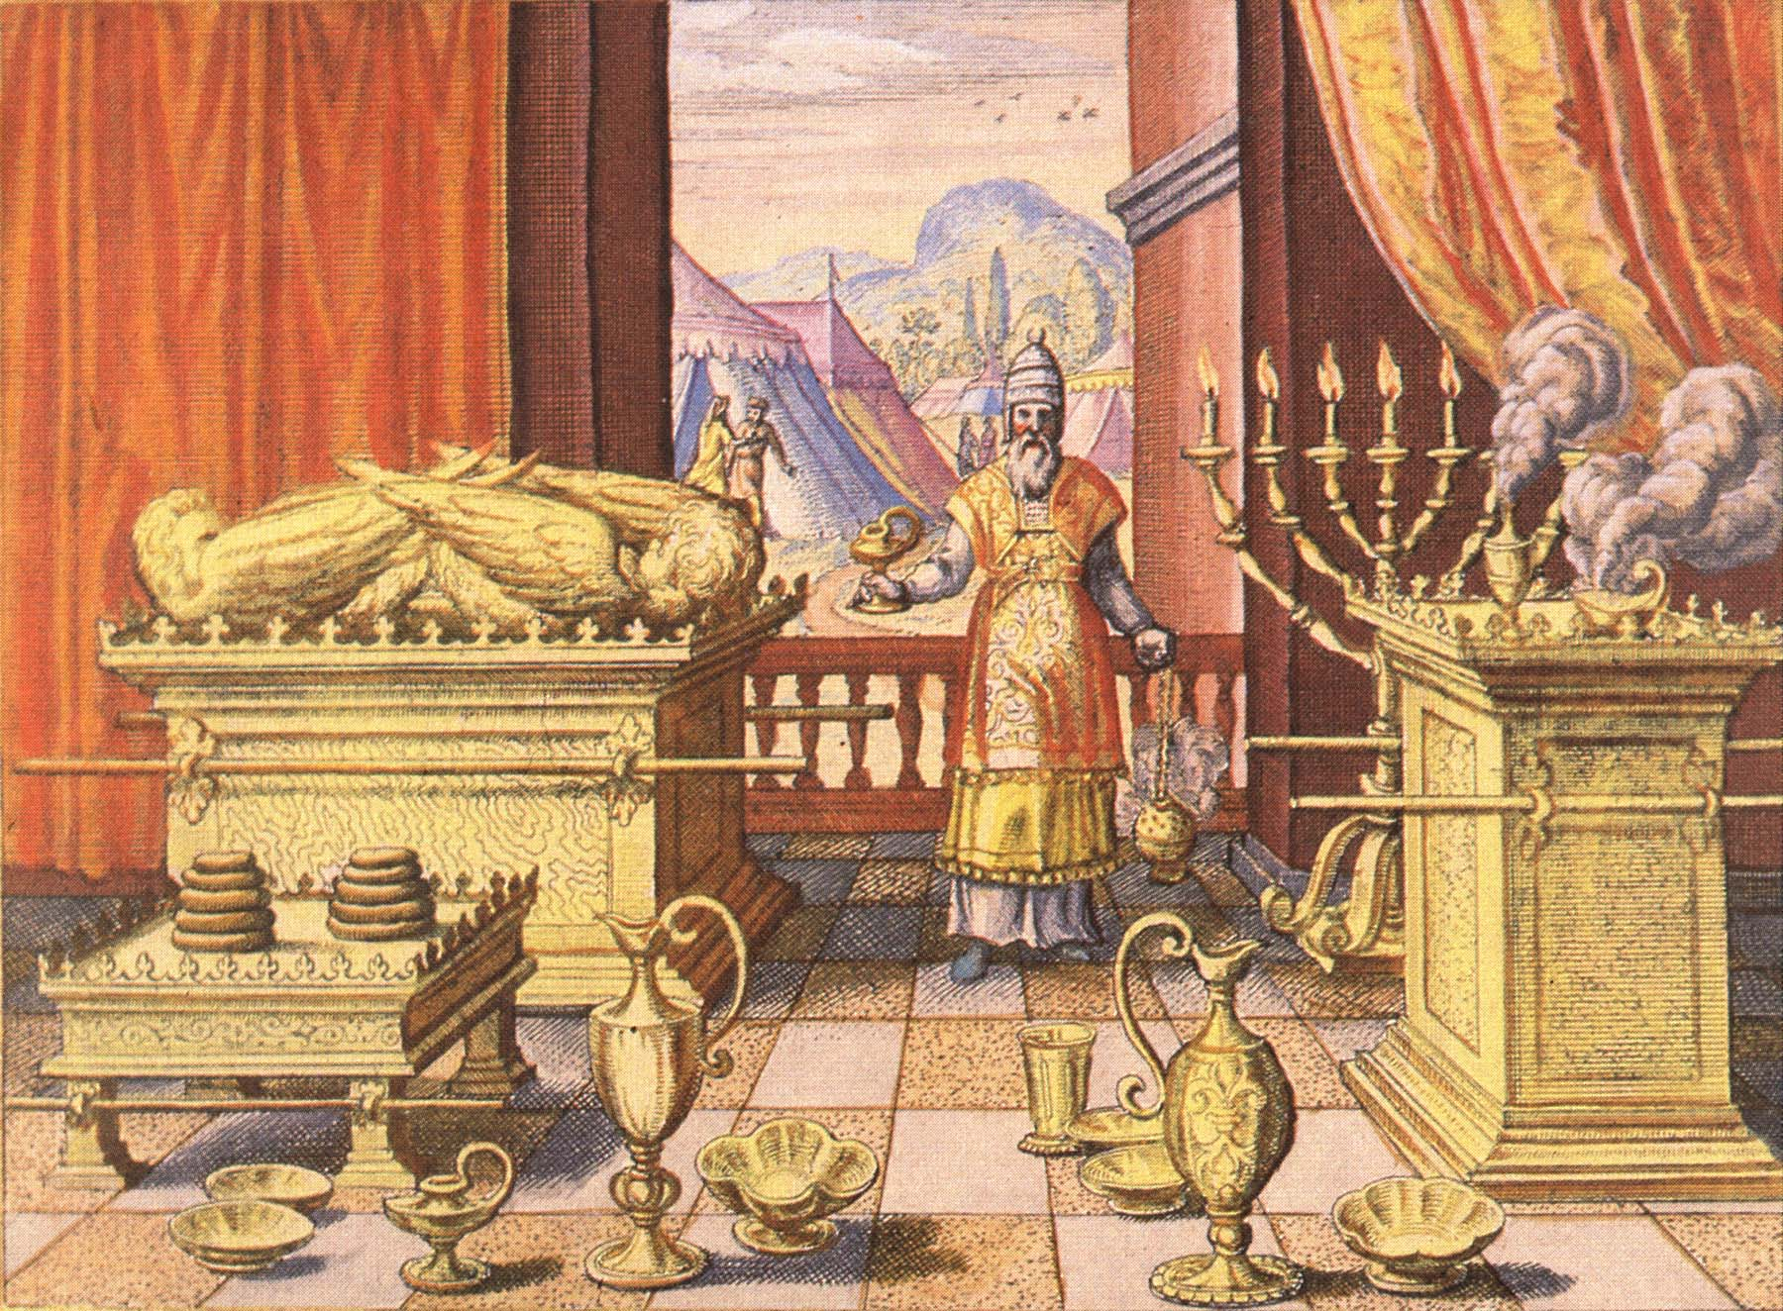
“He as God sitteth in the temple of God, showing himself that he is God.”

Slide 25
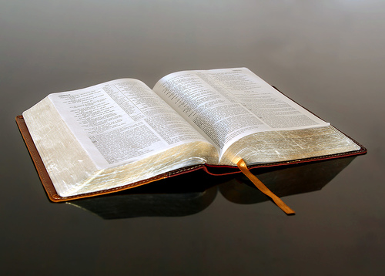
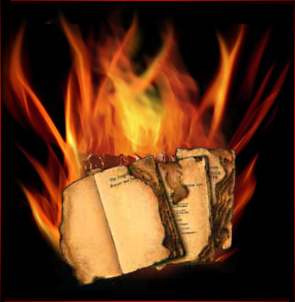
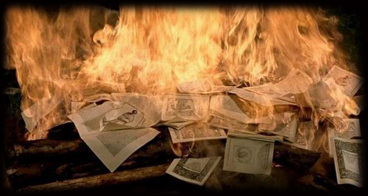
“Cast down the truth to the ground…”

Slide 26
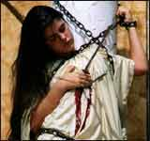
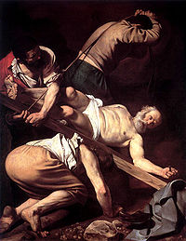
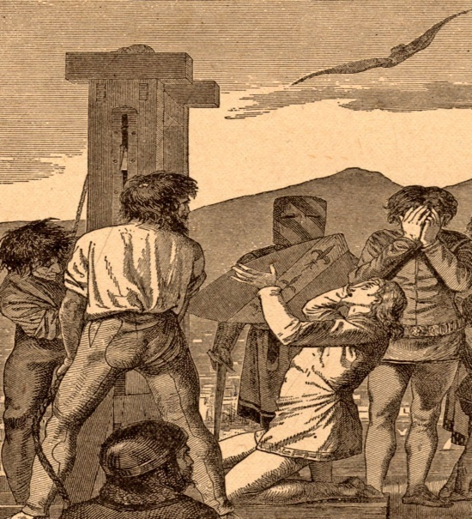
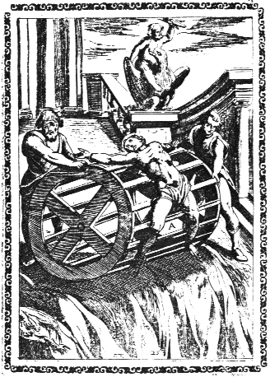
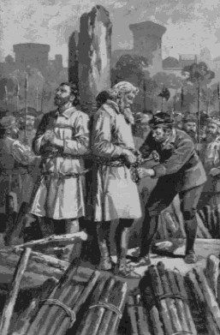
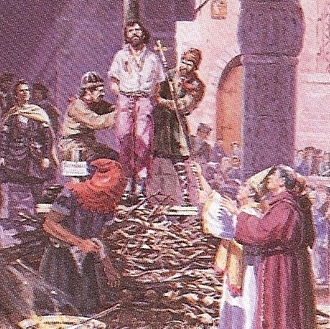
“He shall destroy the mighty and the holy people.”

Slide 27
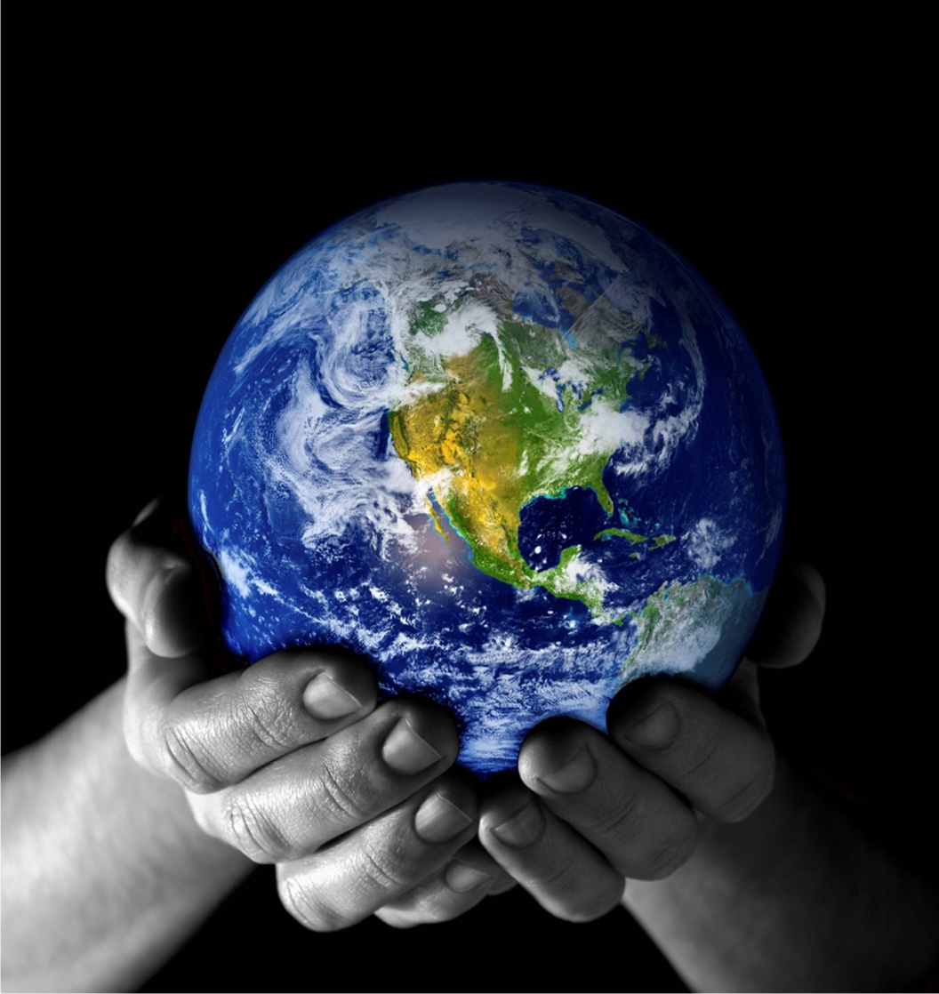
“It (the little horn) practiced, and prospered.”

Slide 28
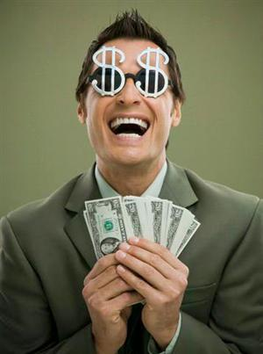
“Through his policy also he shall cause craft (business) to prosper, and he shall magnify himself in his heart…”

Slide 29
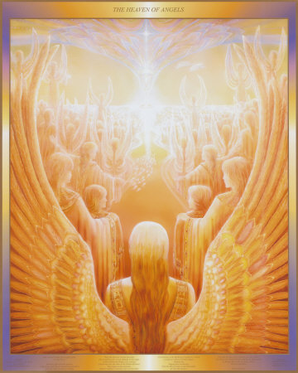
“Then I heard one saint speaking to another…”

Slide 30
The Question “How long shall be the vision concerning the daily sacrifice, and the transgression of desolation, to give both the sanctuary and the host to be trodden under foot?”

Slide 31
The Answer “Unto two thousand and three hundred days; then shall the sanctuary be cleansed.”

Slide 32
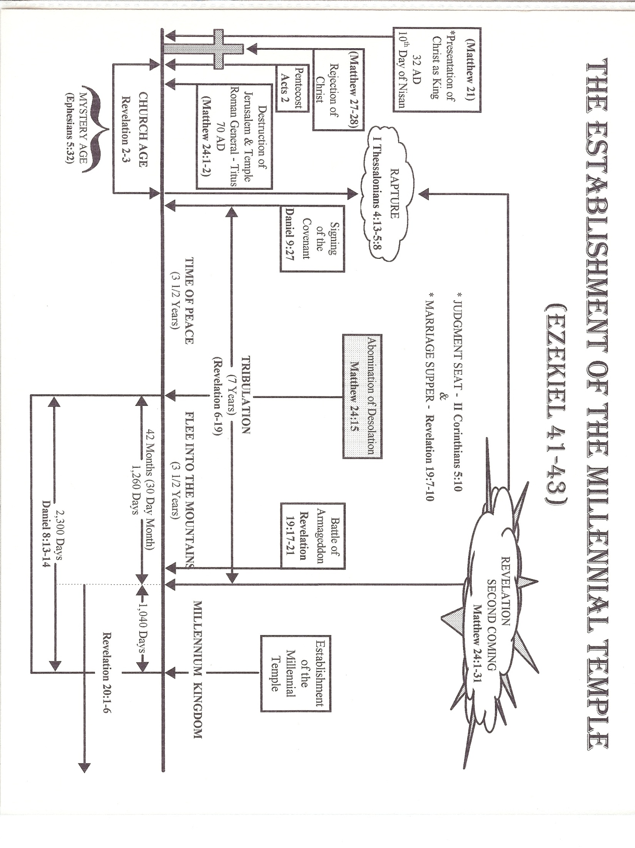

Slide 34
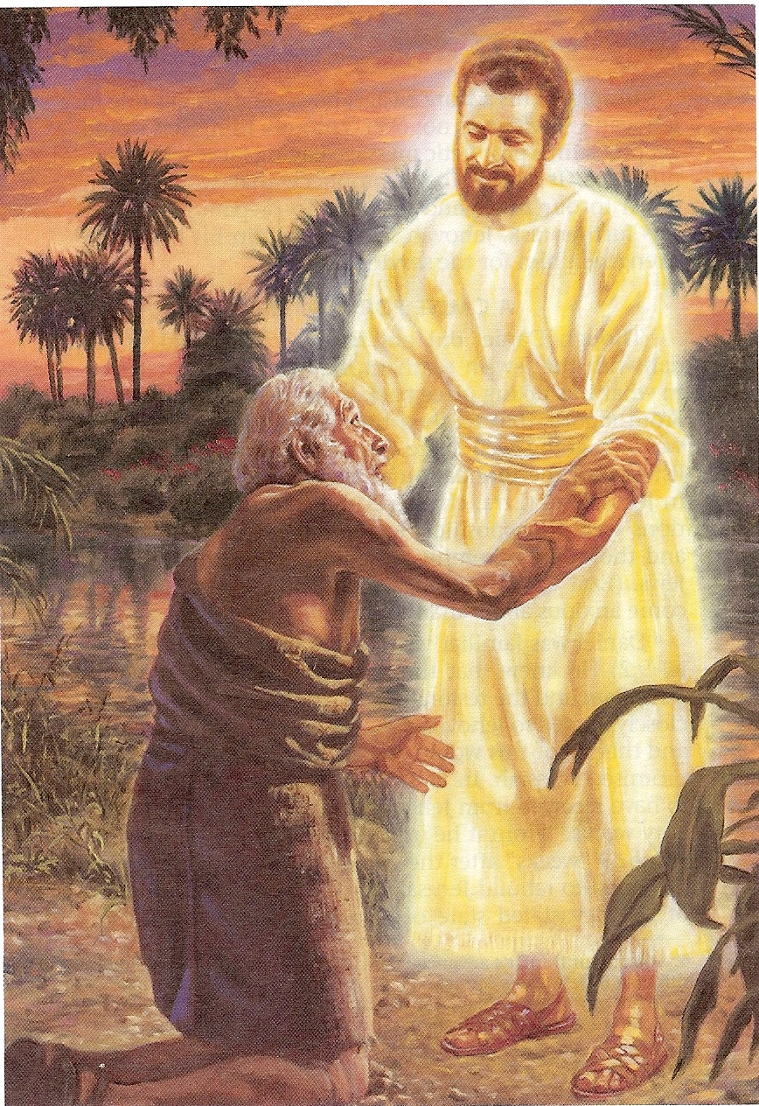
“Gabriel, make this man to understand the vision…”

Slide 35
“Understand, O son of man: for at the time of the end shall be the vision…”

Slide 36
Medo-Persian Empire (Darius the Mede) (Cyrus the Persian)

Slide 37
The King of Grecia (Alexander the Great)

Slide 38
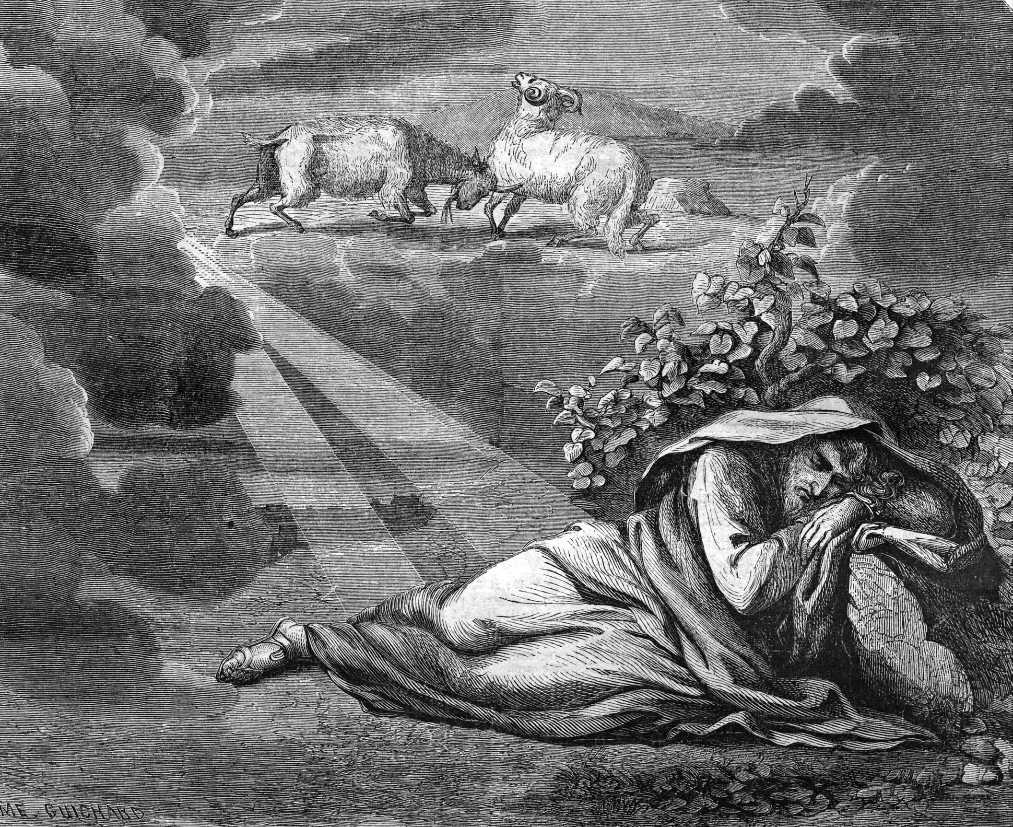

Slide 39
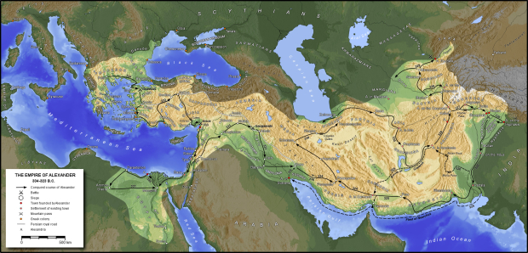

Slide 42
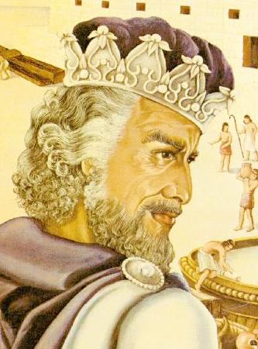
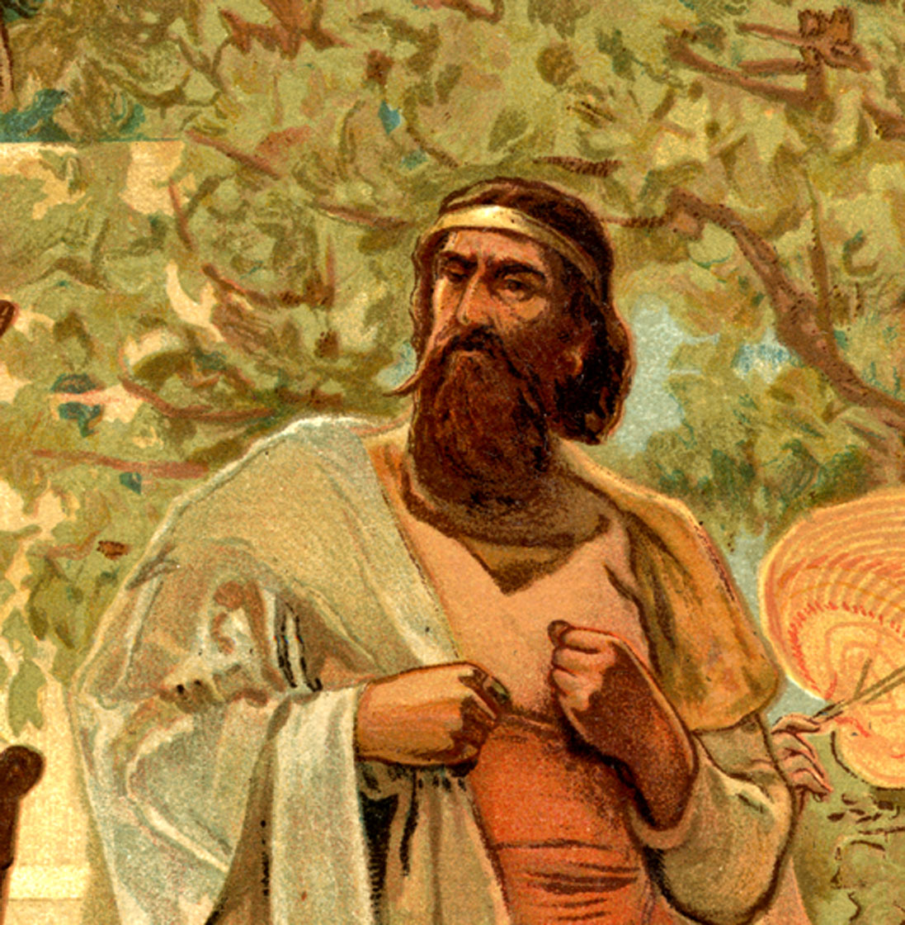
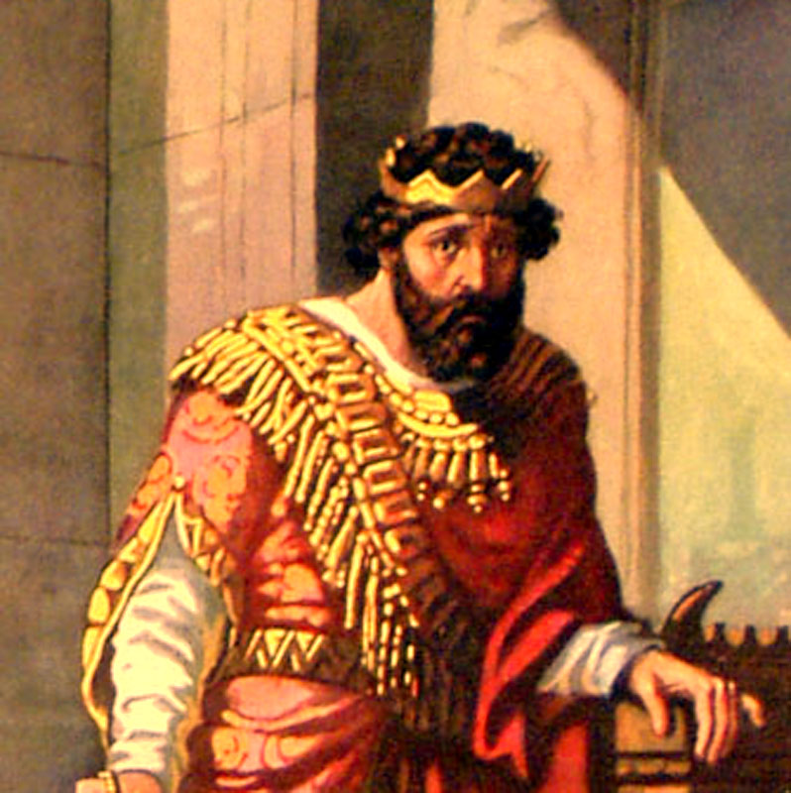
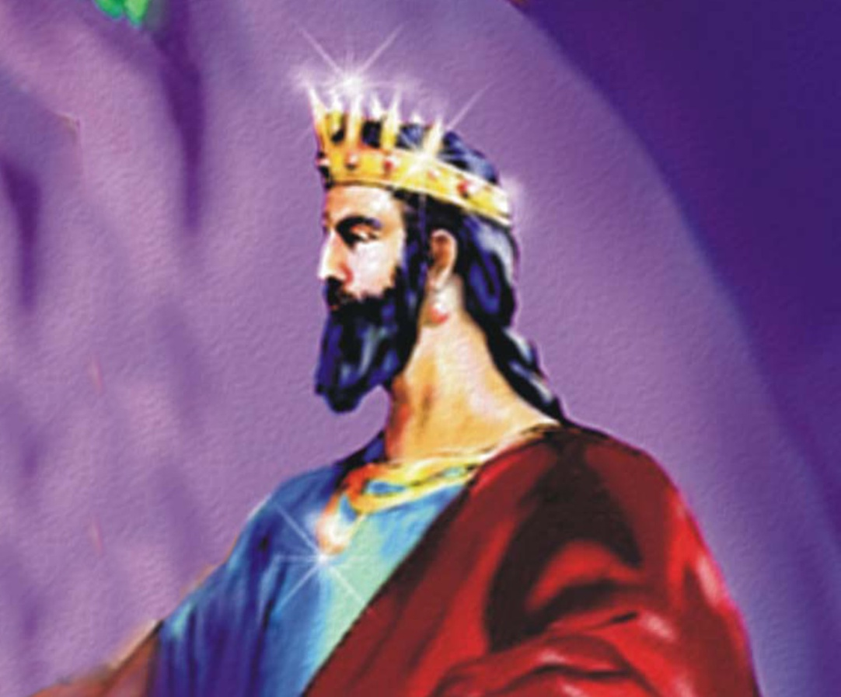
Macedonia Egypt Syria Thrace

Slide 43
“…and behold, there came up among them another little horn…” (Daniel 7:8)

Slide 44
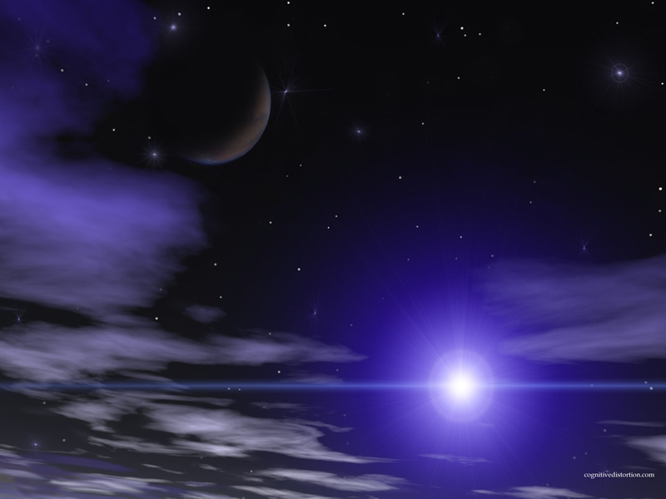
The Anti-Christ Daniel 8:23-25, 9:27
Powerful warrior / military leader
Very intelligent and articulate
Rises to power quickly
Mighty in power but not his own (Satan’s)
Conquers
Prospers politically
Advances and flourishes

Slide 45
Destroys powerful kingdoms (nations)
Persecutes Israel (seeking to destroy her as a nation)
Business will prosper under his policies
Secures a peace covenant (7 years)
Breaks the covenant (3 ½ years) / cause worship to cease
Commits the “Abomination of Desolation” / Exalt himself as God

Slide 46
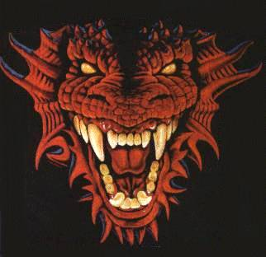
“He (Anti-Christ) shall stand up against the Prince of Princes; but he shall be broken without hand.” (without human hands or by human means)

Slide 47
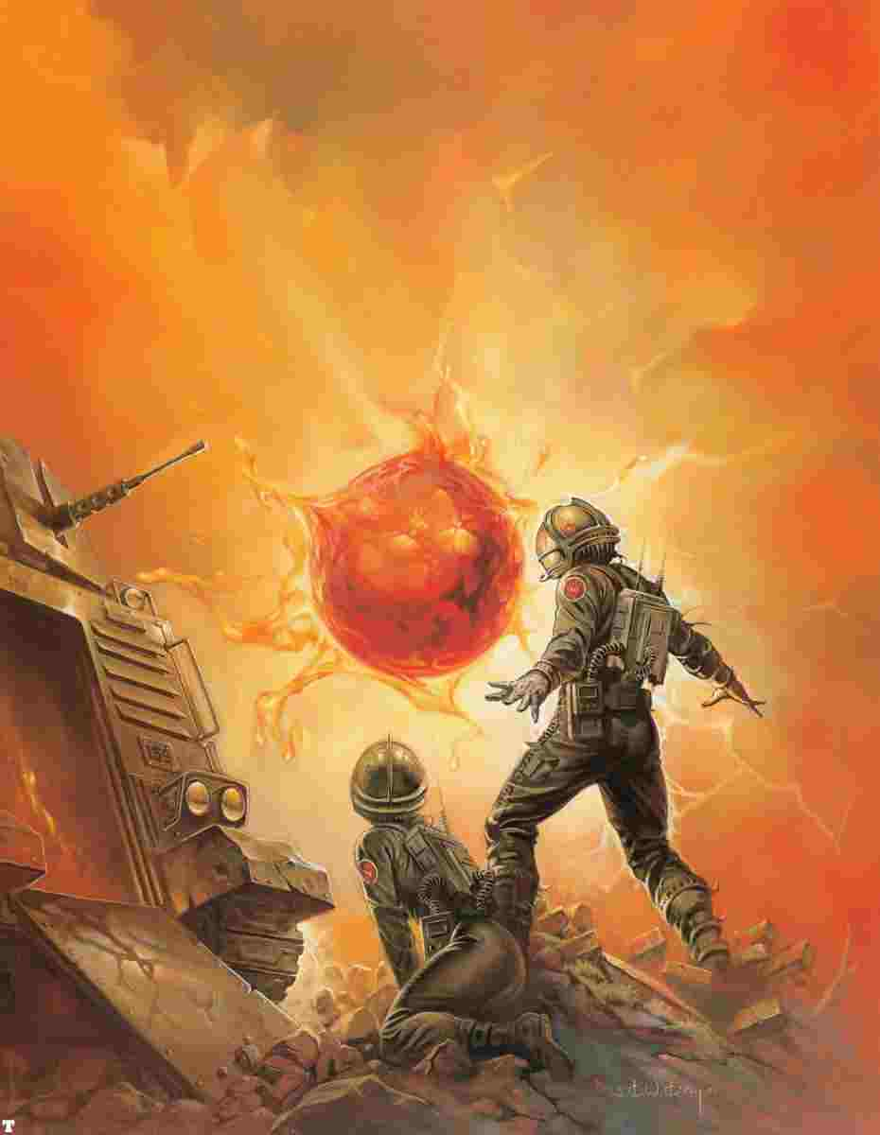
“And I saw the beast (Anti-Christ / little horn), and the kings of the earth, and their armies, gathered together to make war against Him that sat on the horse and against His army.” (Revelation 19:19)

Slide 48
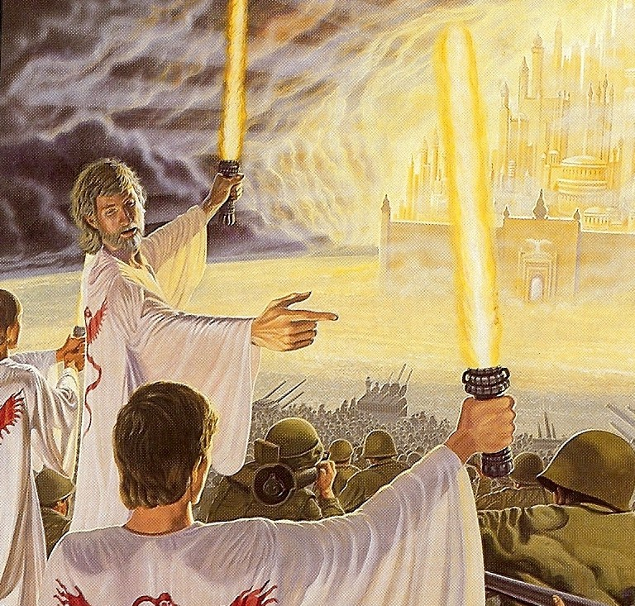
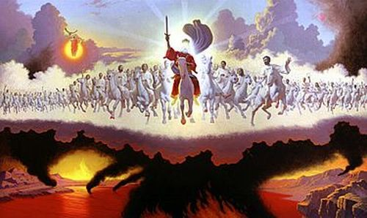

Slide 49
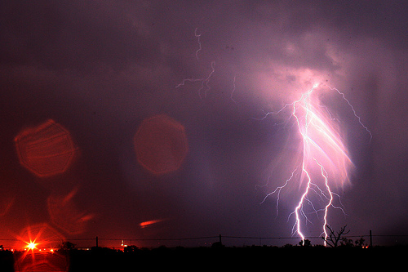
“I beheld, and the same horn made war with the saints…until the Ancient of days came, and judgment was given to the saints of the most High; and the time came that the saints possessed the kingdom…”

Slide 50
“And the greatness of the kingdom under the whole heaven, shall be given to the people of the saints of the most High, whose kingdom is an everlasting kingdom, and all dominions shall serve and obey Him…”

Slide 51
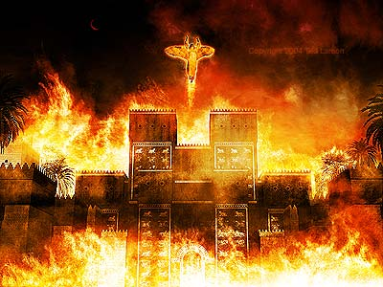
“His sanctuary was cast down…” (Revelation 18)

Slide 52
“And the beast was taken and with him the false prophet that wrought miracles…which deceived them that had received the mark…these both were cast alive into a like of fire burning with brimstone. And the remnant were slain with the sword of Him that sat upon the horse…” (Revelation 19:20-21)

Slide 53
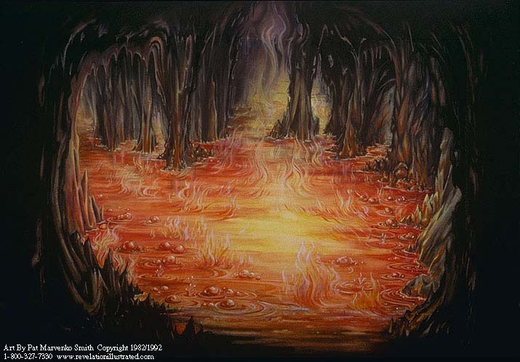
“What shall it profit a man, if he gain the whole world, and lose his own soul.” (Mark 8:36)

