Slide 1
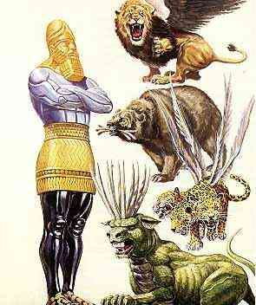
The Vision of Nebuchadnezzar’s
Daniel 2:1-45

Slide 2
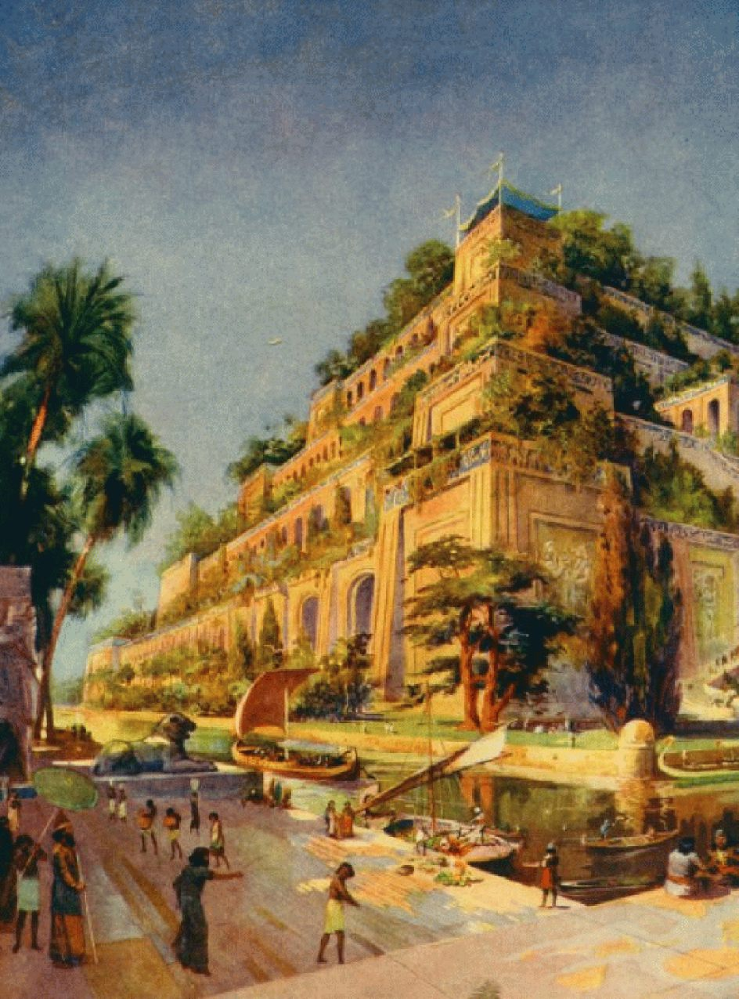

Slide 3
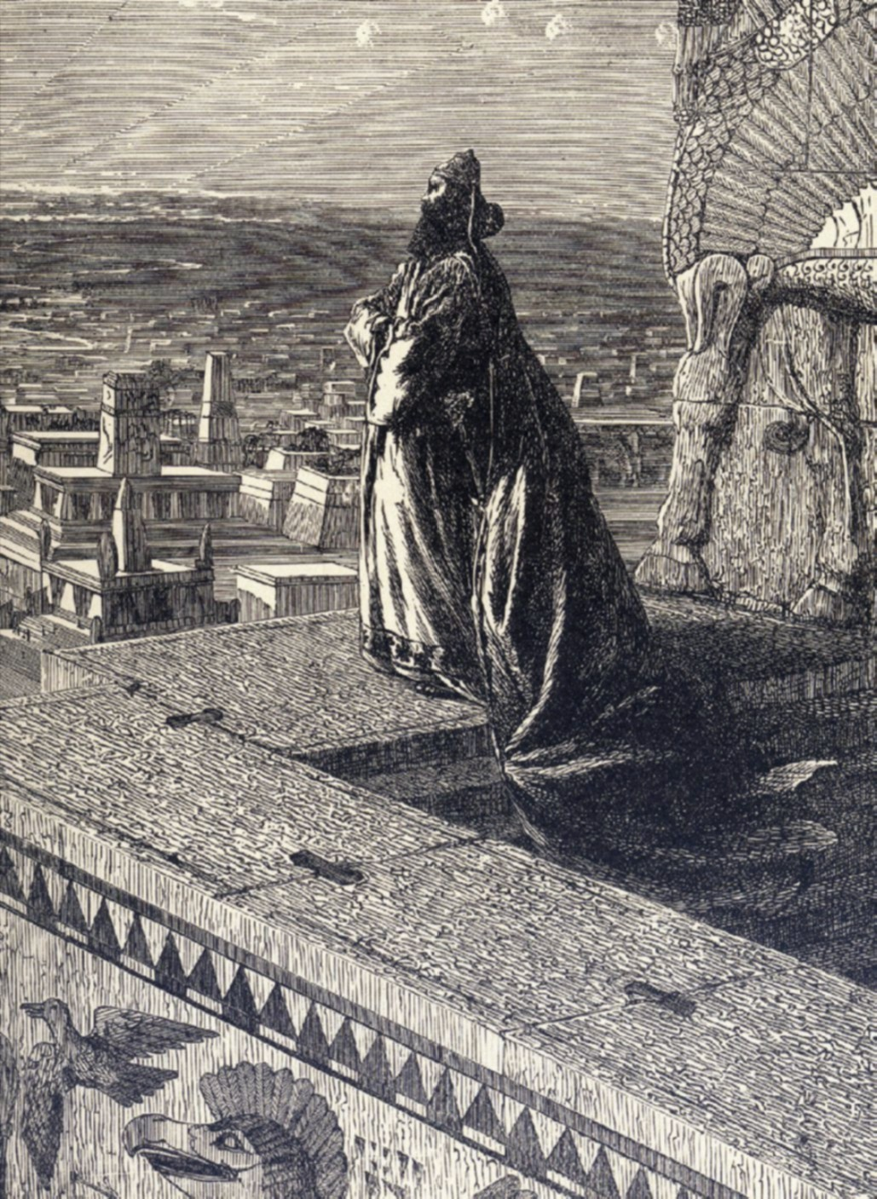

Slide 4
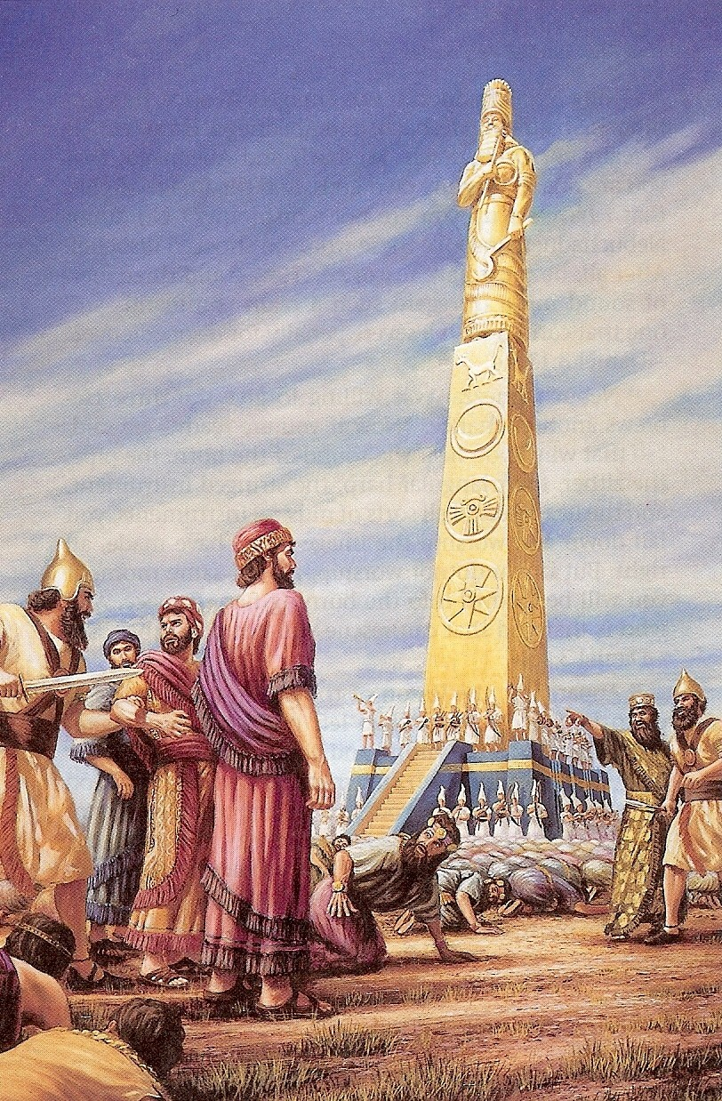
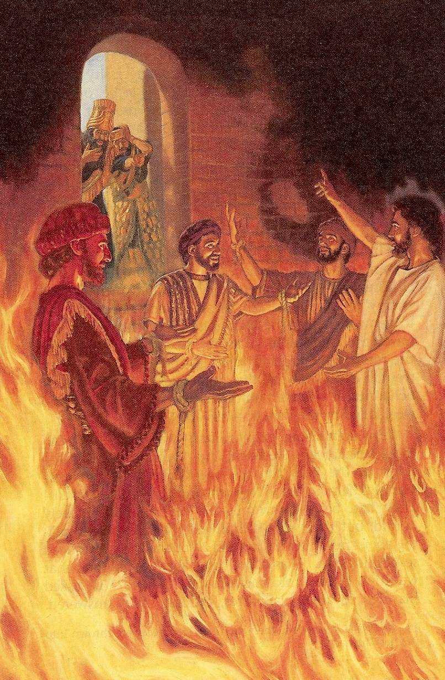

Slide 5
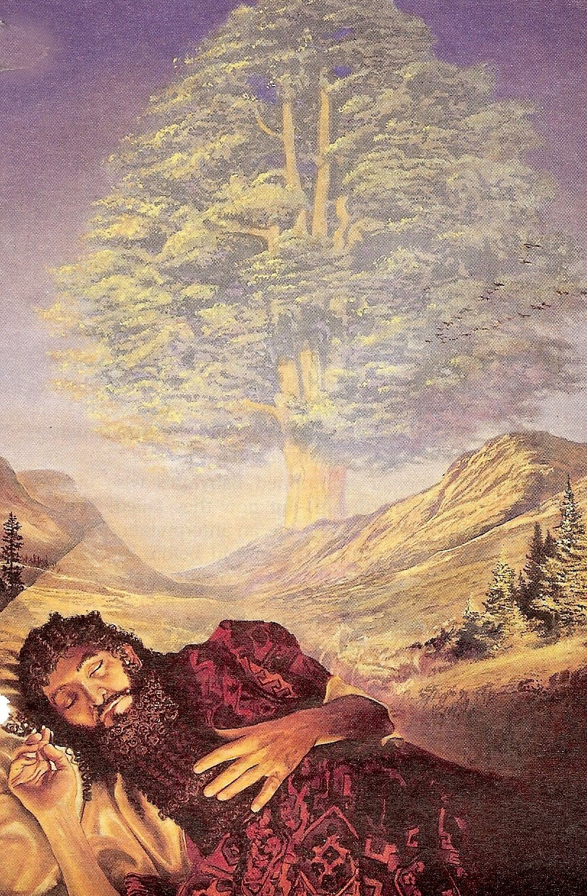
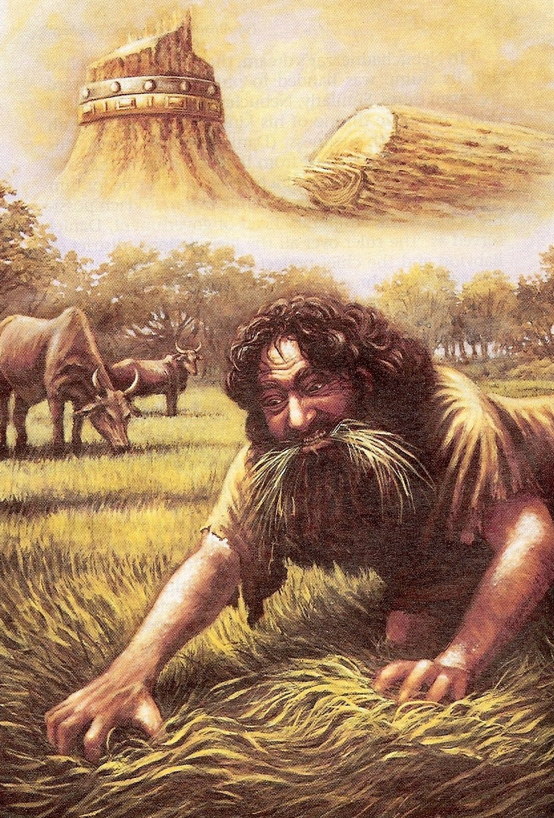
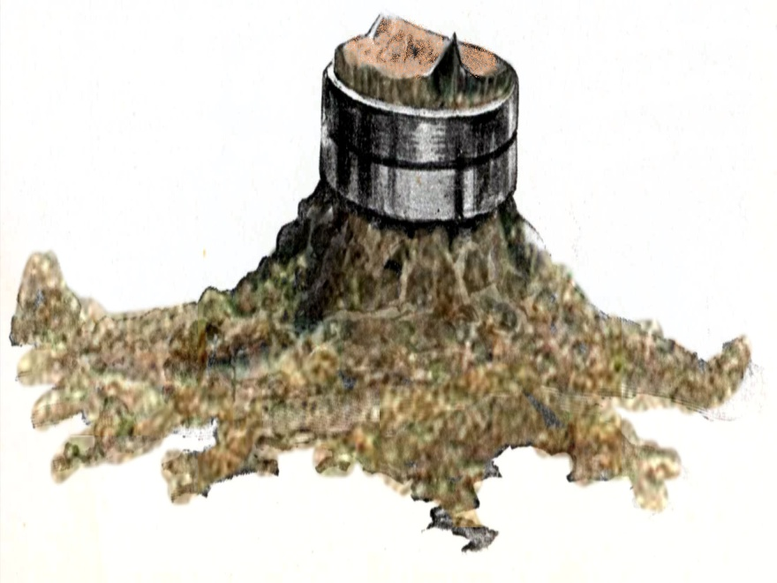

Slide 6
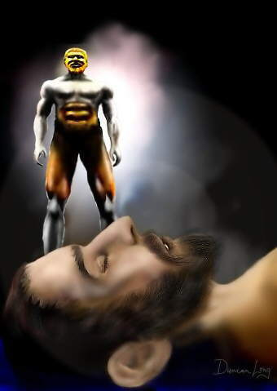

Slide 7
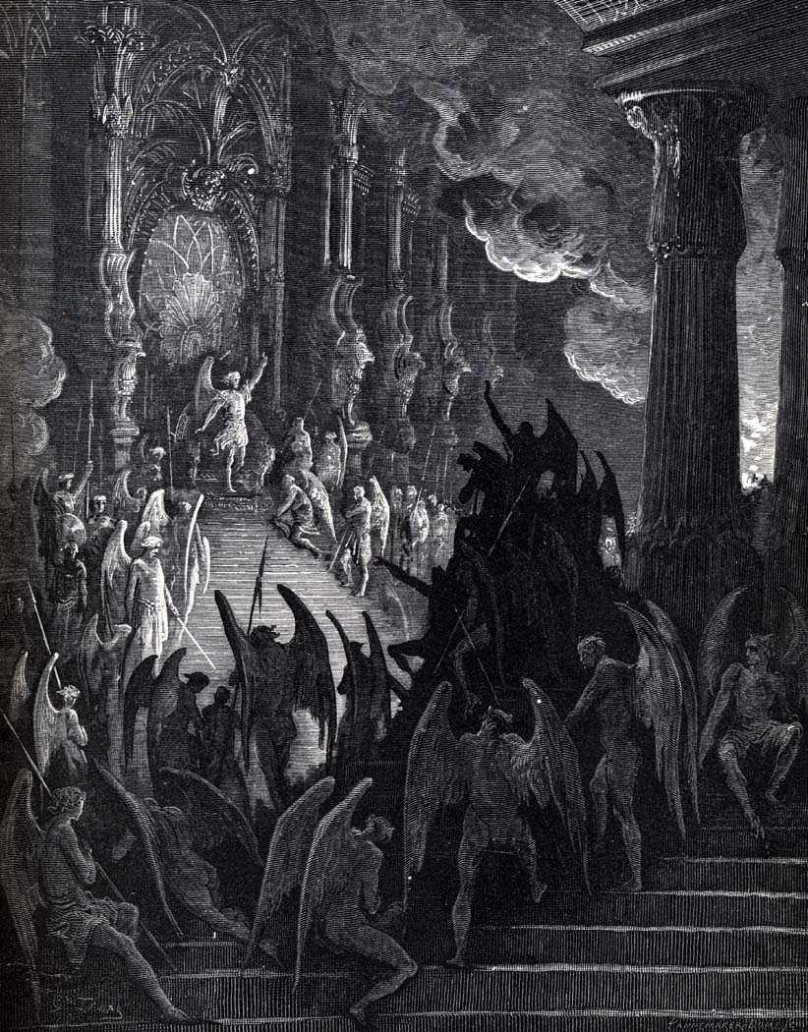
Magicians
Experts in Magic; supernatural power to produce baffling effects or illusions by sleight of hand

Slide 8
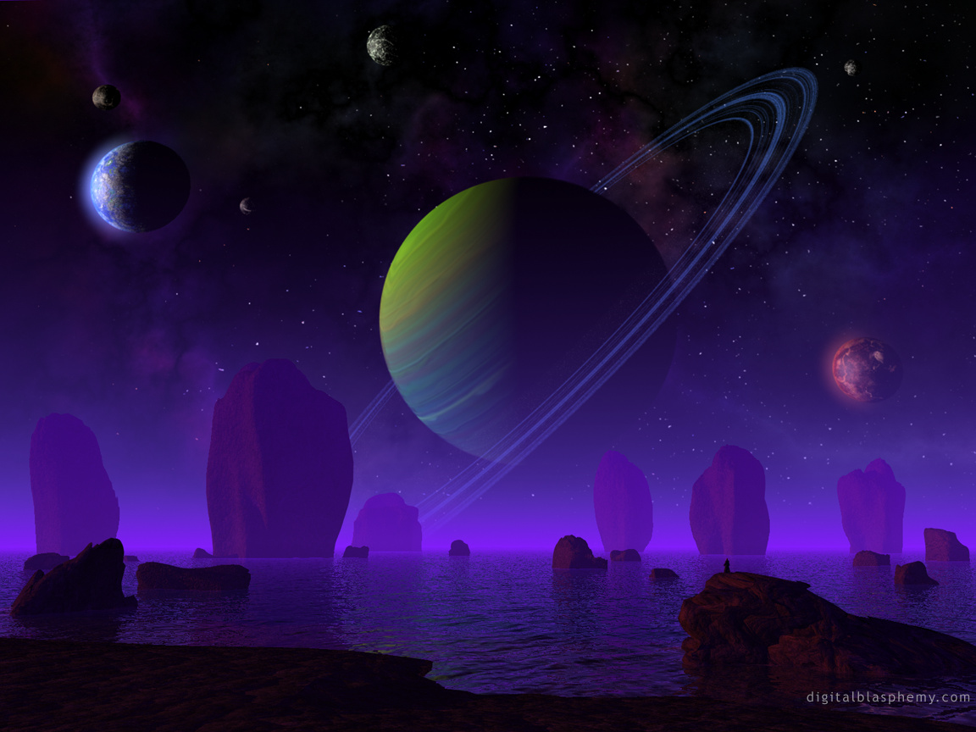
Astrologer
One who professes to interpret the influence of the stars on the affairs of men; foretells events by the positions of the stars

Slide 9
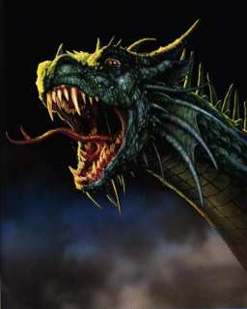
Sorcerer
An enchanter; one who is invested with the power to cast magical spells or charms.

Slide 10
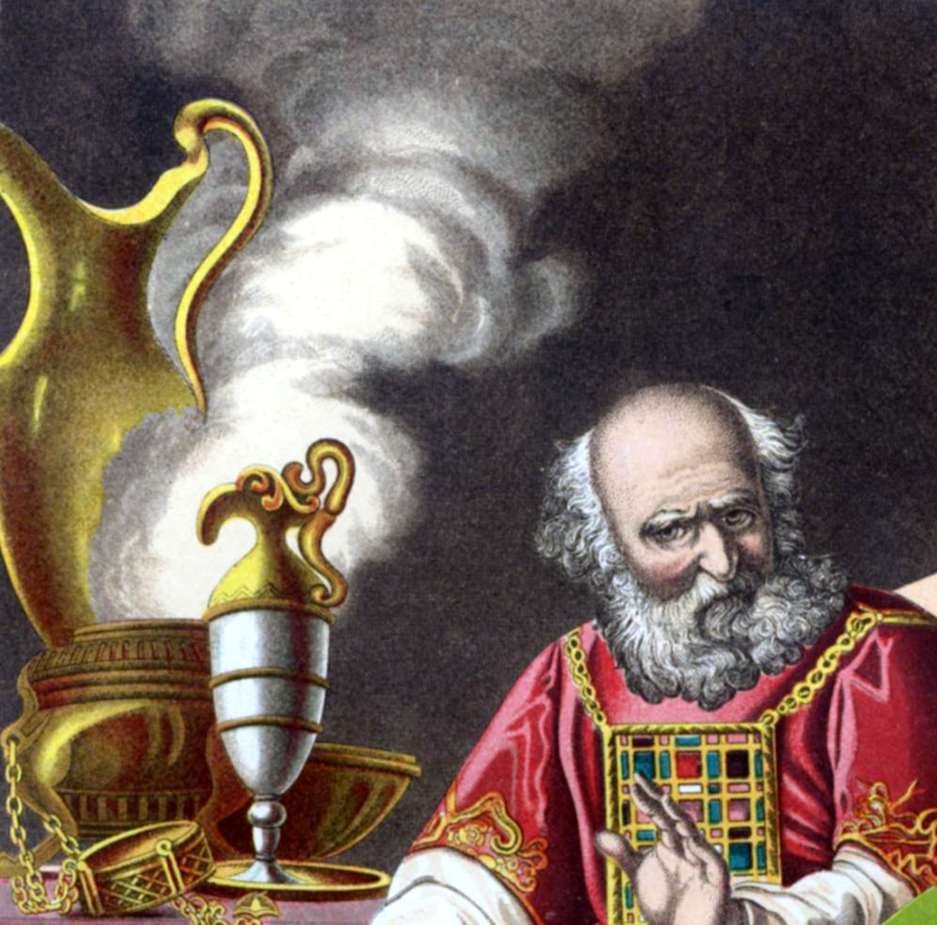
Chaldeans
Babylonian wise men / pagan priest

Slide 11
“But the natural man receiveth not the things of the Spirit of “God: for they are foolishness unto him: neither can he know the, because they are spiritually discerned…But God hath revealed them unto us by His Spirit.” (I Corinthians 2:10, 14)

Slide 12
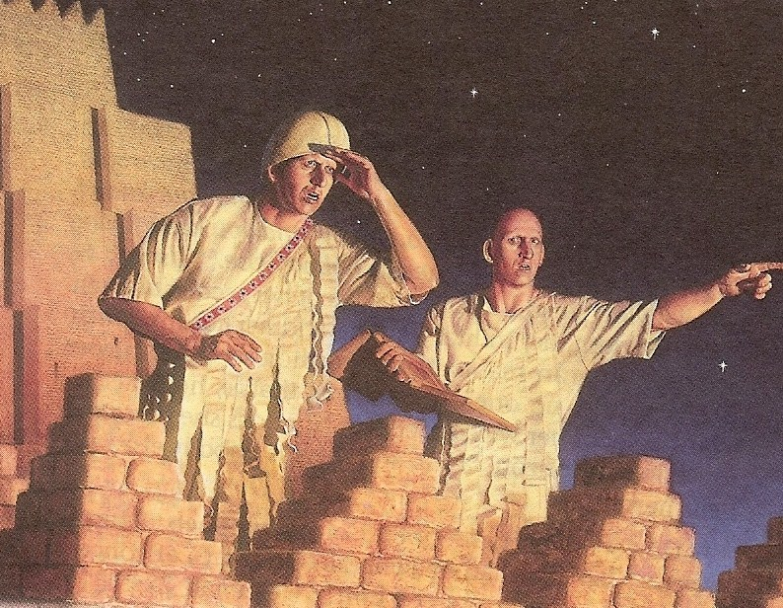

Slide 13
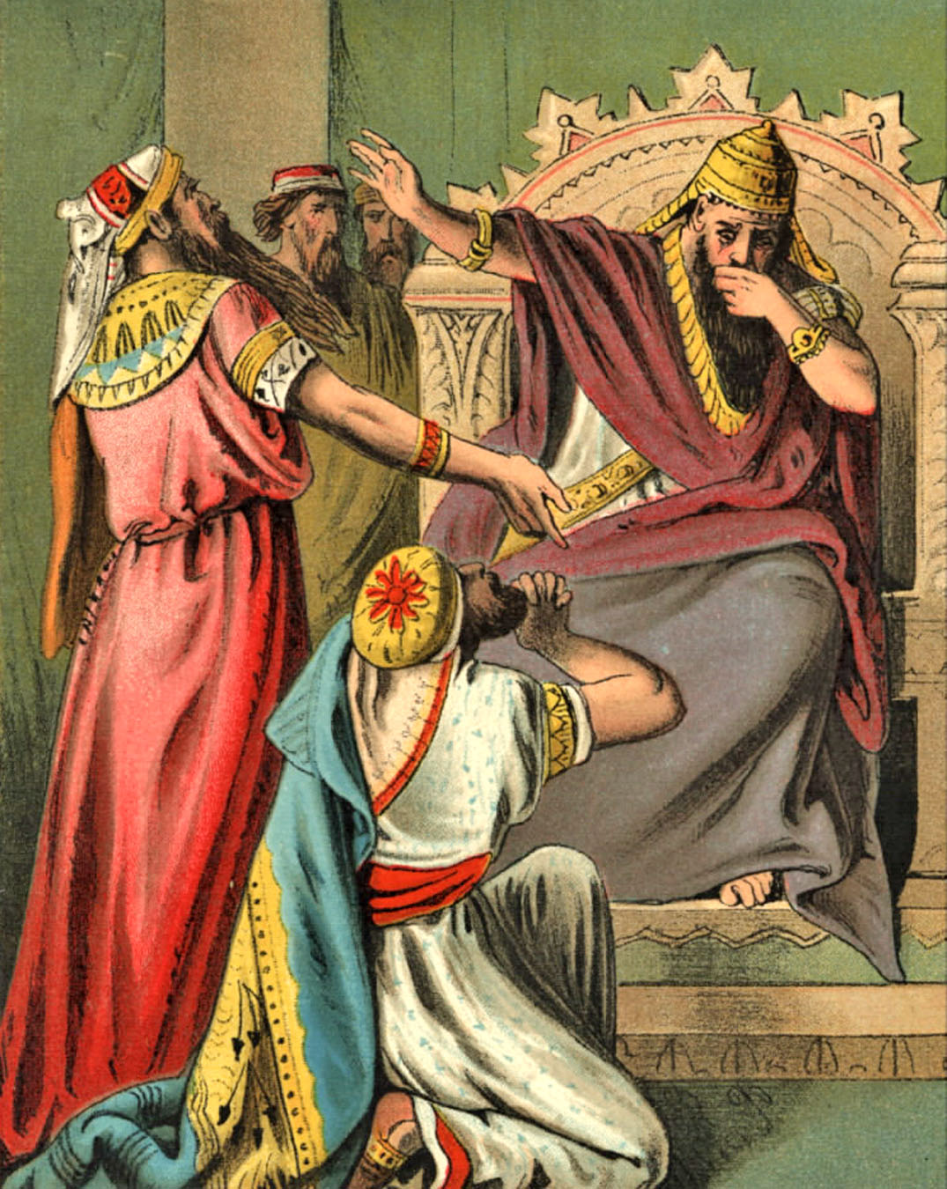

Slide 14
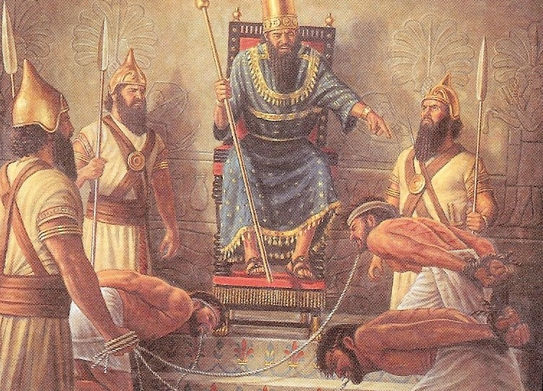

Slide 15
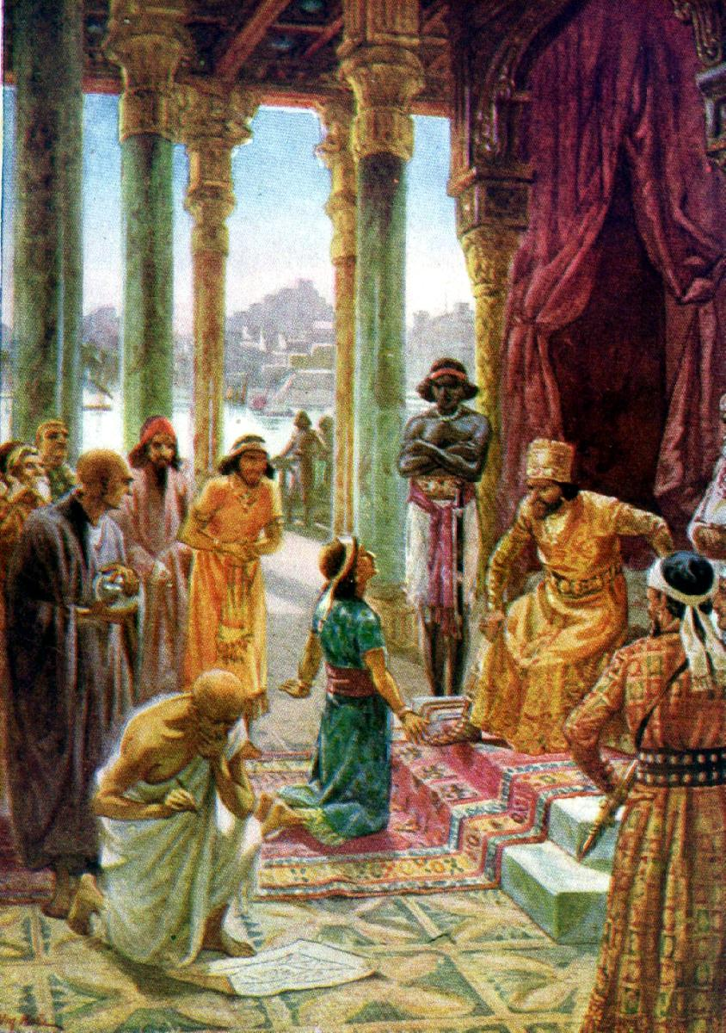
Daniel exercise prudence
Daniel 2:14-16

Slide 16
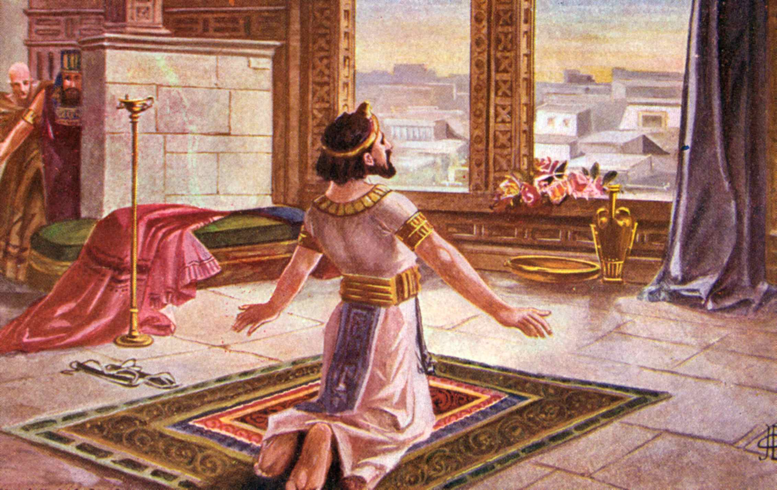
Daniel exercise prayer
Daniel 2:17-19

Slide 17
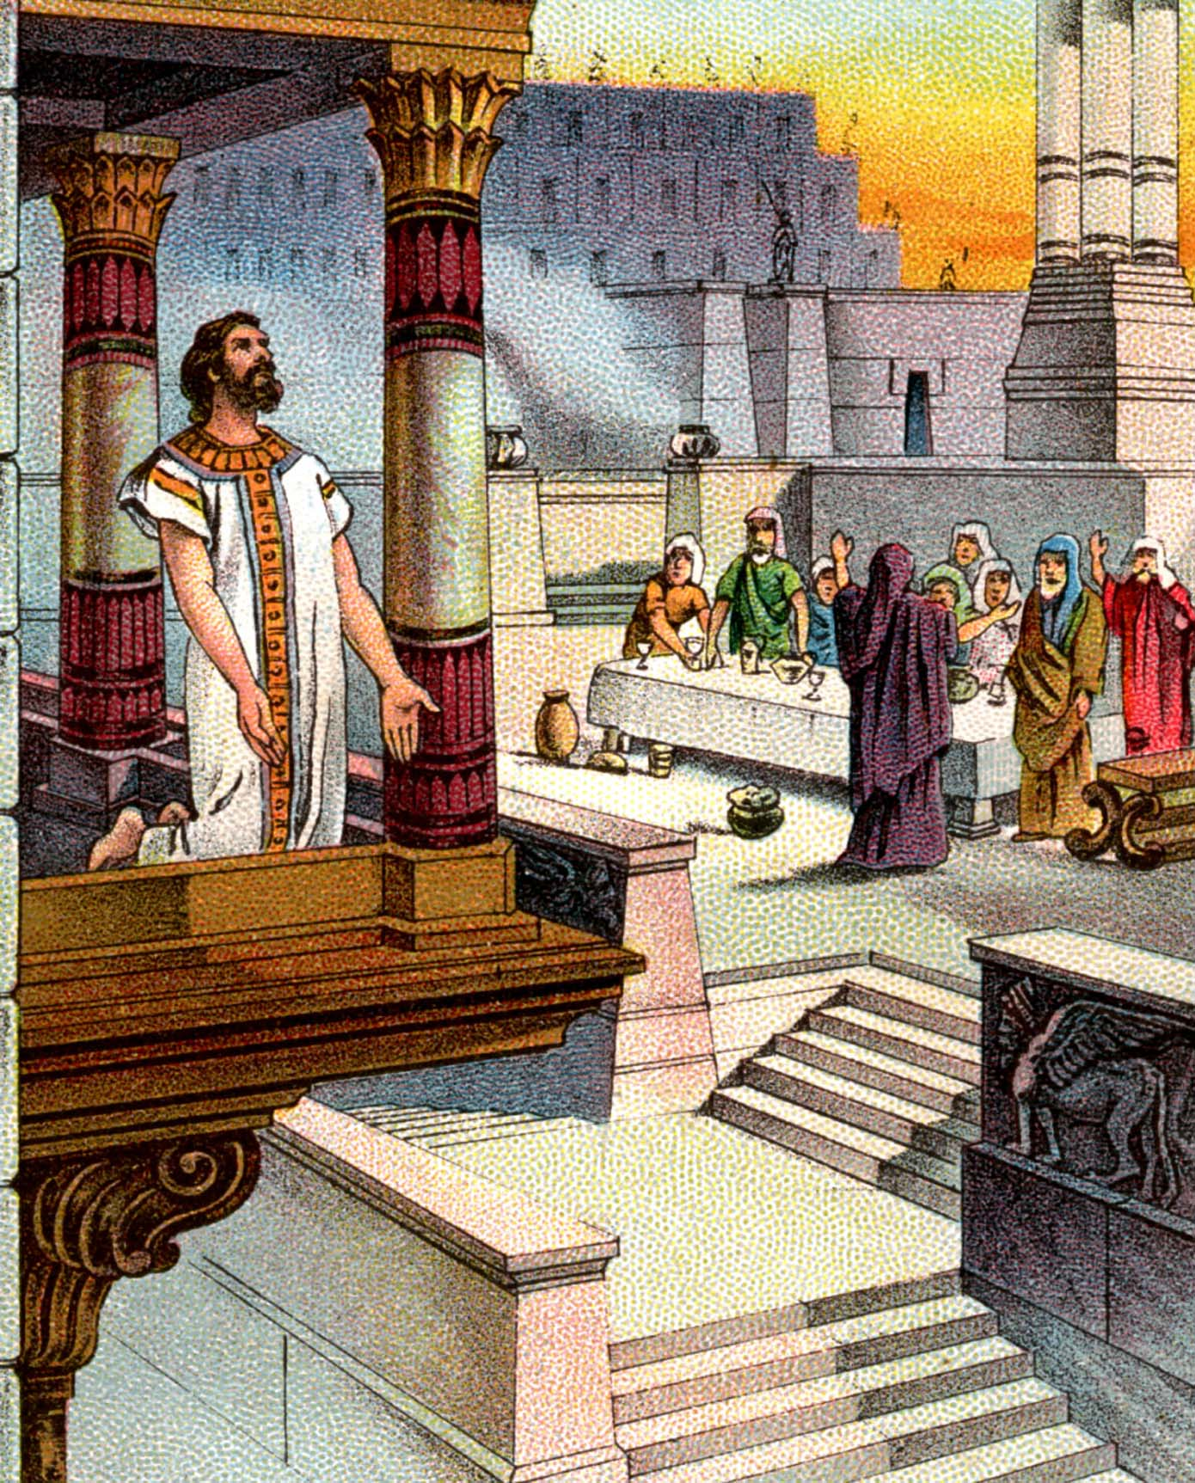
Daniel exercise praise
Daniel 2:19-23

Slide 18
Daniel’s Appeal Daniel 2:24-30
Daniel appeals to Arioch (the royal executioner) – vs. 24
Arioch presents Daniel to the King – vs. 25
Nebuchadnezzar ask Daniel to reveal to him the dream and its interpretation – vs. 26
Daniel gives praise and glory to God – vs. 27-28
Daniel gives the interpretation of the dream – vs. 29-30

Slide 19
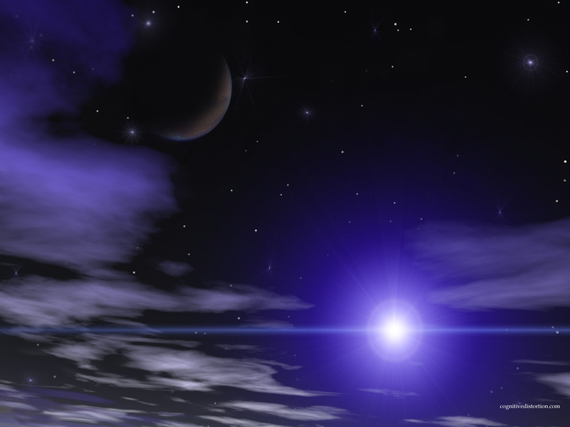
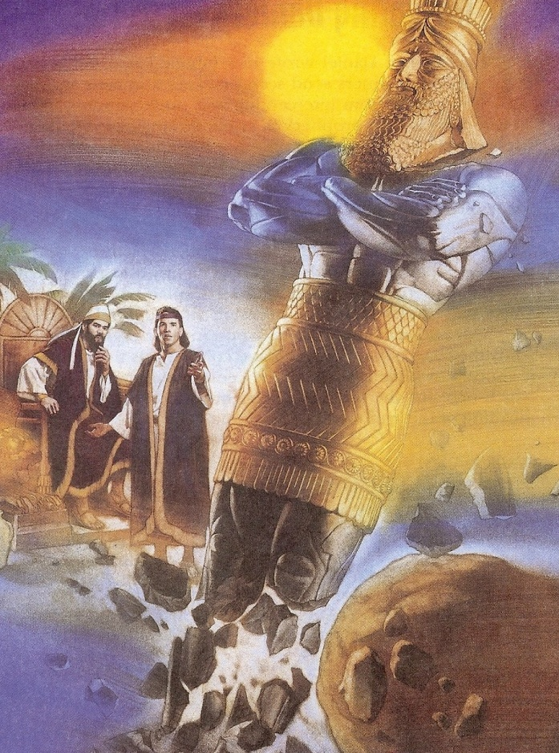
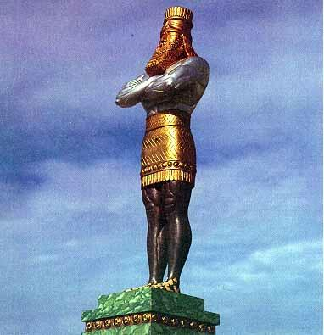
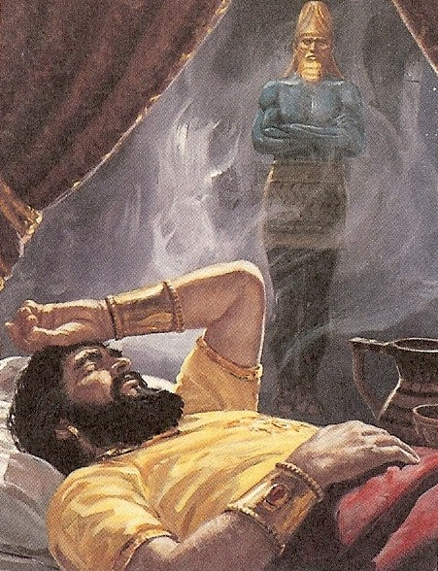

Slide 20
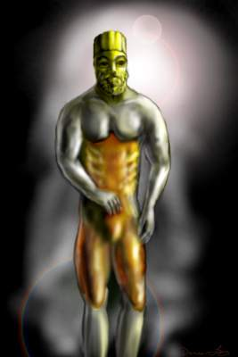
The vision of the image Daniel 2:31-33
Great image – Refers to the size of he image; it was an immense statue
Bright image – Refers to the extraordinary splendor of it’s shining metal
Terrible image – Refers to the terrifying appearance of the image
Manly image – Head of gold / chest and arms of silver / belly and thighs of brass / legs of iron/ feet mixed with iron and clay

Slide 21
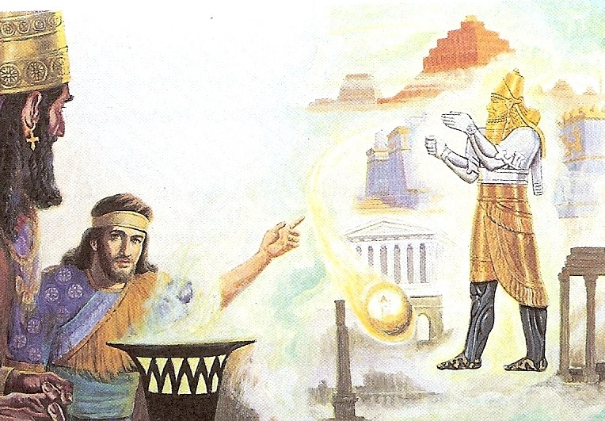

Slide 22
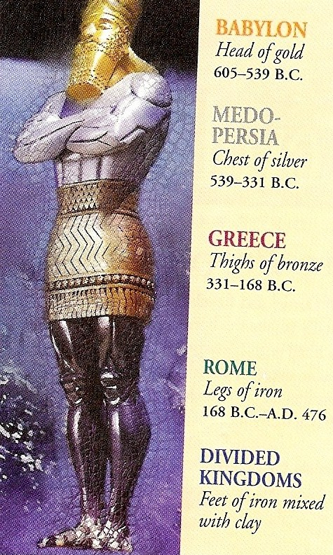

Slide 23
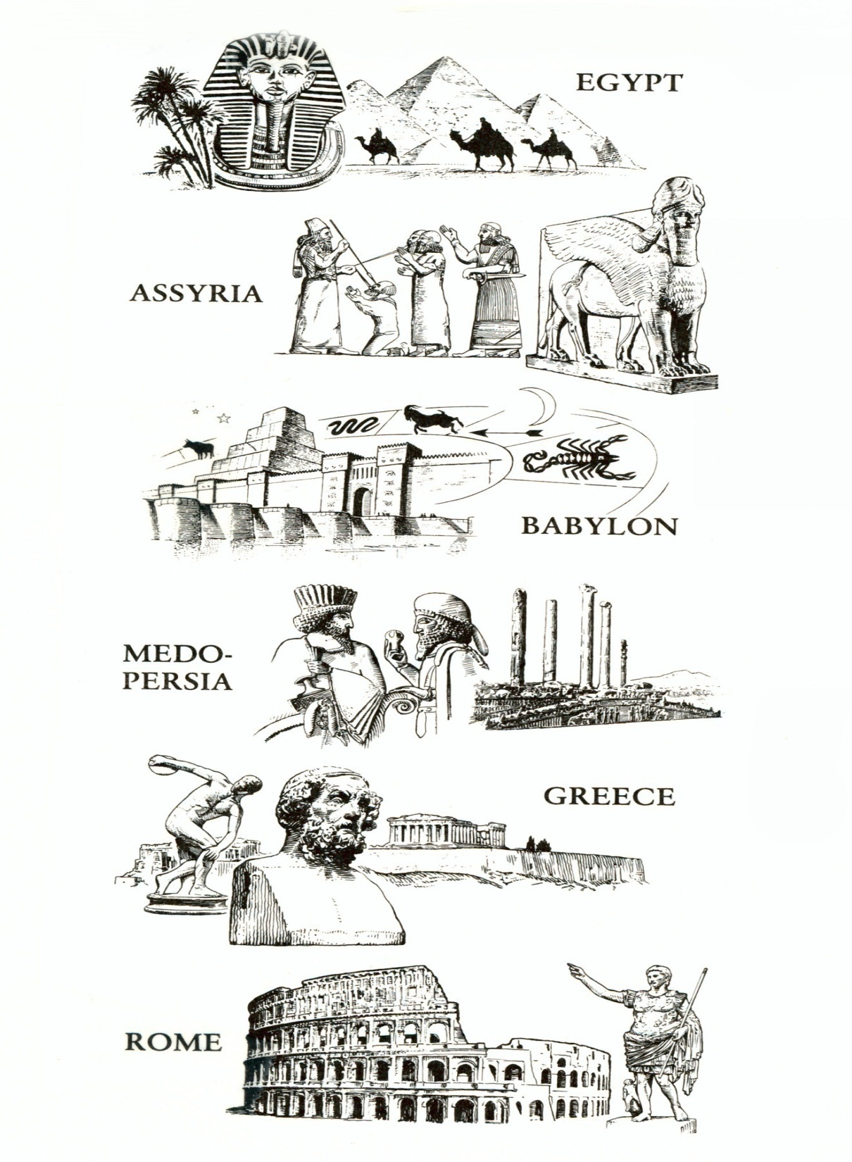

Slide 24
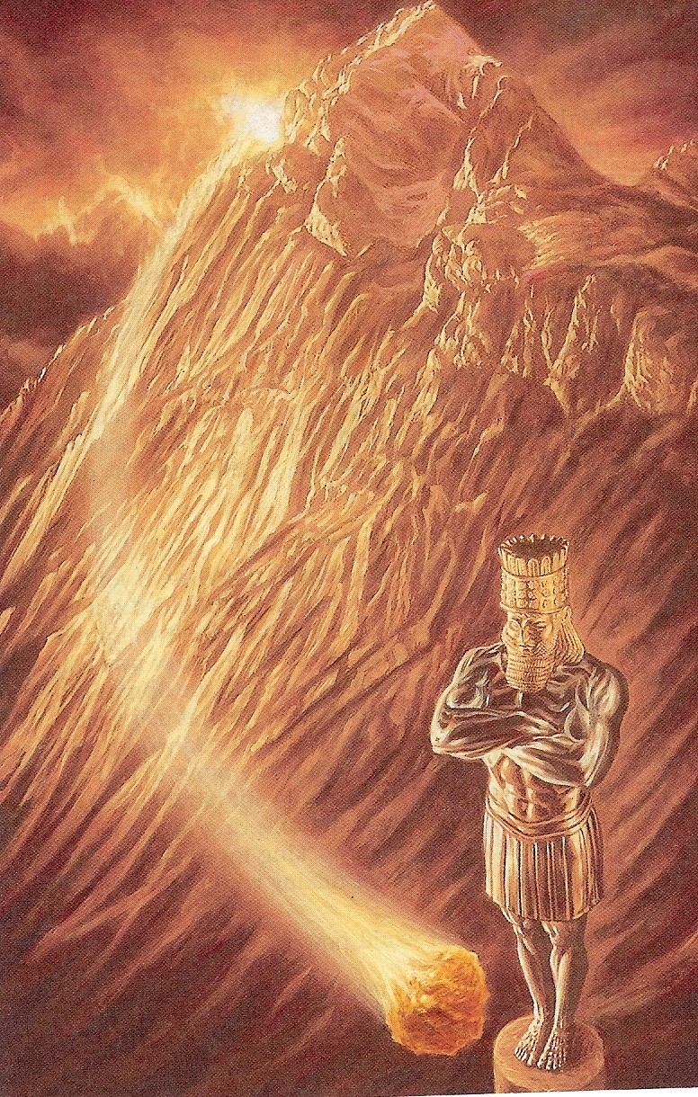
The vision of the stone Daniel 2:34-35
The stone was “cut out without hands” – This stone was formed by God without human power or assistance
The stone struck the great image directly upon the feet of iron and clay
The stone “break” (crushed) the image into pieces
The stone reduced the metal to power – “like the chaff of the summer threshingfloors; and the wind carried them away; that no place was found for them.” (no trace left)
The stone which had smitten the image grew to such a gigantic proportion that it became a huge mountain which filed the whole earth

Slide 25
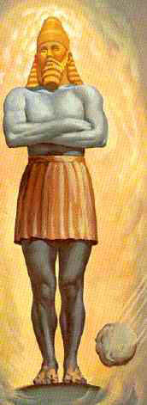
Feet of iron and clay Daniel 2:41-43
Revived Roman Empire
10 Nation Federation over which the Anti-Christ will rule during the Tribulation
Clay = weak nation
Iron = strong nations
(Revelation 13:1-2; 17:12)

Slide 26
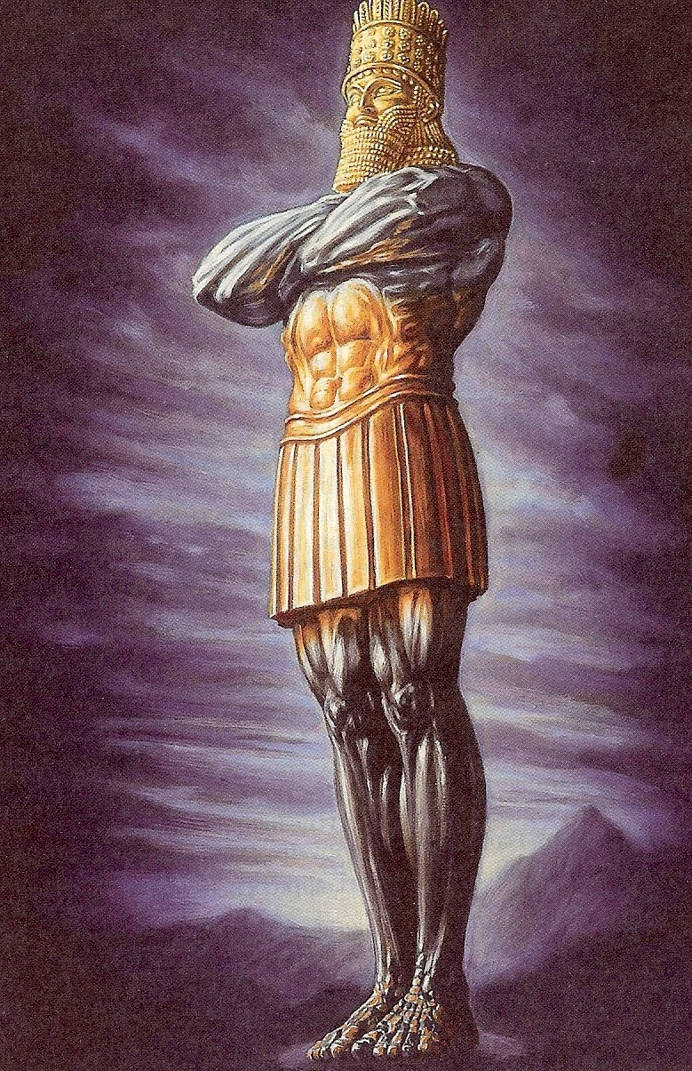
Explanation of Daniel 2:43 “…they mingle themselves with the seed of men.”
The mingling is the uniting of governments with the “seed of men”. The seed refers to the sowing of a field with mixed seeds, and denotes the different nationalities that will be united together in the revived Roman Empire
(United Nations)
One world government.

Slide 27
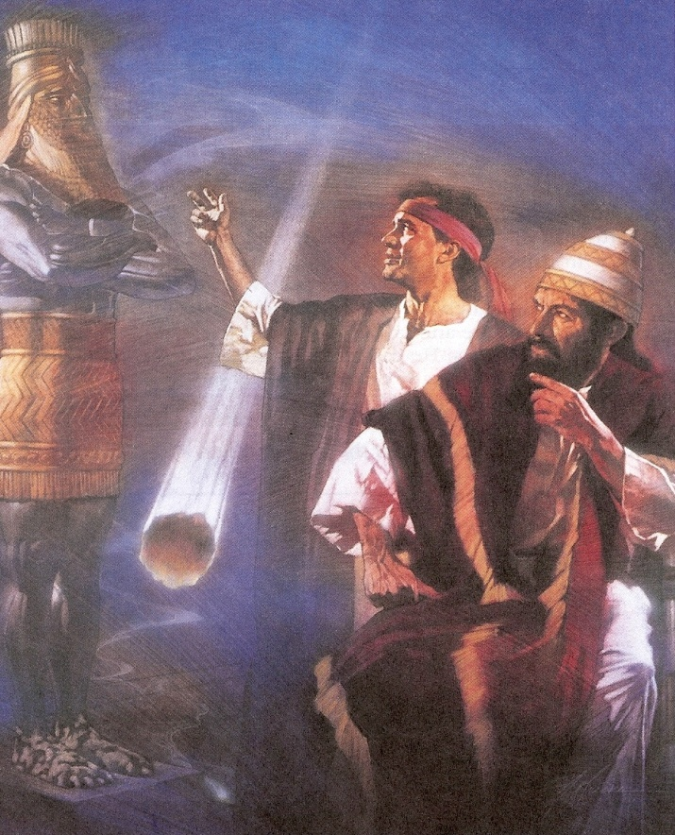
“Behold, a King shall reign in righteousness, and princes shall rule in judgment…as the shadow of a great rock in a weary land.” (Isaiah 32:1-2)
“Upon this rock I will build my church; and the gates of hell shall not prevail against it.”
(Matthew 16:18)

Slide 28
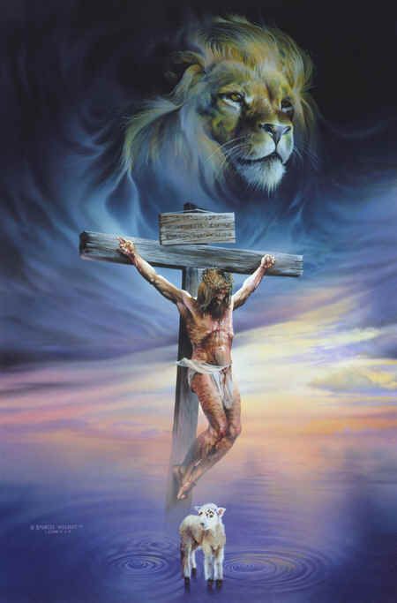
“Weep not” behold the Lion of the tribe of Judah, the Root of David, hath prevailed…And (He) cried with a loud voice, as when a lion roareth…” (Revelation 5:5; 10:13)

Slide 29
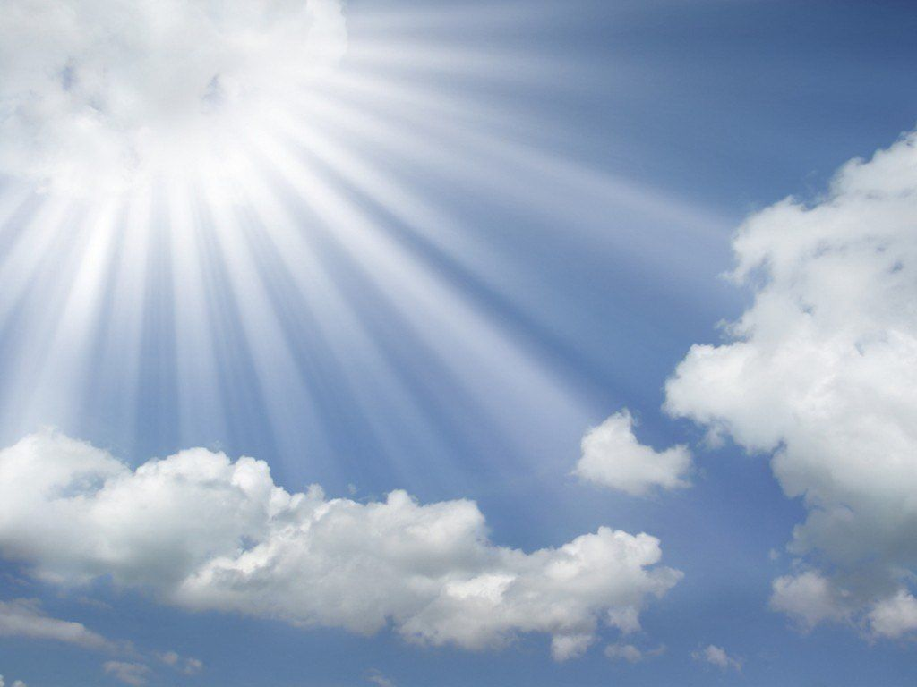
“Immediately after the tribulation of those days…then shall appear the sign of the Son of man in heaven: and then shall all the tribes of he earth mourn, and they shall see the Son of man coming in the clouds of heaven with power and great glory.” (Matthew 24:29-30)

Slide 30
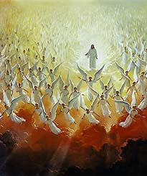
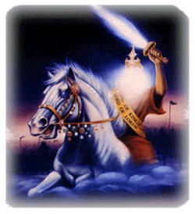
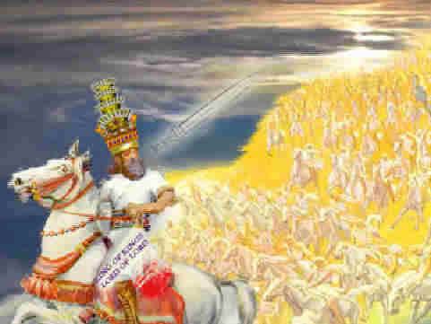
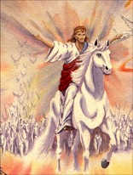
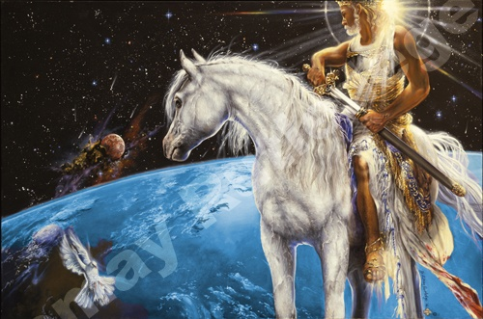
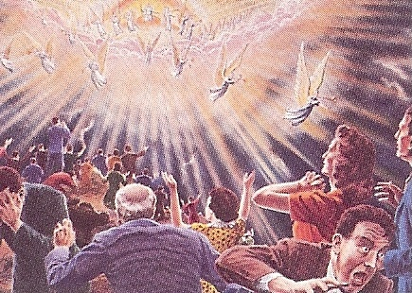

Slide 31
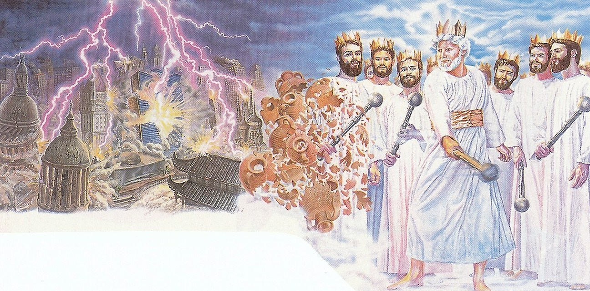
“The kings of the earth set themselves, and the rulers take counsel together, against the Lord, and against His Anointed, saying , let us break their bands asunder, and cast away their cords from us. He that sitteth in the heavens shall laugh: the Lord shall have them in derision. Then shall He speak to them in his wrath…thou shalt break them with a rod of iron; thou shalt dash them in pieces like a potter’s vessel.” (Psalms 2:2-5, 9)

Slide 32
“These (Anti-Christ and kings of the earth) shall make war with the Lamb, and the Lamb shall overcome them: For He is the Lord of lords and King of kings; and they that are with Him are called, and chosen, and faithful.” (Revelation 17:14)

Slide 33
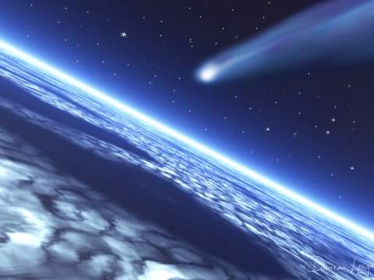
“The kingdoms of this world are become the kingdoms of our Lord, and of His Christ; and He shall reign forever and ever…” (Revelation 11:15)

Slide 34
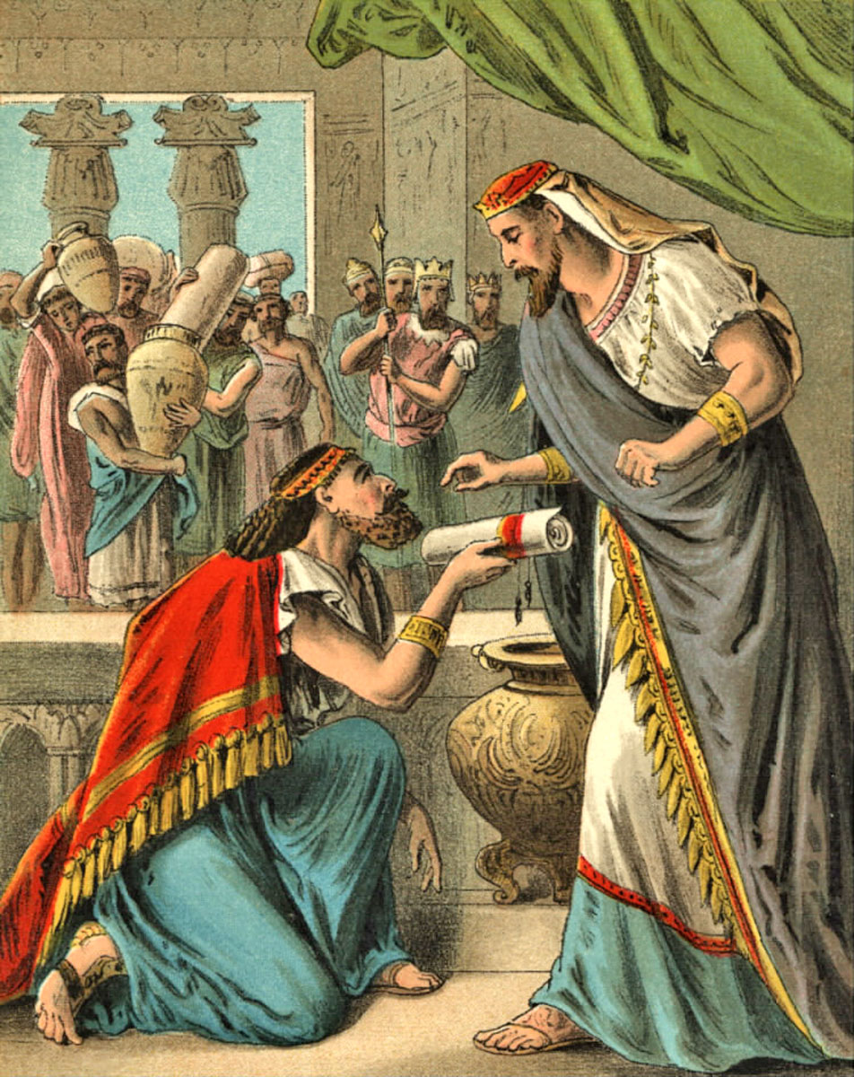
Nebuchadnezzar worship Daniel and makes him ruler over the whole province of Babylon and chief over all the wise men.
Daniel 2:46-48

Slide 35
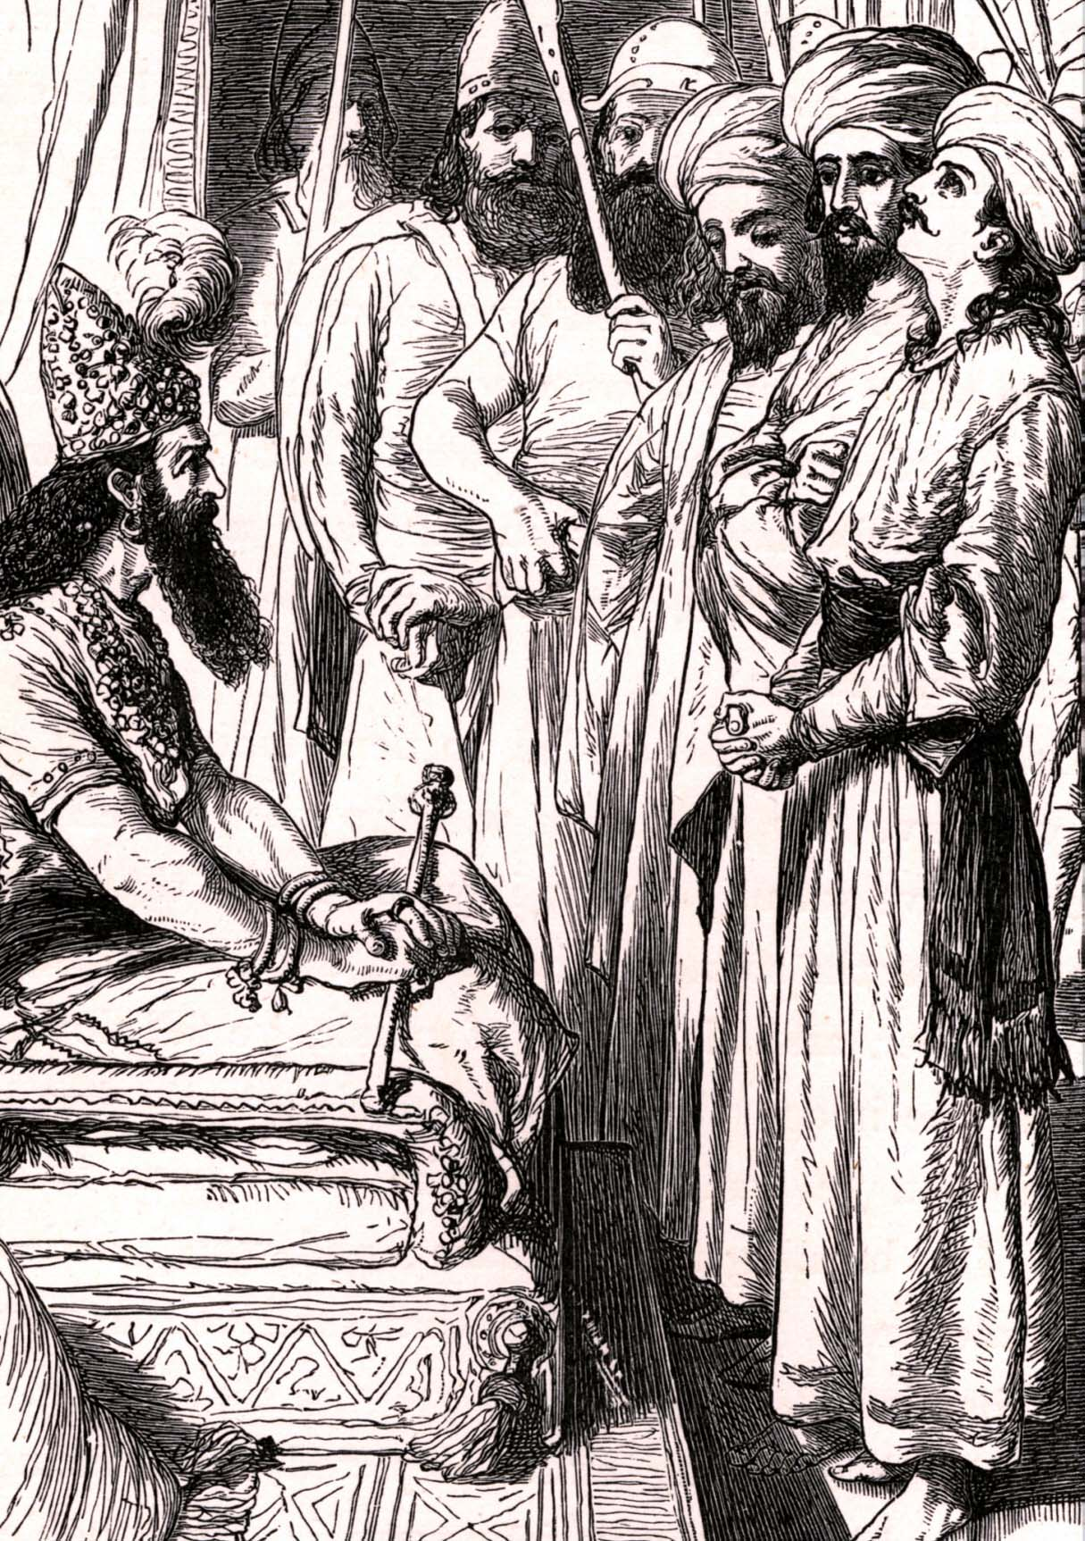
Daniel request that Shadrach, Meshach, and Abednego, be set over the affairs of the province of Babylon…and Daniel sat at the gate of the King.
Daniel 2:49

Slide 37
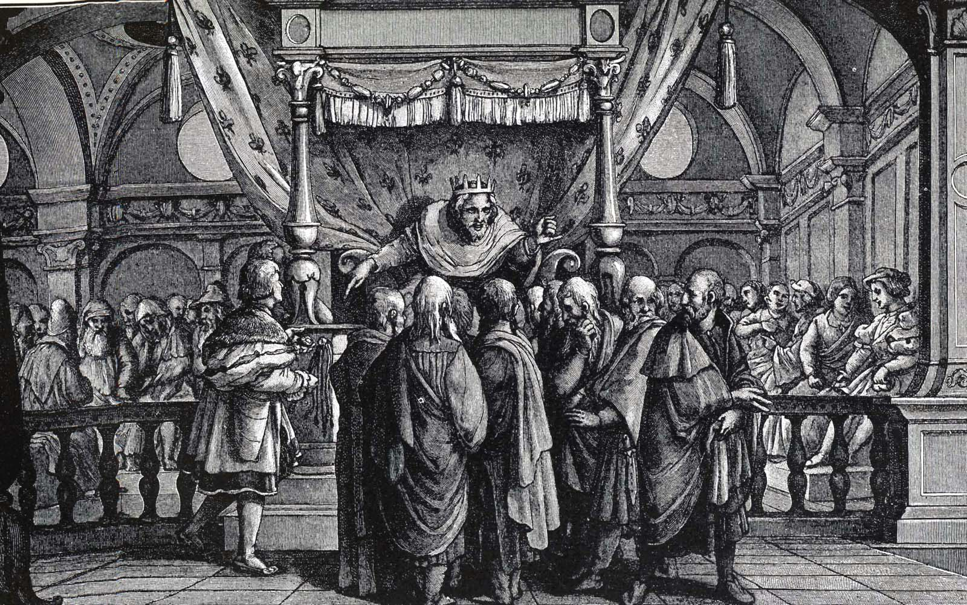

Slide 38
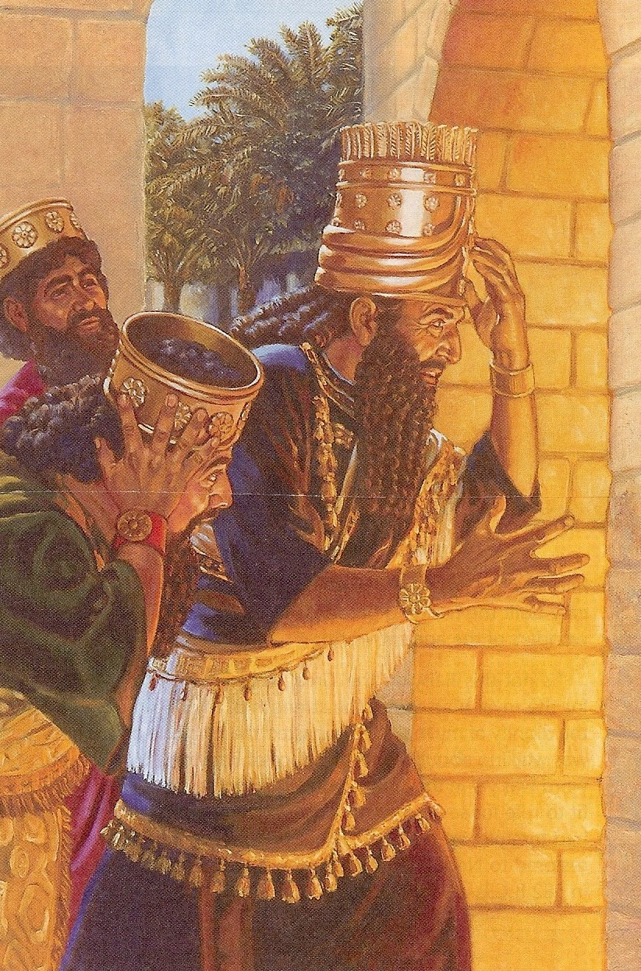

Slide 40
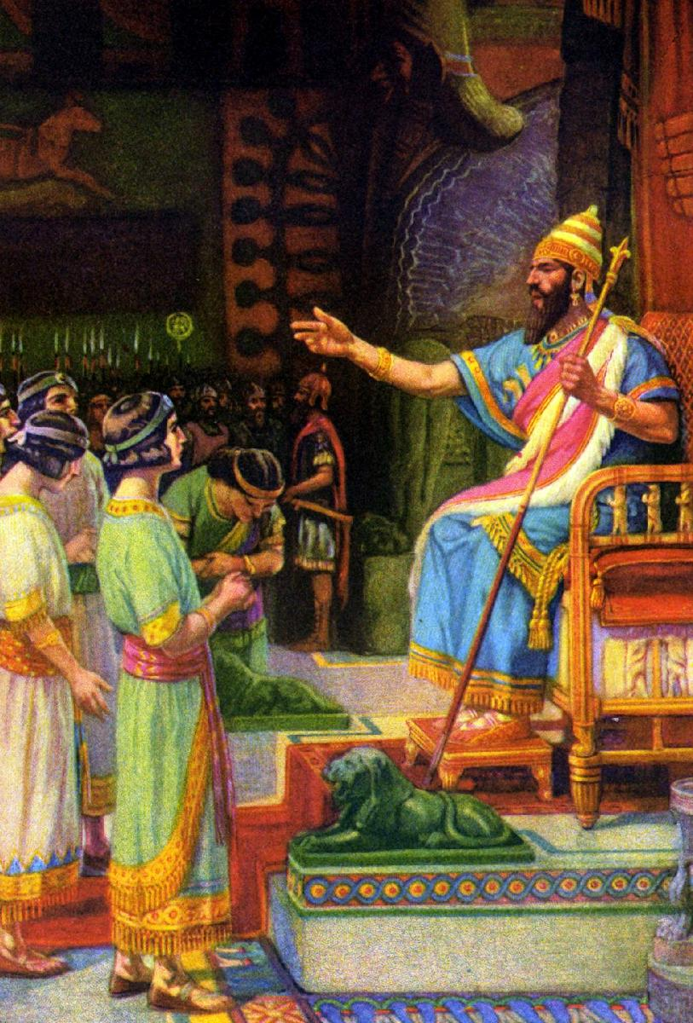

Slide 41
