Slide 1
The Revelation of Jesus Christ
A study of the book
of Revelation

Slide 2
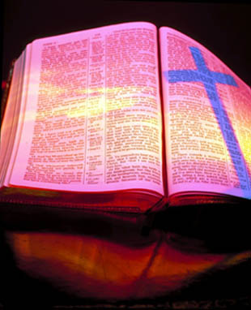
Revelation 20:1-10
“Satan Bound for 1000 Years in the Bottomless Pit”

Slide 3
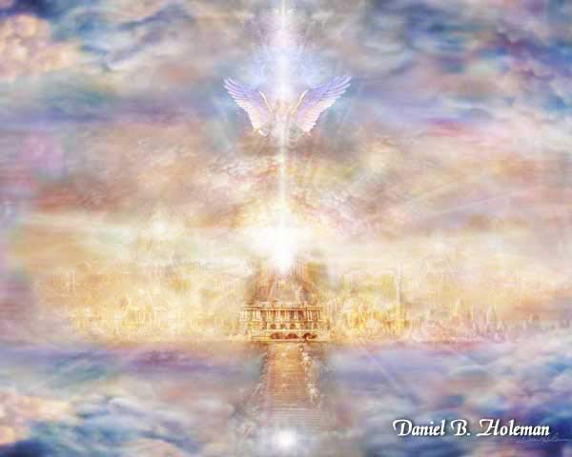
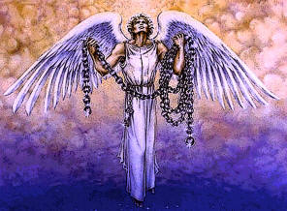
“And I saw an angel come down from heaven, having the key of the bottomless pit and a great chain in his hand.”

Slide 4
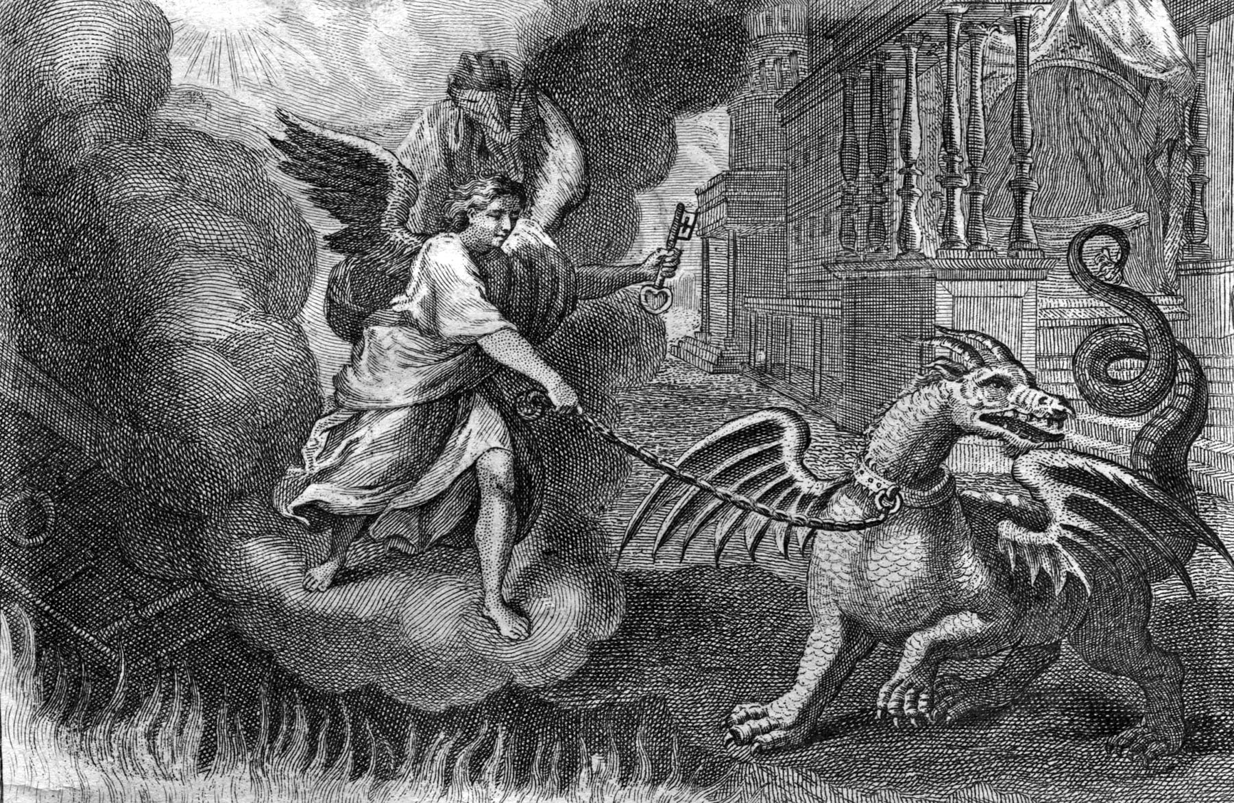
“And he laid hold on the dragon, that old serpent, which is the Devil, and Satan...”

Slide 5
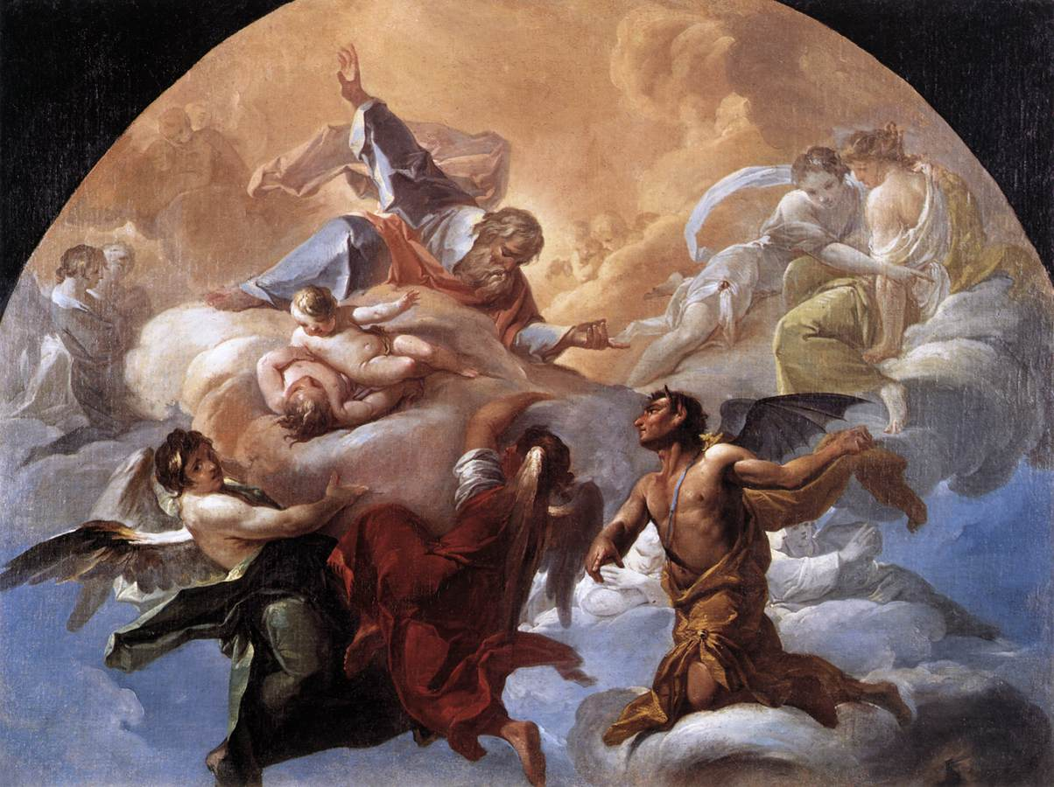
Satan our Great Adversary (I Peter 5:8)
Devil (slander)
Prince of the power of the air
God of this age
Spirit that worketh in the children of disobedience
King of death
Enemy
Prince of this world
Ruler of darkness
Angel of light
Liar
Murder
Leviathan
Lucifer
Dragon
Deceiver
Apollyon
Beelzebub
Belial
Wicked one
Tempter
Accuser of the brethren
Roaring lion

Slide 6
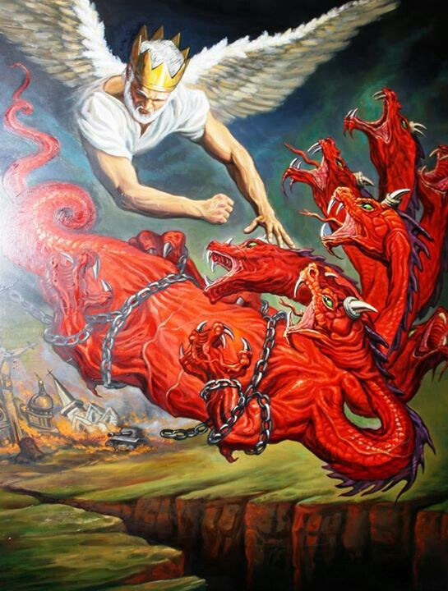
“…and bound him a thousand years. And cast him into the bottomless pit…”

Slide 7
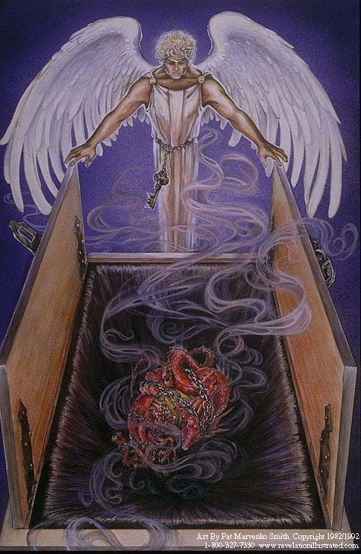
“And shut him up, and set a seal upon him, that he should deceive the nations no more, till the thousand years should be fulfilled.”

Slide 11
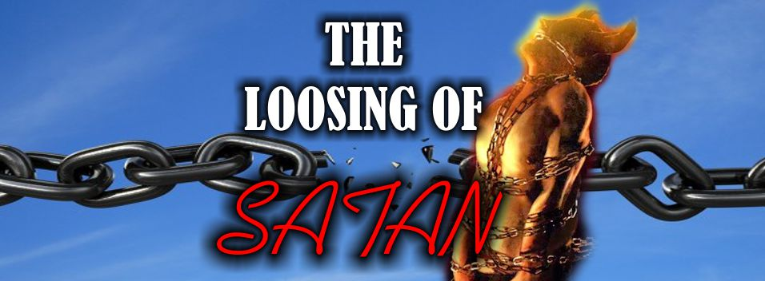

Slide 13
“And when the thousand years are expired, Satan shall be loosed out of his prison, And shall go out to deceive the nations which are in the four quarters of the earth, Gog and Magog, to gather them together to battle: the number of whom is as the sand of the sea..” (Revelation 20:7-8)

Slide 14
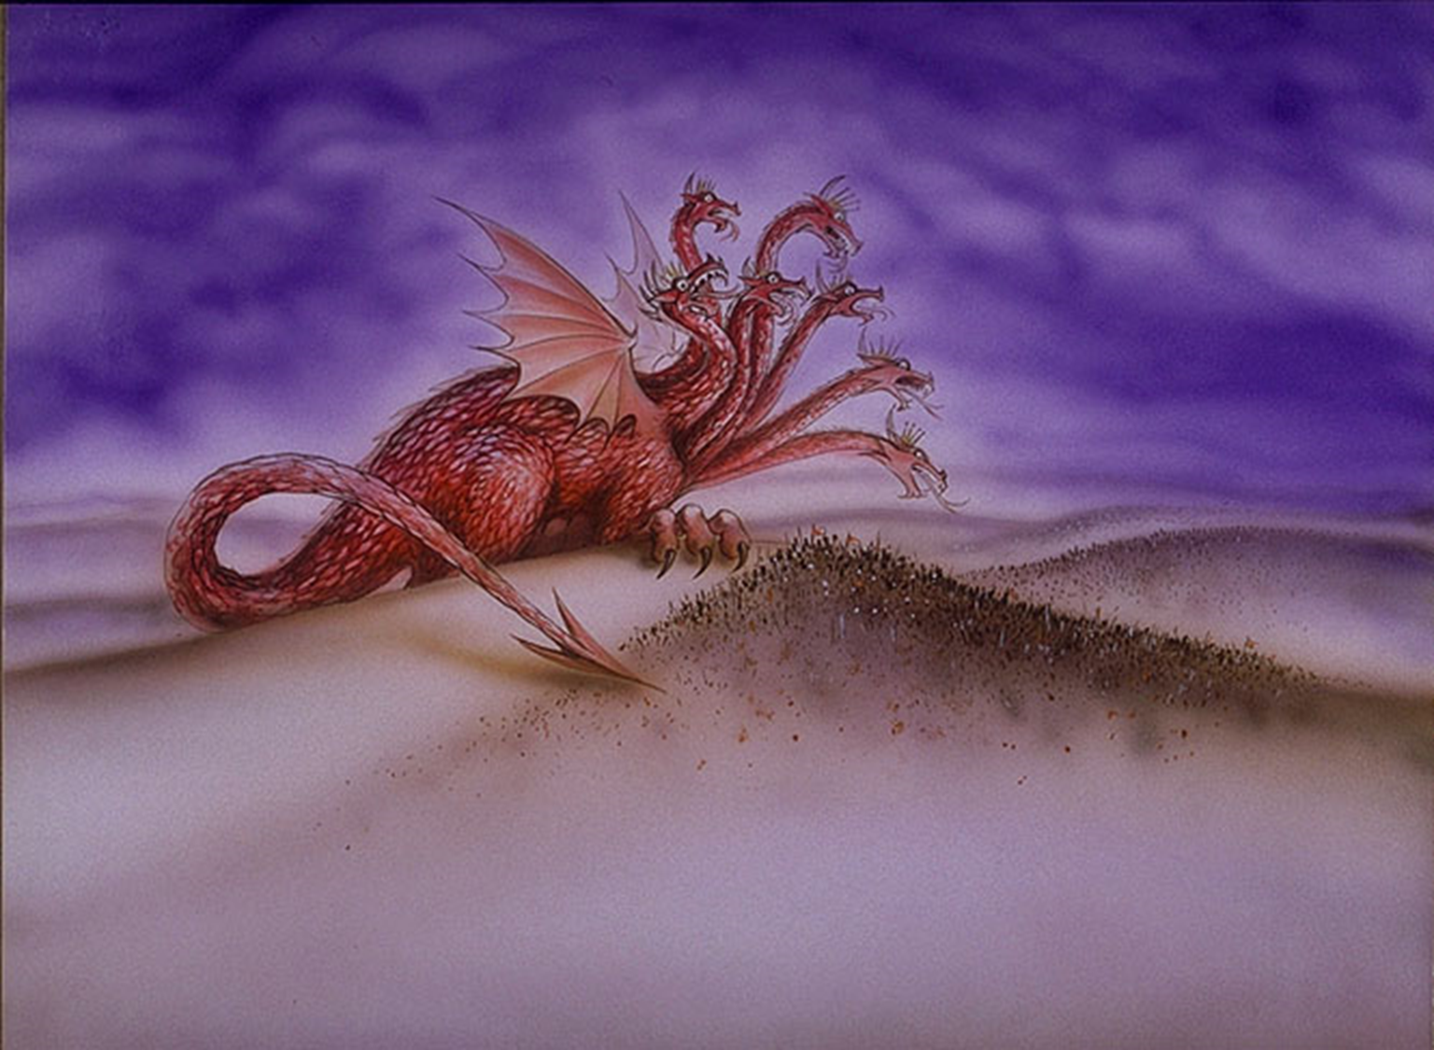

Slide 15
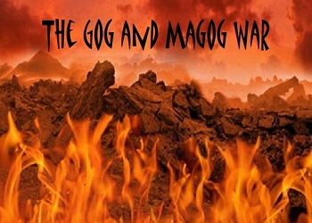
Who is Gog and Magog?

Slide 16
Gog – 9 times
Magog – 5 times
1Ch 5:4 The sons of Joel; Shemaiah his son, Gog his son, Shimei his son,
Eze 38:2 Son of man, set thy face against Gog, the land of Magog, the chief prince of Meshech and Tubal, and prophesy against him,
Eze 38:3 And say, Thus saith the Lord GOD; Behold, I am against thee, O Gog, the chief prince of Meshech and Tubal:
Re 20:8 And shall go out to deceive the nations which are in the four quarters of the earth, Gog and Magog, to gather them together to battle: the number of whom is as the sand of the sea.
Eze 38:2 Son of man, set thy face against Gog, the land of Magog, the chief prince of Meshech and Tubal, and prophesy against him,
Eze 39:6 And I will send a fire on Magog, and among them that dwell carelessly in the isles: and they shall know that I am the LORD.
Re 20:8 And shall go out to deceive the nations which are in the four quarters of the earth, Gog and Magog, to gather them together to battle: the number of whom is as the sand of the sea.
Gog = A symbolic name for some future Antichrist ruler.
Magog = A barbarous northern nation or region.

Slide 17
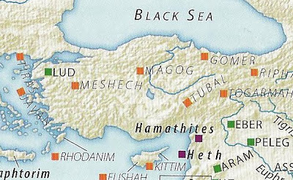
“Meshech and Tubal”
Meshech = who is drawn by force
Tubal = world of confusion
Magog second son of Japheth
Meshech sixth son of Japheth
Tubal fifth son of Japheth

Slide 18
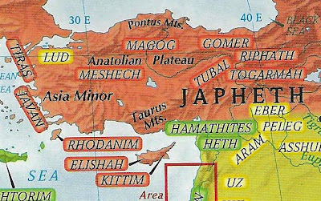

Slide 19
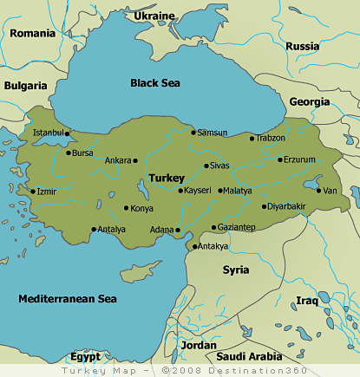

Slide 20
“Because thy rage against me, and thy tumult, is come up into mine ears, therefore will I put my hook in thy nose (Meshech = who is drawn by force), and my bridle in thy lips, and I will turn thee back by the way by which thou camest” Isa. 37:29
“Therefore, thou son of man, prophesy against Gog, and say, Thus saith the Lord GOD; Behold, I am against thee, O Gog, the chief prince of Meshech and Tubal: I will cause thee to come up from the north parts (Magog = A barbarous northern nation or region), and will bring thee upon the mountains of Israel.” Ezek. 39:1-2

Slide 21
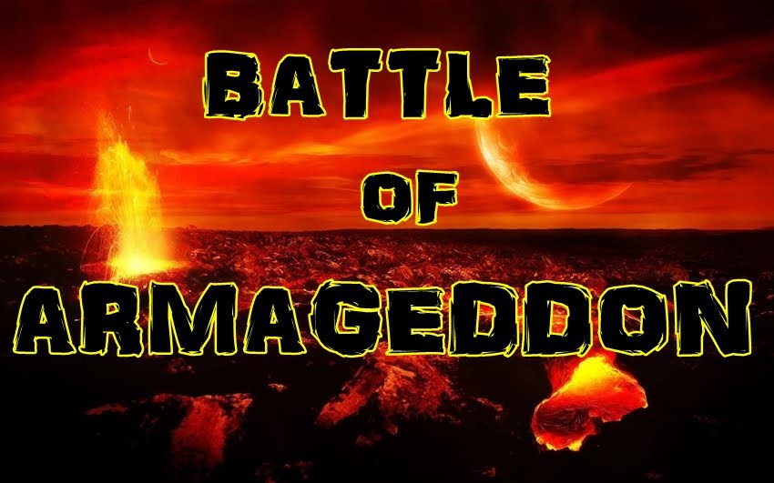
“And I will smite thy bow out of thy left hand, and will cause thine arrows to fall out of thy right hand. Thou shalt fall upon the mountains of Israel, thou, and all thy bands, and the people that is with thee: I will give thee unto the ravenous birds of every sort, and to the beasts of the field to be devoured. Thou shalt fall upon the open field: for I have spoken it, saith the Lord GOD…and they shall burn them with fire seven years.”
(Ezekiel 39:3-5, 7)

Slide 22
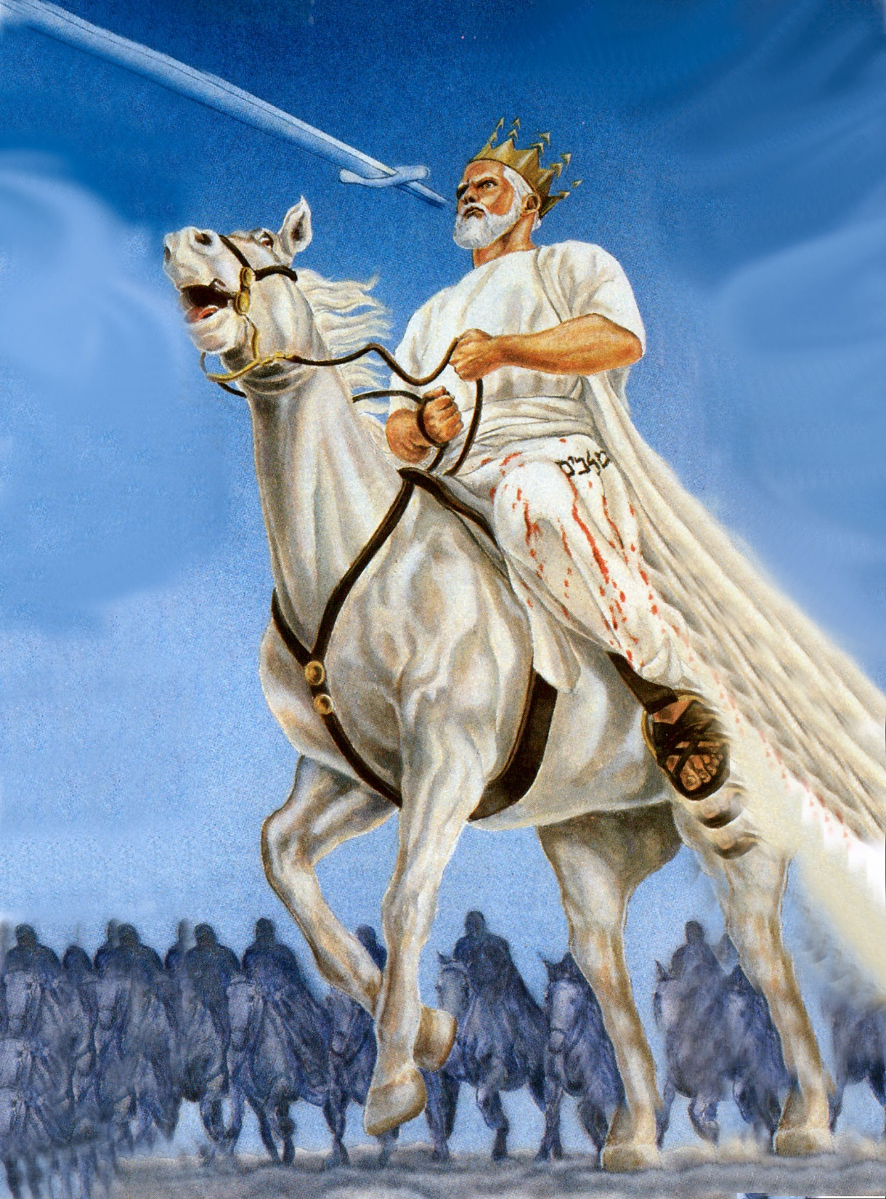
“And he was clothed with a vesture dipped in blood: and his name is called The Word of God.” (Rev. 19:13)

Slide 23
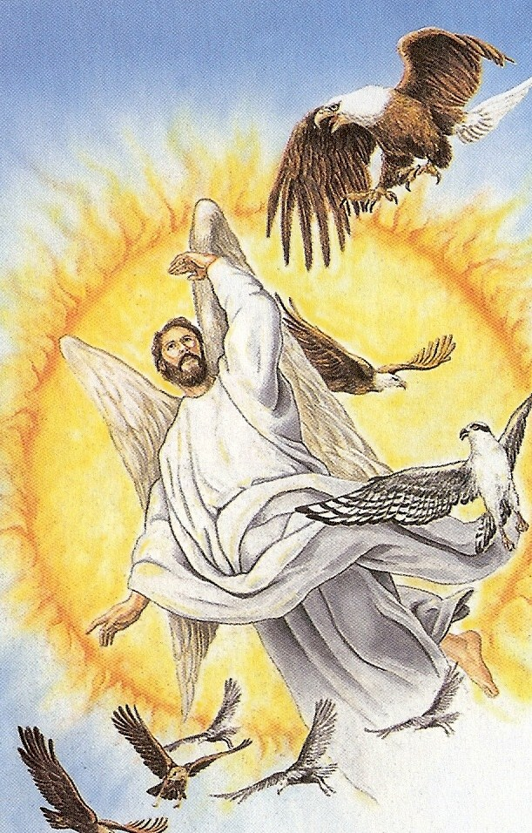
“And I saw an angel standing in the sun; and he cried with a loud voice, saying to all the fowls that fly in the midst of heaven, Come and gather yourselves together unto the supper of the great God.”

Slide 24
“That ye may eat the flesh of kings, and the flesh of captains, and the flesh of mighty men, and the flesh of horses, and of them that sit on them, and the flesh of all men, both free and bond, both small and great.”

Slide 27
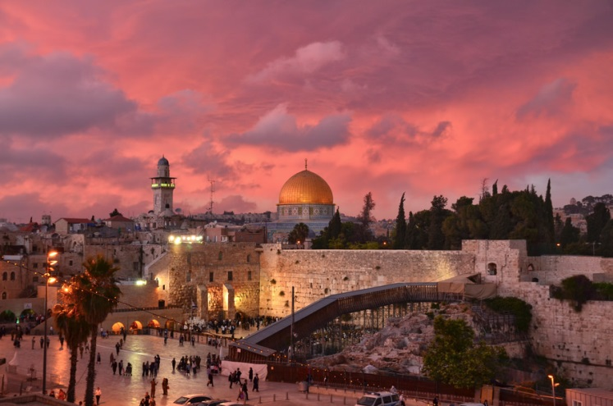
“And they went up on the breadth of the earth, and compassed the camp of the saints about, and the beloved city: and fire came down from God out of heaven, and devoured them.” (Revelation 20:9)

Slide 28
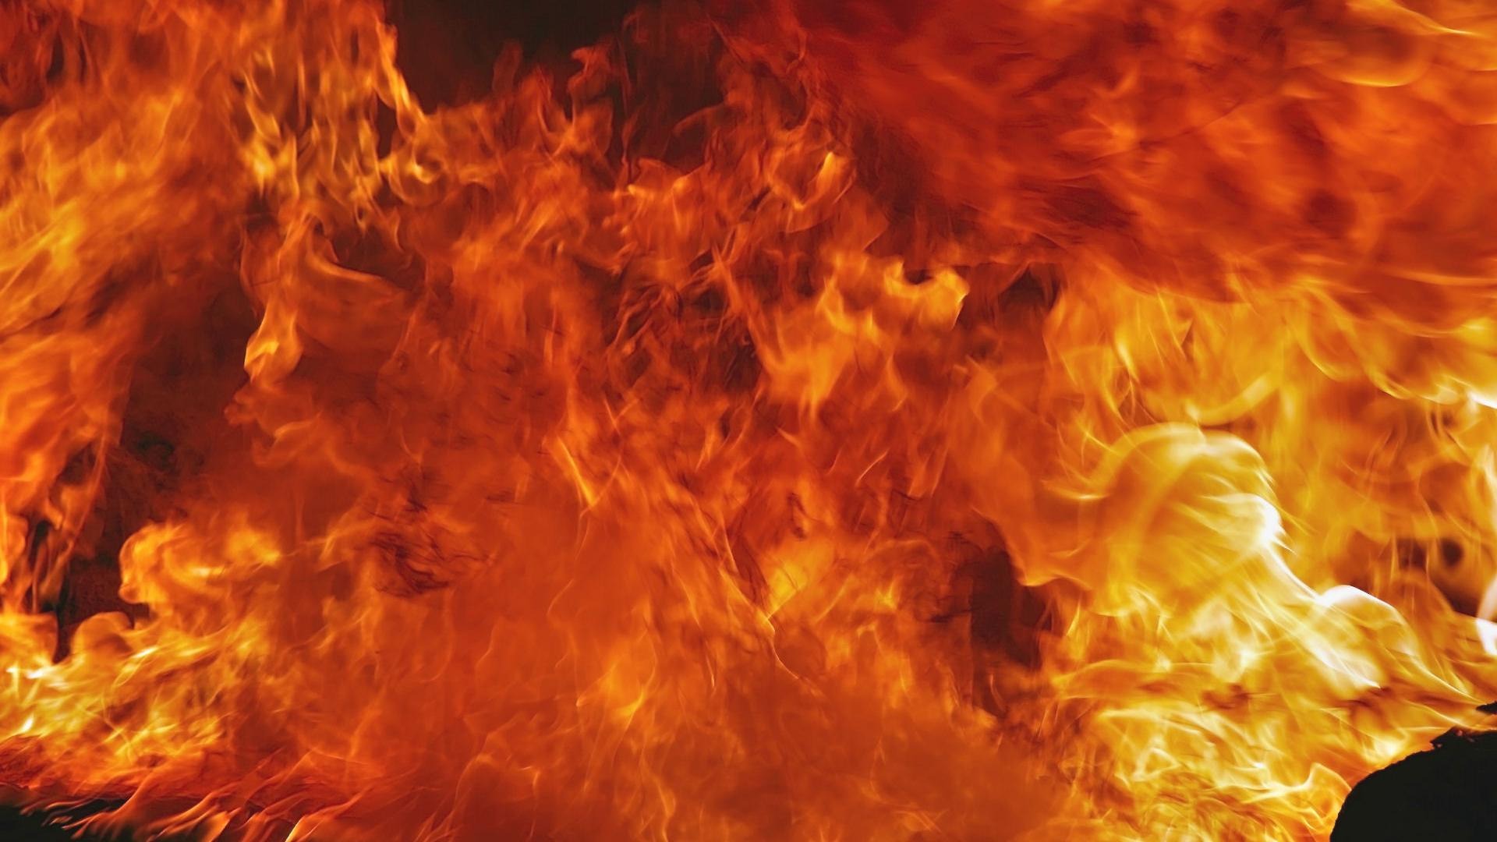
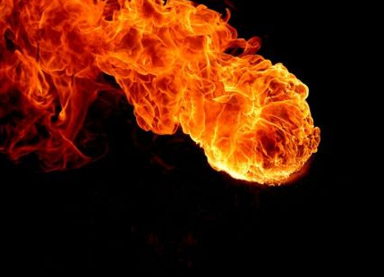

Slide 29
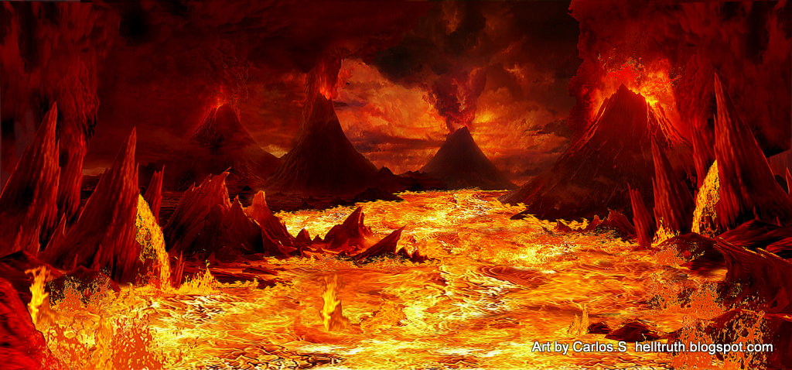
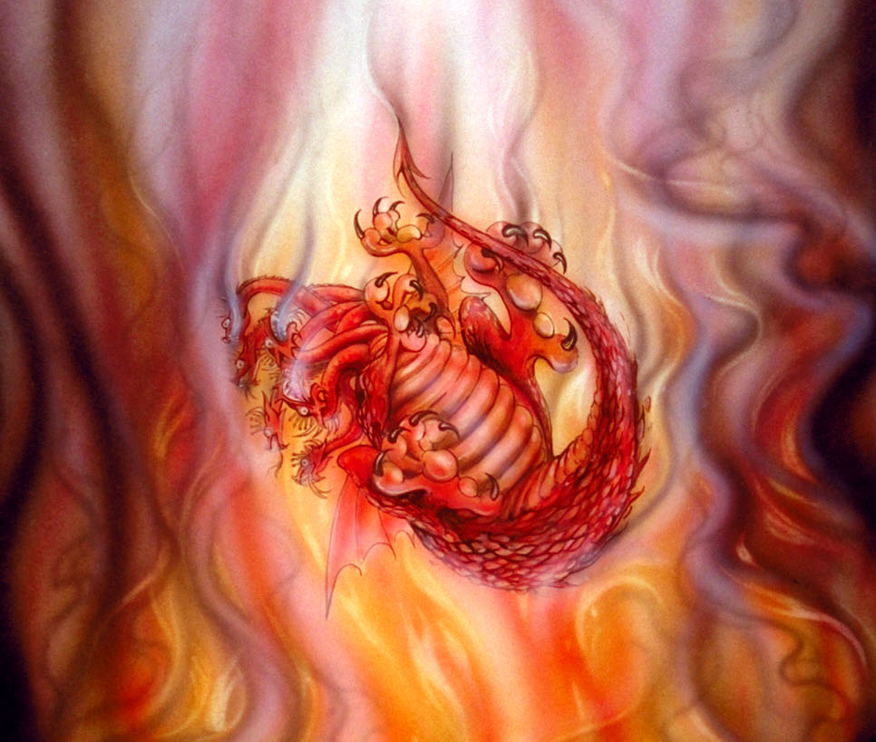
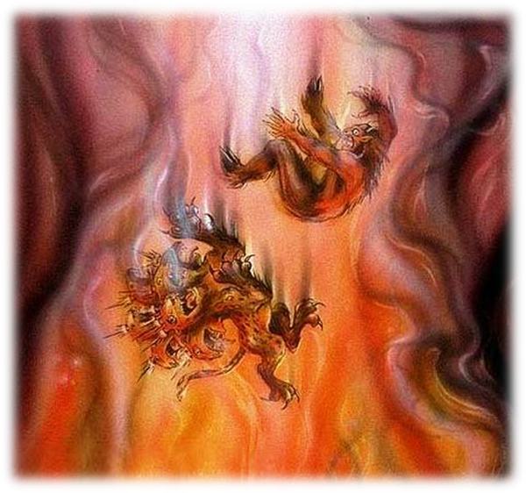
“And the devil that deceived them was cast into the lake of fire and brimstone, where the beast and the false prophet are, and shall be tormented day and night for ever and ever.”

Slide 30
Revelation 20:4-6

Slide 31
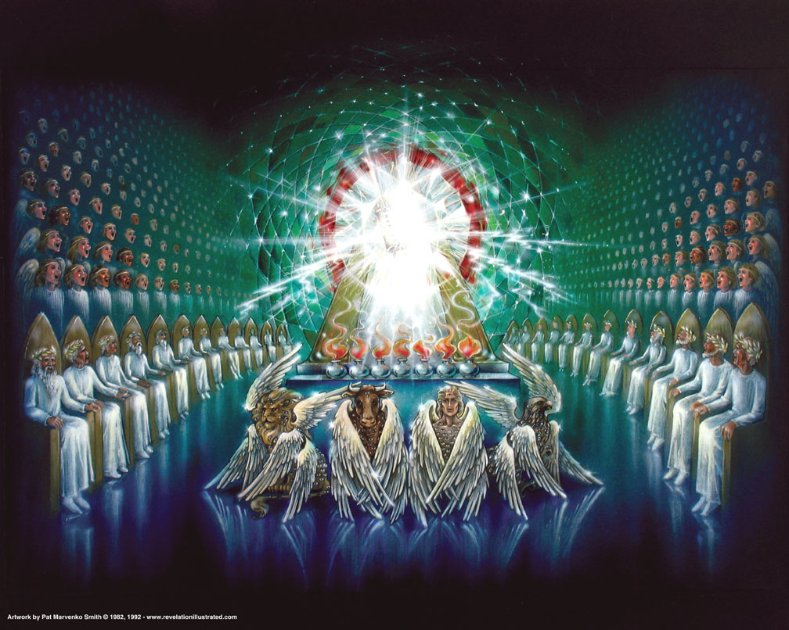
“And I saw thrones, and they sat upon them, and judgment was given unto them.”

Slide 32
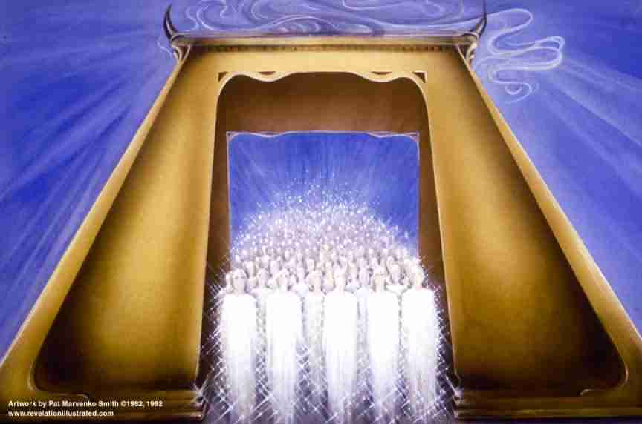
“And I saw the souls of them that were beheaded for the witness of Jesus, and for the word of God, and which had not worshipped the beast, neither his image, neither had received his mark upon their foreheads, or in their hands; and they lived and reigned with Christ a thousand years.”

Slide 33
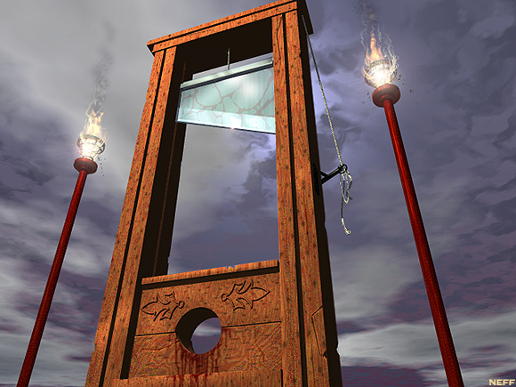
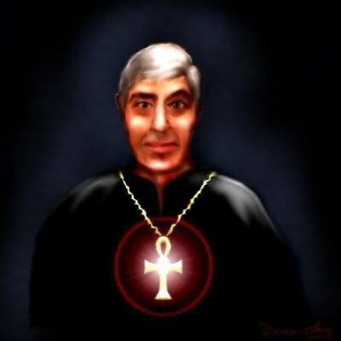
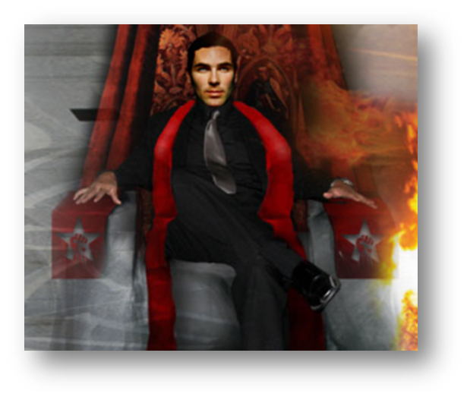

Slide 34
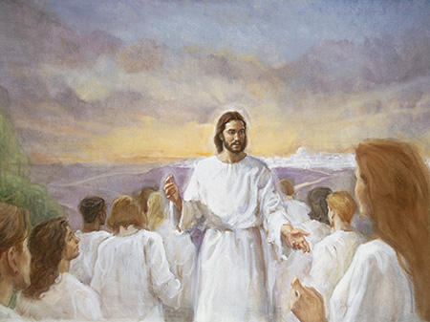
Tribulation Saints

Slide 35
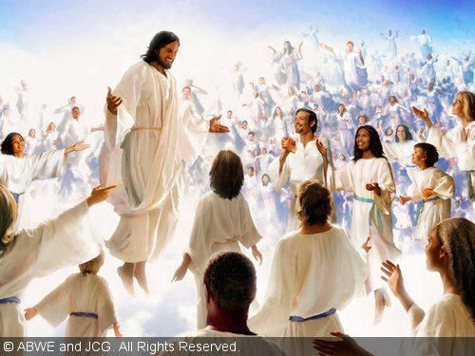
(Revelation 6:9-11) “I saw under the altar the souls of them that were slain for the word of God, and for the testimony which they held: And they cried with a loud voice, saying, How long, O Lord, holy and true, dost thou not judge and avenge our blood on them that dwell on the earth?”

Slide 36
“And white robes were given unto every one of them; and it was said unto them, that they should rest yet for a little season, until their fellow servants also and their brethren, that should be killed as they were, should be fulfilled.”

Slide 37
“And they lived and reigned with Christ a thousand years.”

Slide 38
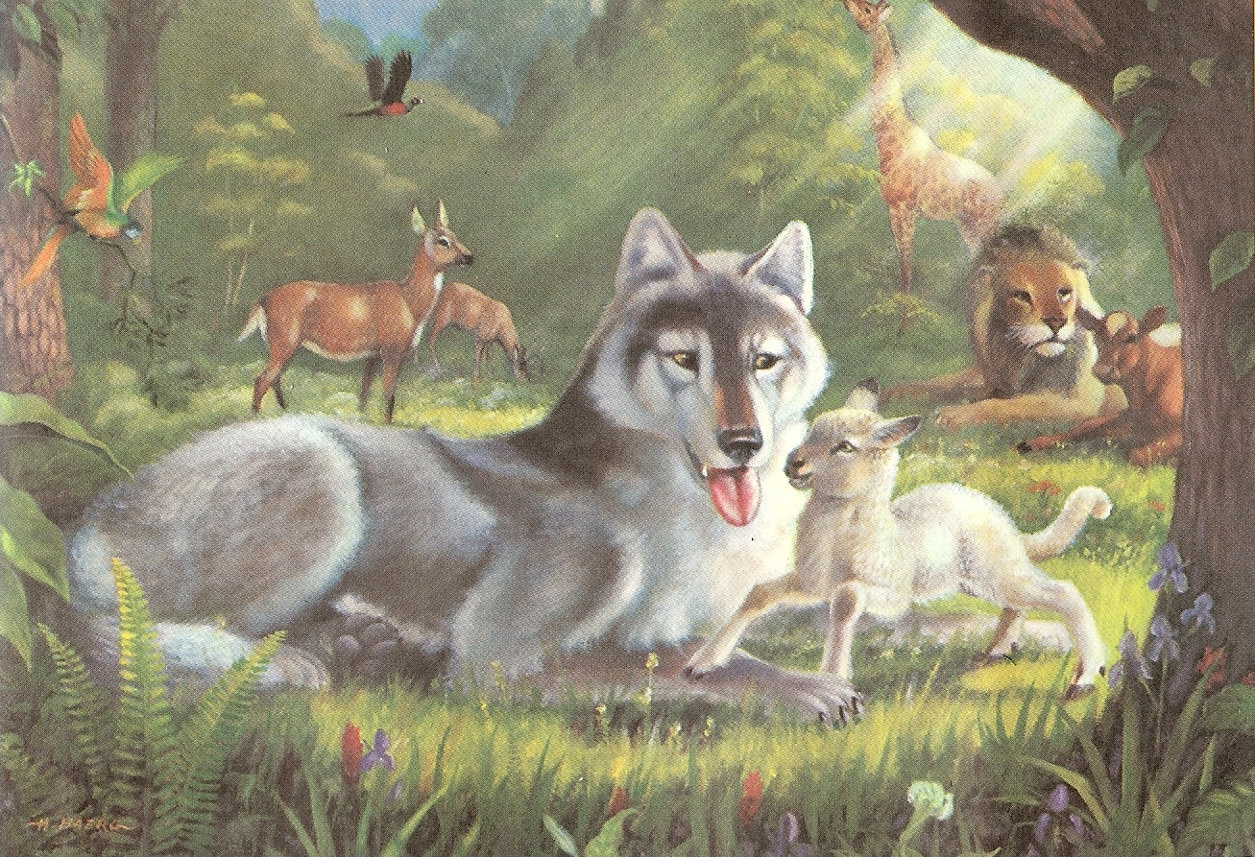
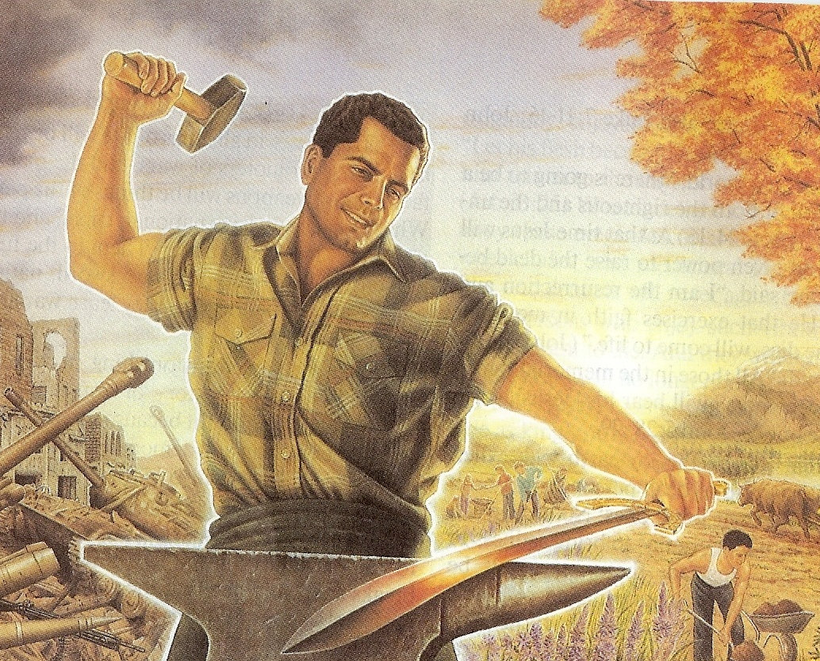
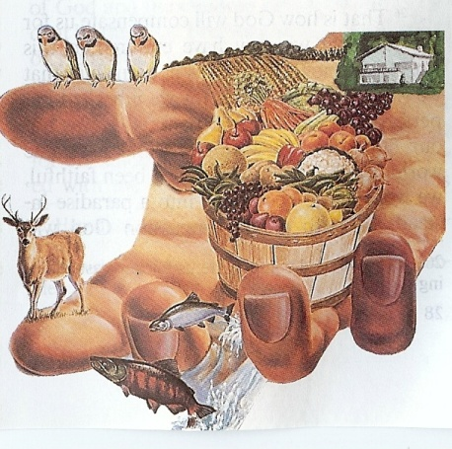
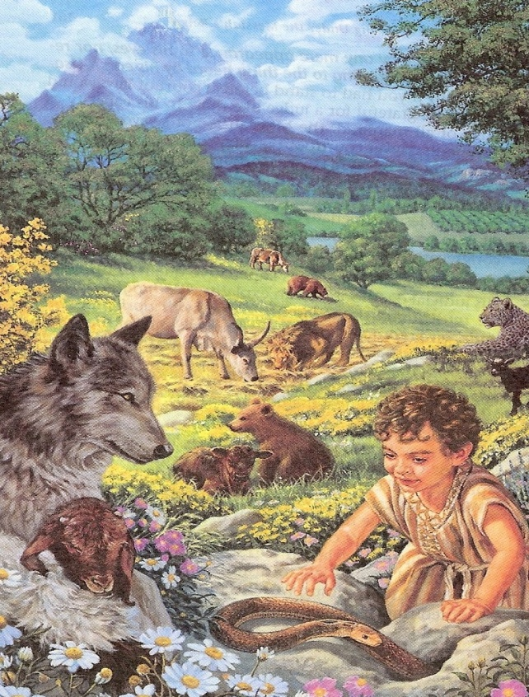
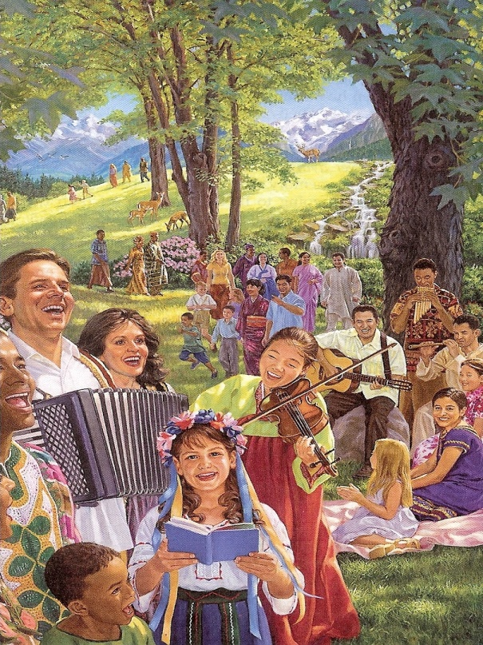
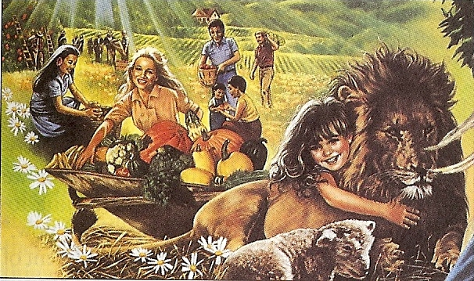
“And he shall judge among the nations, and shall rebuke many people: and they shall beat their swords into plowshares, and their spears into pruninghooks: nation shall not lift up sword against nation, neither shall they learn war any more.” Isa. 2:4

Slide 39
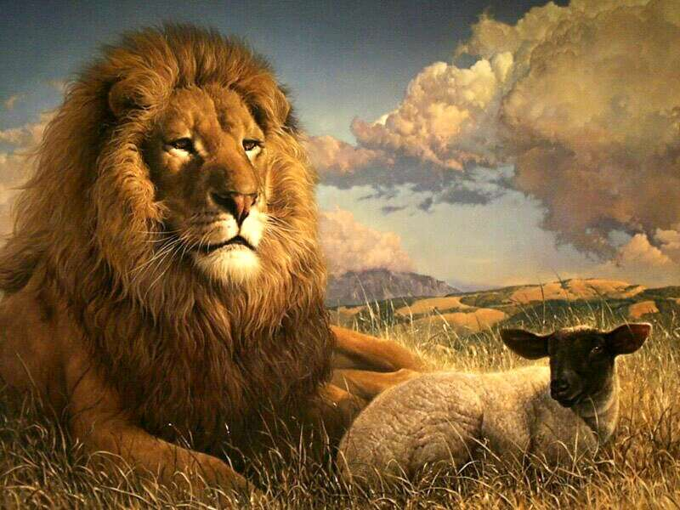
“The wolf also shall dwell with the lamb, and the leopard shall lie down with the kid; and the calf and the young lion and the fatling together; and a little child shall lead them. And the cow and the bear shall feed; their young ones shall lie down together: and the lion shall eat straw like the ox.” Isa.11:6

Slide 40
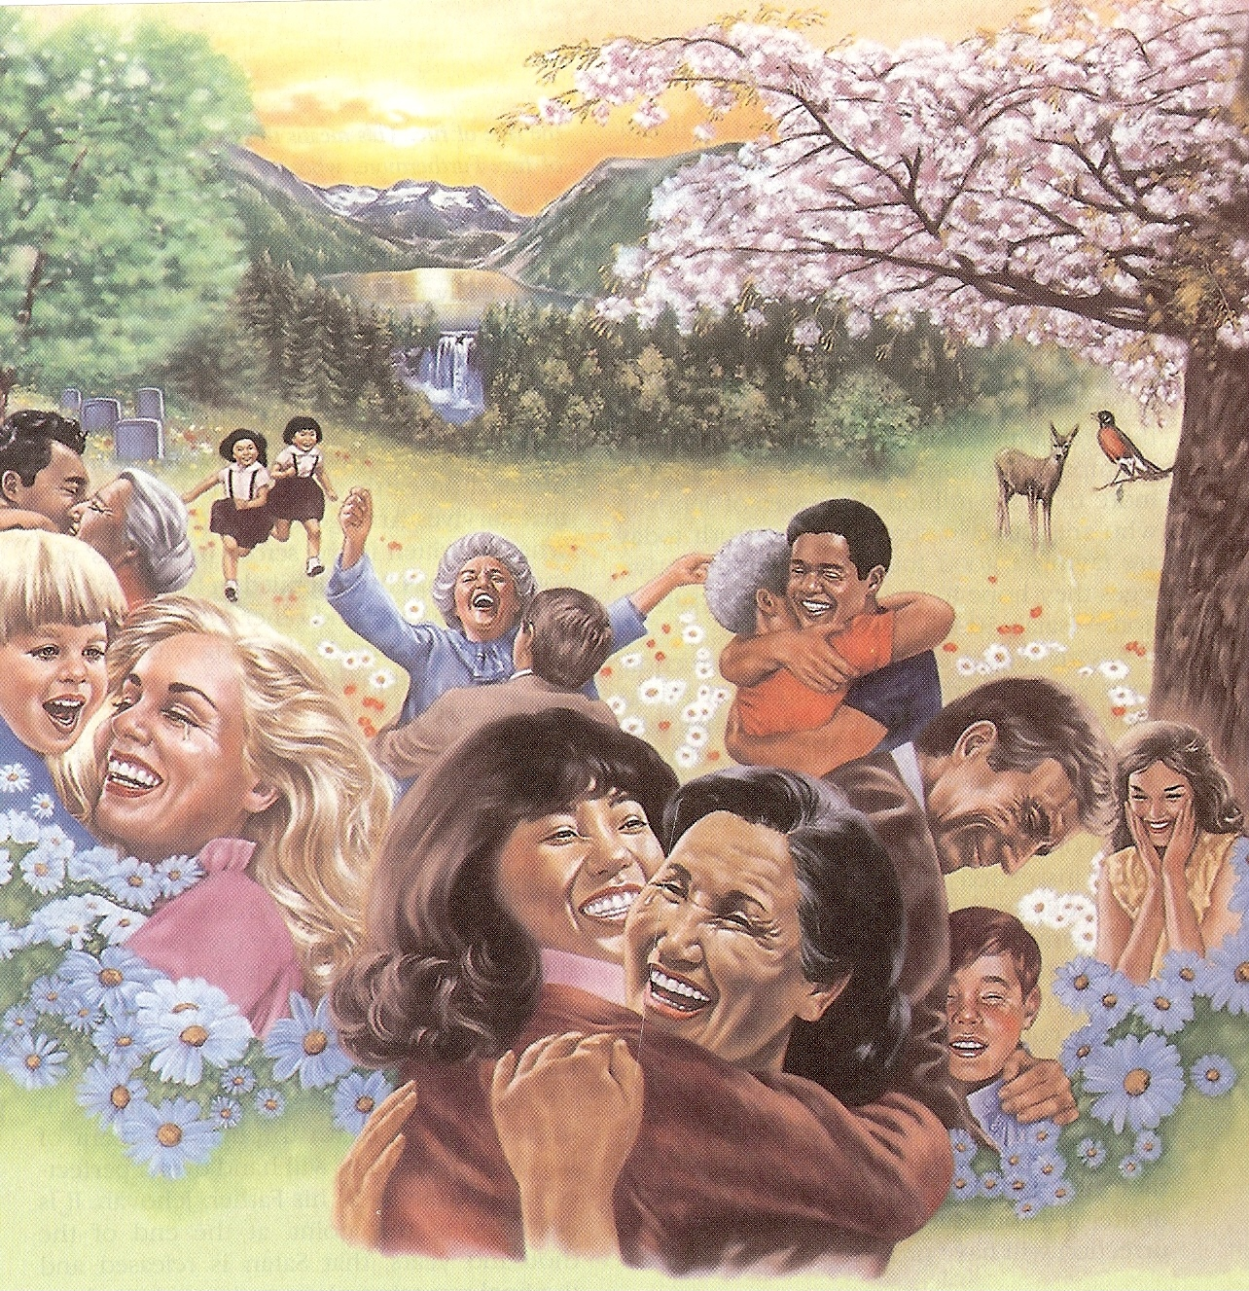
“The wilderness and the solitary place shall be glad for them; and the desert shall rejoice, and blossom as the rose.” Isa. 35:1

Slide 41
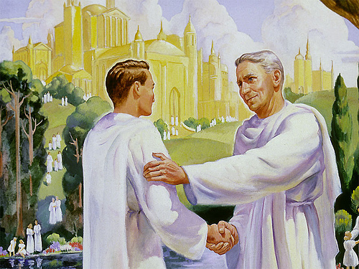
“Do ye not know that the saints shall judge the world?” I Cor. 6:2

Slide 42
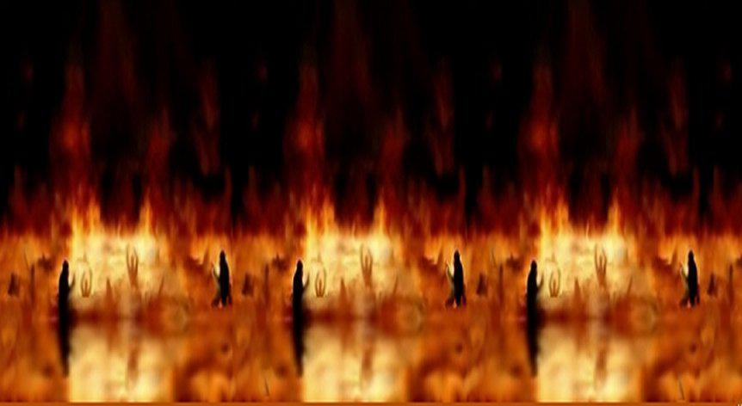
“But the rest of the dead (unbelievers) lived not again until the thousand years were finished.”

Slide 43
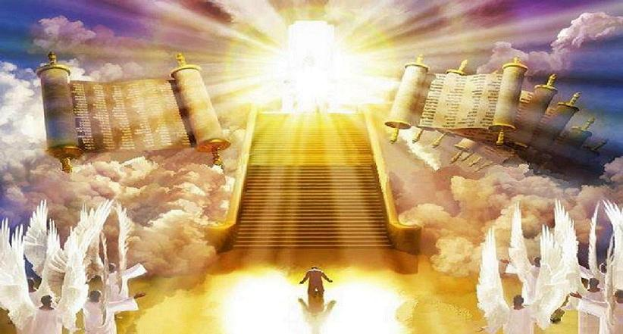
“Great White Throne Judgment” (Revelation 20:11-15)

Slide 44
(Revelation 20:6) “Blessed and holy is he that hath part in the first resurrection: on such the second death hath no power, but they shall be priests of God and of Christ, and shall reign with him a thousand years.”

Slide 45
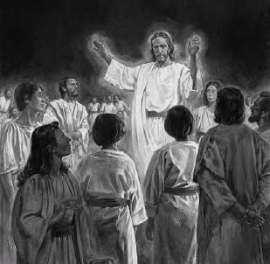
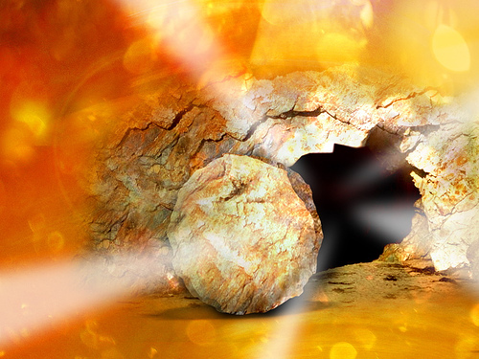
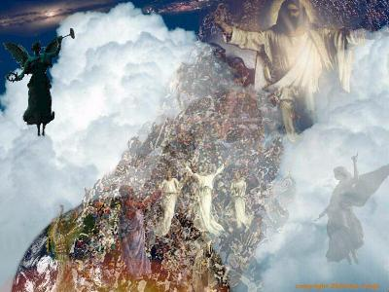
Three Phases of the First Resurrection
Old Testament and Tribulation Saints
Jesus Christ
Church Age Saints

Slide 46
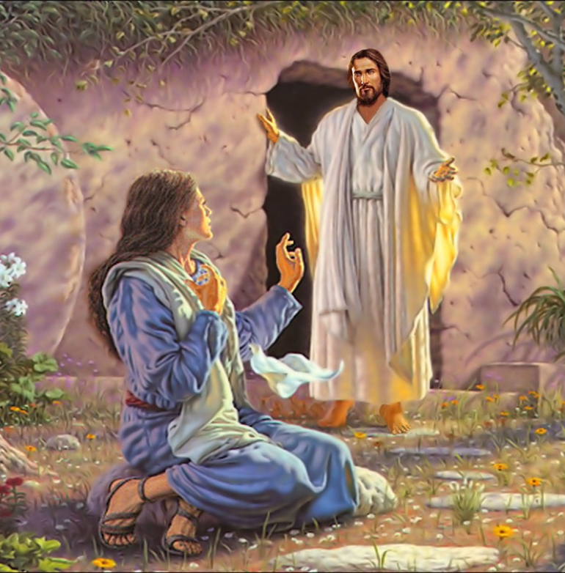
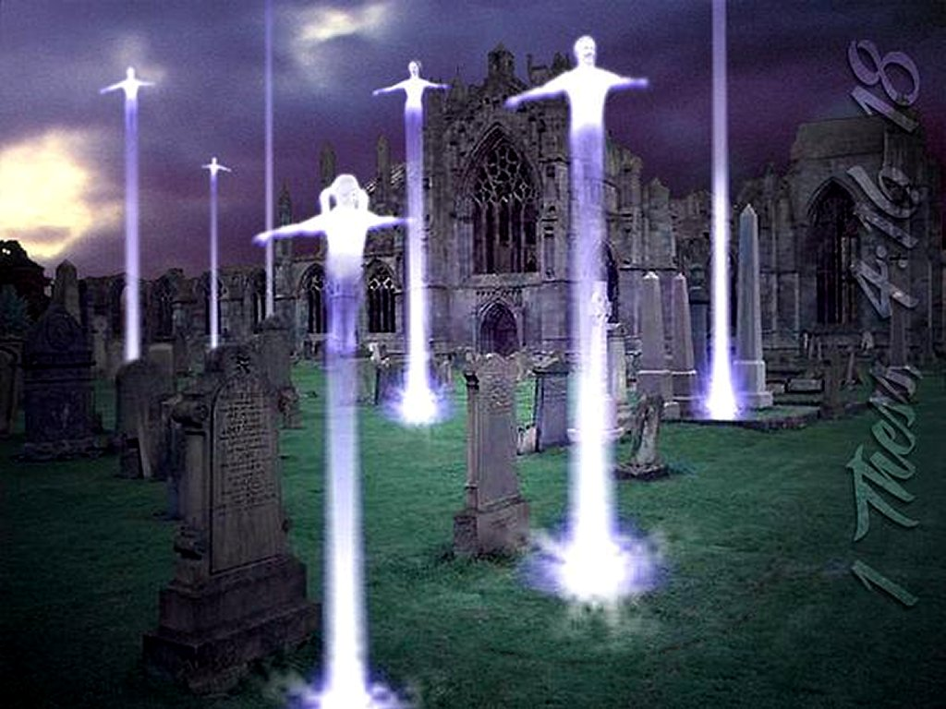
Resurrection of Jesus Christ – The first-fruits (I Corinthians 15:23)
Resurrection of the church – Dead in Christ Rapture – (I Thessalonians 4:16)
3. Resurrection of Old Testament saints and Tribulation saints – (Daniel 12:2, Isaiah 26:19)

Slide 47
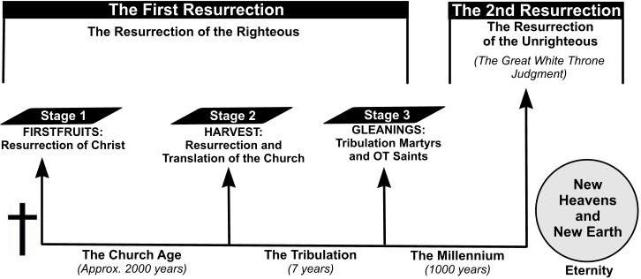
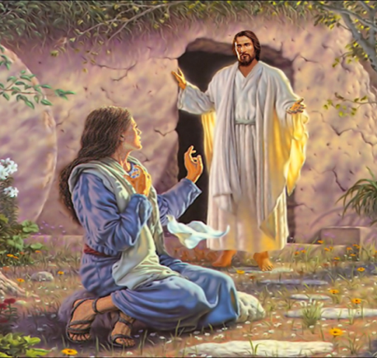
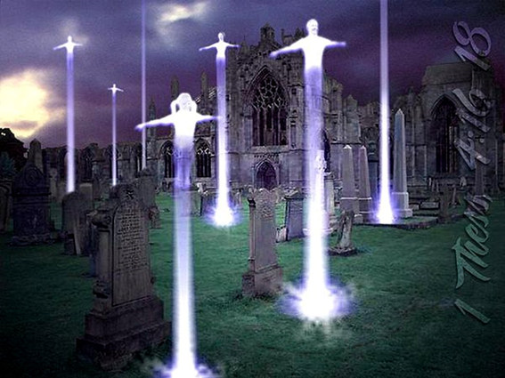
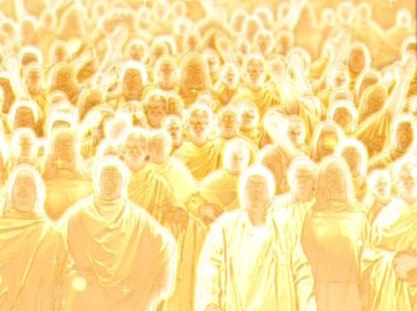
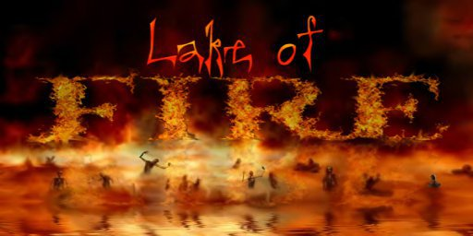

Slide 48
“For in the resurrection they neither marry, nor are given in marriage, but are as the angels of God in heaven. But as touching the resurrection of the dead, have ye not read that which was spoken unto you by God, saying, I am the God of Abraham, and the God of Isaac, and the God of Jacob? God is not the God of the dead, but of the living.”

Slide 49
“Jesus said unto her, I am the resurrection, and the life: he that believeth in me, though he were dead, yet shall he live: And whosoever liveth and believeth in me shall never die. Believest thou this?”

Slide 50
“Verily, verily, I say unto you, He that heareth my word, and believeth on him that sent me, hath everlasting life, and shall not come into condemnation; but is passed from death unto life. Verily, verily, I say unto you, The hour is coming, and now is, when the dead shall hear the voice of the Son of God: and they that hear shall live. For as the Father hath life in
himself; so hath he given to the Son
to have life in himself;

Slide 51
And hath given him authority to execute judgment also, because he is the Son of man. Marvel not at this: for the hour is coming, in the which all that are in the graves shall hear his voice, And shall come forth; they that have done good, unto the resurrection of life; and they that have done evil, unto the resurrection of damnation.” (John 5:24-29)

Slide 53
“That if thou shalt confess with thy mouth the Lord Jesus, and shalt believe in thine heart that God hath raised him from the dead, thou shalt be saved.”

Slide 54
“On such (believers) the Second Death hath no power…”
“And death and hell were cast into the lake of fire. This is the second death.”

Slide 55
“Blessed and holy is he that hath part in the first resurrection: on such the second death hath no power, but they shall be priests of God and of Christ, and shall reign with him a thousand years.”

Slide 56
Revelation 20:11-15
“The Great White Throne Judgment”

