Slide 1
The Revelation of Jesus Christ
A study of the book
of Revelation

Slide 2
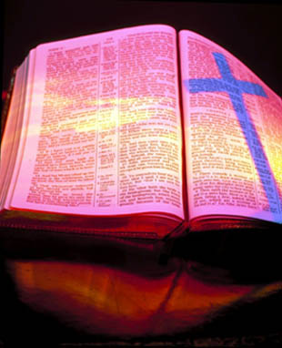
Revelation 15:1-16:21
“The Final Vial
(bowl) Judgments”

Slide 3
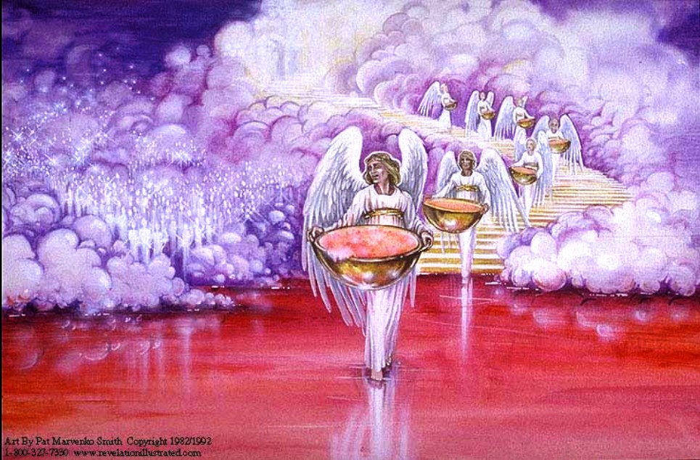
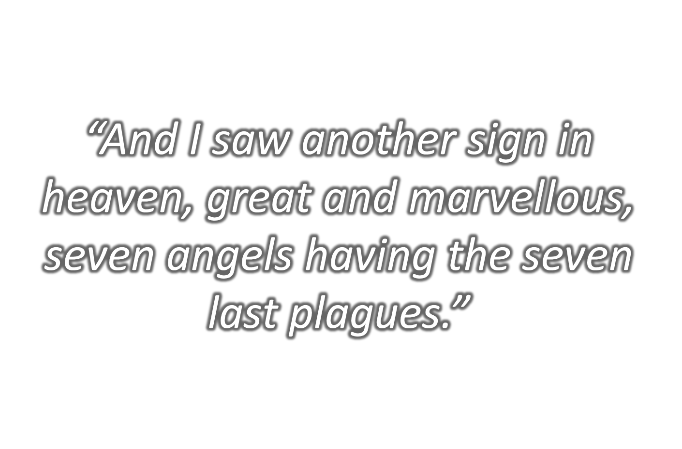
“Seven Angels Having the Seven Last Plagues.”

Slide 4
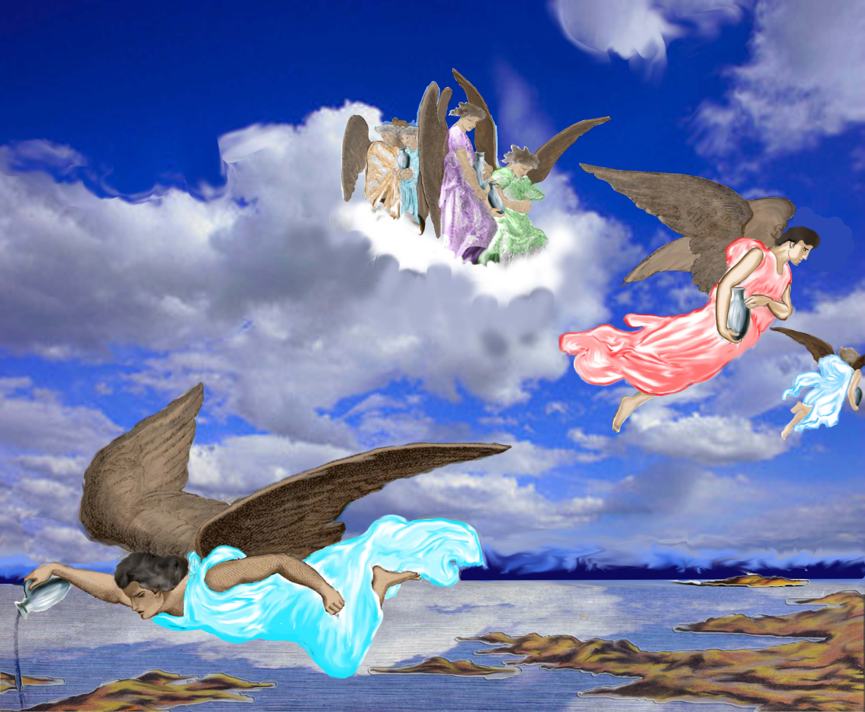
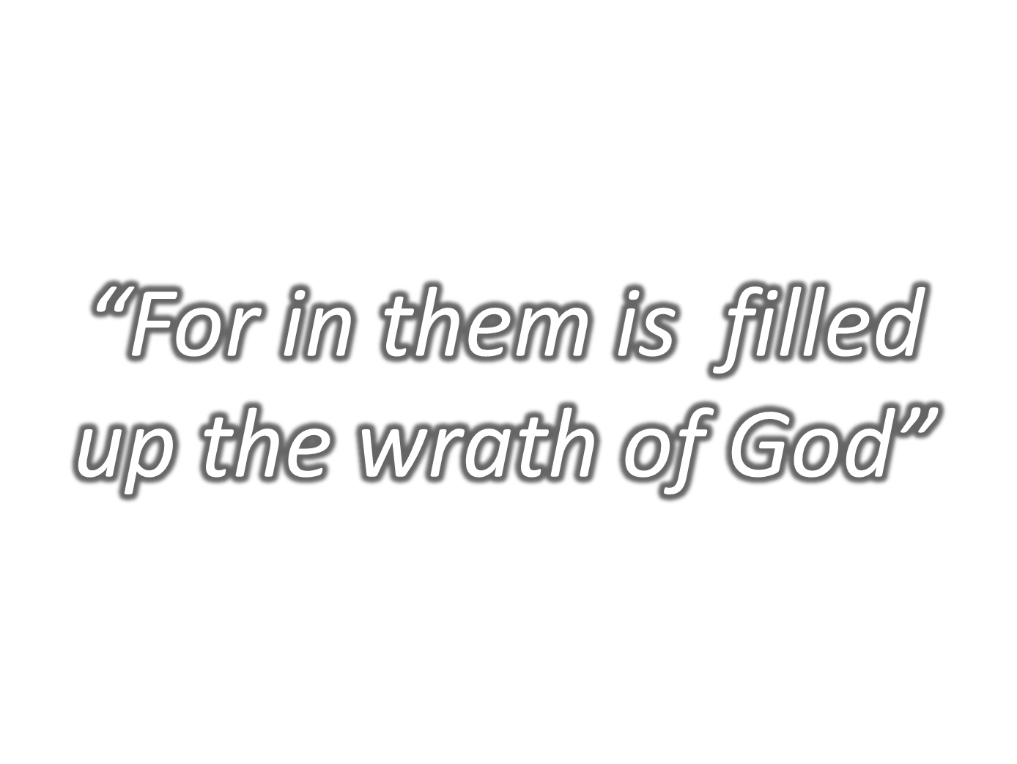

Slide 5
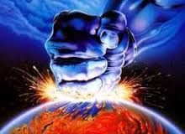
“The same shall drink of the wine of the wrath of God.”
“Cast it into the great winepress of the wrath of God.”
“For in them is filled up the wrath of God.”
“Seven golden vials full of the wrath of God, who liveth for ever and ever.”
“Pour out the vials of the wrath of God upon the earth.”

Slide 6
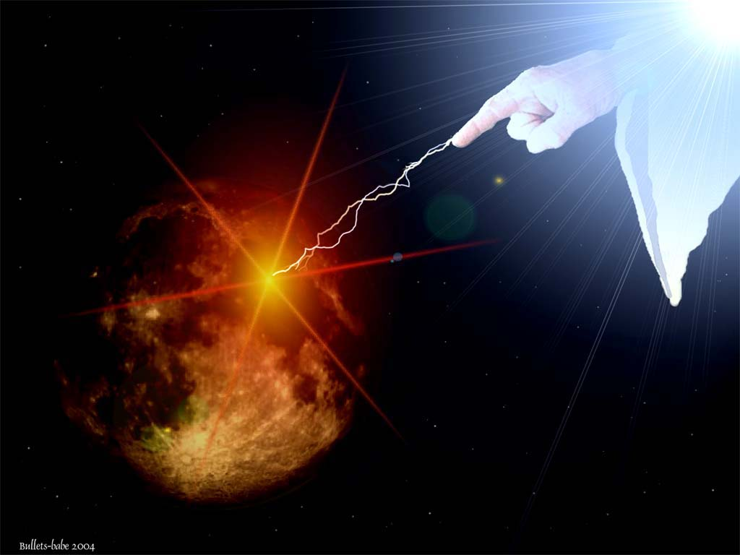
“It is a fearful thing to fall into the hands of
the living God.”
(Hebrews 10:31)

Slide 7
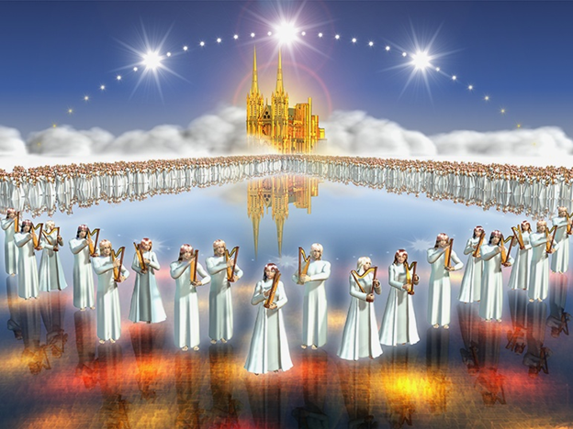
“And I saw as it were a sea of glass mingled with fire: and them that had gotten the victory over the beast, and over his image, and over his mark, and over the number of his name, stand on the sea of glass, having the harps of God.”

Slide 8
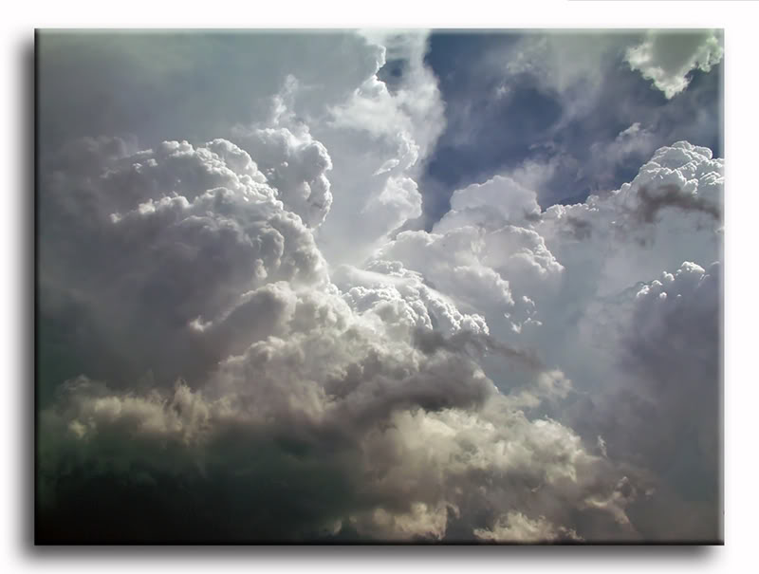
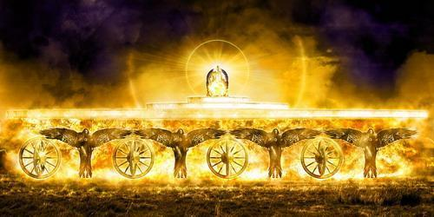
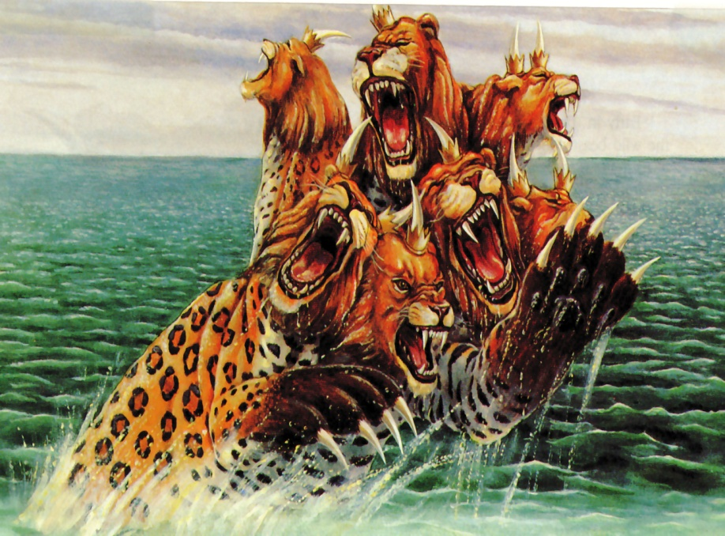
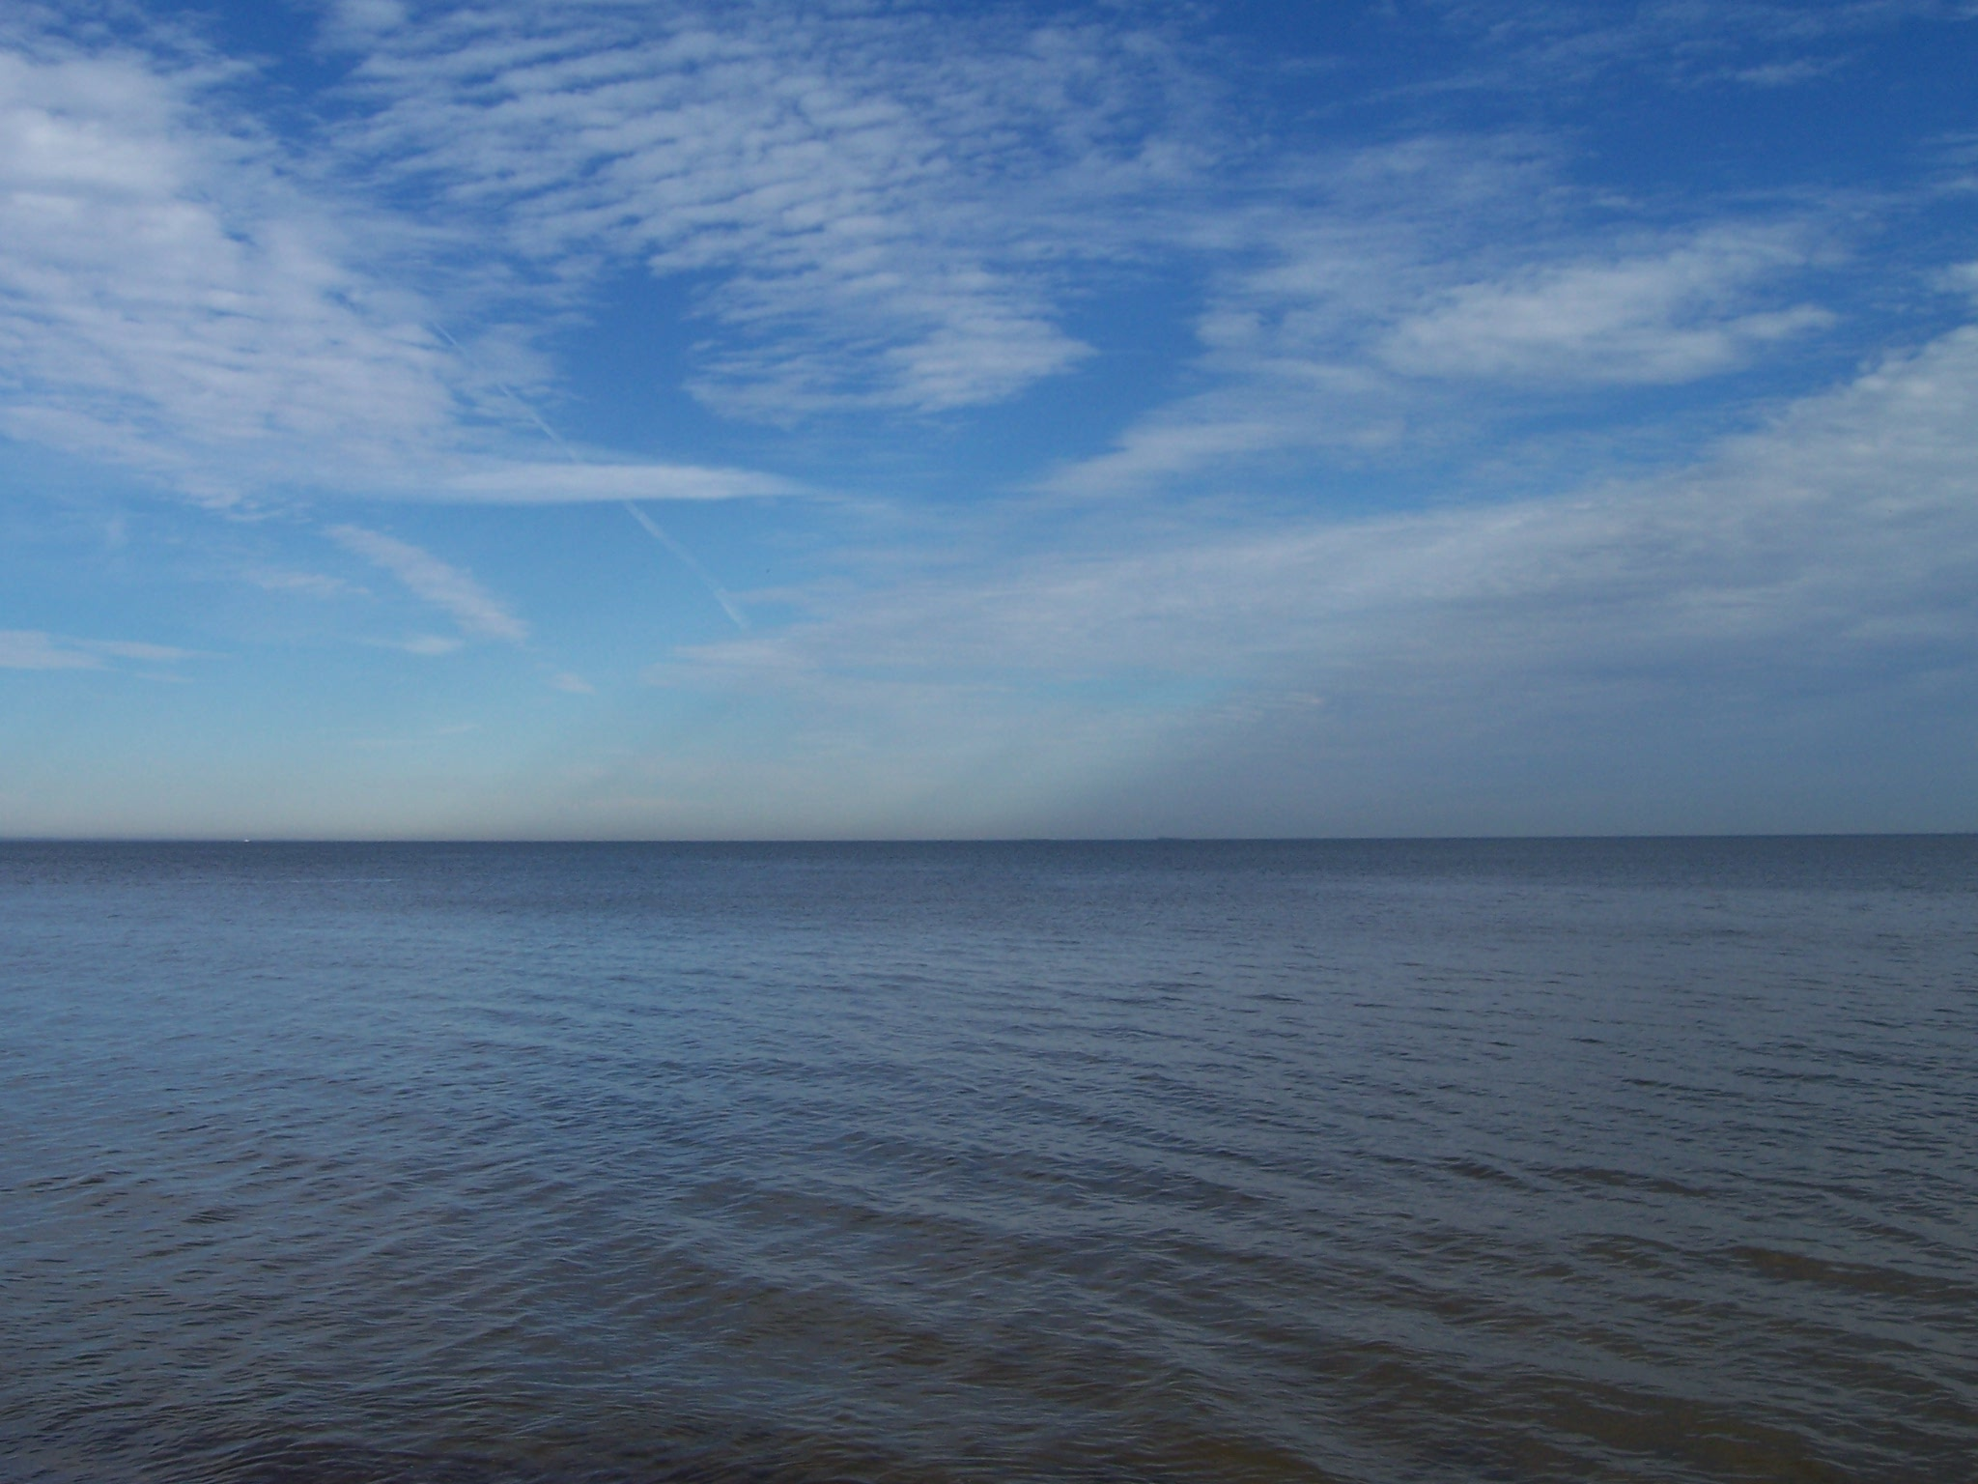
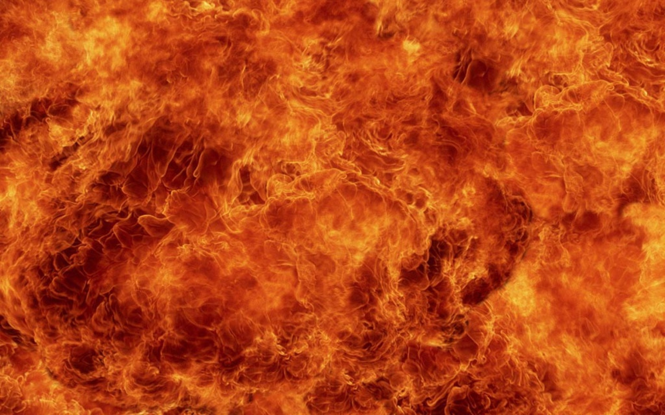

Slide 9
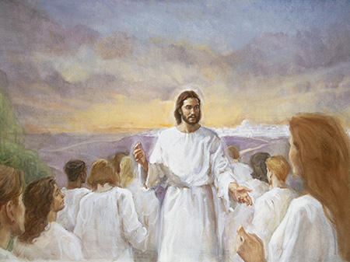
Tribulation Saints

Slide 10
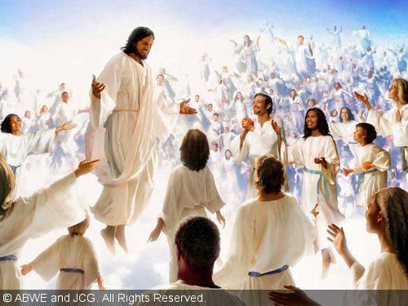
(Revelation 6:9-11) “I saw under the altar the souls of them that were slain for the word of God, and for the testimony which they held: And they cried with a loud voice, saying, How long, O Lord, holy and true, dost thou not judge and avenge our blood on them that dwell on the earth?”

Slide 11
“And white robes were given unto every one of them; and it was said unto them, that they should rest yet for a little season, until their fellow servants also and their brethren, that should be killed as they were, should be fulfilled.”

Slide 12
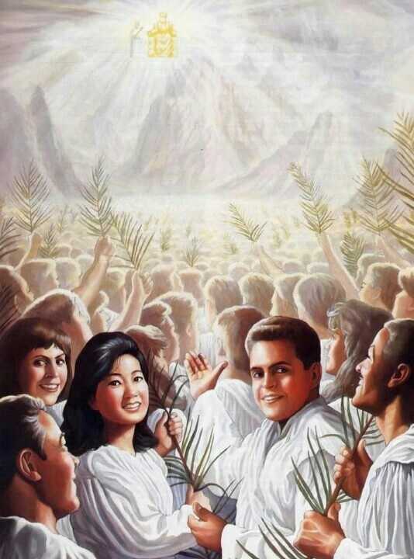
(Revelation 7:9) “After this I beheld, and, lo, a great multitude, which no man could number, of all nations, and kindreds, and people, and tongues, stood before the throne, and before the Lamb, clothed with white robes, and palms in their hands.”

Slide 13
(Revelation 13:7) “And it was given unto him (Anti-Christ) to make war with the saints, and to overcome them: and power was given him over all kindreds, and tongues, and nations.”

Slide 14
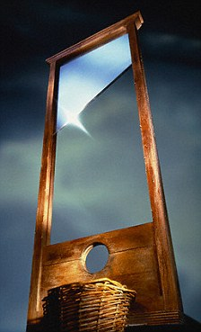
(Revelation 13:15) “And he cause that as many as would not worship the image of the beast should be killed.”

Slide 15
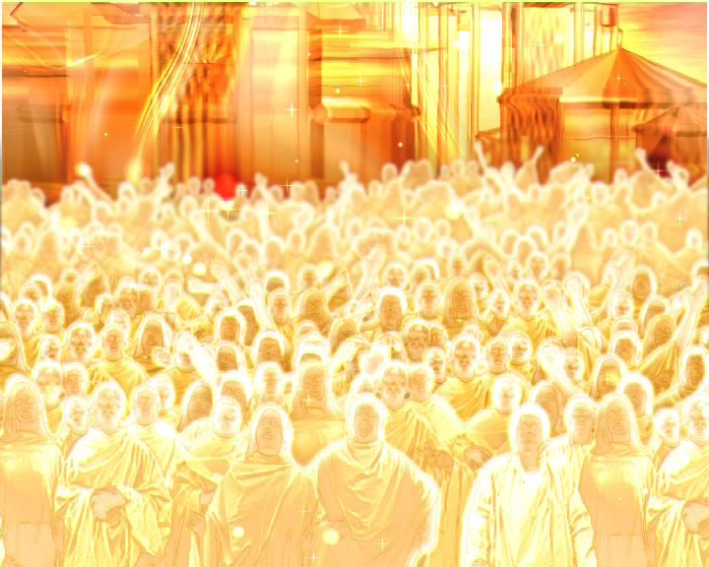
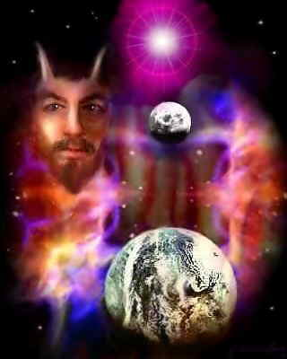
Victory over the Beast

Slide 16
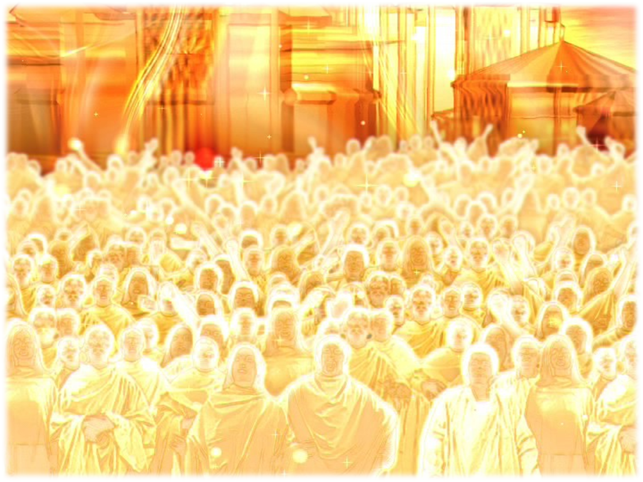
(Revelation 7:14-17) “And he said to me, These are they which came out of great tribulation, and have washed their robes, and made them white in the blood of the Lamb. Therefore are they before the throne of God, and serve him day and night in his temple: and he that sitteth on the throne shall dwell among them. They shall hunger no more, neither thirst any more; neither shall the sun light on them, nor any heat. For the Lamb which is in the midst of the throne shall feed them, and shall lead them unto living fountains of waters: and God shall wipe away all tears from their eyes.”

Slide 17
(Revelation 14:2-3) “And I heard a voice from heaven, as the voice of many waters, and as the voice of a great thunder: and I heard the voice of harpers harping with their harps: And they sung as it were a new song before the throne…”

Slide 18
“Death is swallowed up in victory. O death, where is thy sting? O grave, where is thy victory? But thanks be to God, which giveth us the victory through our Lord Jesus Christ.” I Corinthians 15:54-56
“For to me to live is Christ, and to die is gain.” Philippians 1:21
“Now thanks be unto God, which always causeth us to triumph in Christ.” II Corinthians 2:14

Slide 19
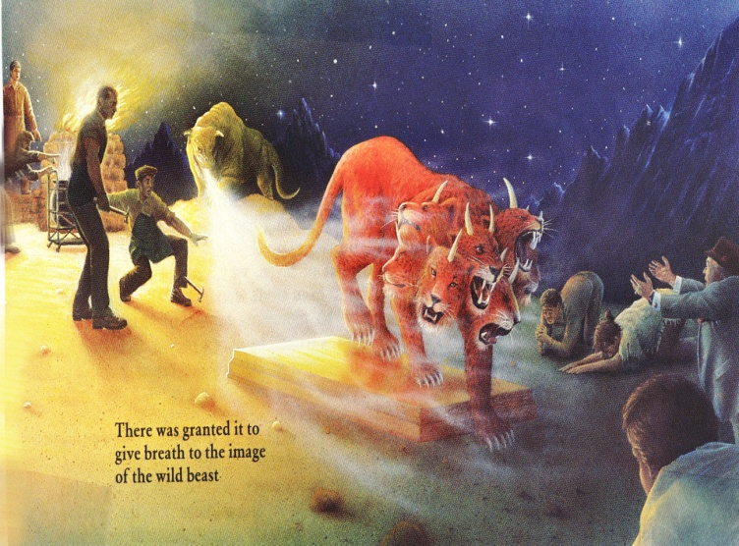
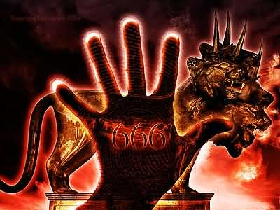
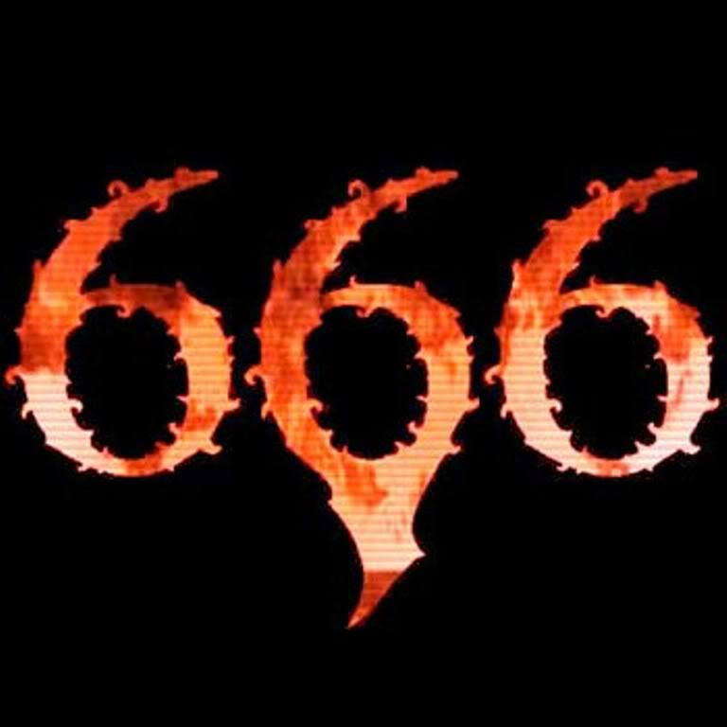
“They overcame him by the blood of the Lamb” Revelation 12:11
Victory over the beast
Victory over his image
Victory over his mark
Victory over the number of his name

Slide 20
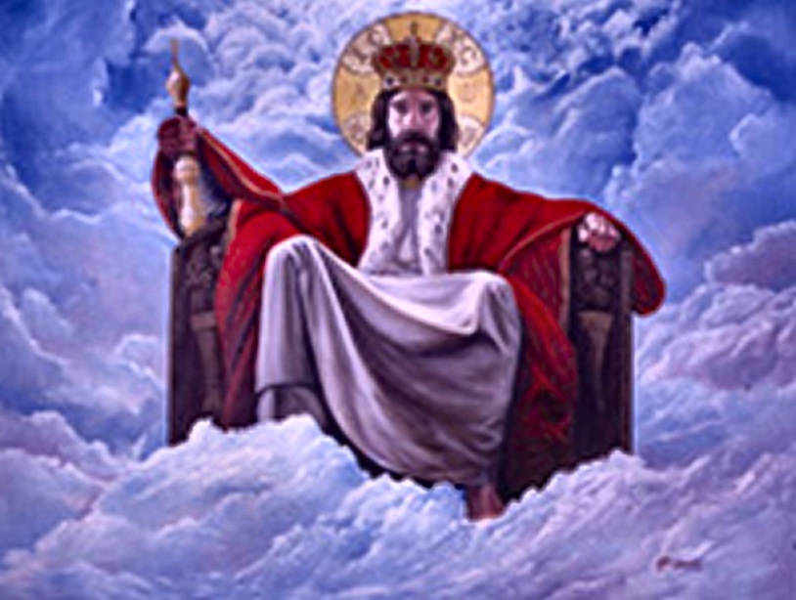
“Having the harps of God. And they sing the song of Moses the servant of God, and the song of the Lamb, saying, Great and marvellous are thy works, Lord God Almighty; just and true are thy ways, thou King of saints. Who shall not fear thee, O Lord, and glorify thy name? for thou only art holy: for all nations shall come and worship before thee; for thy judgments are made manifest.”

Slide 21
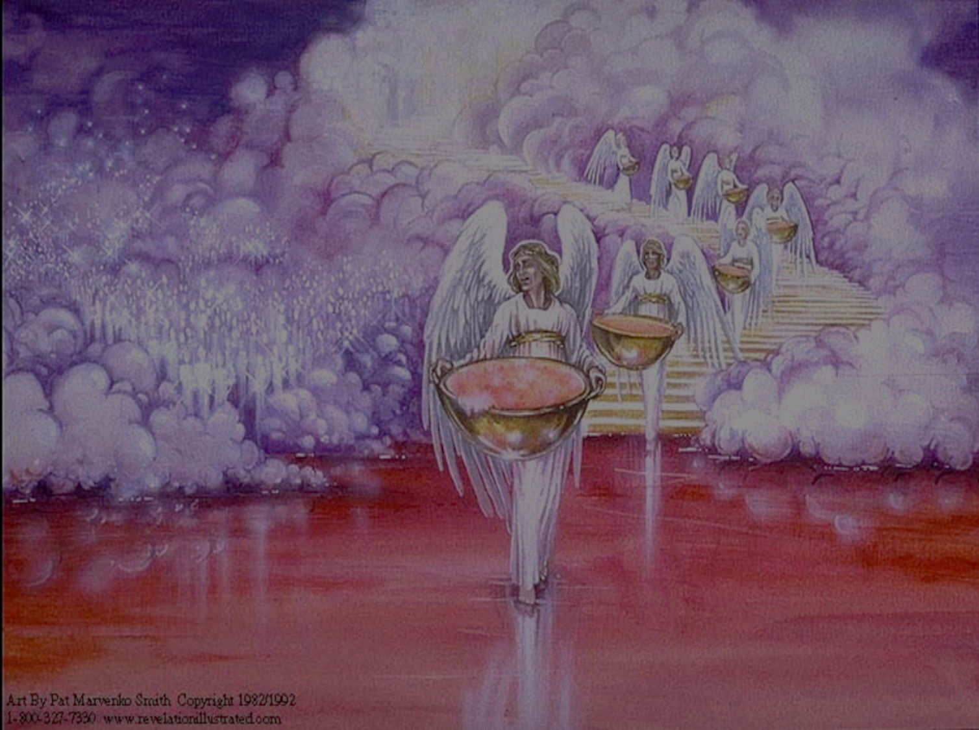
“And after that I looked, and, behold, the temple of the tabernacle of the testimony in heaven was opened: And the seven angels came out of the temple, having the seven plagues, clothed in pure and white linen, and having their breasts girded with golden girdles.”

Slide 22
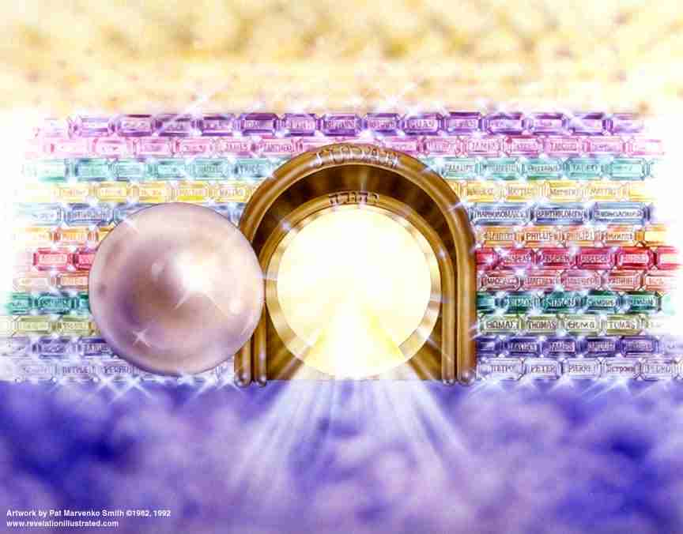
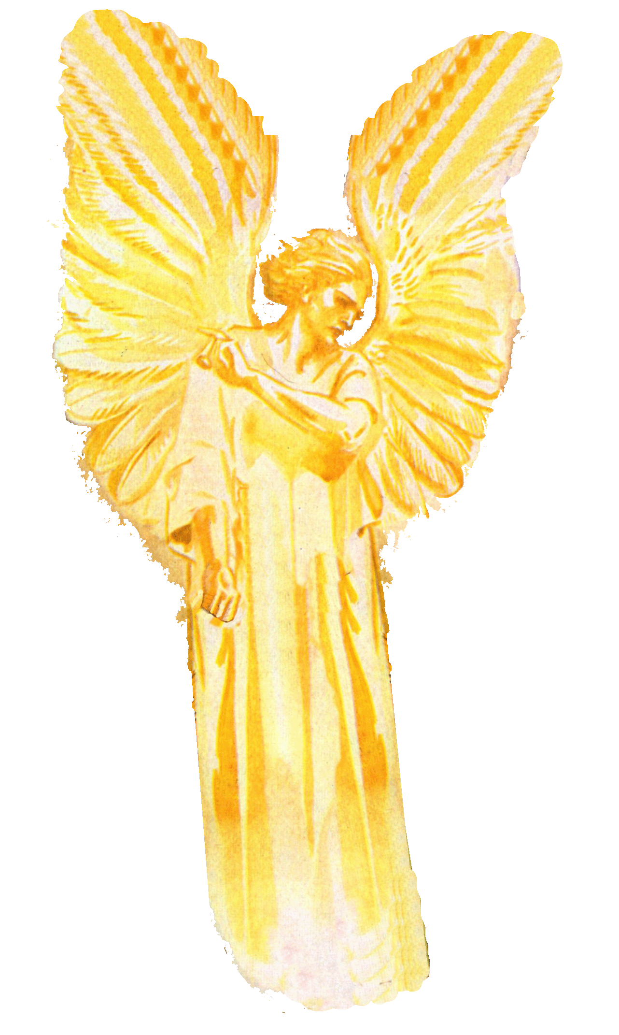

Slide 23
“And one of the four beasts gave unto the seven angels seven golden vials full of the wrath of God, who liveth for ever and ever.”

Slide 24
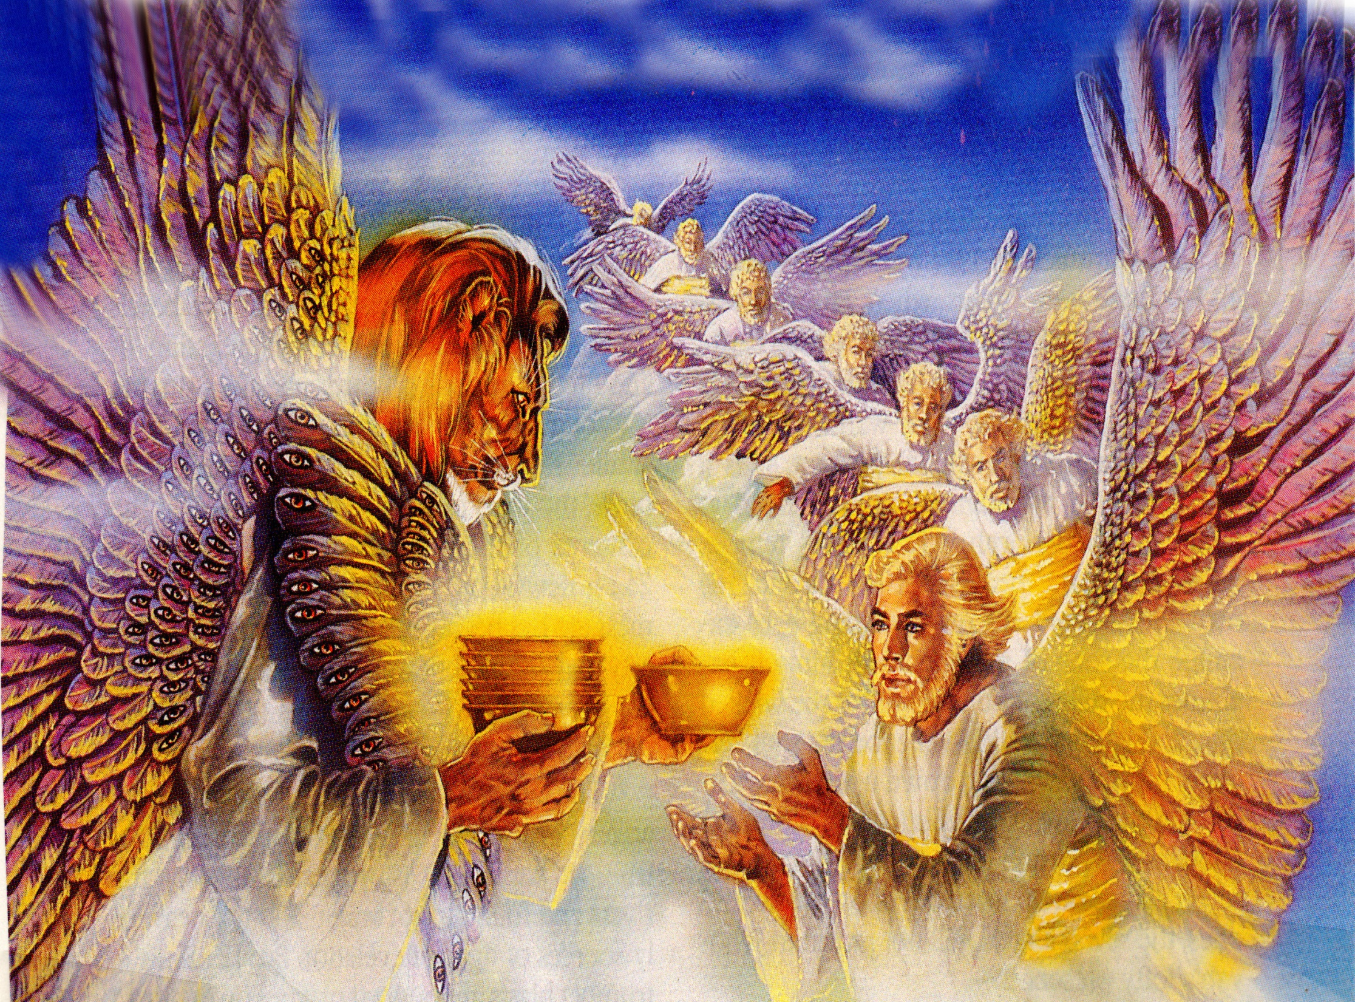
The Seven Vile Judgments (Revelation 16:1-21)

Slide 25
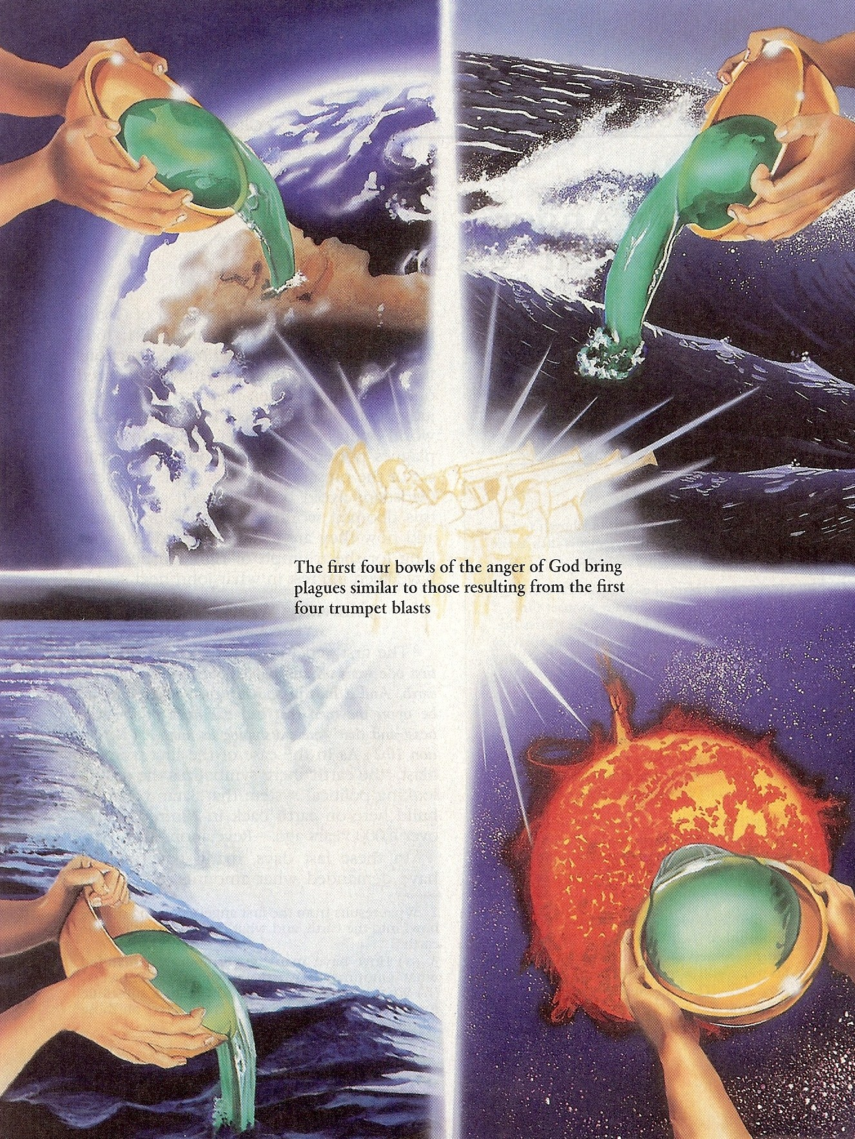
“And I heard a great voice out of the temple saying to the seven angels, Go your ways, and pour out the vials of the wrath of God upon the earth.”

Slide 26
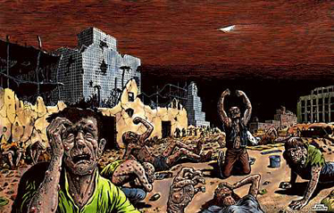
“And the first went, and poured out his vial upon the earth; and there fell a noisome and grievous (painful) sore upon the men which had the mark of the beast, and upon them which worshipped his image.”

Slide 27
“And the second angel poured out his vial upon the sea; and it became as the blood of a dead man: and every living soul died in the sea.”

Slide 28
“And the third angel poured out his vial upon the rivers and fountains of waters; and they became blood.”

Slide 29
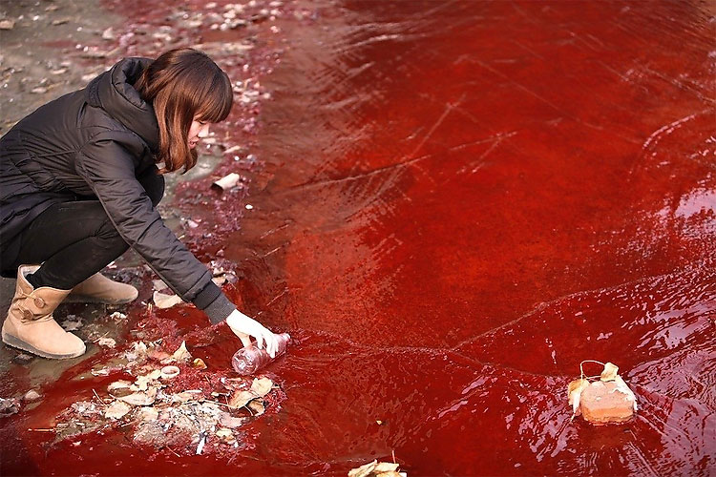
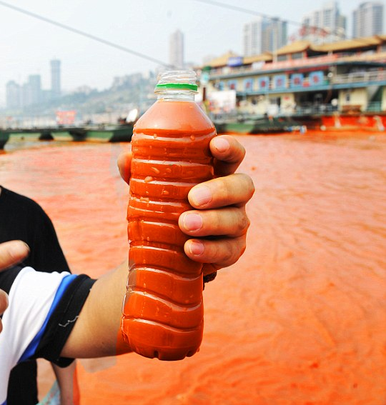
“And I heard the angel of the waters say, Thou art righteous, O Lord, which art, and wast, and shalt be, because thou hast judged thus. For they have shed the blood of saints and prophets, and thou hast given them blood to drink; for they are worthy.”

Slide 30
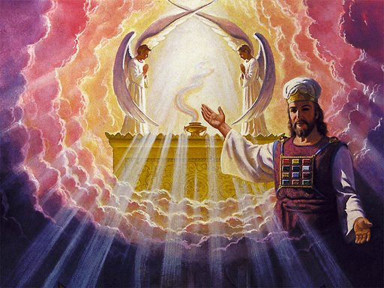
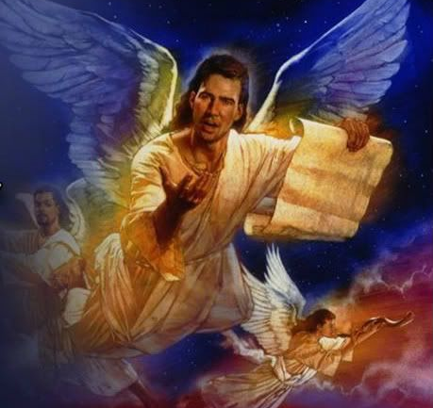
“And I heard another (angel) out of the altar say, Even so, Lord God Almighty, true and righteous are thy judgments.”

Slide 31
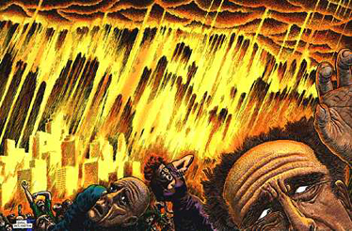
“And the fourth angel poured out his vial upon the sun; and power was given unto him to scorch men with fire. And men were scorched with great heat, and blasphemed the name of God, which hath power over these plagues: and they repented not to give him glory.”

Slide 32
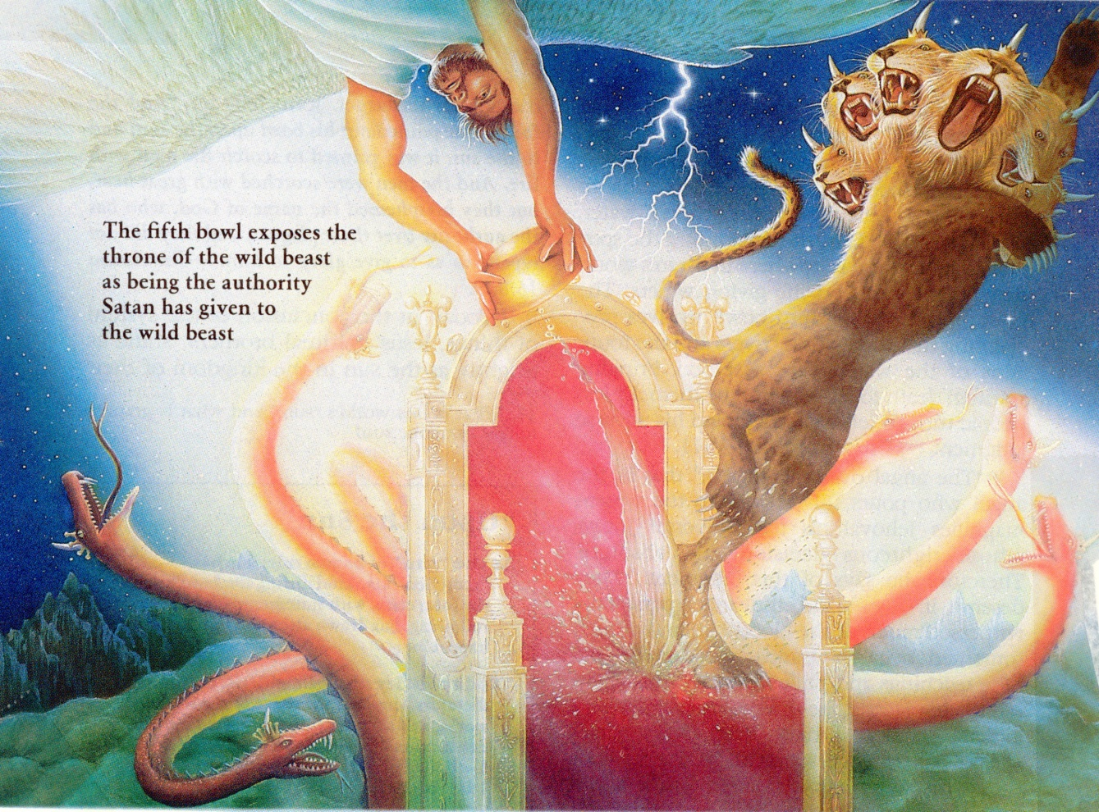
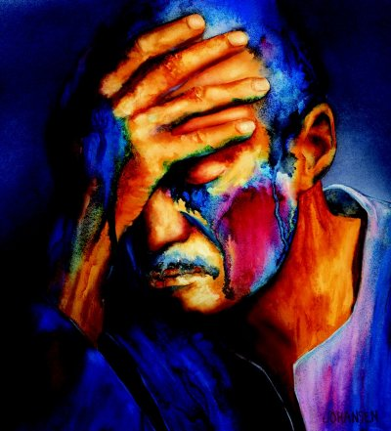
“And the fifth angel poured out his vial upon the seat of the beast; and his kingdom was full of darkness; and they gnawed their tongues for pain.”

Slide 33
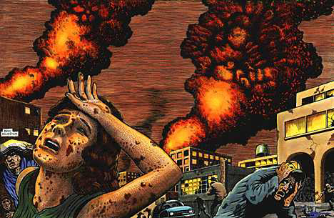
“And blasphemed the God of heaven because of their pains and their sores, and repented not of their deeds.”

Slide 34
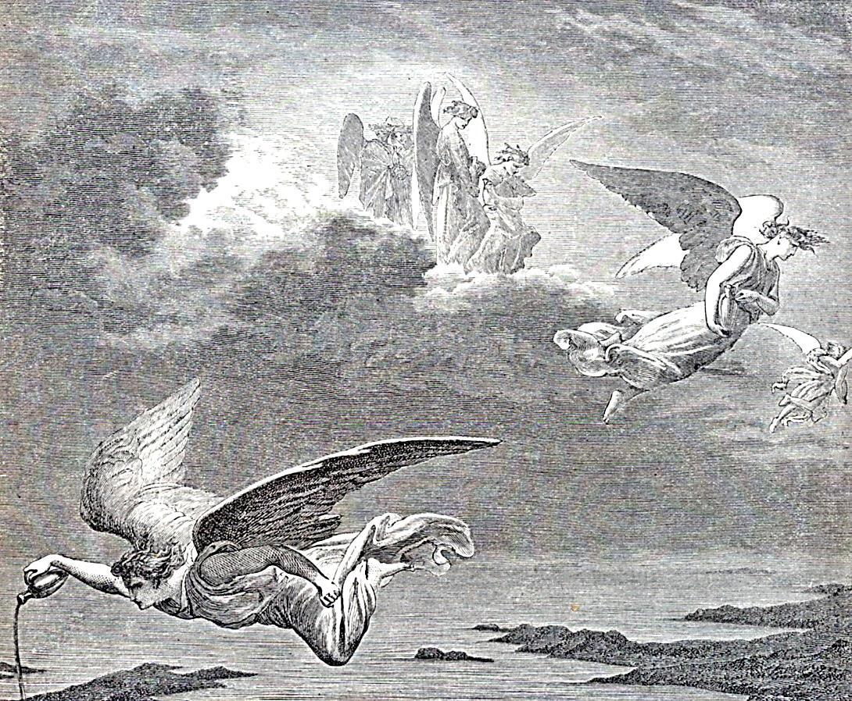
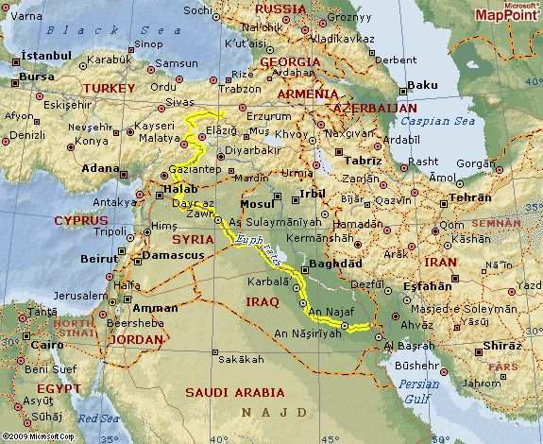
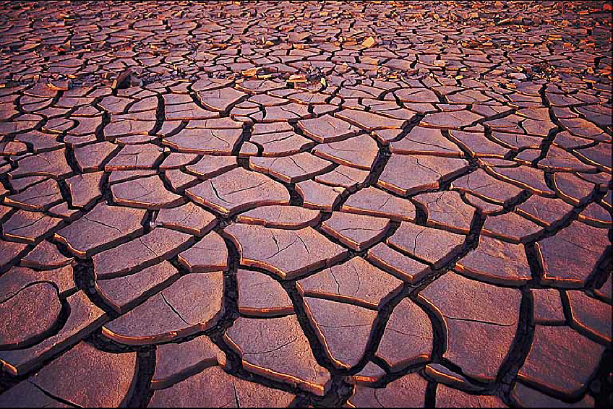
“And the sixth angel poured out his vial upon the great river Euphrates; and the water thereof was dried up, that the way of the kings of the east might be prepared.”

Slide 35
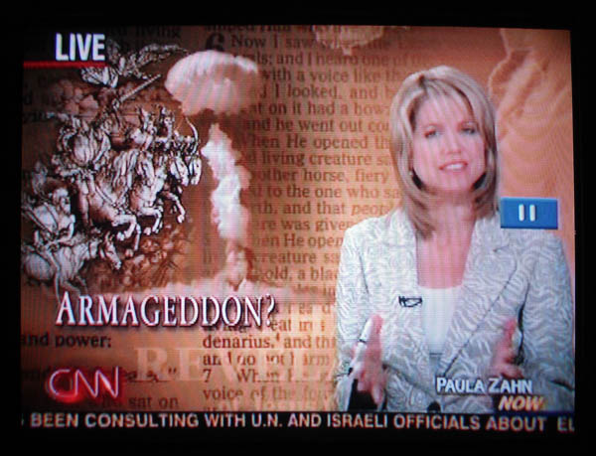
Preparation for the Battle of Armageddon Begins
“And he gathered them together into a place called in the Hebrew tongue Armageddon.”

Slide 36
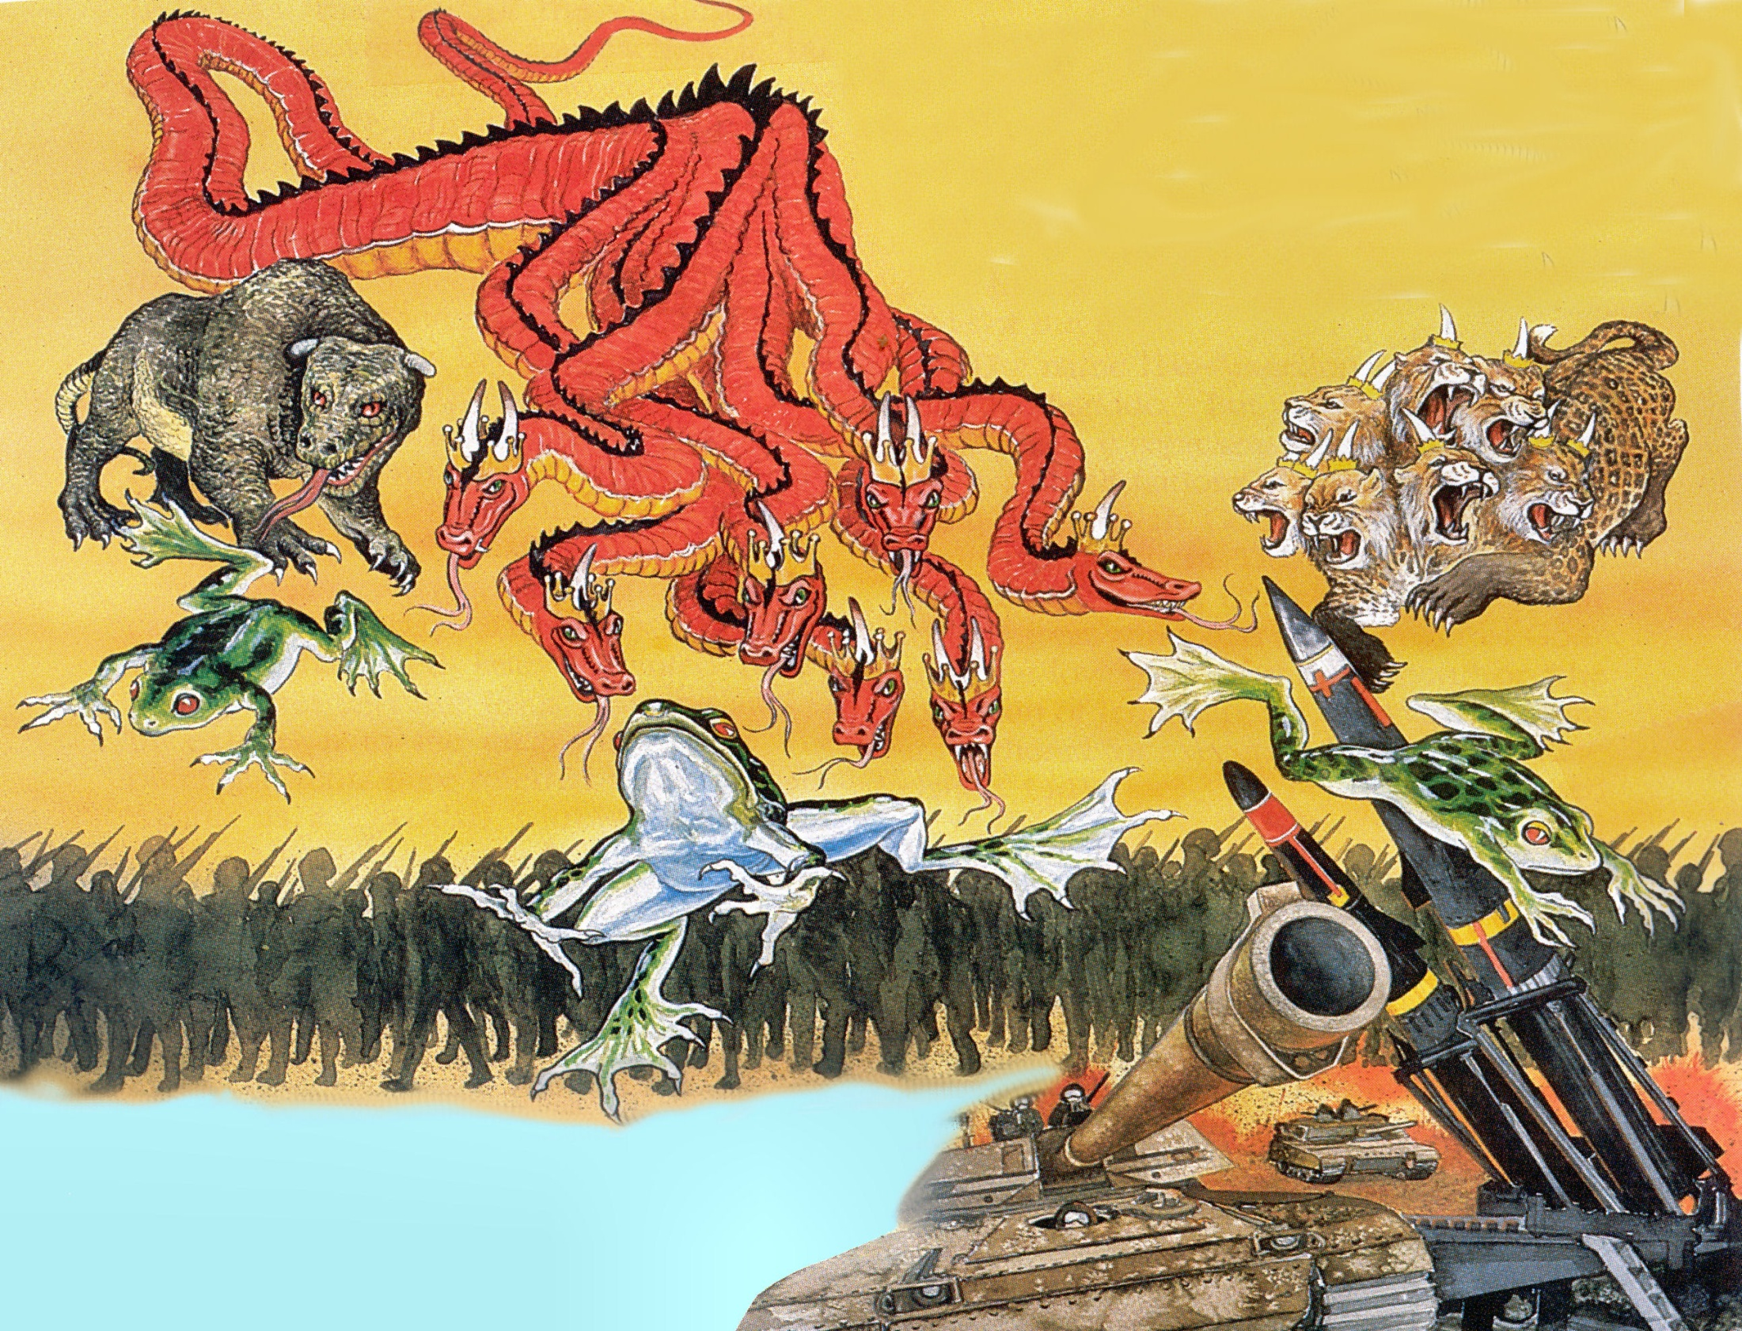
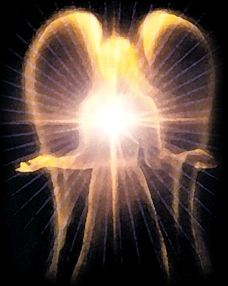
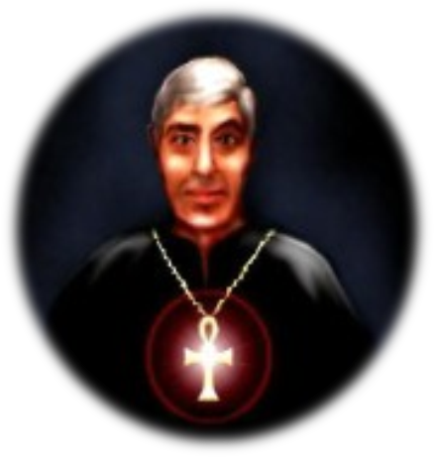
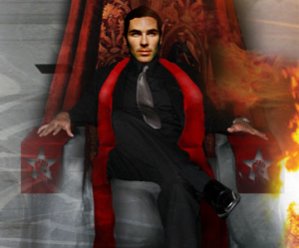
Revelation 16:12-14

Slide 37
“And I saw three unclean spirits like frogs come out of the mouth of the dragon, and out of the mouth of the beast, and out of the mouth of the false prophet. For they are the spirits of devils, working miracles, which go forth unto the kings of the earth and of the whole world, to gather them to the battle of that great day of God Almighty.”

Slide 38
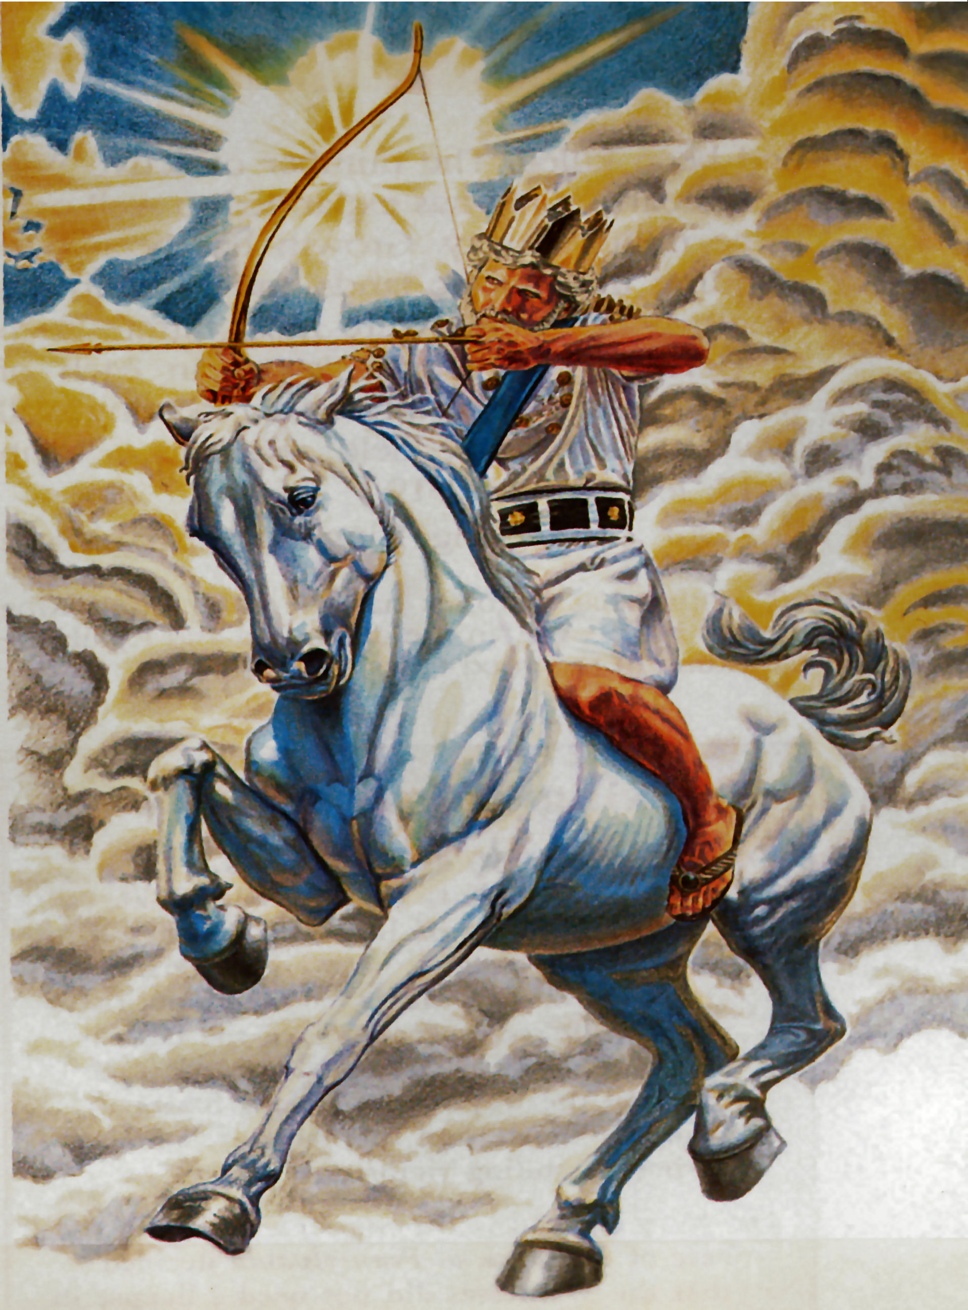
“And I saw, and behold a white horse: and he that sat on him had a bow; and a crown was given unto him: and he went forth conquering; and to conquer.”
(Revelation 6:2)

Slide 39
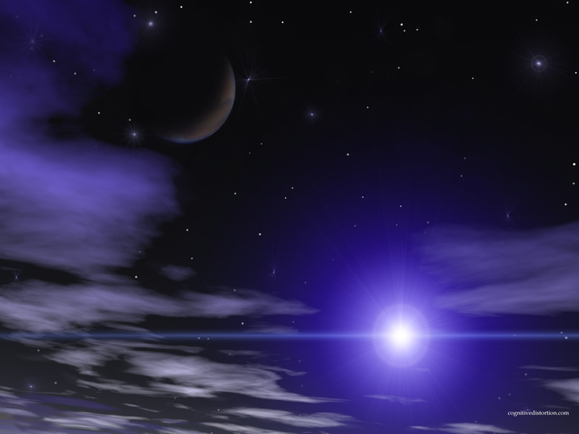
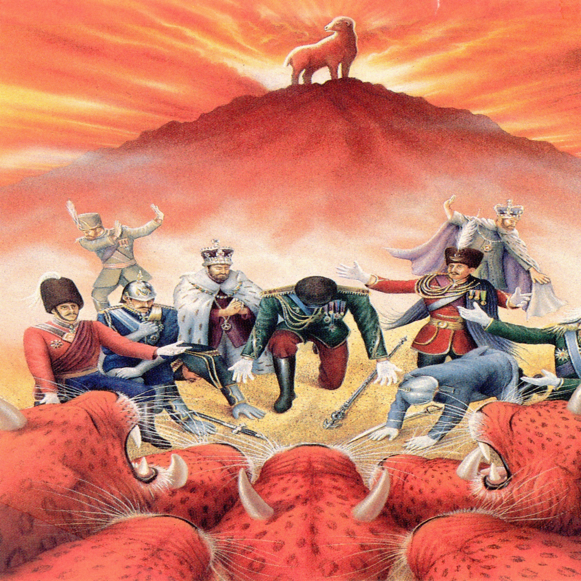
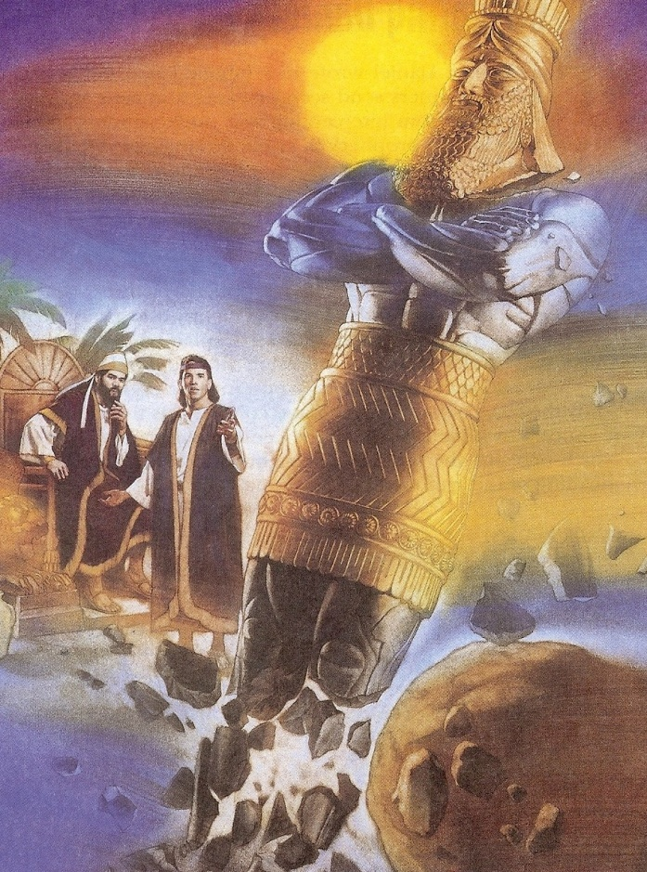

Slide 40
Revelation 19:11-21

Slide 41
“The kings of the earth set themselves, and the rulers take counsel together, against the LORD, and against his anointed, saying, Let us break their bands asunder, and cast away their cords from us. He that sitteth in the heavens shall laugh: the Lord shall have them in derision. Then shall he speak unto them in his wrath, and vex them in his sore displeasure.” (Psalms 2:2-5)

Slide 43
“Behold, I come as a thief. Blessed is he that watcheth, and keepeth his garments, lest he walk naked, and they see his shame.”

Slide 44
“And he gathered them together into a place called in the Hebrew tongue Armageddon.”

Slide 46
“Thrust in thy sickle, and reap: for the time is come for thee to reap; for the harvest of the earth is ripe…And the angel thrust in his sickle into the earth, and gathered the vine of the earth, and cast it into the great winepress of the wrath of God.”

Slide 48
“And his feet shall stand in that day upon the mount of Olives, which is before Jerusalem on the east, and the mount of Olives shall cleave in the midst thereof toward the east and toward the west, and there shall be a very great valley; and half of the mountain shall remove toward the north, and half of it toward the south.” (Zechariah 14:4)

Slide 49
“And the winepress was trodden without the city, and blood came out of the winepress, even unto the horse bridles, by the space of a thousand and six hundred furlongs (184 miles).” (Revelation 14:20)

Slide 50
(184 miles)

Slide 53
“Wherefore art thou red in thine apparel, and thy garments like him that treadeth in the winepress? I have trodden the winepress alone; I will tread them in mine anger, and trample them in my fury; and their blood shall be sprinkled upon my garments, and I will stain all my raiment.” (Isaiah 63:2-3)

Slide 54
“And he was clothed with a vesture dipped in blood: and his name is called The Word of God.” (Rev. 19:13)

Slide 55
“And I saw an angel standing in the sun; and he cried with a loud voice, saying to all the fowls that fly in the midst of heaven, Come and gather yourselves together unto the supper of the great God.”

Slide 56
“That ye may eat the flesh of kings, and the flesh of captains, and the flesh of mighty men, and the flesh of horses, and of them that sit on them, and the flesh of all men, both free and bond, both small and great.”

Slide 57
“And the beast was taken, and with him the false prophet that wrought miracles before him…These both were cast alive into a lake of fire burning with brimstone.”

Slide 58
“And the temple was filled with smoke from the glory of God, and from his power; and no man was able to enter into the temple, till the seven plagues of the seven angels were fulfilled.” (Revelation 15:8)

Slide 59
“And the seventh angel poured out his vial into the air; and there came a great voice out of the temple of heaven, from the throne, saying, It is done. And there were voices, and thunders, and lightnings; and there was a great earthquake, such as was not since men were upon the earth, so mighty an earthquake, and so great.”

Slide 61
“And the great city was divided into three parts, and the cities of the nations fell: and great Babylon came in remembrance before God, to give unto her the cup of the wine of the fierceness of his wrath.”

Slide 62
“Every island fled away, and the mountains were not found.”

Slide 63
“And there fell upon men a great hail out of heaven, every stone about the weight of a talent: and men blasphemed God because of the plague of the hail; for the plague thereof was exceeding great.”

Slide 68
Grievous sores upon those who have the mark of the beast and worship his image
Sea turns to the blood of a dead man
Every living thing in the sea dies
Rivers and fountains of waters become blood
Men are scorched with fire from heaven
Darkness over the face of the whole earth
Men are afflicted with great pain

Slide 69
Powerful storms
Great earthquakes
Major cities around the world are destroyed
Every island disappears
Every mountain is removed
Great hail the weight of a talent
Man blaspheme God
Battle of Armageddon

