Slide 1
The Revelation of Jesus Christ
A study of the book
of Revelation

Slide 2
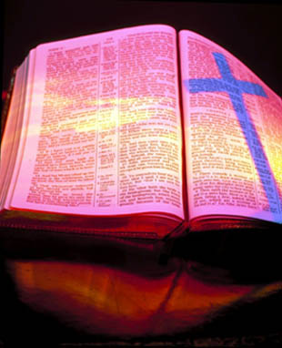
Revelation 14:14-20
“The harvest of the earth and the wrath and mercy of God”

Slide 3
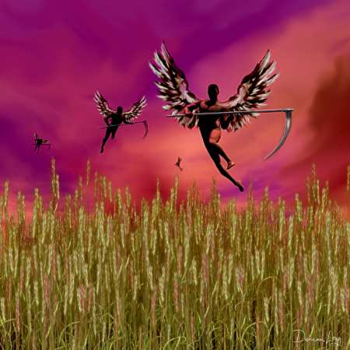
(Revelation 14:14-20) “The Harvest”

Slide 4
“And I looked, and behold a white cloud, and upon the cloud one sat like unto the Son of man, having on his head a golden crown, and in his hand a sharp sickle.”

Slide 5
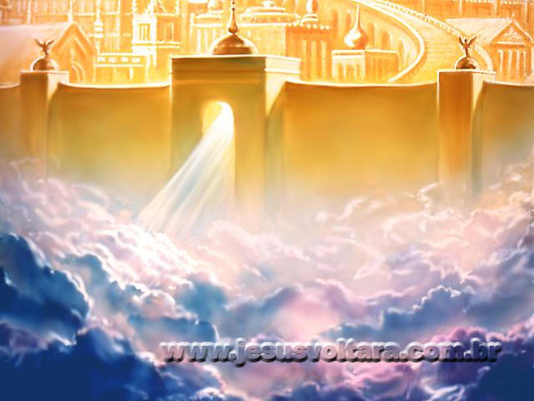

Slide 6
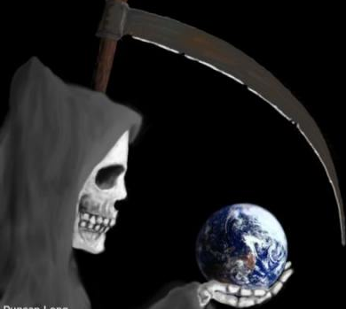
“And another angel came out of the temple, crying with a loud voice to him that sat on the cloud, Thrust in thy sickle, and reap: for the time is come for thee to reap; for the harvest of the earth is ripe.”

Slide 7
“Thrust in thy sickle, and reap.”

Slide 8
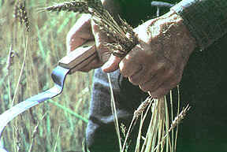
“And he that sat on the cloud thrust in his sickle on the earth; and the earth was reaped.”

Slide 9
“And another angel came out of the temple which is in heaven, he also having a sharp sickle.”

Slide 11
“And another angel came out from the altar, which had power over fire; and cried with a loud cry to him that had the sharp sickle.”

Slide 12
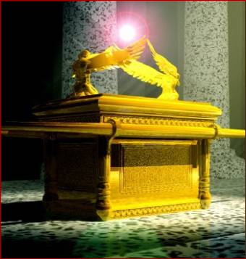

Slide 13
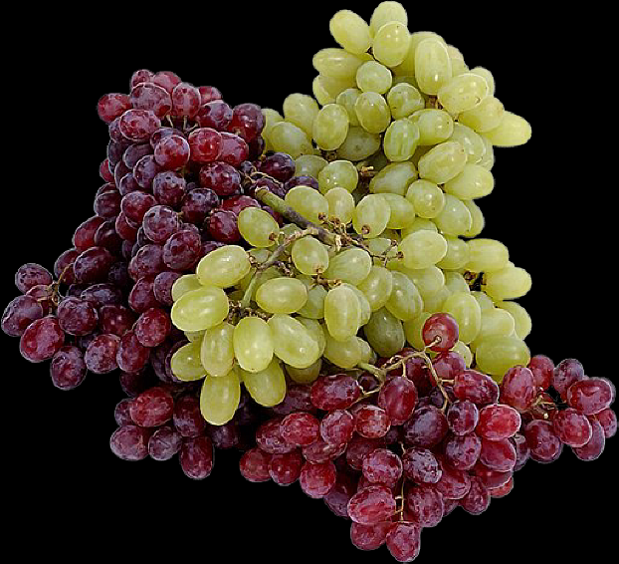
“Thrust in thy sharp sickle, and gather the clusters of the vine of the earth; for her grapes are fully ripe.”

Slide 14
“And the angel thrust in his sickle into the earth, and gathered the vine of the earth, and cast it into the great winepress of the wrath of God.”

Slide 15
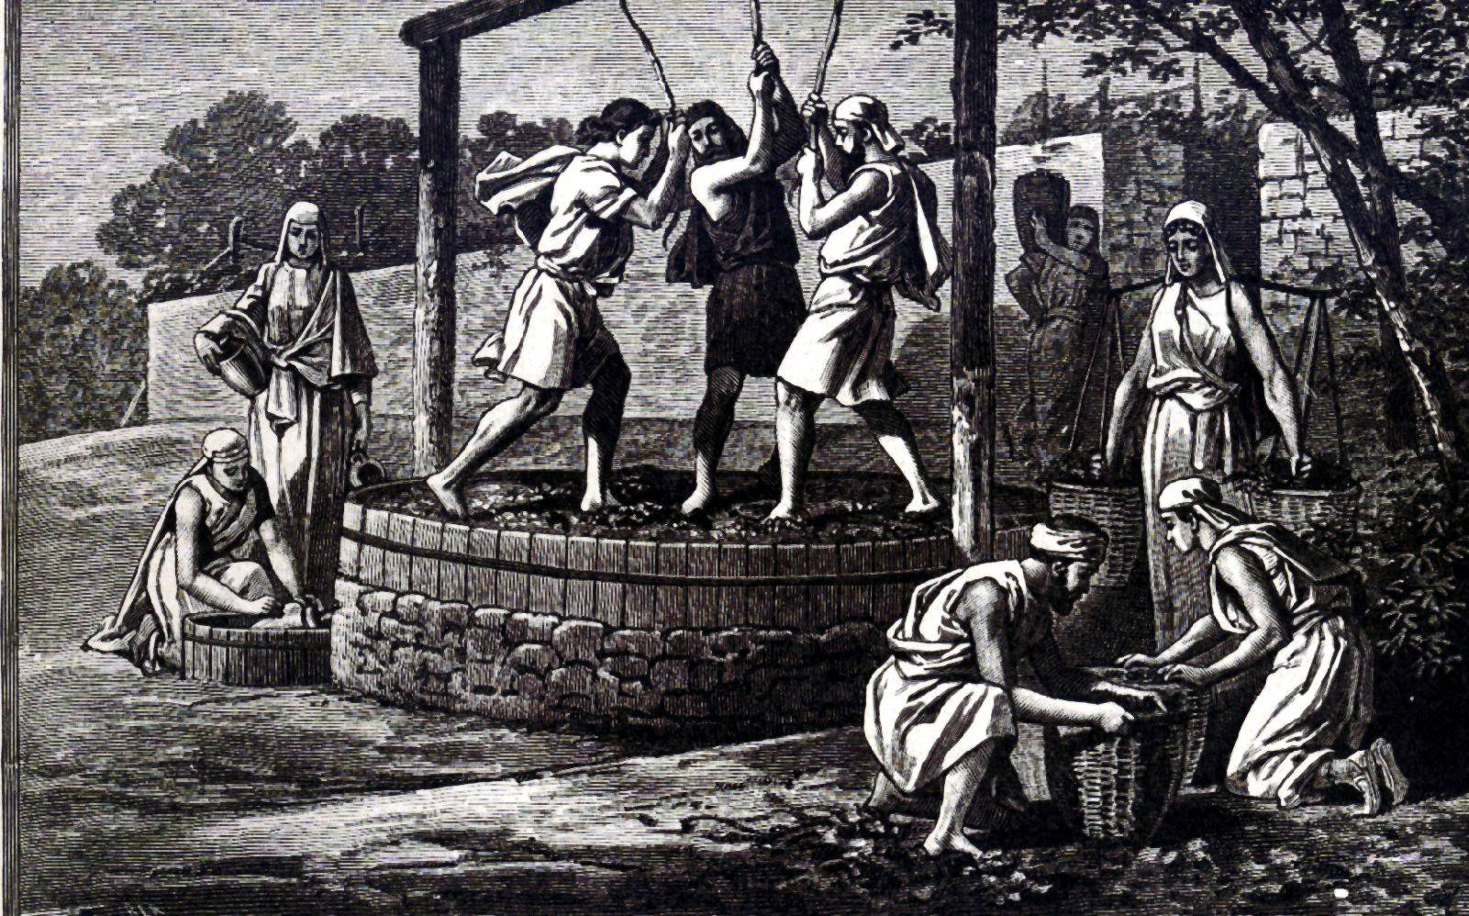
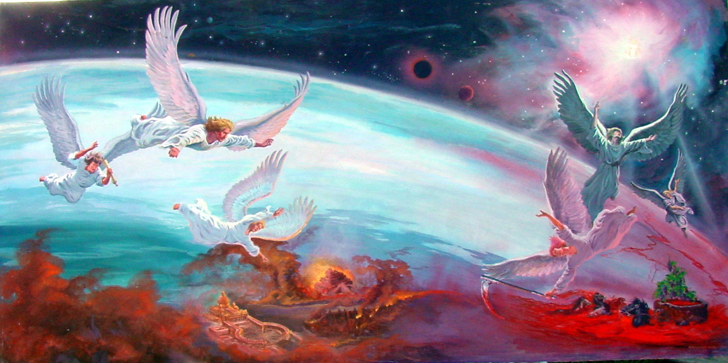
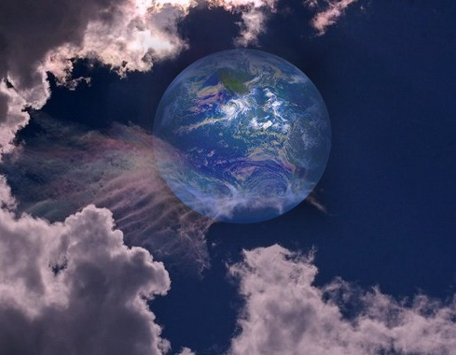

Slide 16
“Wherefore art thou red in thine apparel, and thy garments like him that treadeth in the winepress? I have trodden the winepress alone; I will tread them in mine anger, and trample them in my fury; and their blood shall be sprinkled upon my garments, and I will stain all my raiment.” (Isaiah 63:2-3)

Slide 17
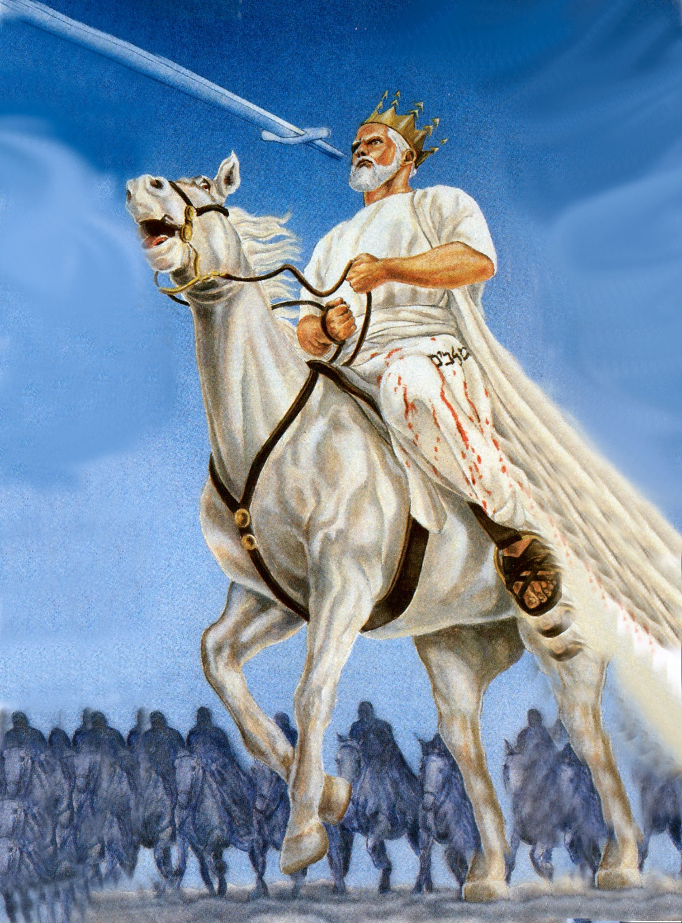
“And he was clothed with a vesture dipped in blood: and his name is called The Word of God.” (Rev. 19:13)

Slide 18
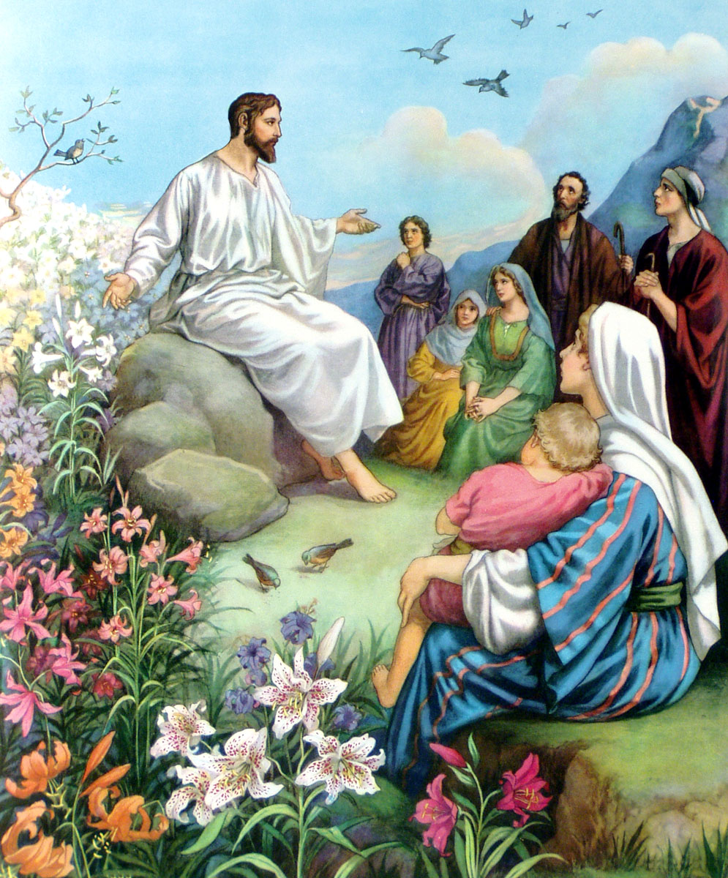
3 Parables of the Harvest

Slide 19
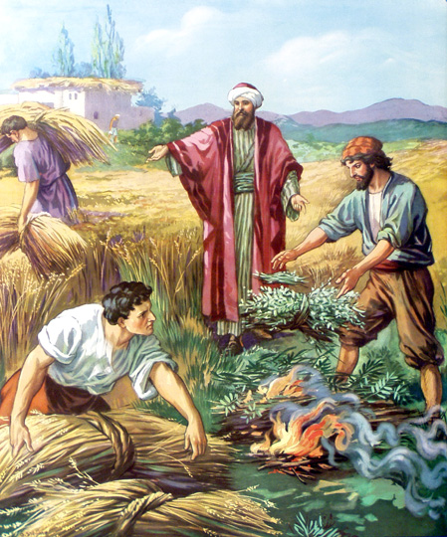
Matthew 13:36-42

Slide 20
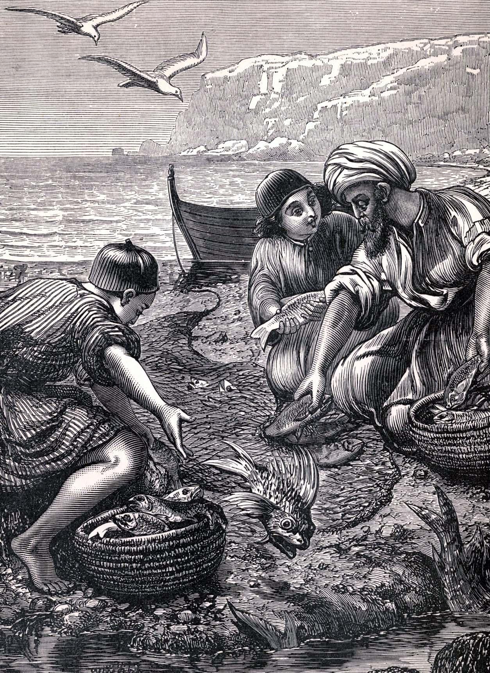
Matthew 13:47-50

Slide 21
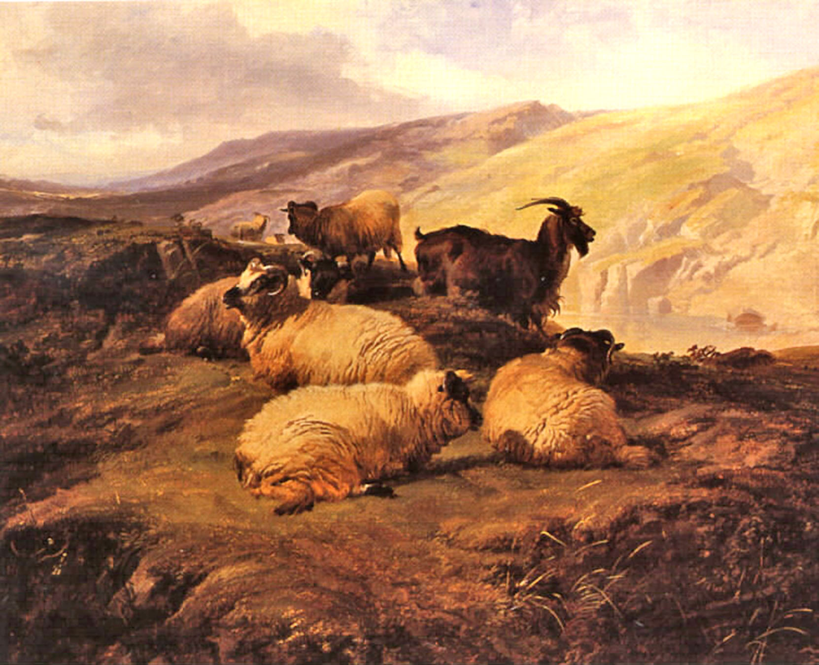
Matthew 25:31-41

Slide 22
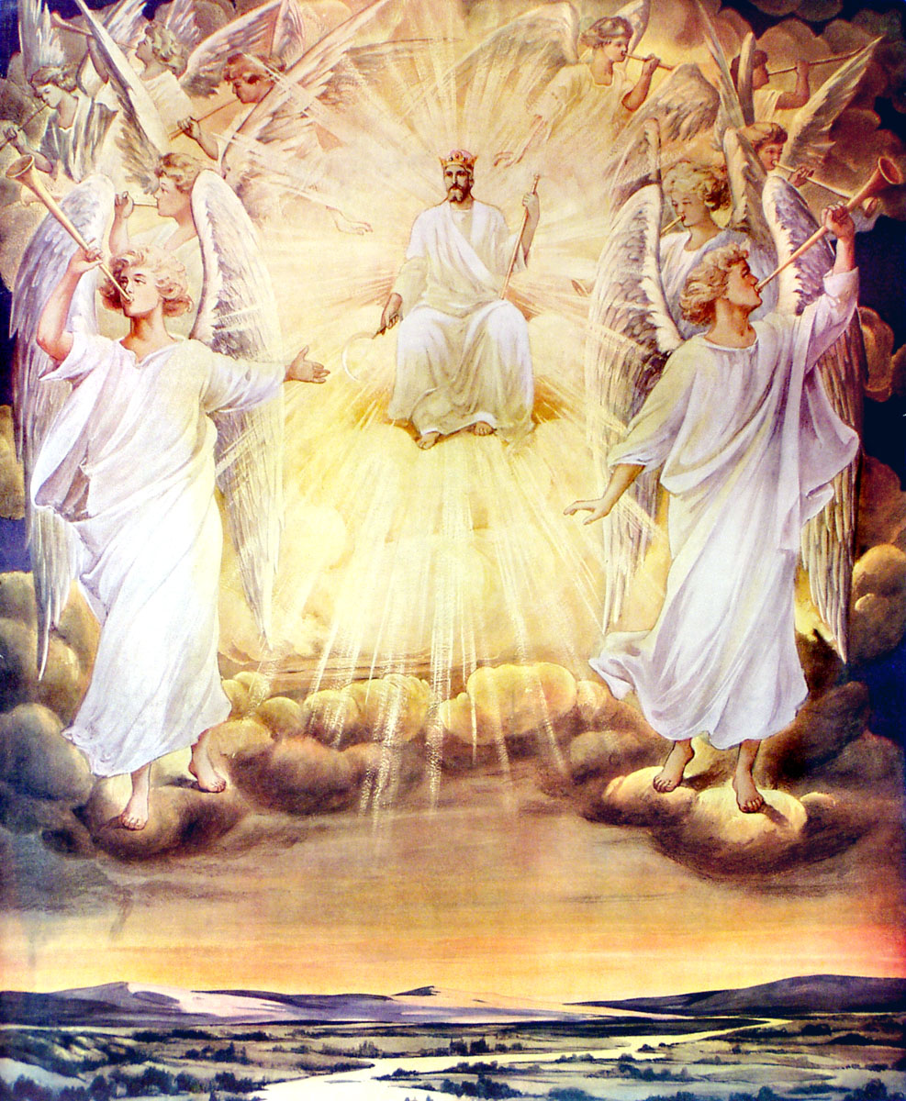
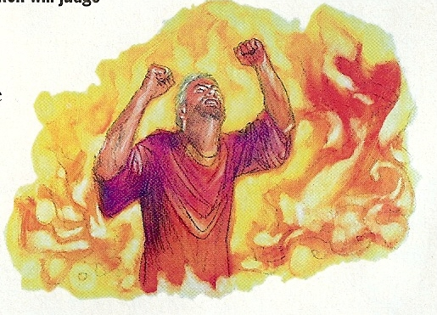

Slide 23
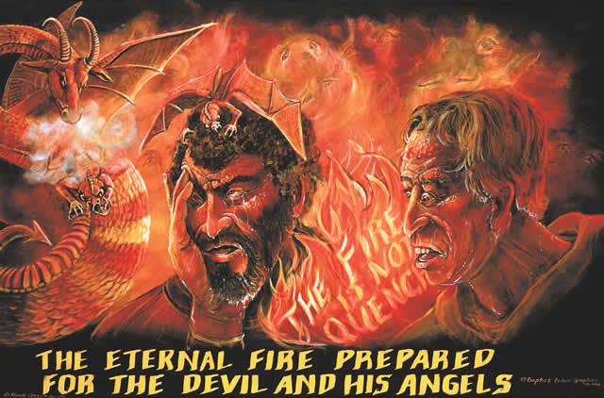

Slide 24
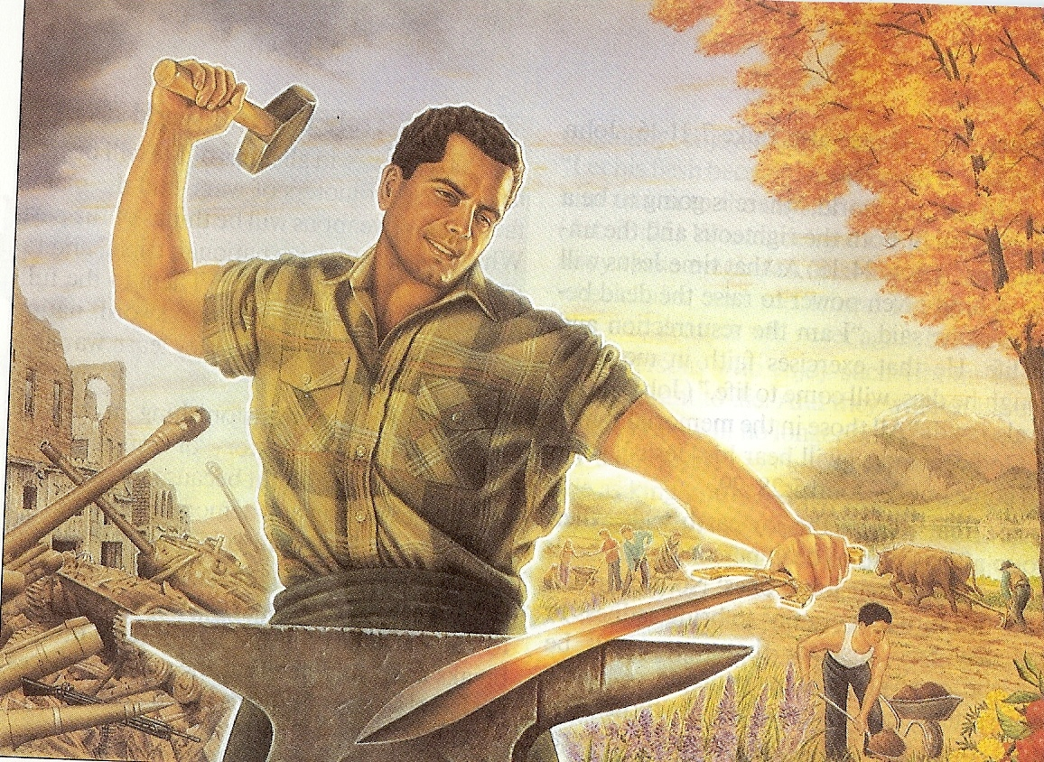
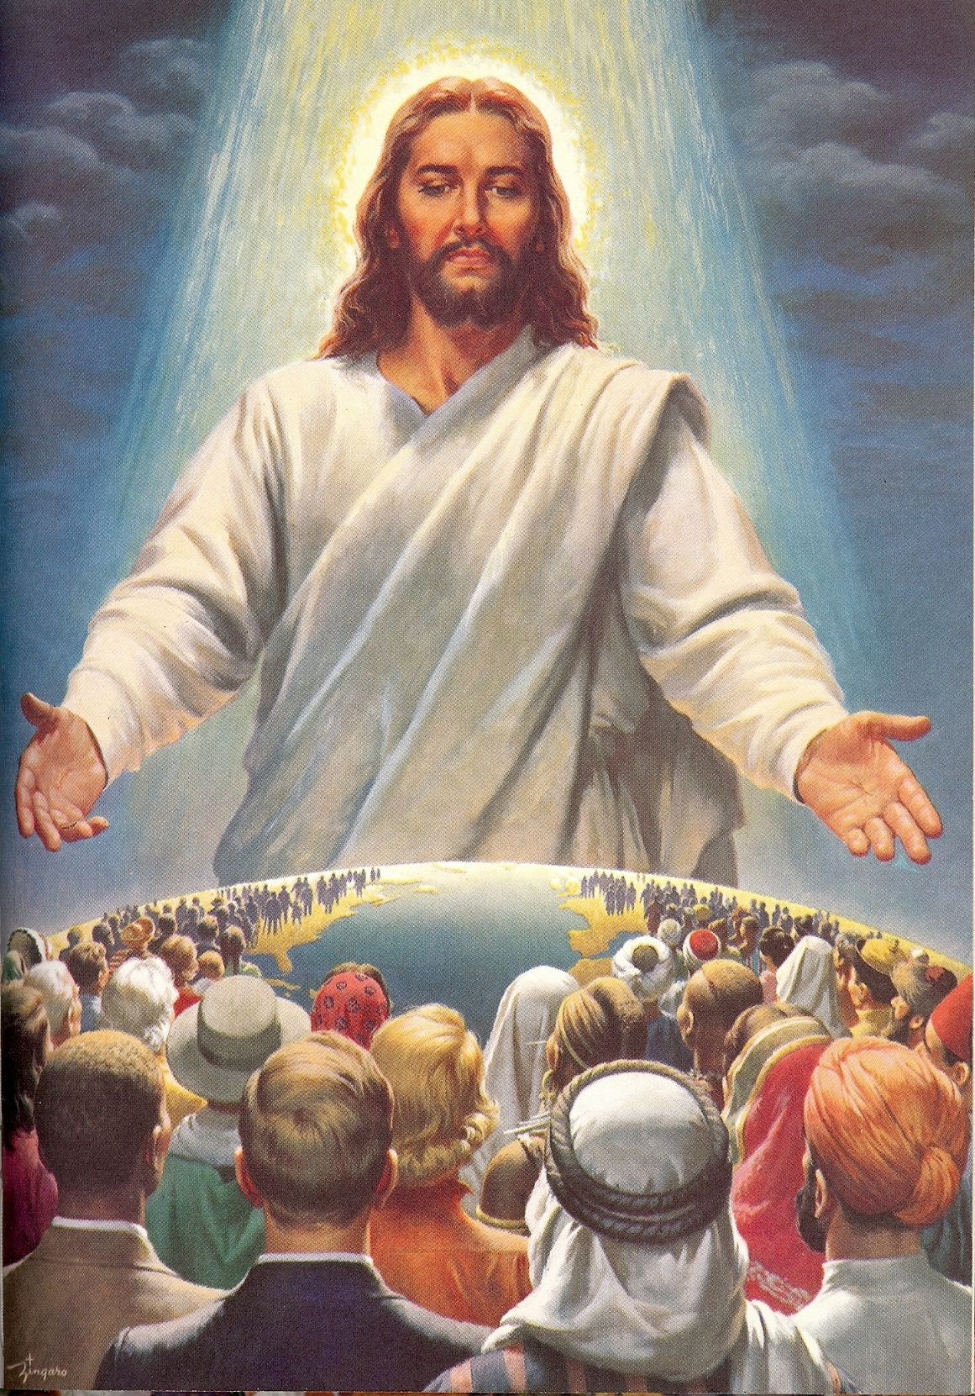
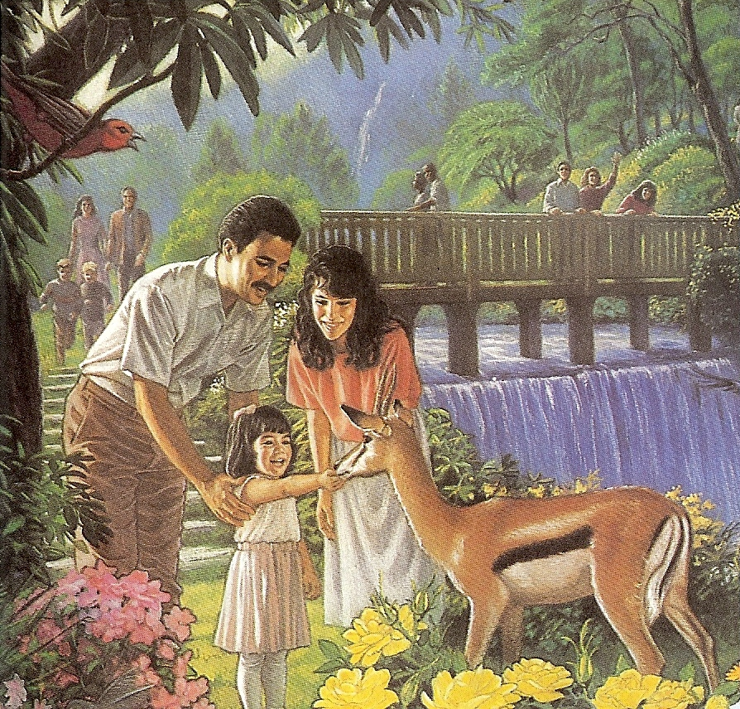
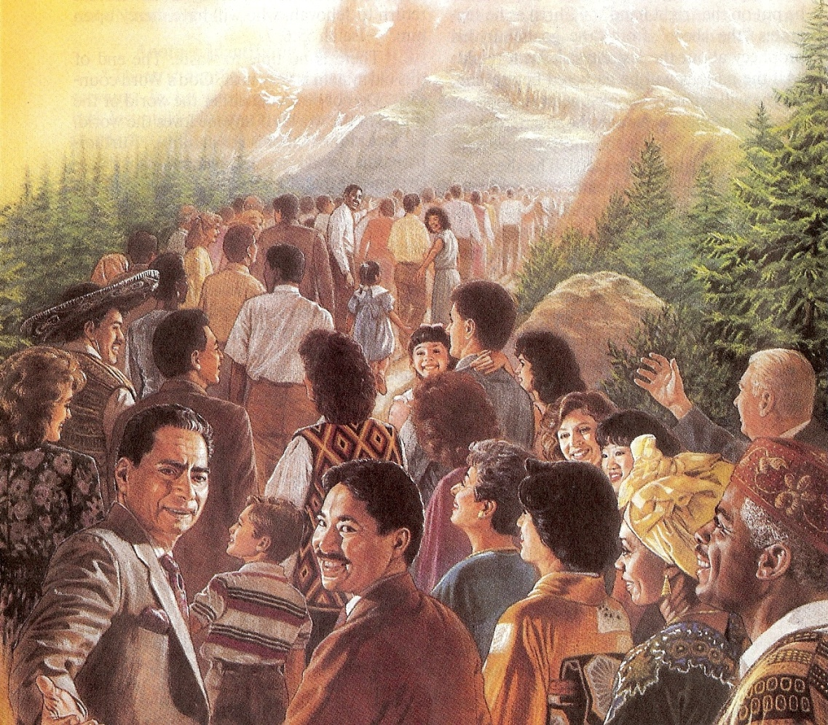
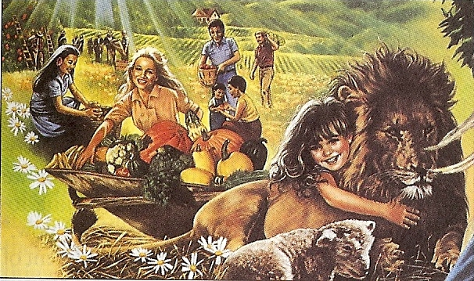

Slide 25
Revelation 16:12-16

Slide 26
“And the sixth angel poured out his vial upon the great river Euphrates; and the water thereof was dried up, that the way of the kings of the east might be prepared. And I saw three unclean spirits like frogs come out of the mouth of the dragon, and out of the mouth of the beast, and out of the mouth of the false prophet. For they are the spirits of devils, working miracles, which go forth unto the kings of the earth and of the whole world, to gather them to the battle of that great day of God Almighty.”

Slide 27
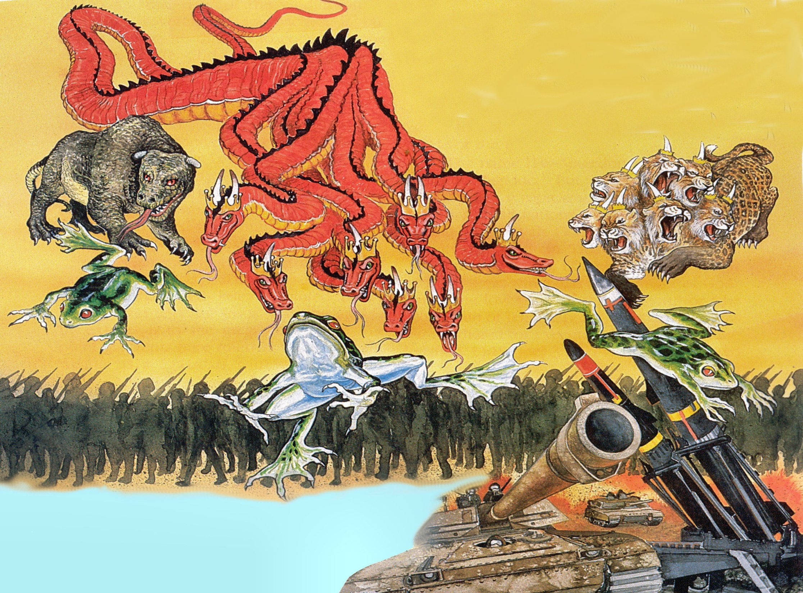

Slide 28
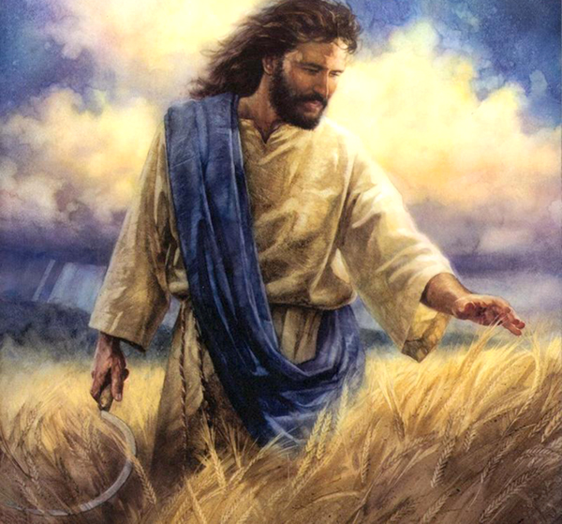
“Assemble yourselves, and come, all ye heathen, and gather yourselves together round about: thither cause thy mighty ones to come down, O LORD. Let the heathen be wakened, and come up to the valley of Jehoshaphat: for there will I sit to judge all the heathen round about. Put ye in the sickle, for the harvest is ripe: come, get you down; for the press is full, the vats overflow; for their wickedness is great.

Slide 29
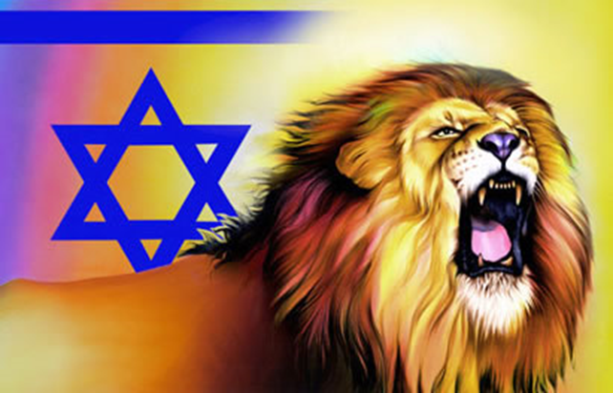
Multitudes, multitudes in the valley of decision: for the day of the LORD is near in the valley of decision. The sun and the moon shall be darkened, and the stars shall withdraw their shining. The LORD also shall roar out of Zion, and utter his voice from Jerusalem; and the heavens and the earth shall shake: but the LORD will be the hope of his people, and the strength of the children of Israel.” (Joel 3:11-16)

Slide 30
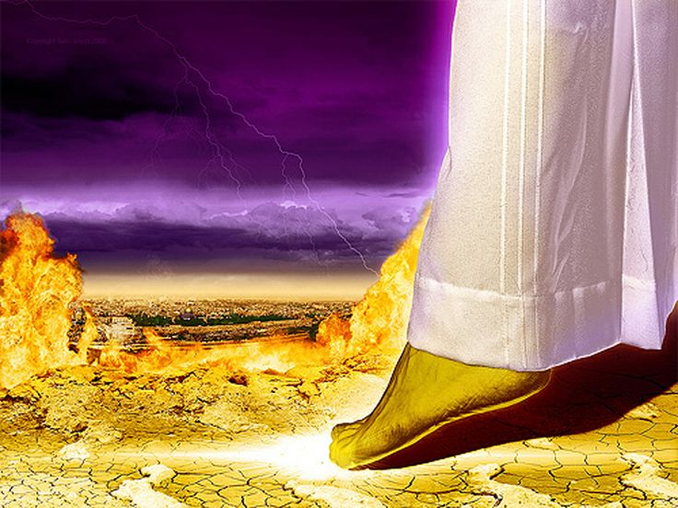
“And his feet shall stand in that day upon the mount of Olives, which is before Jerusalem on the east, and the mount of Olives shall cleave in the midst thereof toward the east and toward the west, and there shall be a very great valley; and half of the mountain shall remove toward the north, and half of it toward the south.” (Zechariah 14:4)

Slide 31
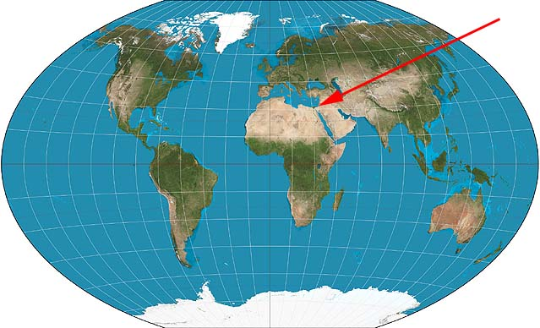

Slide 32
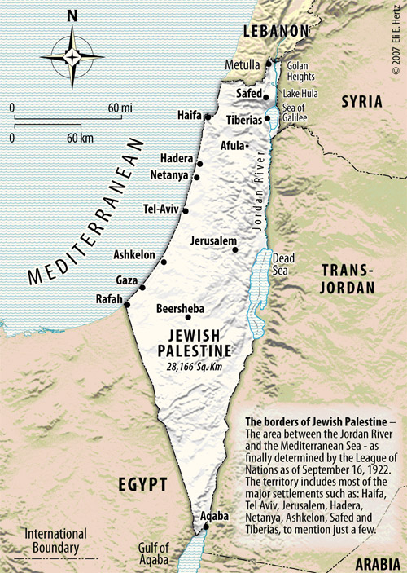

Slide 33
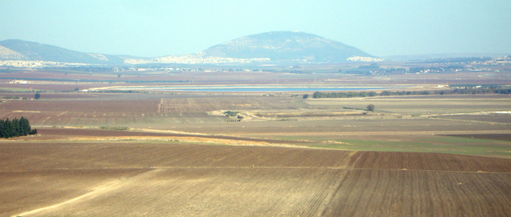
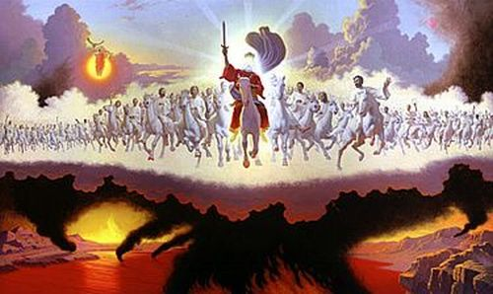

Slide 34
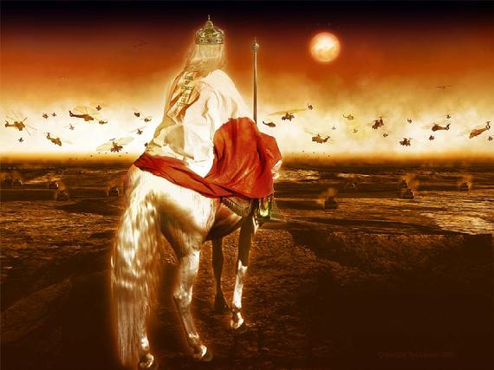
“The kings of the earth set themselves, and the rulers take counsel together, against the LORD, and against his anointed, saying, Let us break their bands asunder, and cast away their cords from us. He that sitteth in the heavens shall laugh: the Lord shall have them in derision. Then shall he speak unto them in his wrath, and vex them in his sore displeasure. Yet have I set my king upon my holy hill of Zion. I will declare the decree…Thou shalt break them with a rod of iron; thou shalt dash them in pieces like a potter's vessel. Be wise now therefore, O ye kings: be instructed, ye judges of the earth…Blessed are all they that put their trust in him.” (Psalms 2:2-12)

Slide 35
Revelation 19:11-21

Slide 36
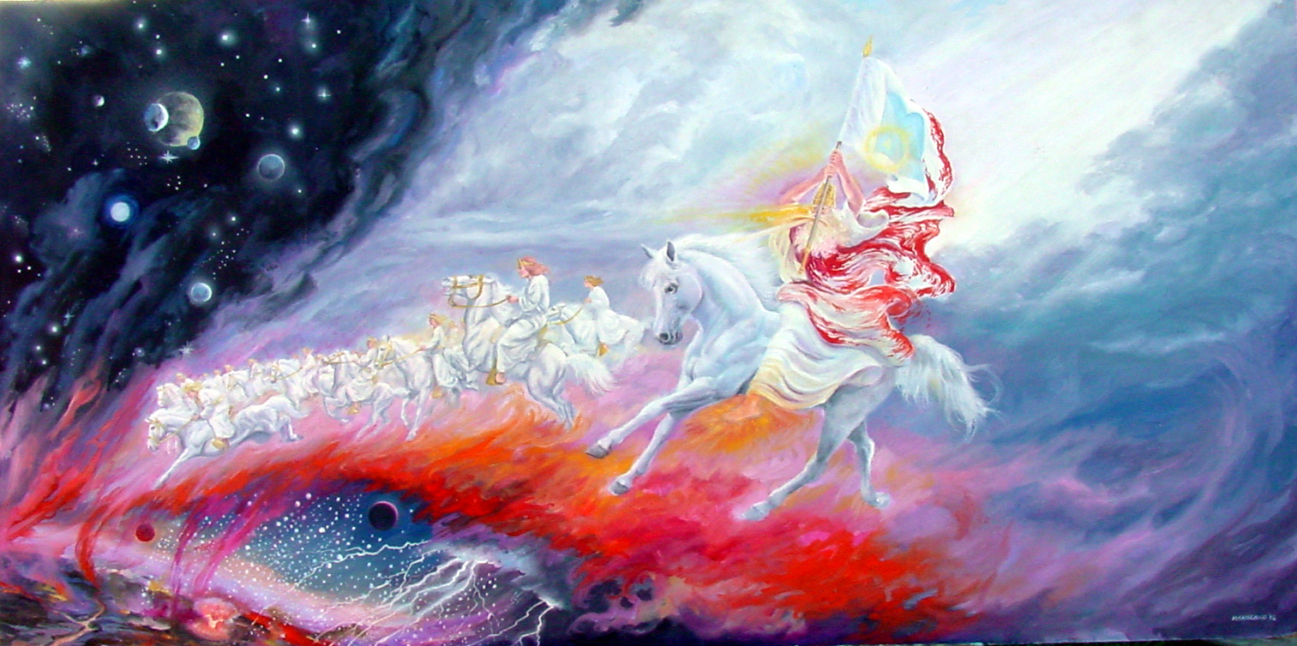

Slide 37
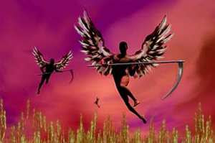
(Revelation 14:19) “And the angel thrust in his sickle into the earth, and gathered the vine of the earth, and cast it into the great winepress of the wrath of God.”

Slide 38
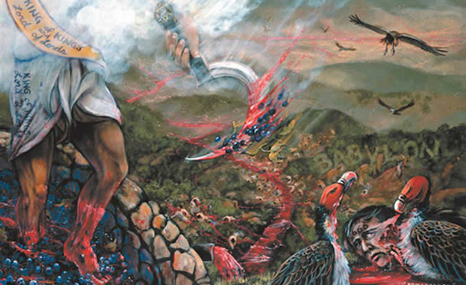

Slide 39
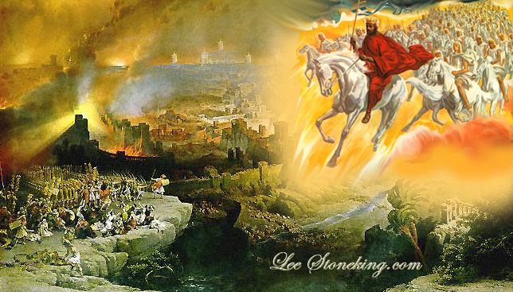
“And he gathered them together into a place called in the Hebrew tongue Armageddon.”

Slide 40
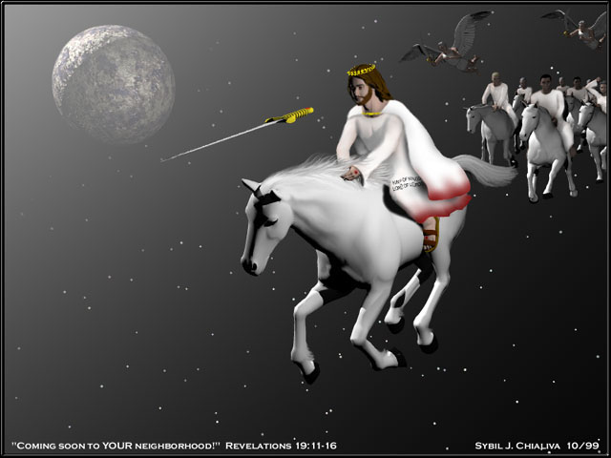

Slide 41
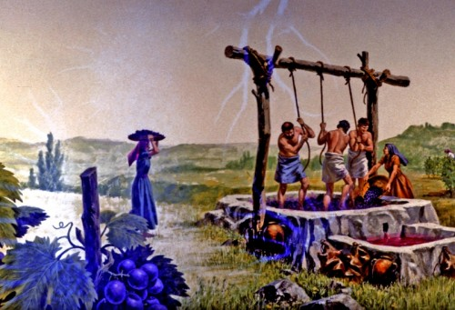
“And the winepress was trodden without the city, and blood came out of the winepress, even unto the horse bridles, by the space of a thousand and six hundred furlongs (184 miles).” (Revelation 14:20)

Slide 42
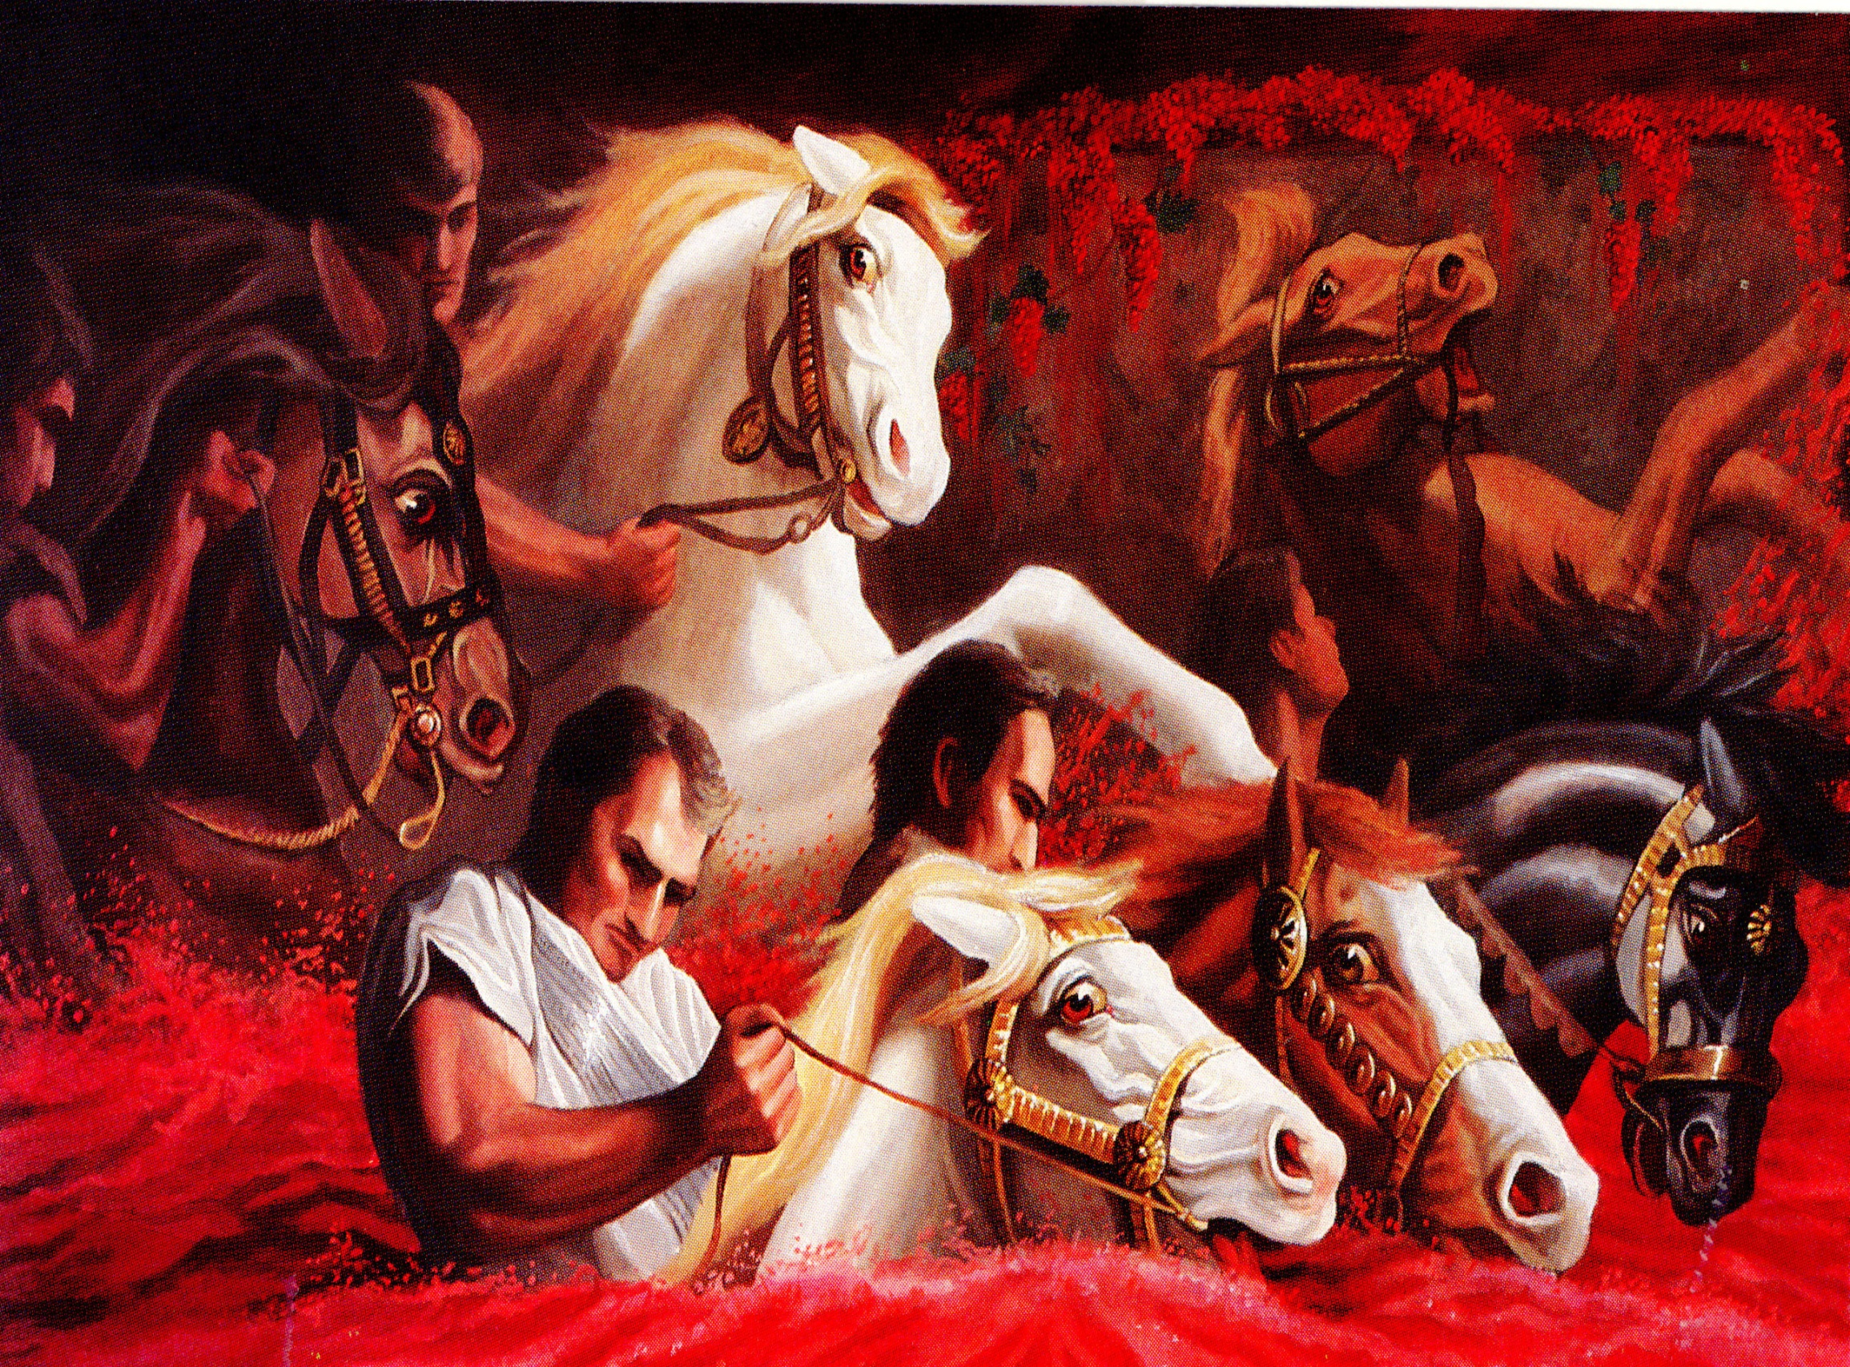

Slide 43
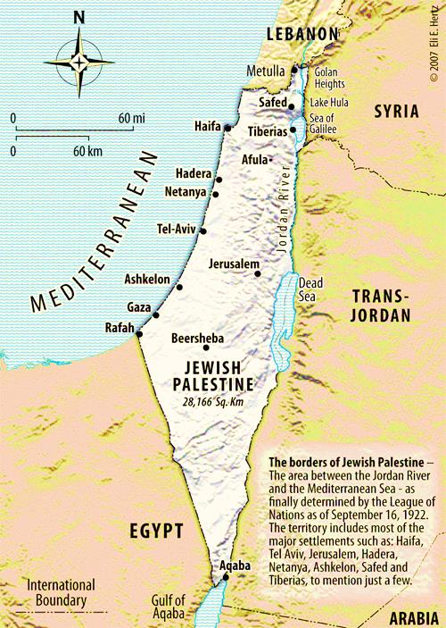
(184 miles)

Slide 44
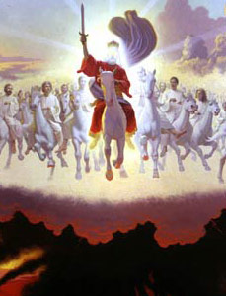
(Revelation 19:21)
“And the remnant were slain with the sword of him that sat upon the horse, which sword proceeded out of his mouth: and all the fowls were filled with their flesh.”

Slide 45
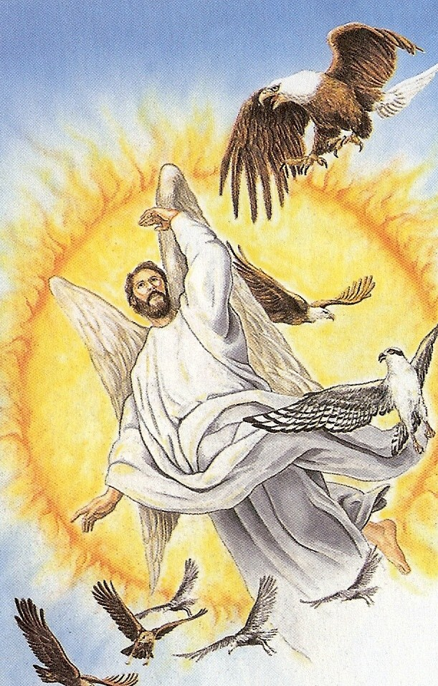

Slide 46
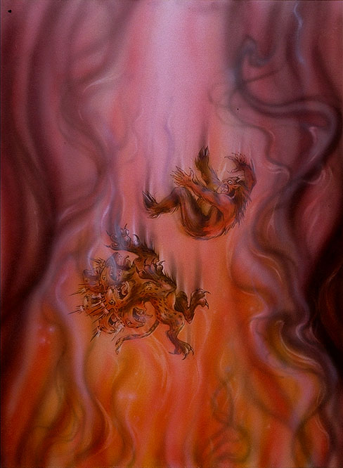
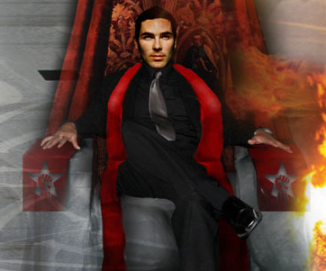
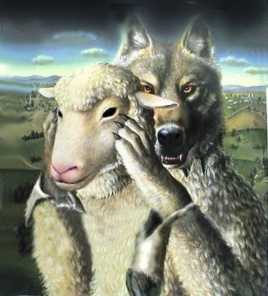
“And the beast was taken, and with him the false prophet that wrought miracles before him, with which he deceived them that had received the mark of the beast, and them that worshipped his image. These both were cast alive into a lake of fire burning with brimstone.”

Slide 47
The Harvest “Hell or the Kingdom?”

Slide 48
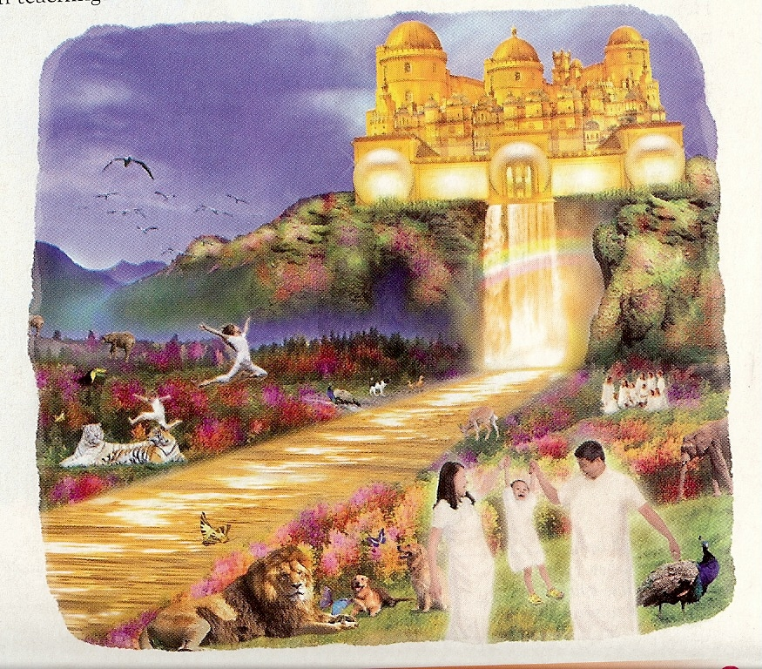
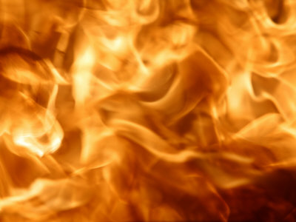
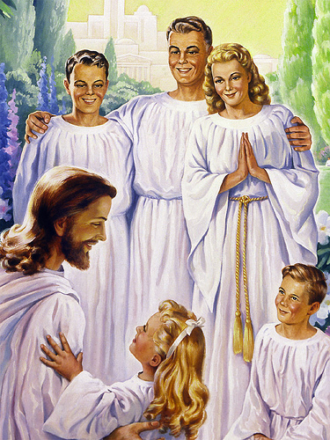
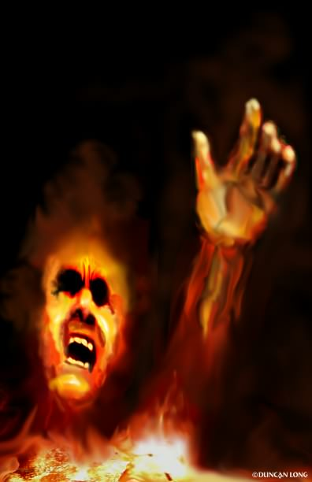

Slide 49
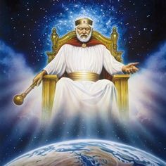
Matt. 3:2 “And saying, Repent ye: for the kingdom of heaven is at hand.”
Matt. 6:10 “Thy kingdom come. Thy will be done in earth, as it is in heaven.”
Luke 17:21 “Neither shall they say, Lo here! or, lo there! for, behold, the kingdom of God is within you.”

