Slide 1
The Revelation of Jesus Christ
A study of the book
of Revelation

Slide 2
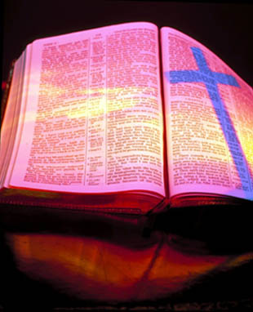
Revelation 14:1-13
“The harvest of the earth and the wrath and mercy of God”

Slide 3
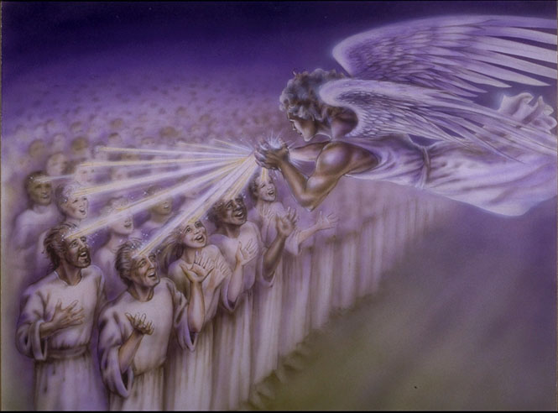
“And I looked, and, lo, a Lamb stood on the mount Sion, and with him an hundred forty and four thousand, having his Father's name written in their foreheads.”

Slide 4
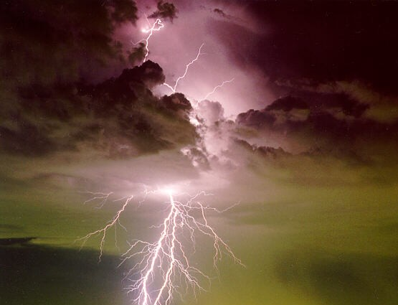
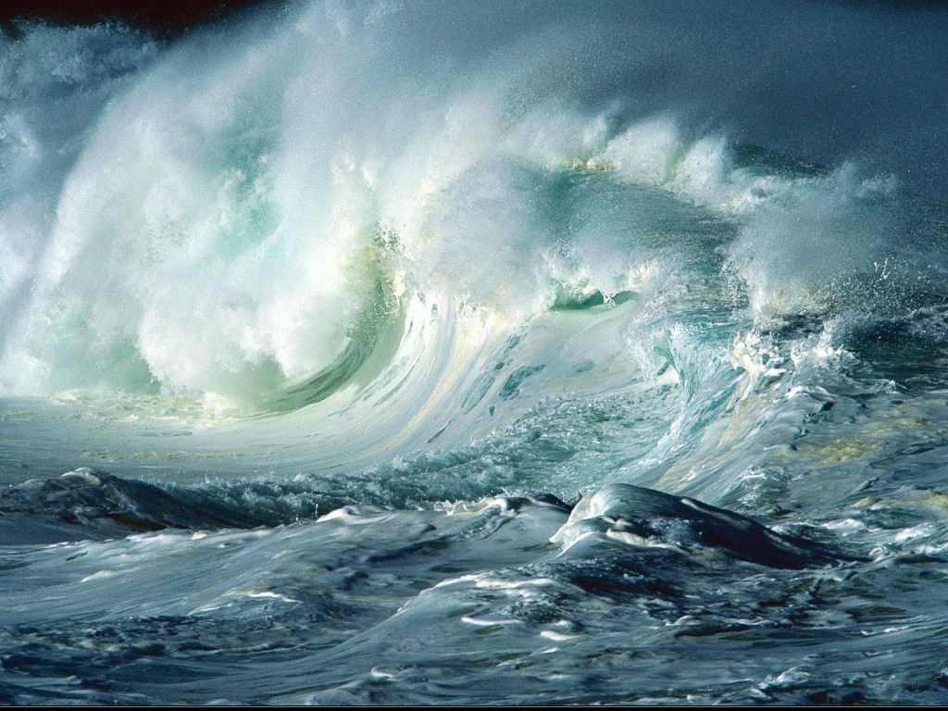
“And I heard a voice from heaven, as the voice of many waters, and as the voice of a great thunder.”

Slide 5
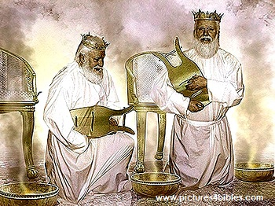
“…and I heard the voice of harpers harping with their harps.”

Slide 6
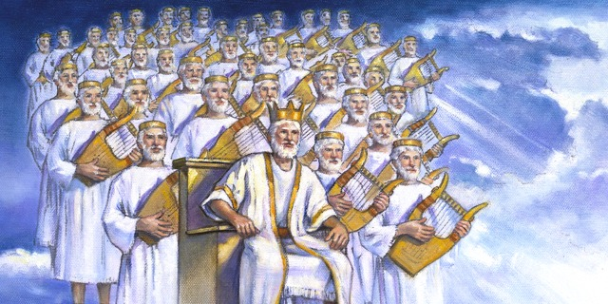
“And they sung as it were a new song before the throne, and before the four beasts, and the elders: and no man could learn that song but the hundred and forty and four thousand, which were redeemed from the earth.”

Slide 7
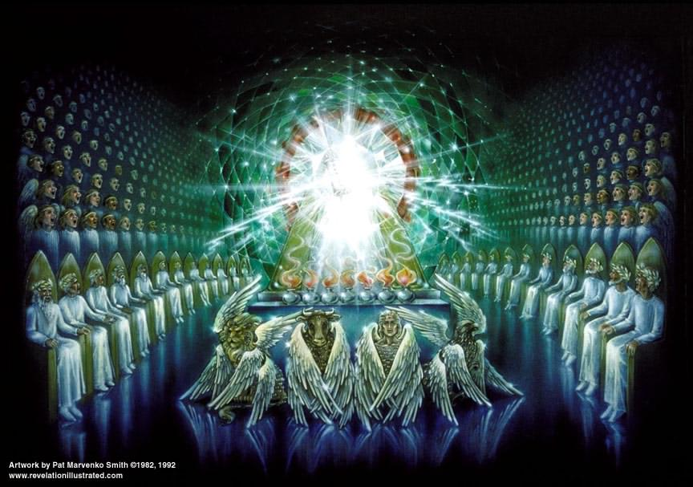

Slide 8
Who are these men from the Twelve Tribes of Israel?
Men who have received Christ as Lord and personal Savior after the rapture of the church – II Thessalonians 2:10-12
Men who have refused the mark of the beast – Revelation 20:4-6
Men who compose a special body of Jewish believers – 12 thousand from each tribe
Men who are called the servants of God – Revelation 7:3
Men who are dedicated to serve the Lord Jesus Christ totally during the tribulation period -

Slide 9
Spiritual men who are morally pure – Revelation 14:1, 4-5
They are redeemed
They are the “first fruits” to be saved
They possess the seal of God on their foreheads
They are virgins
They follow the Lamb of God where ever He leads them “The righteous are as bold as a lion”
No guile (deceit) is found in their mouth
They are without fault before God

Slide 10
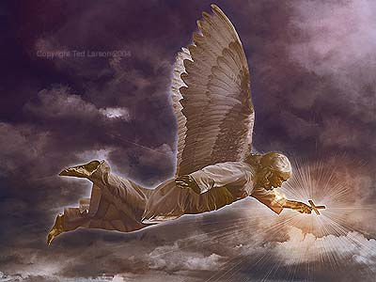
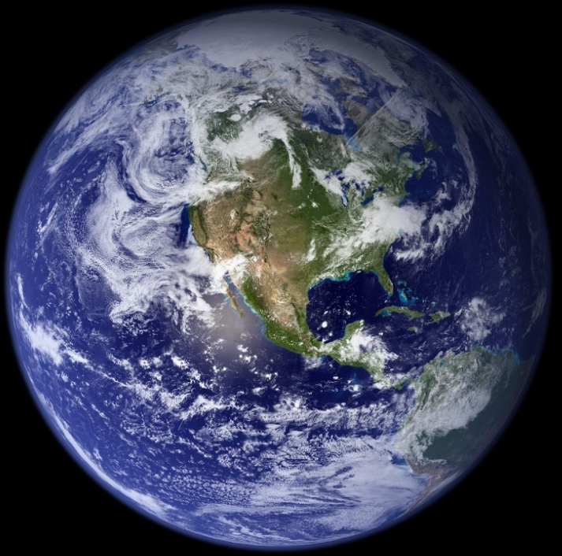
“And I saw another angel fly in the midst of heaven, having the everlasting gospel to preach unto them that dwell on the earth, and to every nation, and kindred, and tongue, and people.”

Slide 11
“Saying with a loud voice, Fear God, and give glory to him; for the hour of his judgment is come: and worship him that made heaven, and earth, and the sea, and the fountains of waters.”

Slide 12
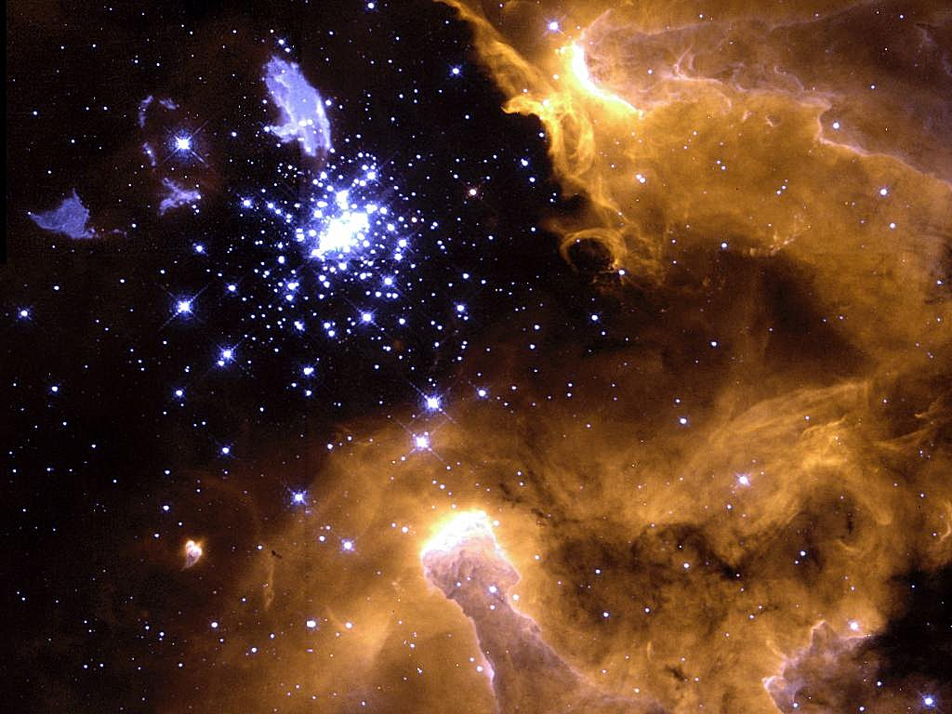
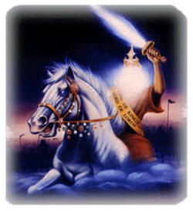
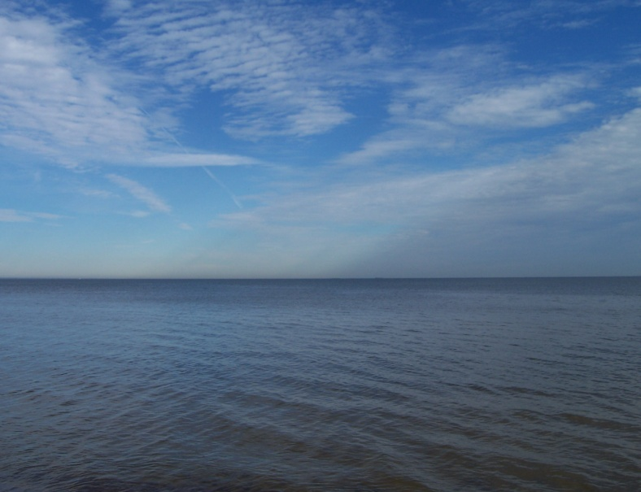
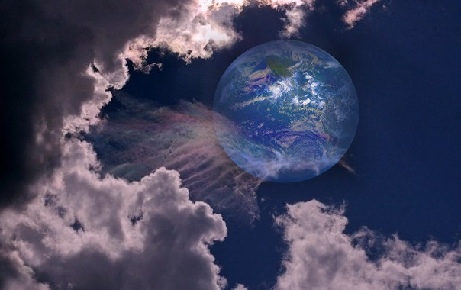
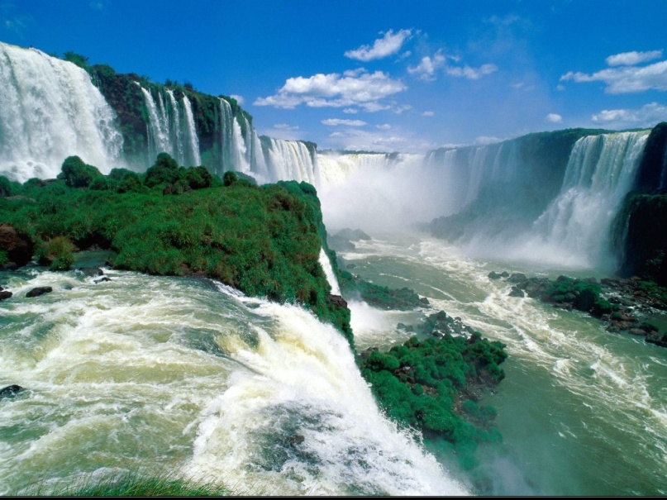

Slide 13
“In the beginning God created the heaven and the earth.”
“So God created man in his own image.”
“For by him were all things created, that are in heaven, and that are in earth, visible and invisible, whether they be thrones, or dominions, or principalities, or powers: all things were created by him, and for him.”
“Thus saith God the LORD, he that created the heavens, and stretched them out; he that spread forth the earth, and that which cometh out of it; he that giveth breath unto the people upon it, and spirit to them that walk therein.”
“Who created heaven, and the things that therein are, and the earth, and the things that therein are, and the sea, and the things which are therein.”
“For thou hast created all things
“The beginning of the creation which God created.”

Slide 15
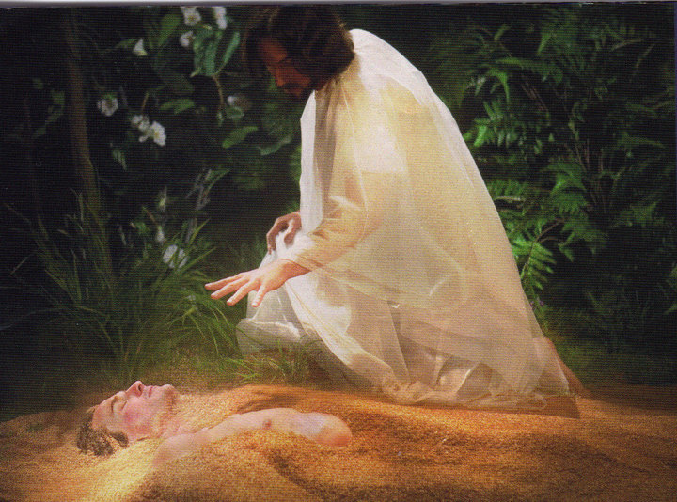

Slide 16
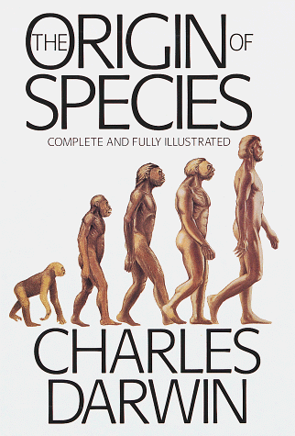
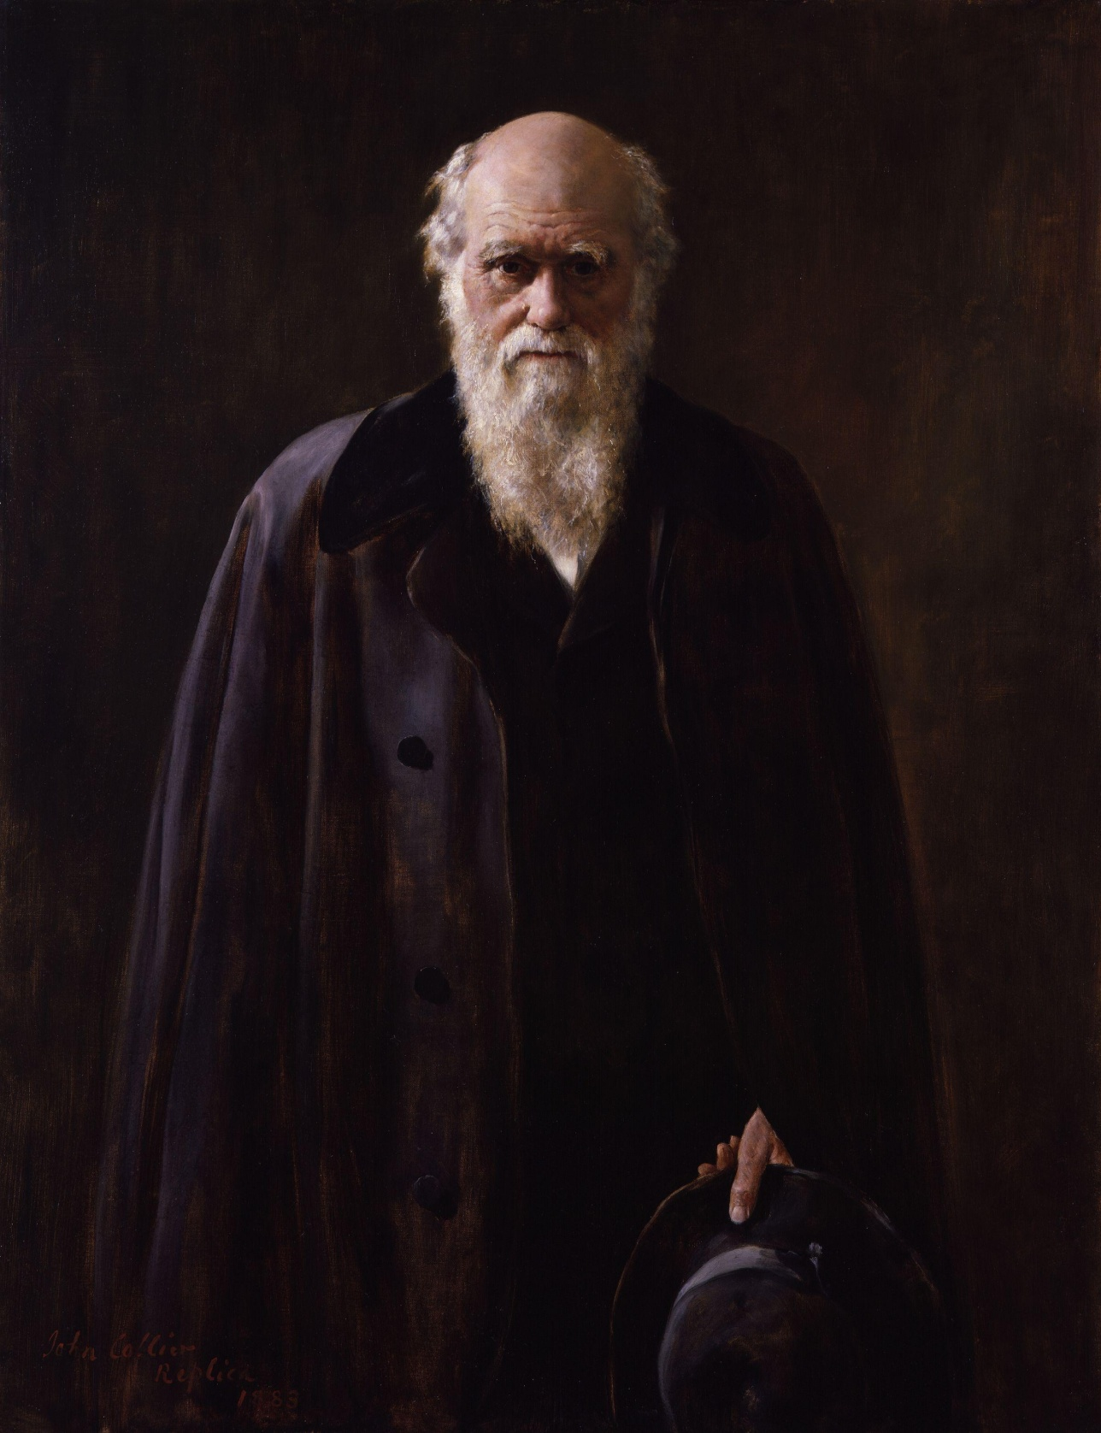

Slide 17
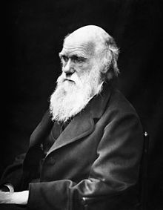
I have never been an atheist in the sense of denying the existence of a god, and that generally "an Agnostic would be the more correct description of my state of mind. For myself, I do not believe that there ever has been any revelation. As for a future life, every man must judge for himself between conflicting vague probabilities."

Slide 18
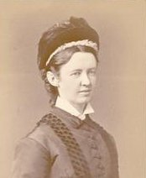
Elizabeth Cotton
THE LADY HOPE "STORY"

Slide 19
It was one of those glorious autumn afternoons, that we sometimes enjoy in England, when I was asked to go in and sit with the well known professor, Charles Darwin. He was almost bedridden for some months before he died. I used to feel when I saw him that his fine presence would make a grand picture for our Royal Academy; but never did I think so more strongly than on this particular occasion. He was sitting up in bed, wearing a soft embroidered dressing gown, of rather a rich purple shade. Propped up by pillows, he was gazing out on a far-stretching scene of woods and cornfields, which glowed in the light of one of those marvelous sunsets. His noble forehead and fine features seem to be lit up with pleasure as I entered the room.

Slide 20
He waved his hand toward the window as he pointed out the scene beyond, while in the other hand he held an open Bible, which he was always studying. "What are you reading now?" I asked as I seated myself beside his bedside. "Hebrews!" he answered - "still Hebrews. 'The Royal Book' I call it. Isn't it grand?" Then, placing his finger on certain passages, he commented on them. I made some allusions to the strong opinions expressed by many persons on the history of the Creation, its grandeur, and then their treatment of the earlier chapters of the Book of Genesis.

Slide 21
He seemed greatly distressed, his fingers twitched nervously, and a look of agony came over his face as he said: "I was a young man with unformed ideas. I threw out queries, suggestions, wondering all the time over everything, and to my astonishment, the ideas took like wildfire. People made a religion of them."

Slide 22
Then he paused, and after a few more sentences on "the holiness of God" and the "grandeur of this book," looking at the Bible which he was holding tenderly all the time, he suddenly said: "I have a summer house in the garden which holds about thirty people. It is over there," pointing through the open window. "I want you very much to speak there. I know you read the Bible in the villages. To-morrow afternoon I should like the servants on the place, some tenants and a few of the neighbors; to gather there. Will you speak to them?"

Slide 23
"What shall I speak about?" I asked. "Christ Jesus!" he replied in a clear, emphatic voice, adding in a lower tone, "and his salvation. Is not that the best theme? And then I want you to sing some hymns with them. You lead on your small instrument, do you not?" The wonderful look of brightness and animation on his face as he said this I shall never forget, for he added: "If you take the meeting at three o'clock this window will be open, and you will know that I am joining in with the singing." How I wished I could have made a picture of the fine old man and his beautiful surroundings on that memorable day!

Slide 24
“Saying with a loud voice, Fear God, and give glory to him; for the hour of his judgment is come: and worship him that made heaven, and earth, and the sea, and the fountains of waters.”

Slide 25
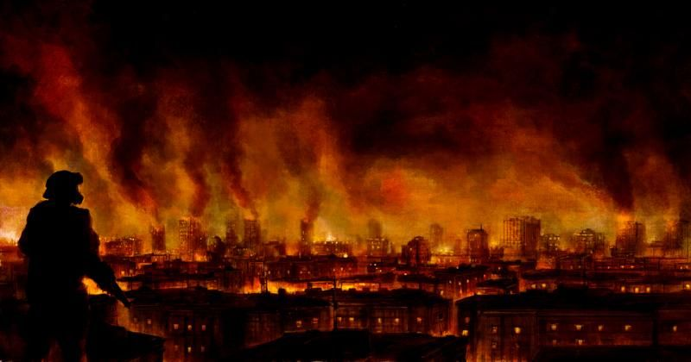
“And there followed another angel, saying, Babylon is fallen, is fallen, that great city.”

Slide 26
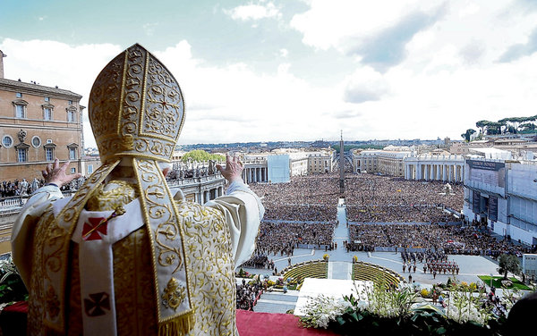
“…because she made all nations drink of the wine of the wrath of her fornication.”

Slide 27
Babylon Identified (Revelation 17:1-18)

Slide 28
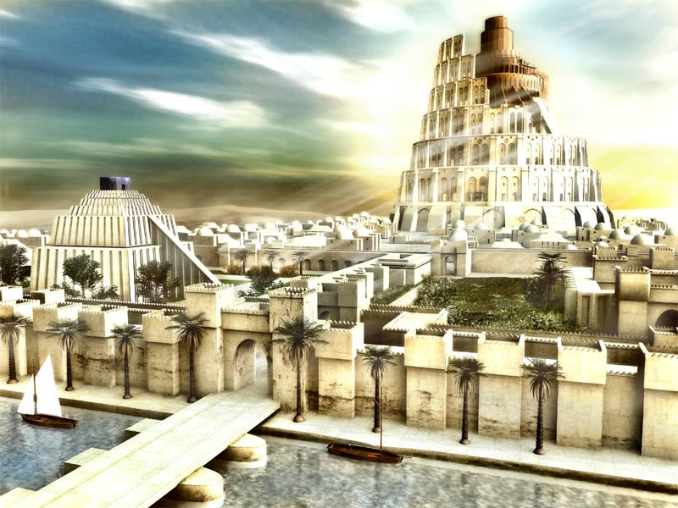
“Mystery, Babylon the Great” .

Slide 29
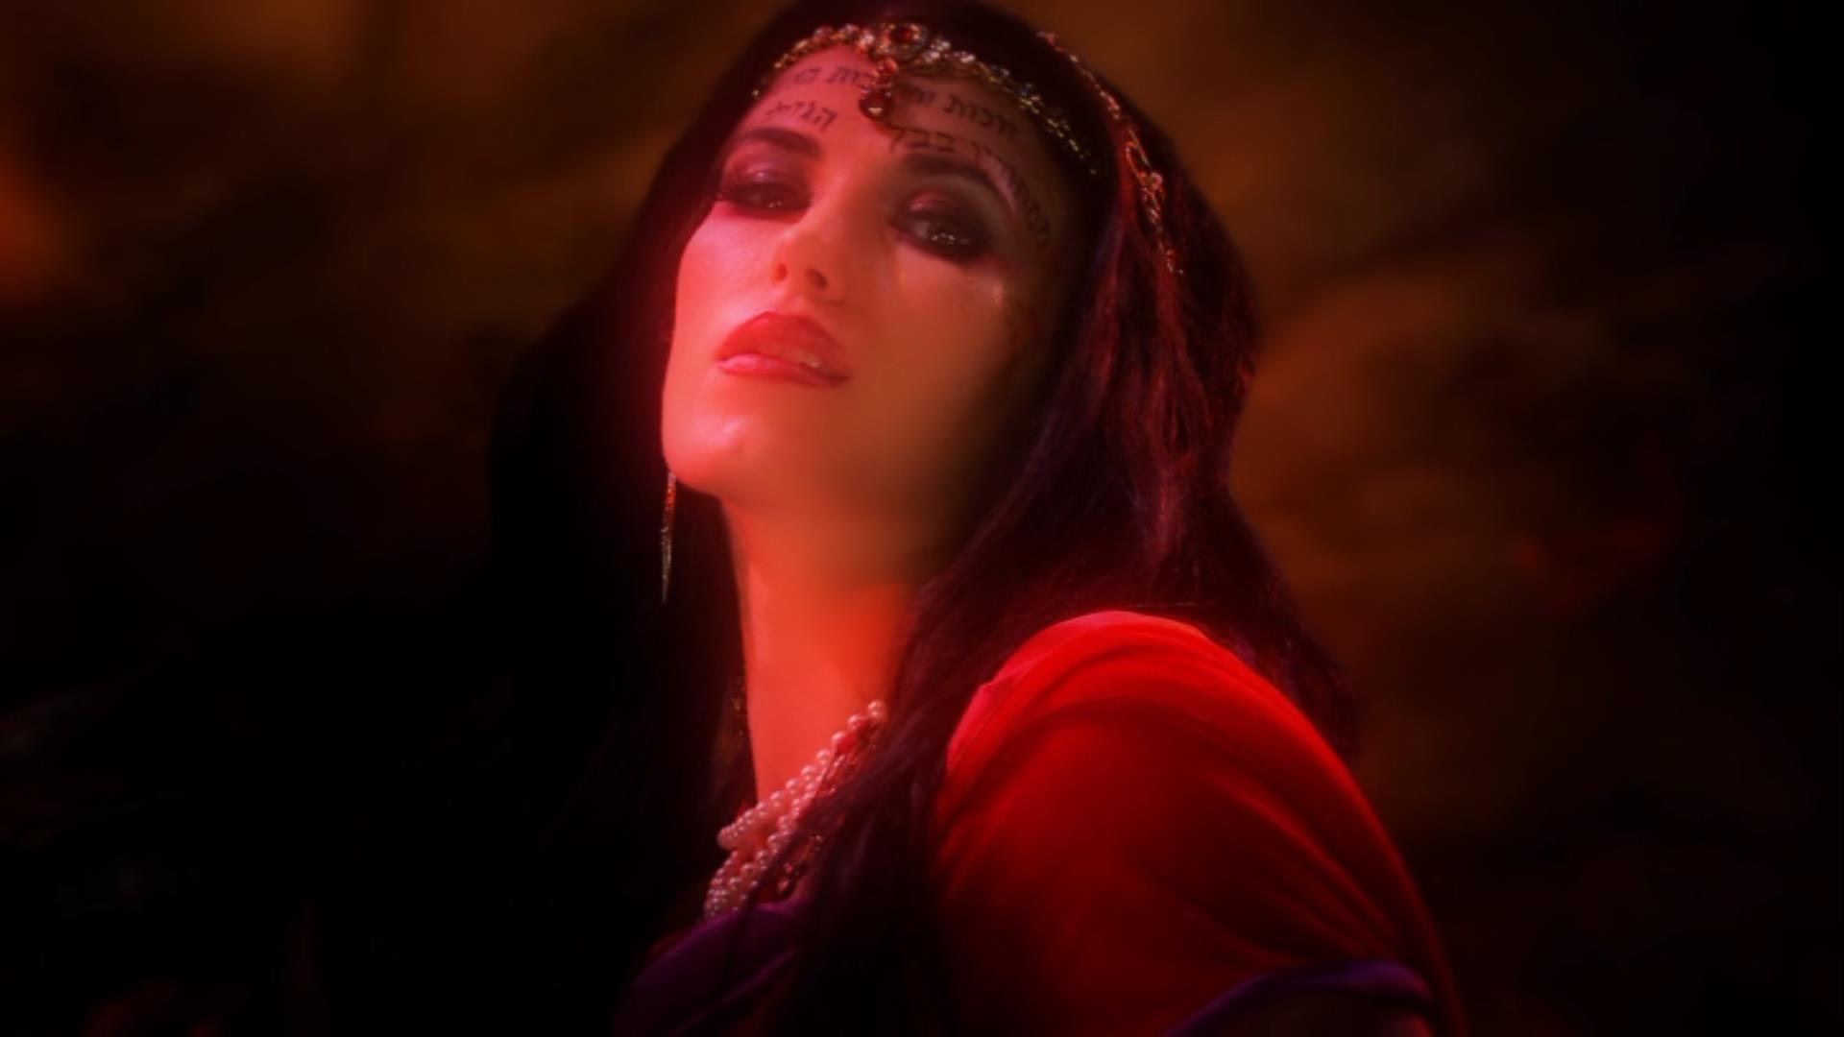
“And upon her forehead was a name written, Mystery, Babylon the Great, the Mother of Harlots and Abominations of the Earth.”

Slide 30
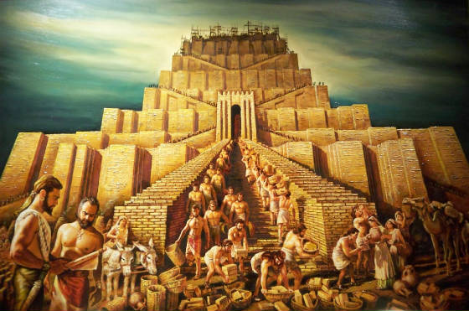
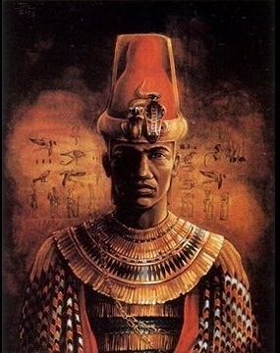
Nimrod And The Tower Of Babel

Slide 31
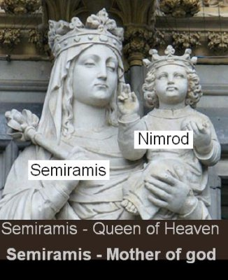
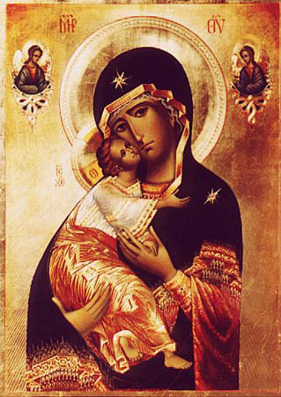
Nimrod Rebellion against God To Revolt against God

Slide 32
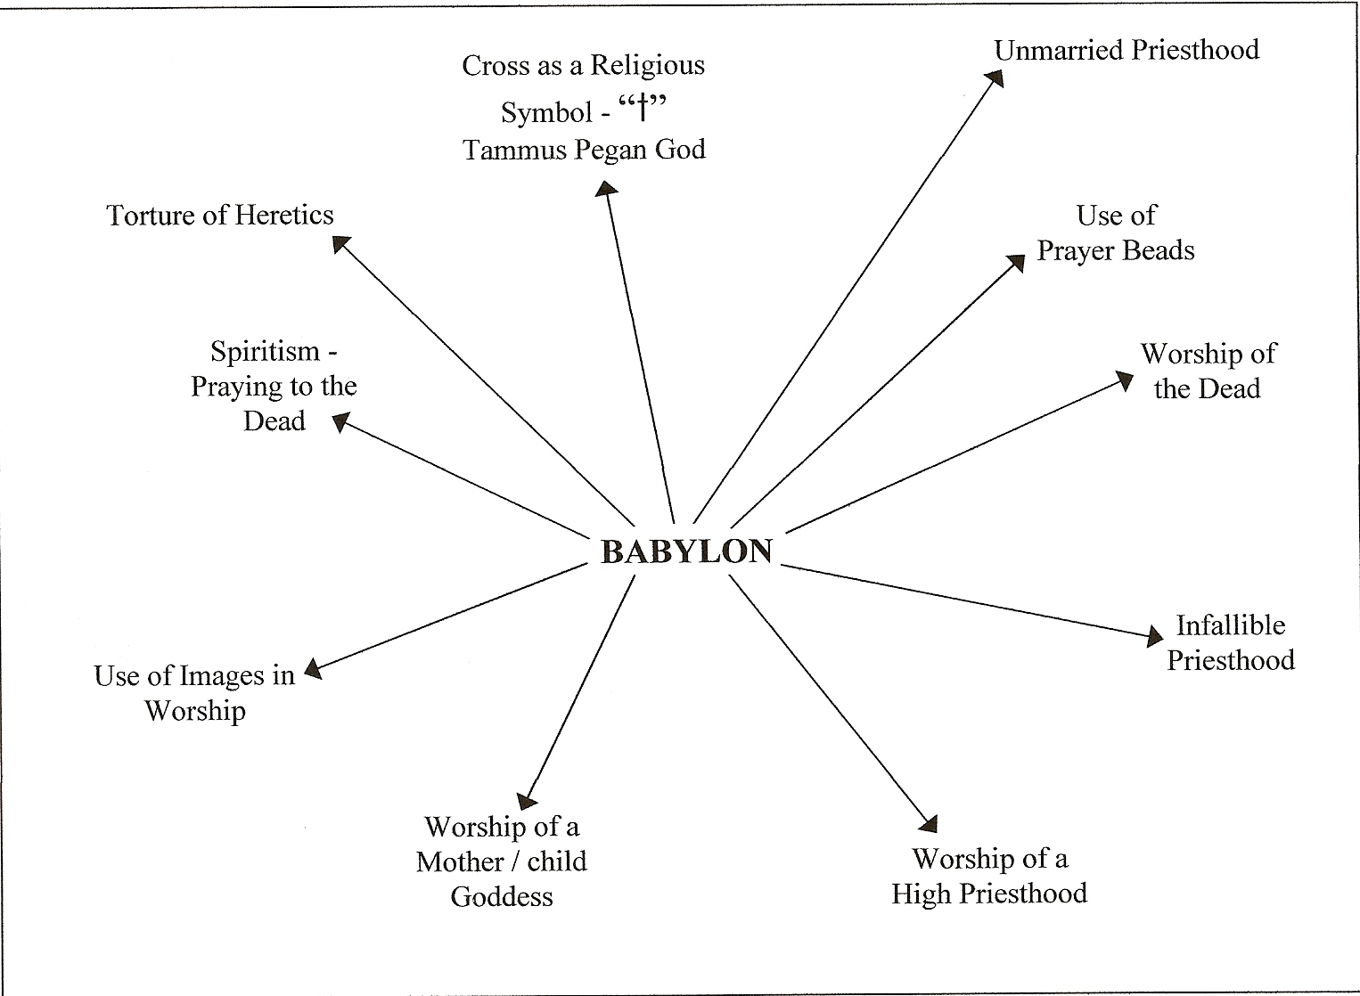
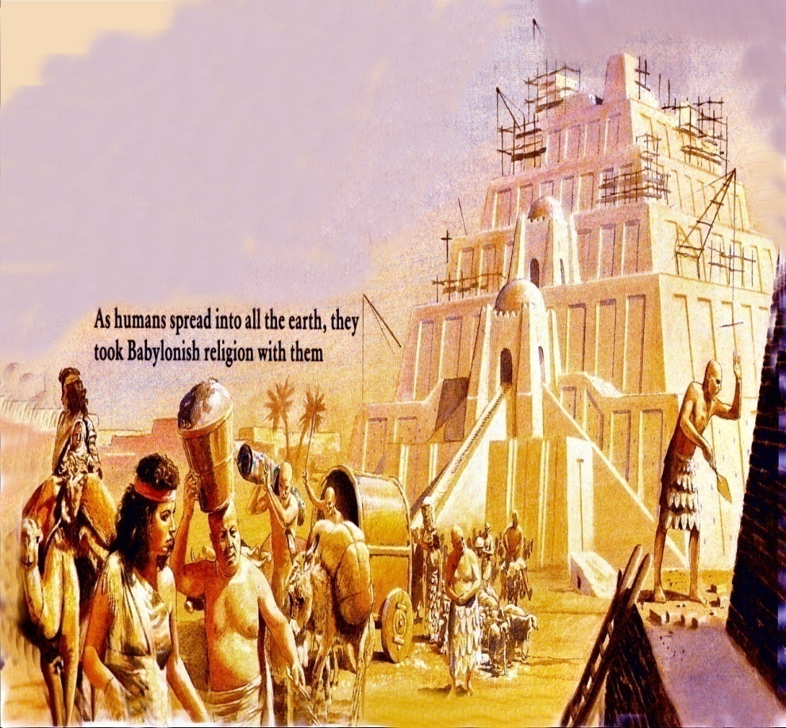

Slide 33
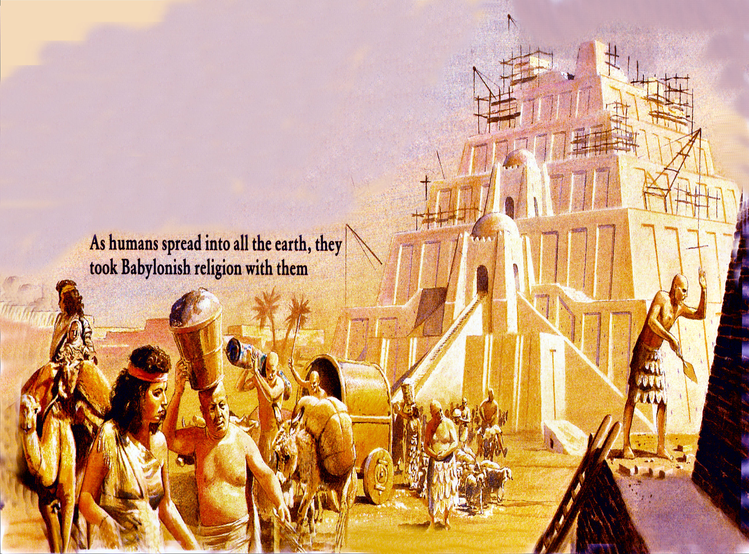

Slide 34
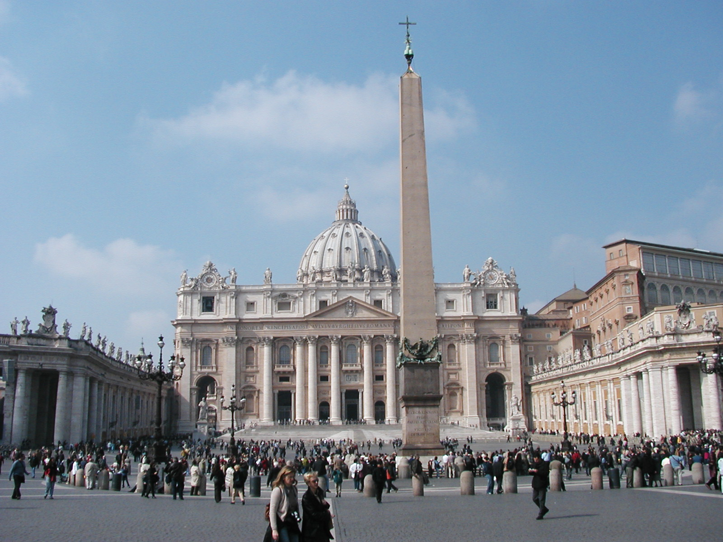
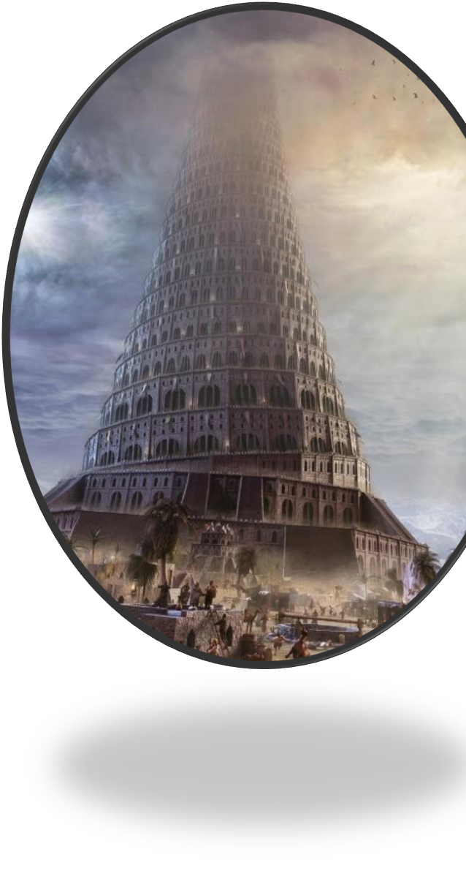
Obelisk in front of Saint Peter's Basilica

Slide 35
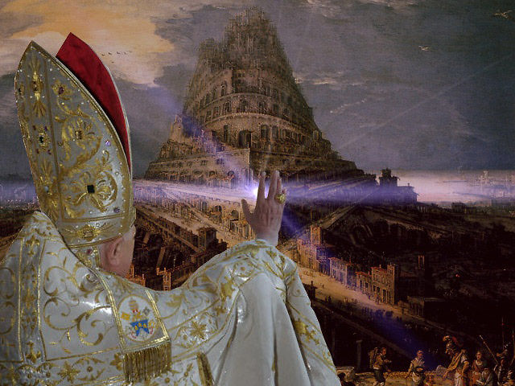
MYSTERY, BABYLON THE GREAT, THE MOTHER OF HARLOTS AND ABOMINATIONS OF THE EARTH

Slide 36
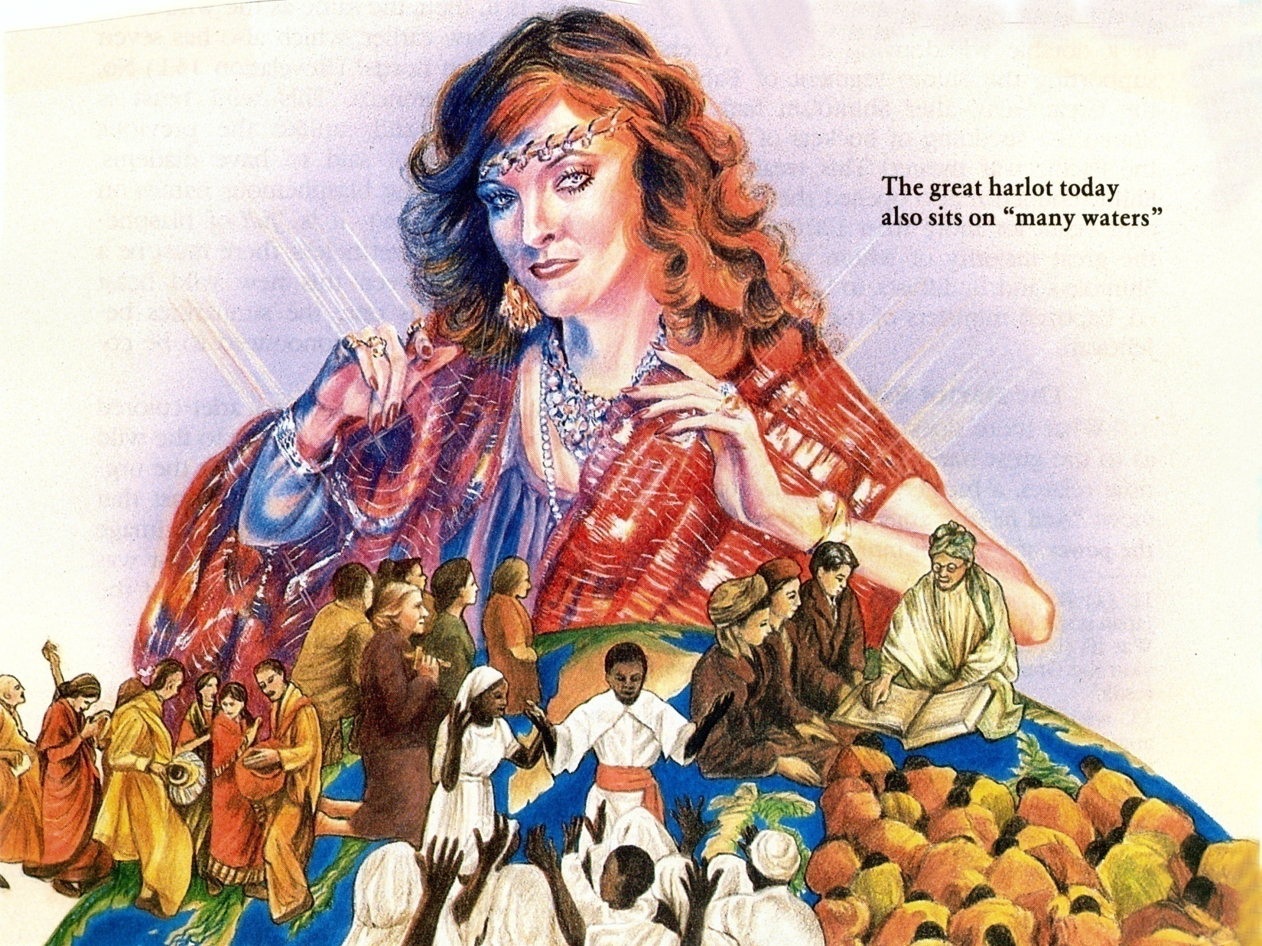
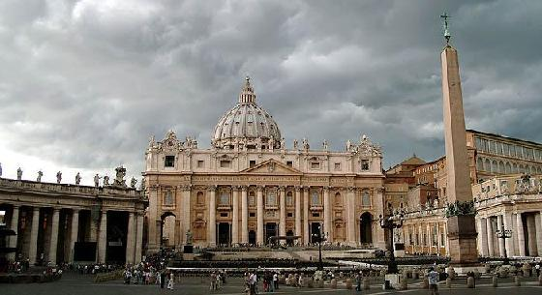
“And he said unto me, the waters which thou sawest, where the whore sitteth, and peoples, and multitudes, and nations and tongues.”
Catholic = Universal

Slide 37
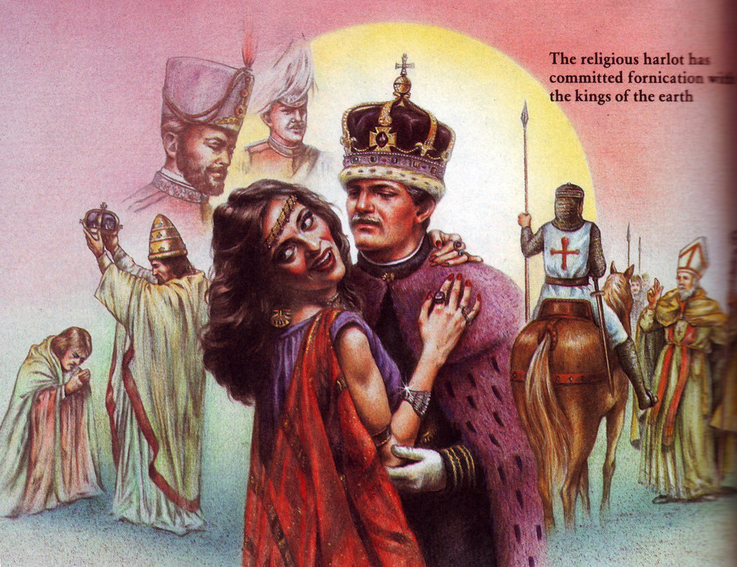
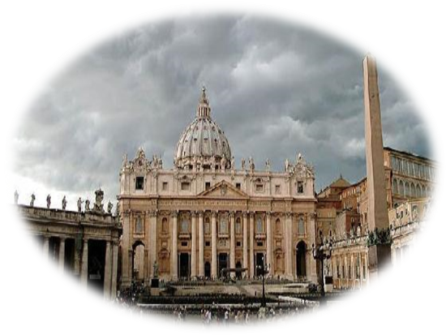
“With whom the kings of the earth have committed fornication…”

Slide 38
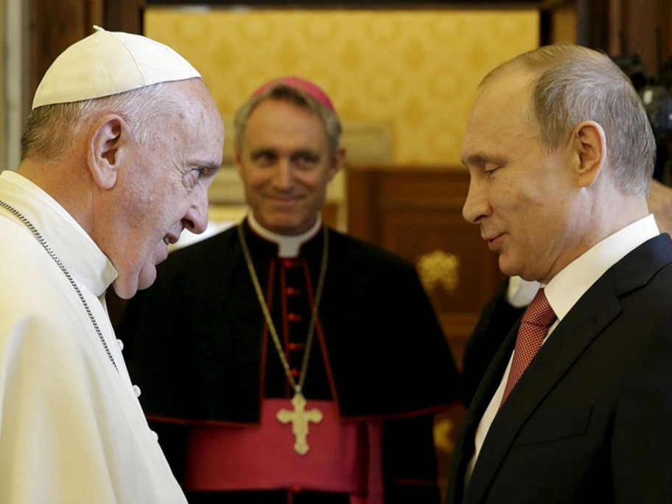
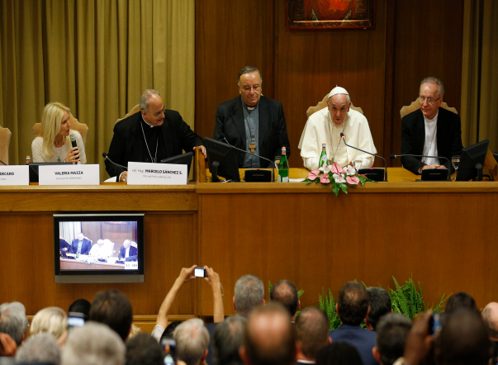
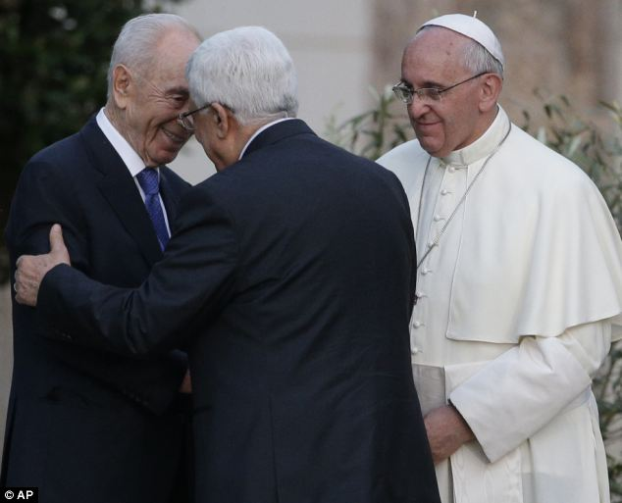
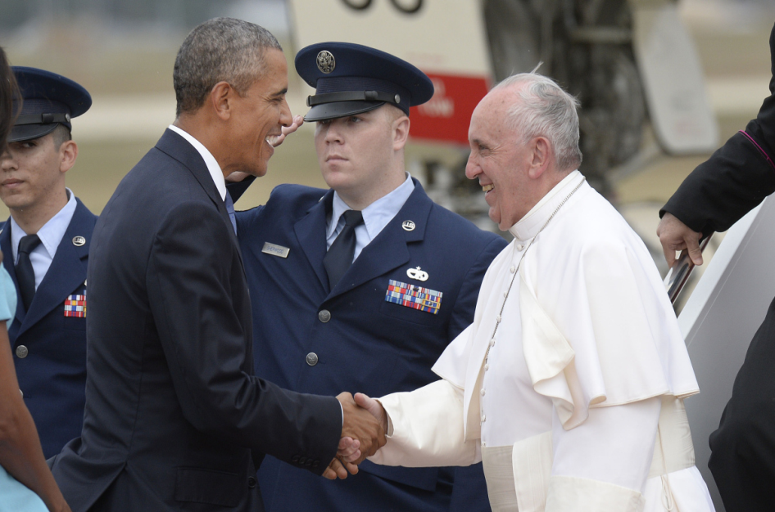
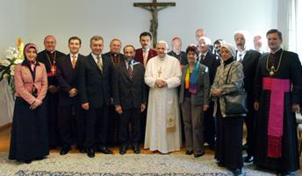
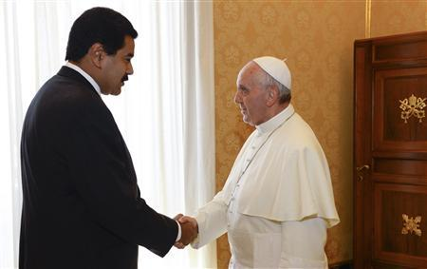
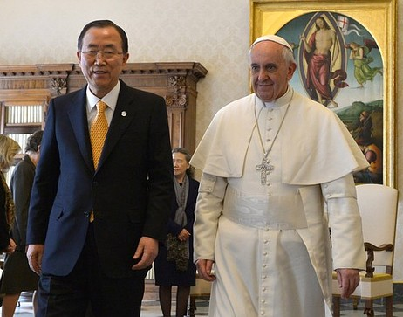
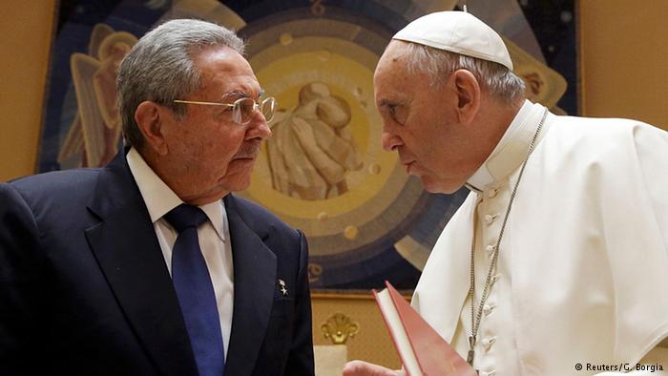
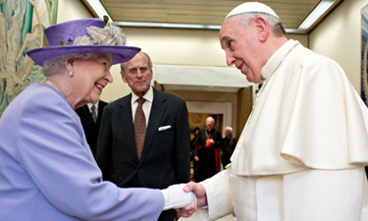
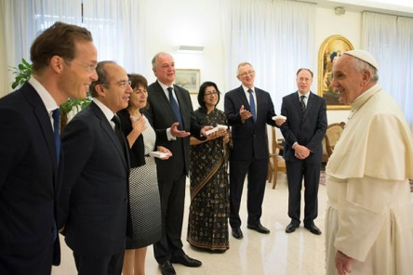

Slide 39
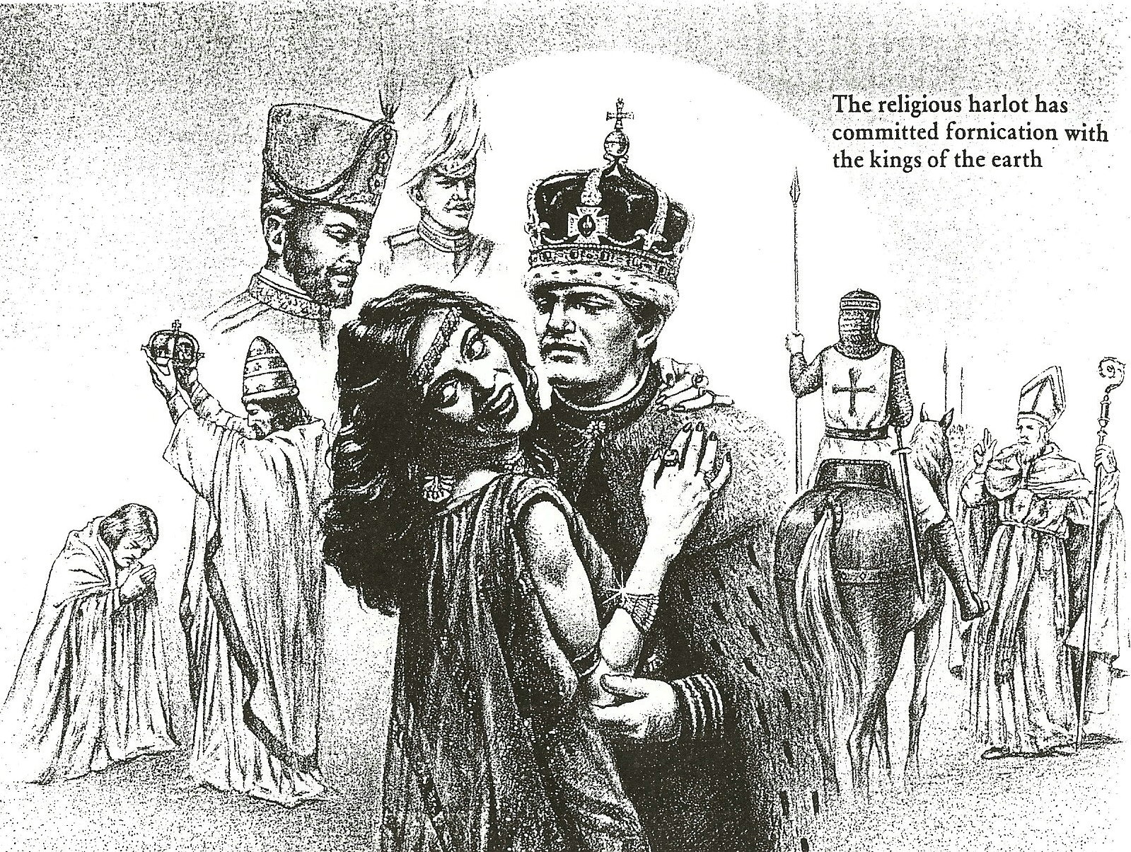
“…and the inhabitants of the earth have been made drunk with the wine of her fornication.”

Slide 40
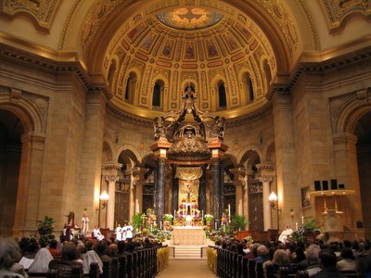
“She made all nations drink of the wine of the wrath of her fornication.”

Slide 41
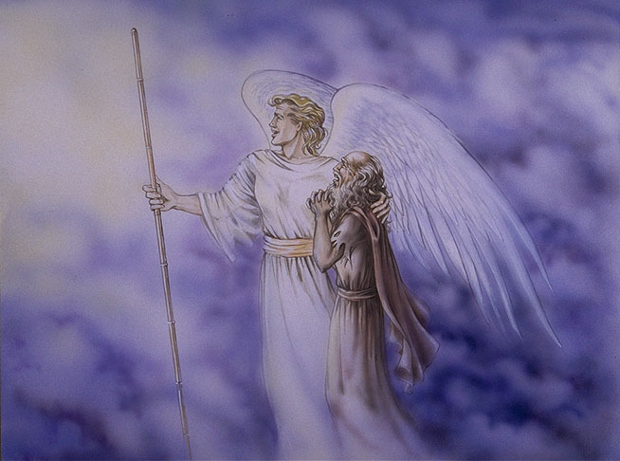
“So he carried me away in the spirit into the wilderness: and I saw a woman sit upon a scarlet coloured beast.” (Rev. 17:3)

Slide 42
Full of the names of blasphemy -
Seven heads – vs. 15
10 horns – vs. 12
Arrayed in purple and scarlet –
Decked with gold and precious stones and pearls –
Golden cup full of abominations and filthiness of her fornication -

Slide 43
The city of seven hills
“Seven heads

Slide 45
“The Ten Horns.”

Slide 46
“The ten horns which thou sawest are ten kings…these have one mind, and shall give their power and strength unto the beast (Anti-christ).”

Slide 47
“Arrayed in purple and scarlet color.”

Slide 48
“Decked with gold and precious stones and pearls.”

Slide 49
“Golden cup full of abominations and filthiness of her fornication.”

Slide 50
“Drunk with the blood of the saints.”

Slide 52
“And the Angel said unto me, I will tell thee the mystery of the woman, and of the beast that carrieth her, which hath the seven heads and ten horns.”

Slide 53
The Apostate Church “The identity of the great whore”
(Revelation 17:1-19:10)

Slide 54
Babylon Destroyed (Revelation 17:16, 19:1-5)

Slide 55
“And the ten horns which thou sawest upon the beast, these shall hate the whore, and shall make her desolate and naked, and shall eat her flesh, and burn her with fire. For God hath put in their hearts to fulfill his will, and to agree, and give their kingdom unto the beast, until the words of God shall be fulfilled.”(Revelation 17:16-17)

Slide 57
“And she shall be utterly burned with fire…” Revelation 18:8

Slide 58
“…the habitation of devils, and every foul spirit…”

Slide 59
“Her sins have reached unto heaven…”

Slide 60
“Babylon the great is fallen…”

Slide 61
“Come out of her, my people, that ye be not partakers of her sins.” (Revelation 18:4)

Slide 62
“I heard a great voice of much people in heaven, saying, Alleluia…for He hath judged the great whore, which did corrupt the earth with her fornication, and hath avenged the blood of his servants at her hand…And her smoke rose up forever and ever.” (Revelation 19:1-3)
Heaven rejoices over the judgment of the whore

Slide 63
Revelation 14:9-13 “The Warning”

Slide 64
“And the third angel followed them, saying with a loud voice, If any man worship the beast and his image, and receive his mark in his forehead, or in his hand, The same shall drink of the wine of the wrath of God, which is poured out without mixture into the cup of his indignation; and he shall be tormented with fire and brimstone.”

Slide 65
Wrath of God

Slide 66
“And he shall be tormented with fire and brimstone in the presence of the holy angels, and in the presence of the Lamb: And the smoke of their torment ascendeth up for ever and ever: and they have no rest day nor night, who worship the beast and his image,
and whosoever receiveth the
mark of his name.”

Slide 67
“Here is the patience of the saints: here are they that keep the commandments of God, and the faith of Jesus. And I heard a voice from heaven saying unto me, Write, Blessed are the dead which die in the Lord from henceforth: Yea, saith the Spirit, that they may rest from their labours; and their works do follow them.”

