Slide 1
The Revelation of Jesus Christ
A study of the book
of Revelation

Slide 2
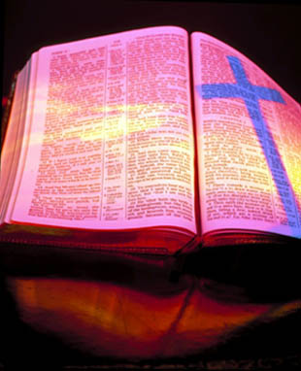
Revelation 13:11-18
“The False Prophet”

Slide 3
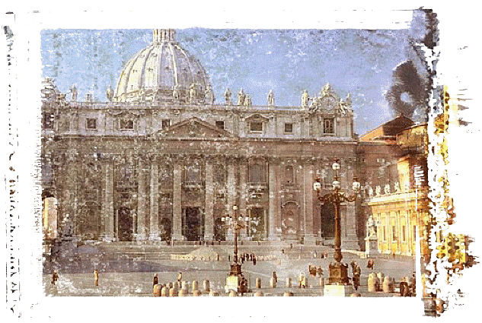
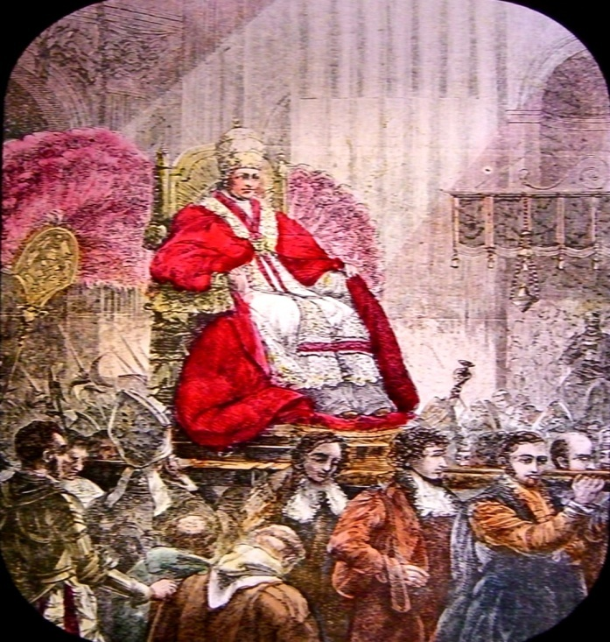
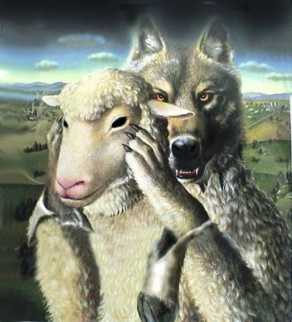
The Identity of the False Prophet (Revelation 13:11-18)

Slide 4
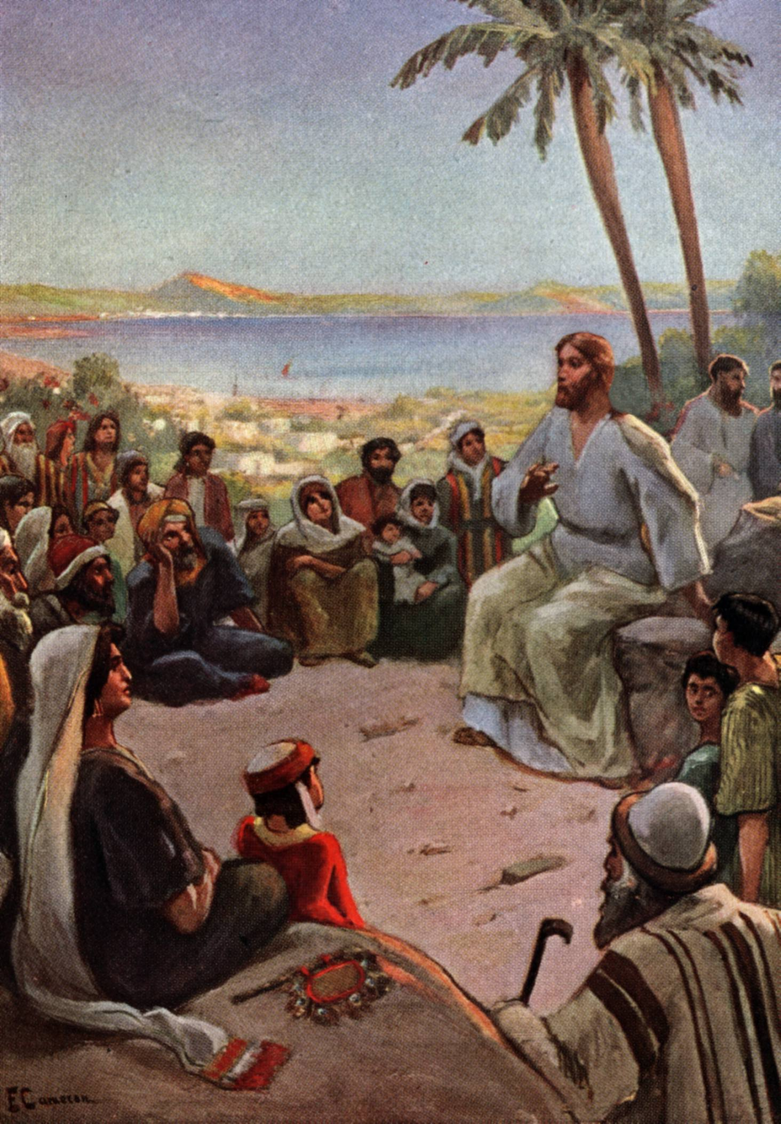
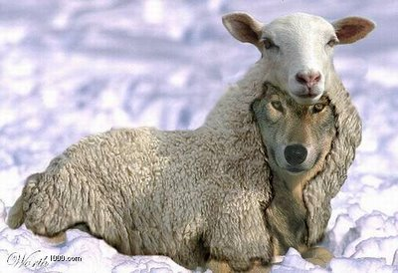
“Beware of false prophets, which come to you in sheep’s clothing, but inwardly they are ravening wolves.” (Matthew 7:15)

Slide 5
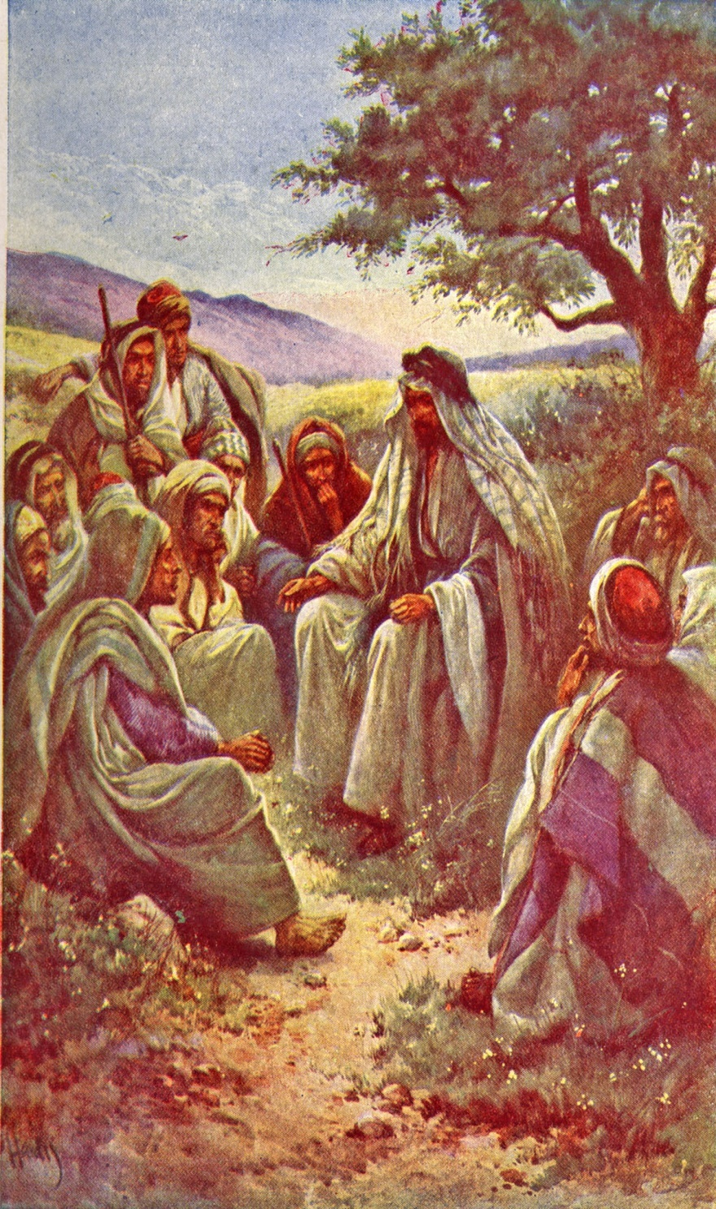
“And many false prophets shall arise and deceive many…for there shall arise false Christ’s, and false prophets, and shall shew great signs and wonders…believe it not.” (Matthew 24)

Slide 6
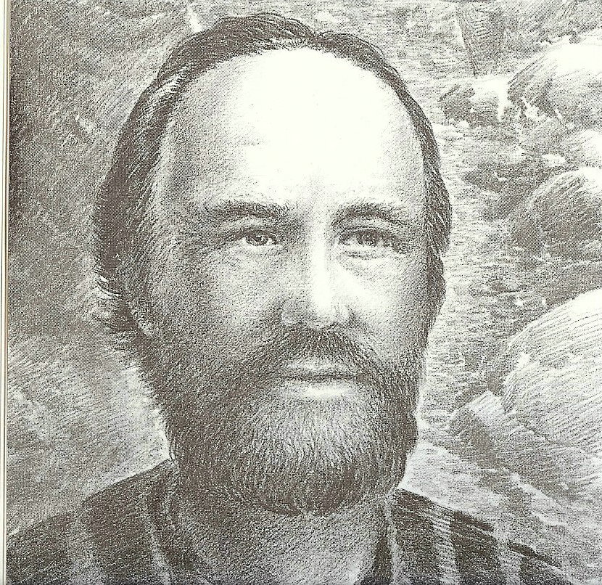
“For such are false apostles, deceitful workers, transforming themselves into the apostles of Christ. And no marvel; for Satan himself is transformed into an angel of light. Therefore it is no great thing if his ministers also be transformed as the ministers of righteousness.” (II Corinthians 11:14-15)

Slide 7
“Beloved, believe not every spirit, but try the spirits whether they are of God: because many false prophets are gone out into the world.” (I John 4:1)

Slide 8
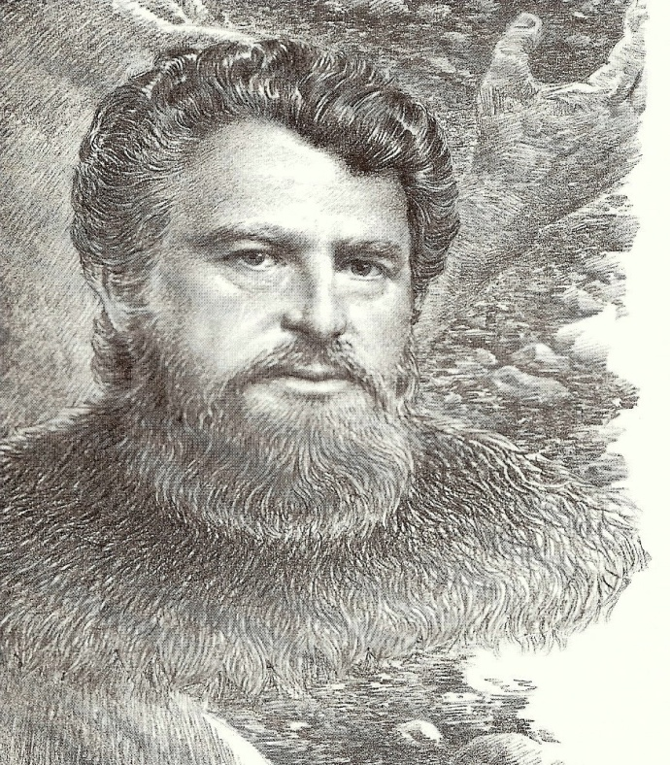
“But there were false prophets also among the people, even as there shall be false teachers among you.” (II Peter 2:1)

Slide 9
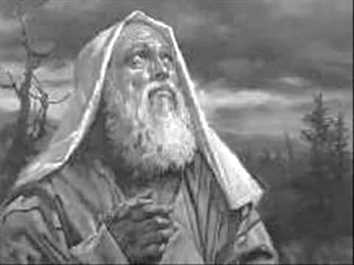
“That this is a rebellious people, lying children, children that will not hear the law of the LORD: Which say to the seers, See not; and to the prophets, Prophesy not unto us right things, speak unto us smooth things, prophesy deceits.” (Isaiah 30:9-10)

Slide 10
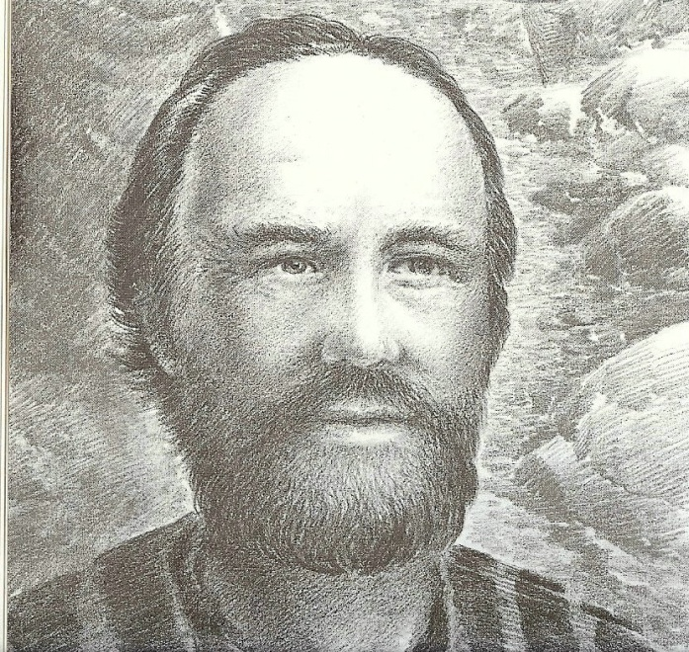
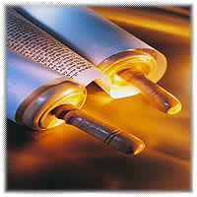
“They searched the scriptures daily, whether those things were so.” (Acts 17:11)

Slide 11
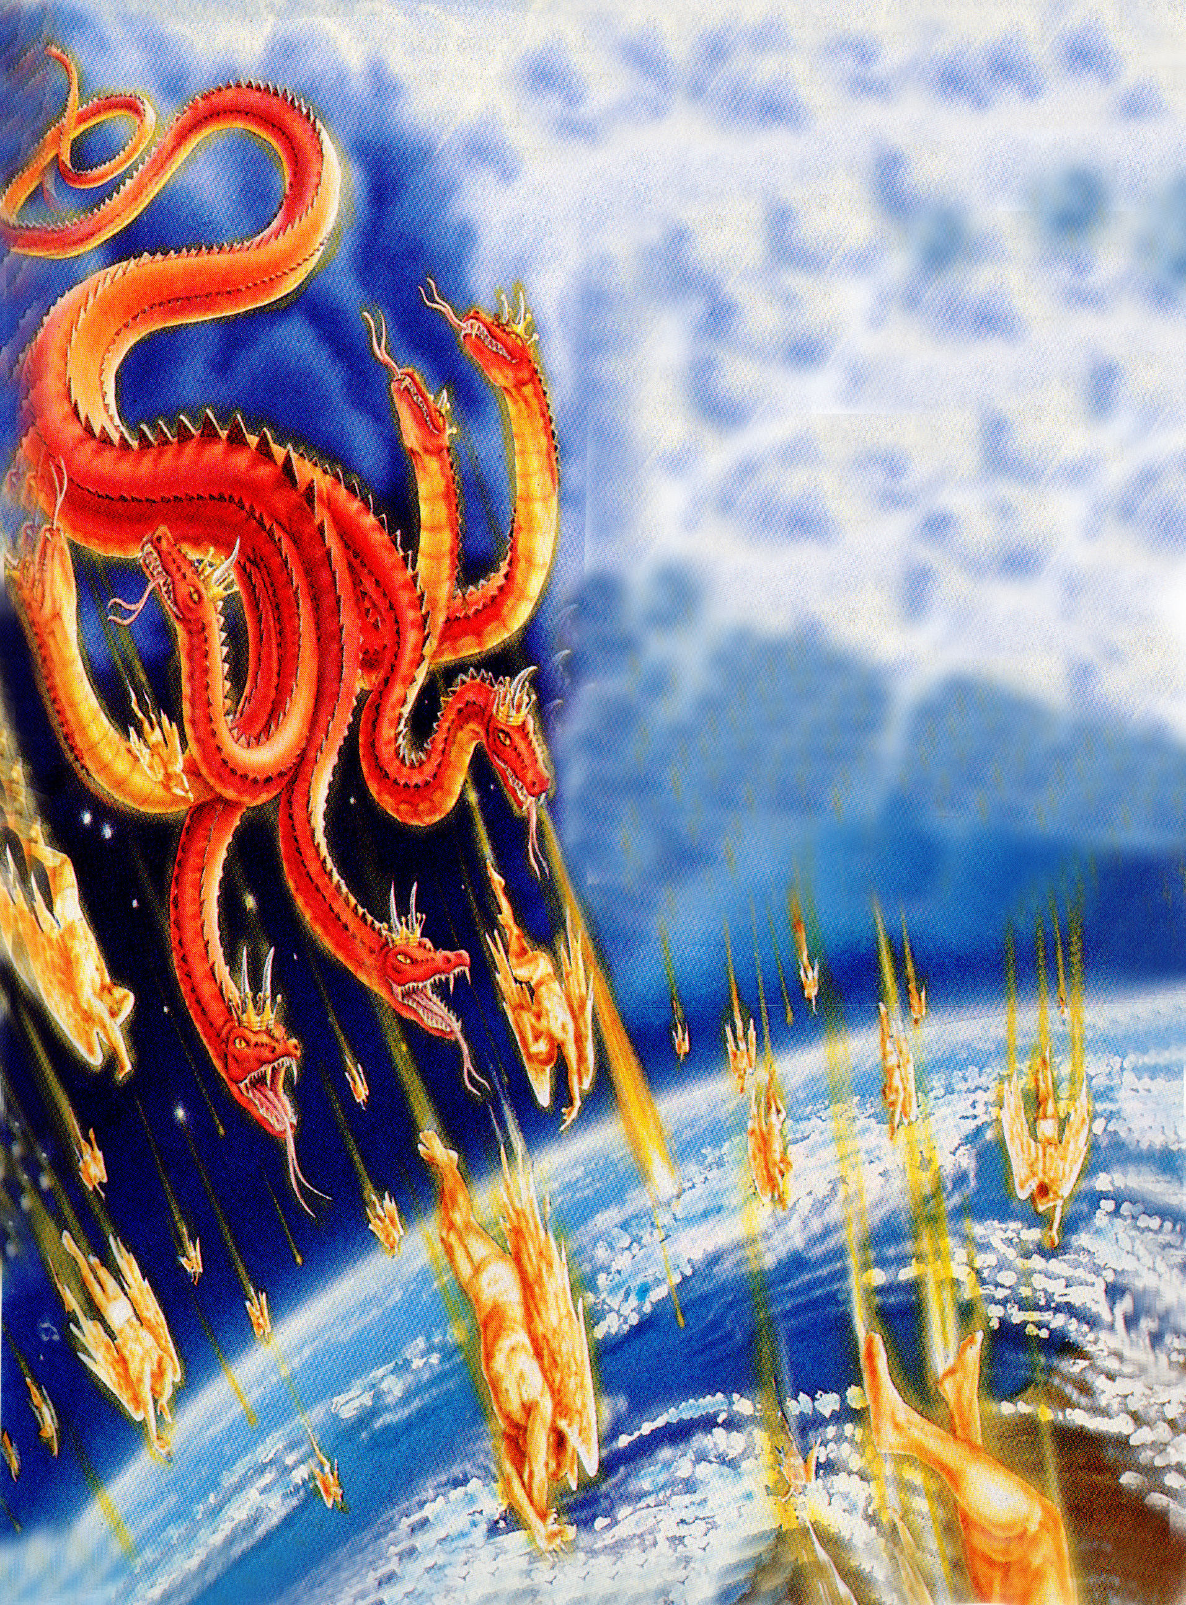
“And the great dragon was cast out, that old serpent, called the Devil, and Satan, which deceiveth the whole world: he was cast out into the earth, and his angels were cast out with him.” (Revelation 12:9)

Slide 12
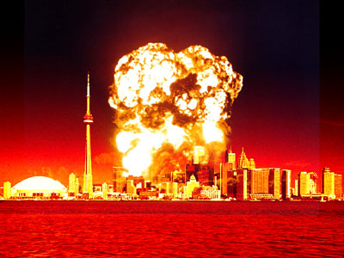
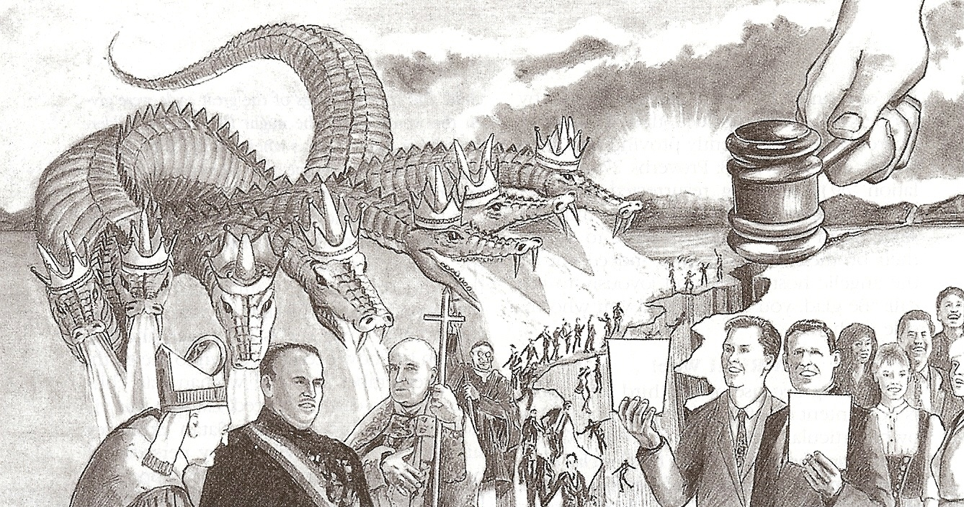
“Woe unto the inhabiters of the earth and of the sea! For the devil is come down unto you, having great wrath, because he knoweth that he hath but a short time.” (Revelation 12:12)

Slide 13
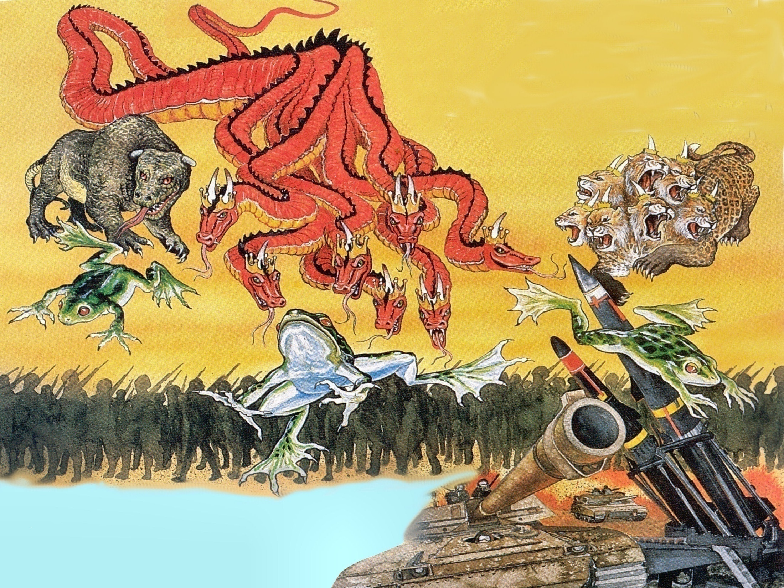
Revelation 16:13-15

Slide 14
“And I saw three unclean spirits like frogs come out of the mouth of the dragon, and out of the mouth of the beast, and out of the mouth of the false prophet. For they are the spirits of devils, working miracles.”

Slide 15
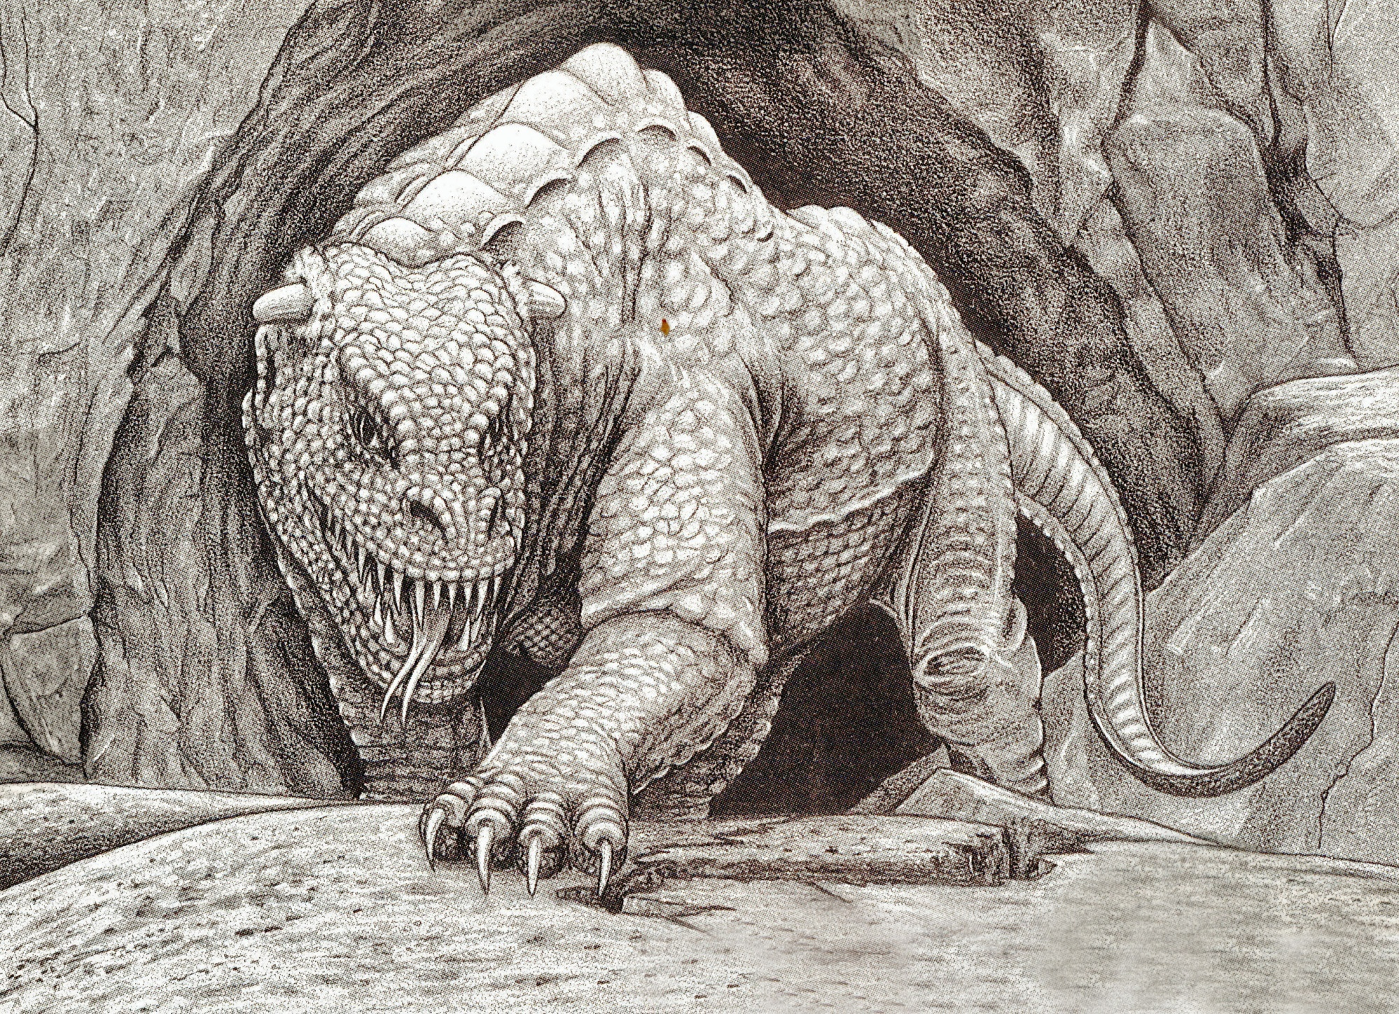
“And I beheld another beast coming up out of the earth; and he had two horns like a lamb, and he spake as a dragon.”

Slide 16
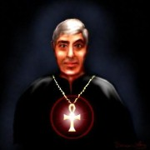
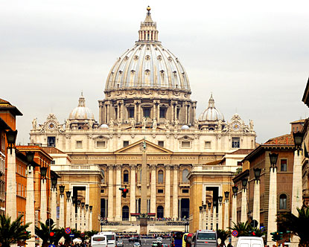
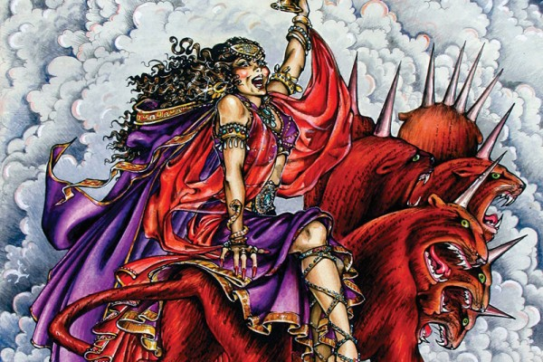
Revelation 13:11

Slide 17
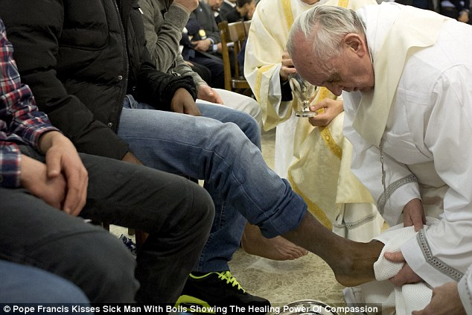
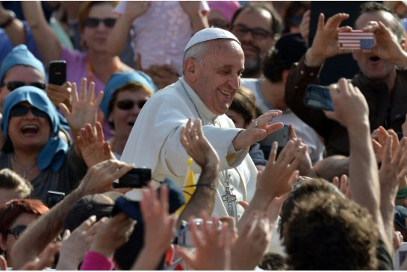
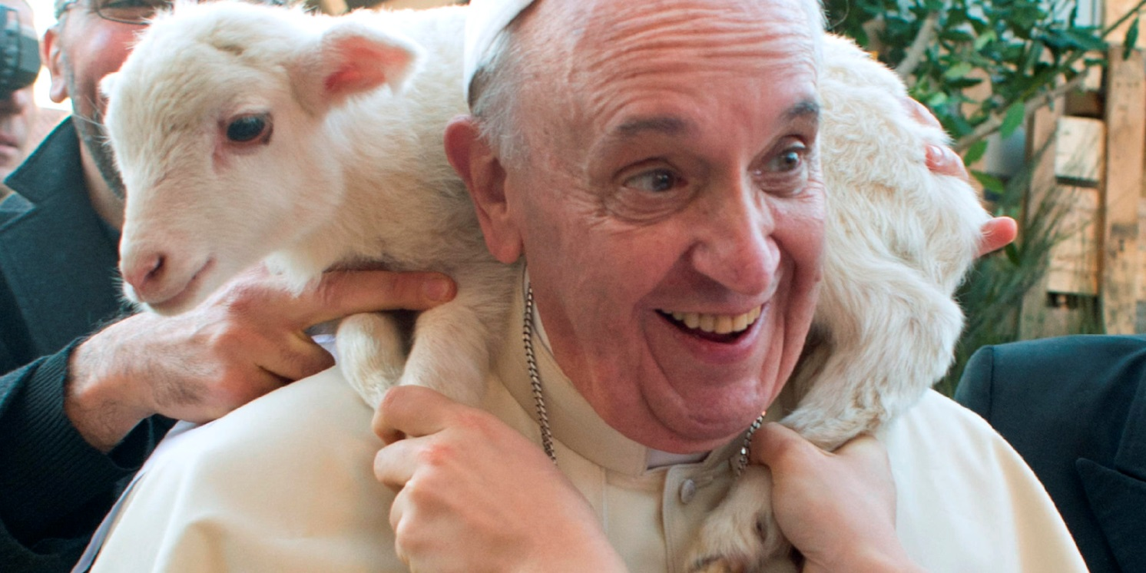
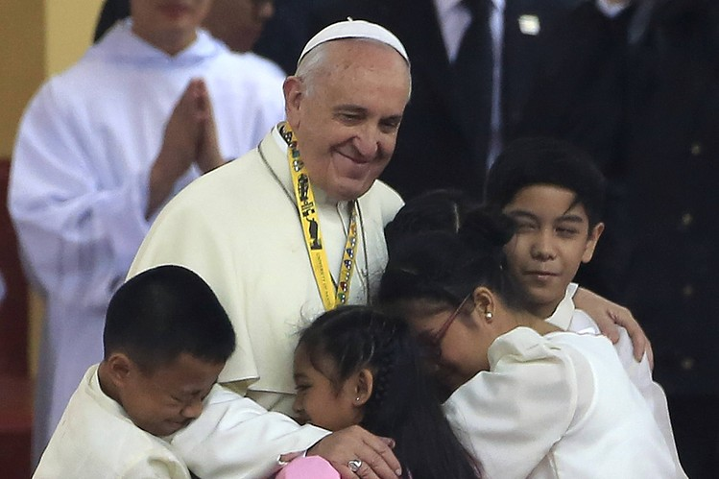
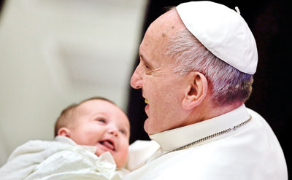
“He had two horns like a lamb…”

Slide 18
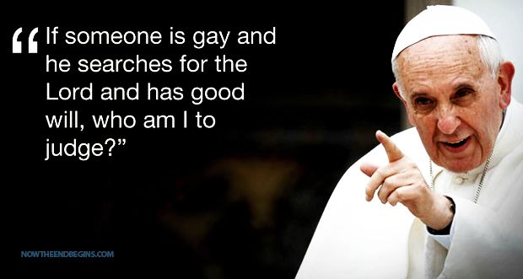

Slide 19
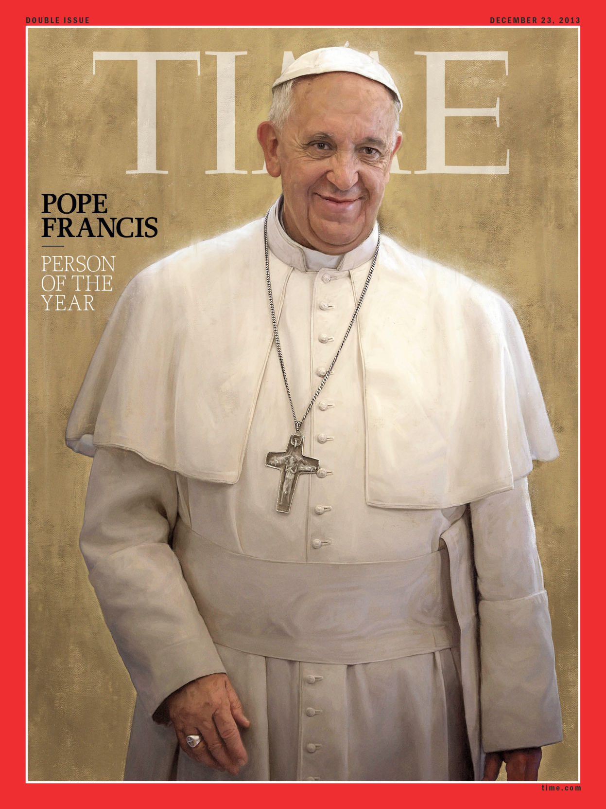

Slide 20
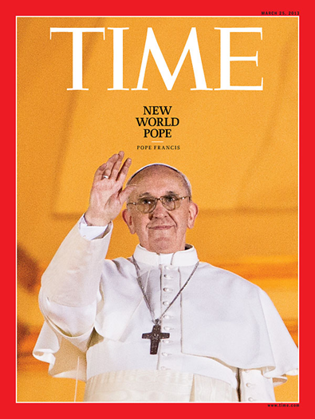

Slide 21
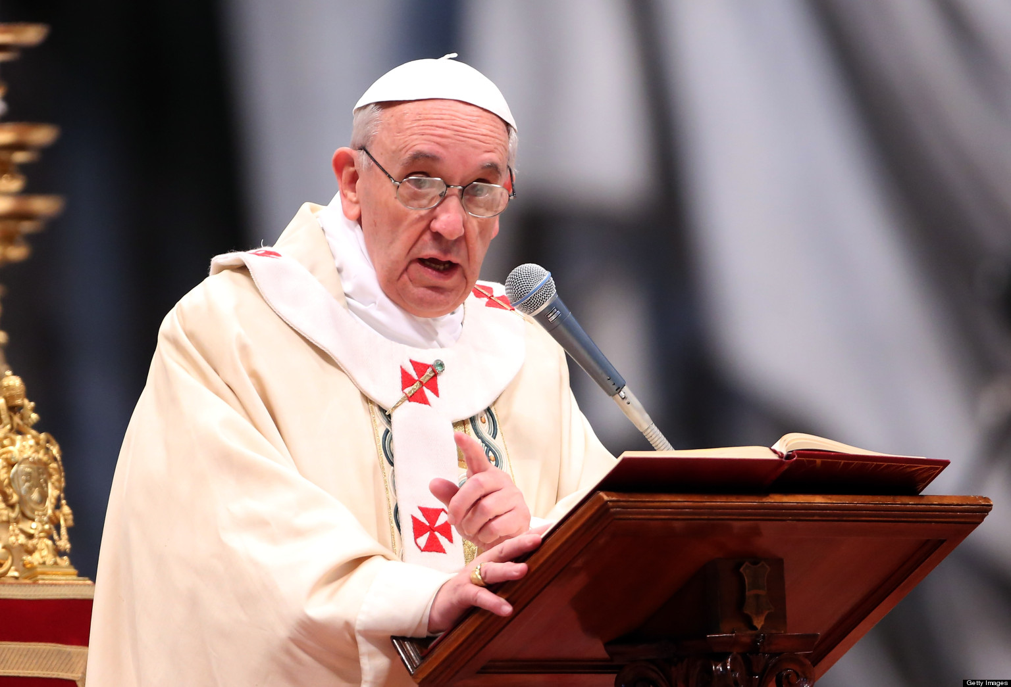
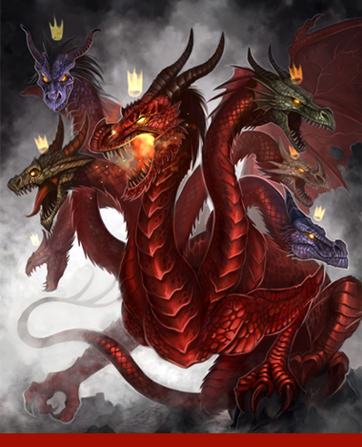
“He spake as a dragon…”

Slide 22
“Ye are of your father the devil, and the lusts of your father ye will do. He was a murderer from the beginning, and abode not in the truth, because there is no truth in him. When he speaketh a lie, he speaketh of his own: for he is a liar, and the father of it.” (John 8:44)

Slide 23
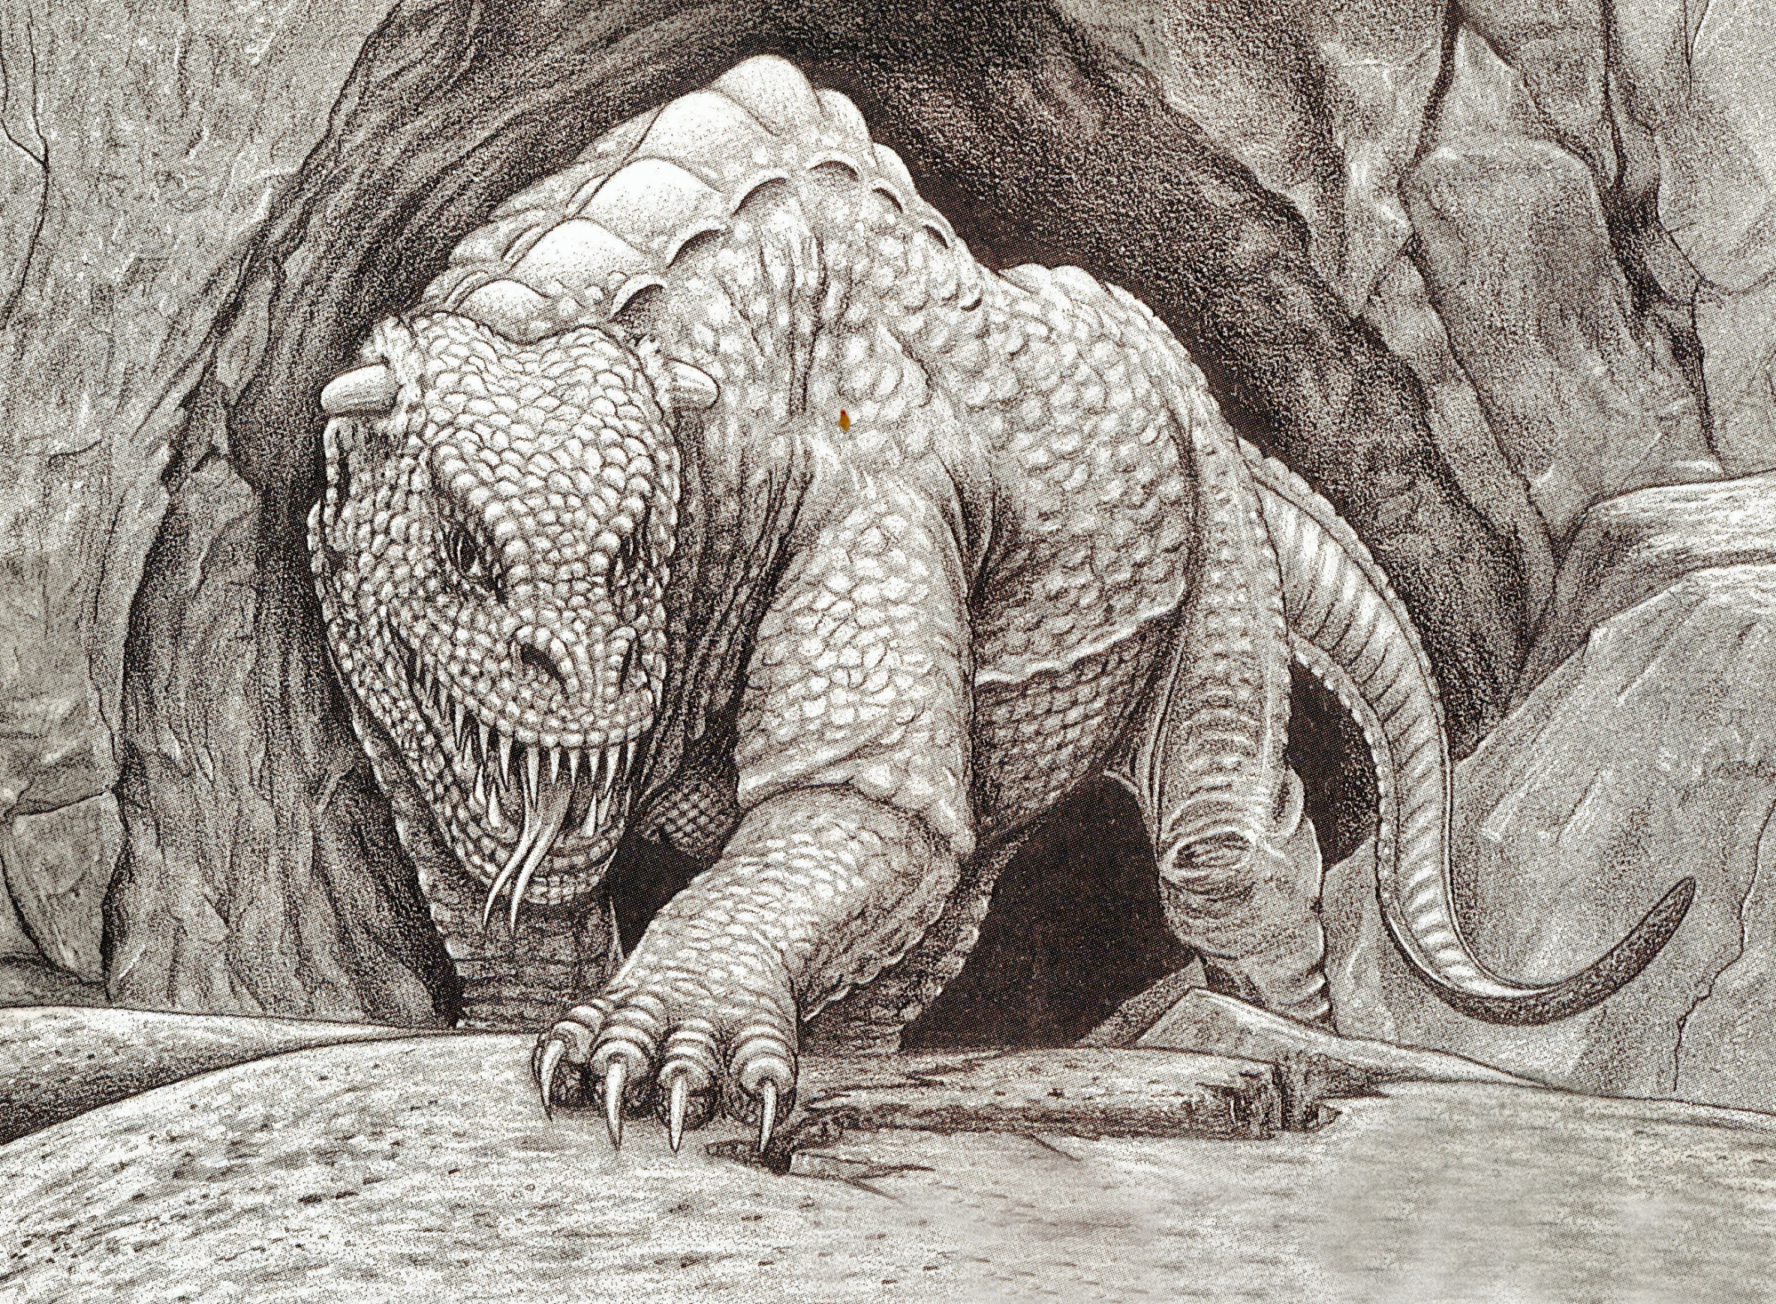
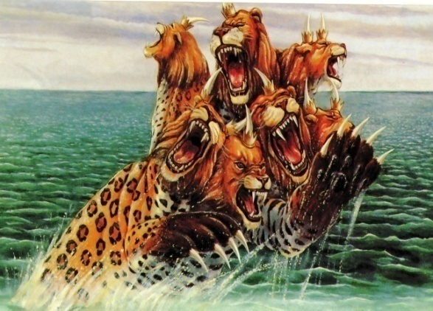
Revelation 13:12

Slide 24
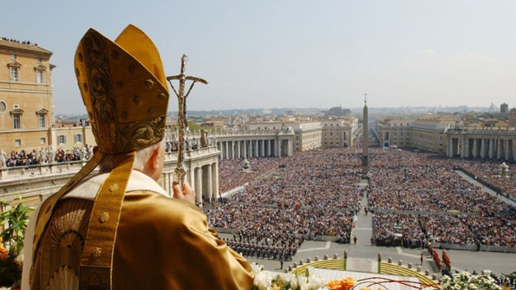
“And he exerciseth all the power of the first beast before him, and causeth the earth and them which dwell therein to worship the first beast, whose deadly wound was healed.”

Slide 25
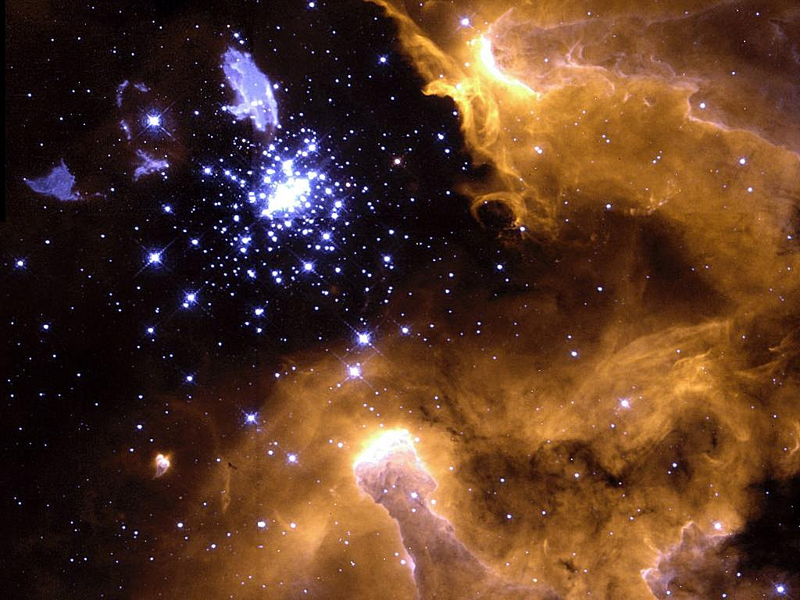
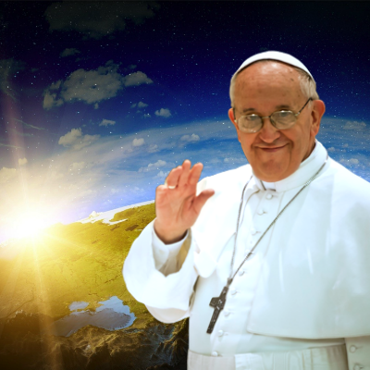
The Second Beast
False Prophet – Rev. 16:13; 19:20; 20:10
Role – bring people to worship the first beast (Anti-Christ) – Rev. 13:14
He is a deceiver – “With all deceivableness of unrighteousness.” II Thess. 2:10
He has two horns – represents his attempt to give the impression of being harmless and gentle.
He has all the power (authority) of the Anti- Christ.
He priestly role identifies him as the most powerful (universal) religious leader.
He exercise all the power of the Anti-Christ who is the most powerful (universal) political leader.

Slide 26
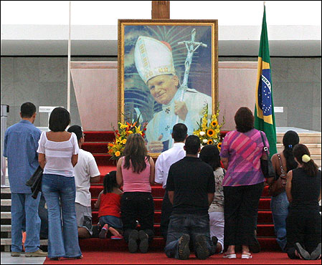
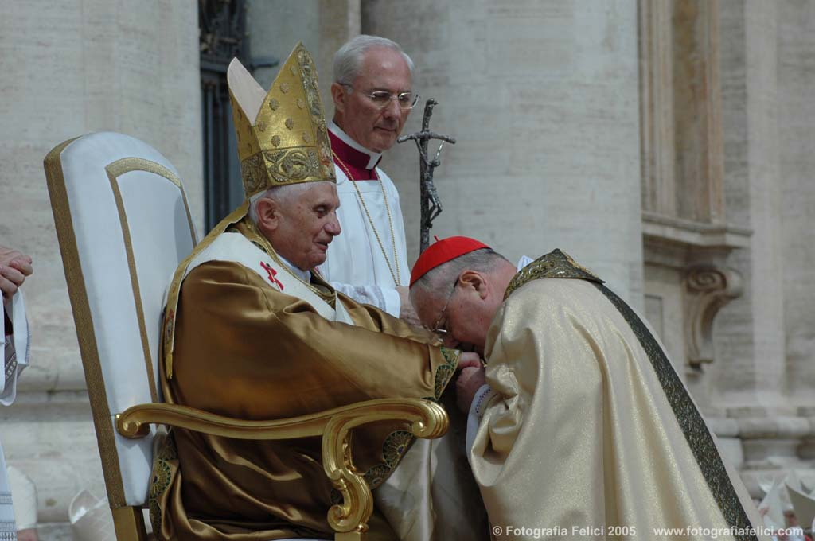
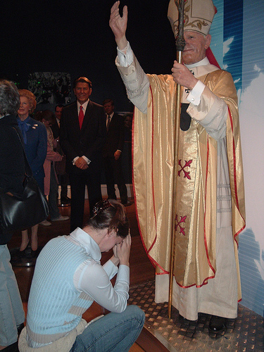
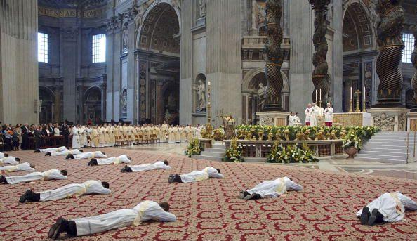
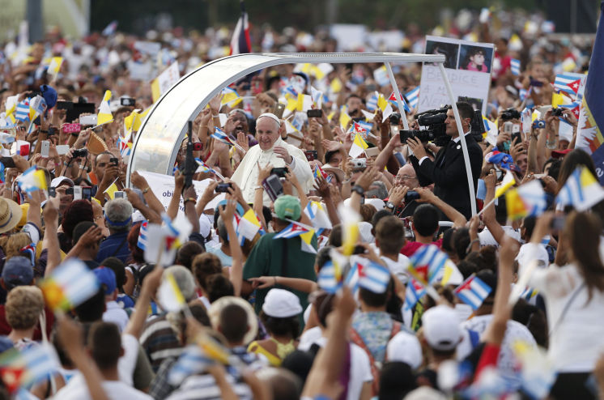

Slide 27
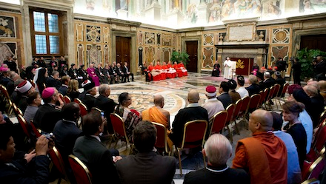

Slide 28
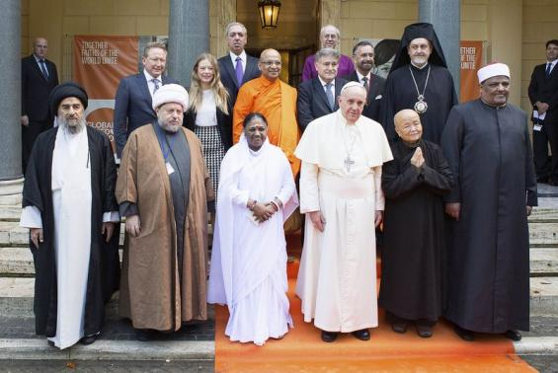
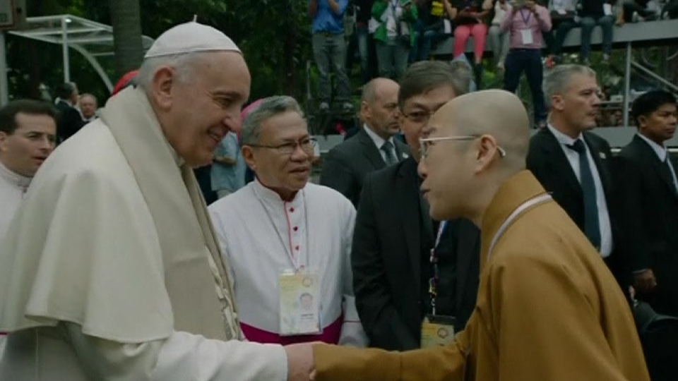
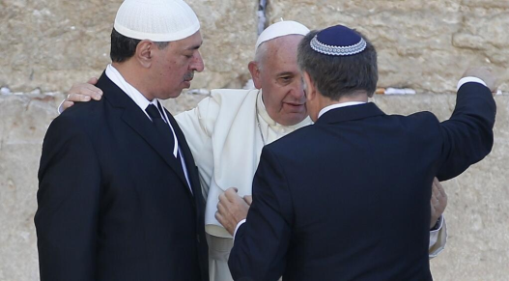
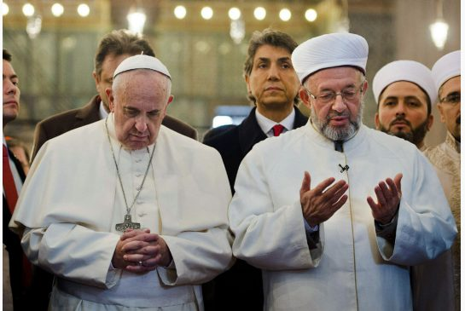
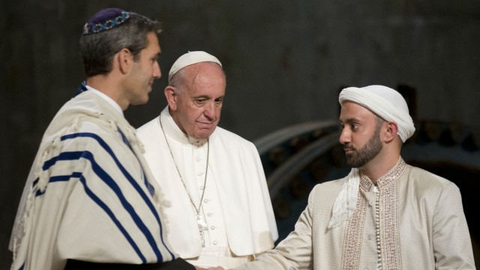
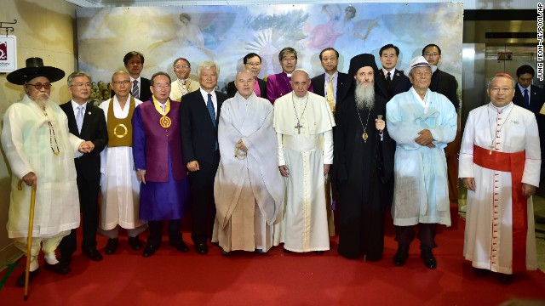
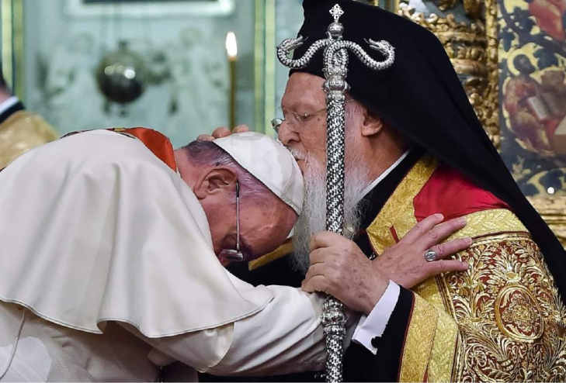
Pope – Positioning Himself to Be Head of Planned One World Religion?
Pope Francis to be Chief Priest of
the One World Religion?
Pope Francis And Rick Warren To Unite For Global Chrislam Conference
Pope Francis And The Emerging One World Religion
The Pope's Push for a One-World Religion

Slide 29
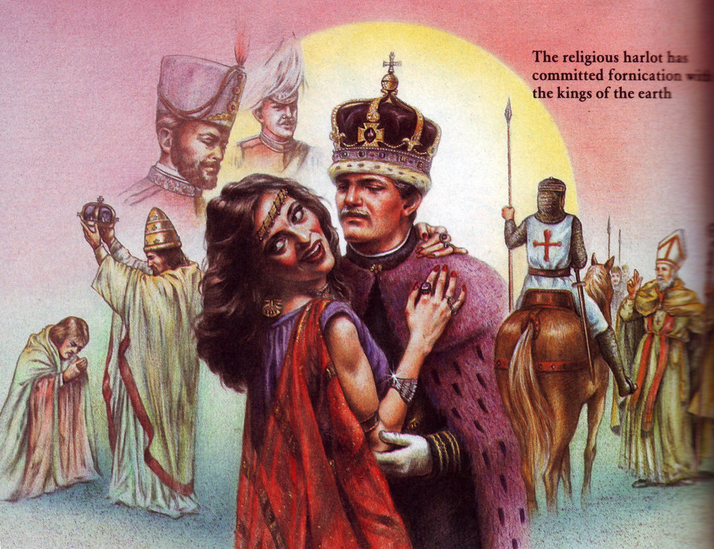
Pope with World Political Leaders
“With whom the kings of the earth have committed fornication, and the inhabitants of the earth have been made drunk with the wine of her fornication.” (Rev. 17:2)

Slide 30
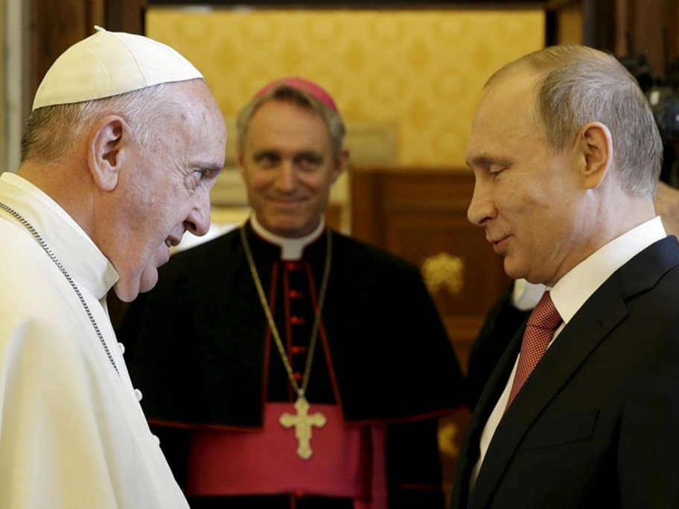

Slide 31
U.S. Ambassador to the Holy See. Ambassador Ken Hackett was nominated by President Barack Obama on June 14, 2013 to serve as the U.S. Ambassador to the Holy See.

Slide 32
Pope Francis calls for a new system of global government to tackle climate change
Pope Francis Doesn’t Even Hide It- He Calls For One World Government
Pope Francis Paving The Way For
Communist World Government
Pope Calls for New World Government
Pope Francis Calls For A New Global Government To Save Humanity

Slide 35
The Deception of the False Prophet
He deceives by means of wonders and miracles – Magic / Witchcraft – Deut. 13:1-5; Mark 13:22-23; II Thess. 2:9-10
His power is given to him by Satan the “Great deceive” - Rev. 12:9
Leads people in the worship of the false Messiah (Anti-Christ) - (Matt. 24:24)
He will produce the miracles of Elijah - (I Kings 18:28-39; II Kings 1:10)

Slide 36
Revelation 13:12-13

Slide 37
“And he doeth great wonders, so that he maketh fire come down from heaven on the earth in the sight of men, and deceiveth them that dwell on the earth by the means of those miracles which he had power to do in the sight of the beast…”

Slide 38
“Behold, I will send you Elijah the prophet before the coming of the great and dreadful day of the Lord.” (Malachi 4:5)

Slide 39
“The fire of the Lord fell, and consumed the burnt sacrifice, and when all the people saw it, they fell on their faces: and they said, The Lord he is God, the Lord He is God.” (I Kings 18:36)

Slide 40
“(False Prophet) saying to them that dwell on the earth, that they should make an image to the beast, which had the wound by a sword, and did live.”

Slide 41
“And his deadly wound was healed: and all the world wondered (marveled) after the beast (Anti-Christ). And they worshiped the dragon which gave power unto the beast: and they worshiped the beast…” (Revelation 13:3-4)

Slide 44
“He (false prophet) deceiveth them that dwell on the earth by the means of those miracles which he had power to do…saying to them…that they should make an image to the beast, which had the wound by a sword, and did live.”

Slide 48
666

Slide 49
“And he (false prophet) had power to give life unto the image of the beast, that the image of the beast should both speak…” (Revelation 13:15)

Slide 51
“And he (false prophet) cause that as many as would not worship the image of the beast should be killed.”

Slide 55
“And the woman was arrayed in purple and scarlet colour, and decked with gold and precious stones and pearls, having a golden cup in her hand full of abominations and filthiness of her fornication: And upon her forehead was a name written, MYSTERY, BABYLON THE GREAT, THE MOTHER OF HARLOTS AND ABOMINATIONS OF THE EARTH. And I saw the woman drunken with the blood of the saints, and with the blood of the martyrs of Jesus: and when I saw her, I wondered with great admiration.” (Revelation 17:4-6)

Slide 56
“That no man might buy or sell, save he that had the mark.”
666

Slide 57
“Here is wisdom…”

Slide 58
“And that no man might buy or sell, save he that had the mark, or the name of the beast, or the number of his name. Here is wisdom. Let him that hath understanding count the number of the beast.”
He that had the mark – Mark = Image, stamp, brand, or other mark
or the name of the beast – his name
or the number of his name – 666 “For it is the number of man…”

Slide 59
“And he (false prophet) causeth all, both small and great, rich and poor, free and bond, to receive a mark in their right hand, or in there foreheads.”

Slide 64
“There shall arise false Christ, and false prophets, and shall show great signs and wonders…. believe it not.”

Slide 65
Do not take the mark!
“And the smoke of their torment ascendeth up for ever and ever: and they have no rest day or night, who worshiped the beast and his image, and whosoever receiveth the mark of his name.” (Revelation 14:11)

Slide 66
“And I saw the souls of them that were beheaded for the witness of Jesus, and for the Word of God, and which had not worshiped the beast, neigher his image, neither had received his mark upon their foreheads, or in their hands; and they lived and reigned with Christ a thousand years.” (Revelation 20:4)

Slide 67
“And the beast was taken, and with him the false prophet that wrought miracles before him, with which he deceived them that had received the mark of the beast, and them that worshipped his image. These both were cast alive into a lake of fire burning with brimstone.” (Revelation 19:20)

Slide 68
“And then shall that Wicked be revealed, whom the Lord shall consume with the spirit of his mouth, and shall destroy with the brightness of his coming: Even him, whose coming is after the working of Satan with all power and signs and lying wonders, And with all deceivableness of unrighteousness in them that perish; because they received not the love of the truth, that they might be saved. And for this cause God shall send them strong delusion, that they should believe a lie: That they all might be damned who believed not the truth, but had pleasure in unrighteousness.” (2 Thessalonians 2:8-12)

Slide 69
“He which testifieth these things saith, surely I come quickly. Amen. Even so, come, Lord Jesus.”
(Revelation 22:20)

