Slide 1
The Revelation of Jesus Christ
A study of the book
of Revelation

Slide 2
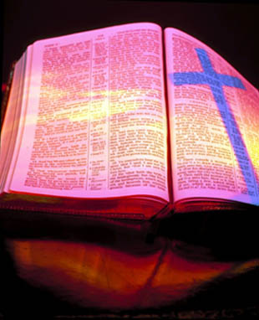
Revelation 10:1-11
“The Mighty Angel and
the Little Book”

Slide 3
“And I saw another mighty angel come down from heaven, clothed with a cloud: and a rainbow was upon his head, and his face was as it were the sun, and his feet as pillars of fire: And he had in his hand a little book open: and he set his right foot upon the sea, and his left foot on the earth.”

Slide 4
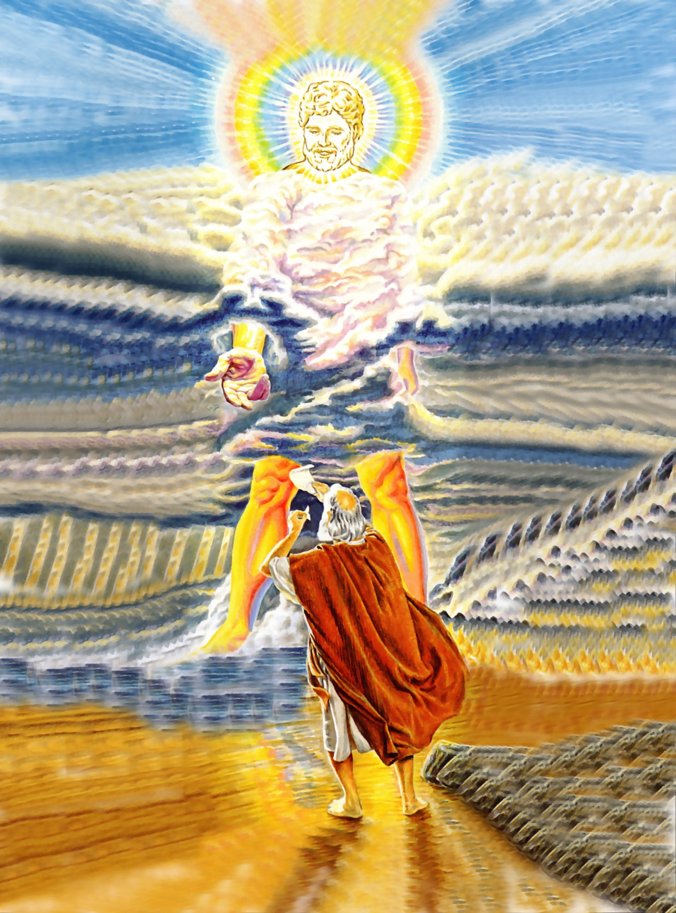

Slide 5
“And I saw another mighty (powerful) angel come down from heaven…”
273 reference to angels in the Word of God
Created by Jesus Christ – John 1:1-3
Glorify God – Colossians 1:16
They are Spirit beings which are invisible (Colossians 2:18) and visible (Hebrews 13:2)
They are innumerable – Hebrews 12:22
They are ministers of God – Psalms 148:2
They obey God’s commandments – Psalms 103:20

Slide 6
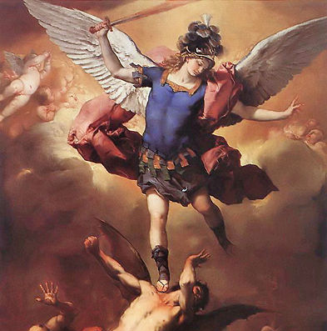
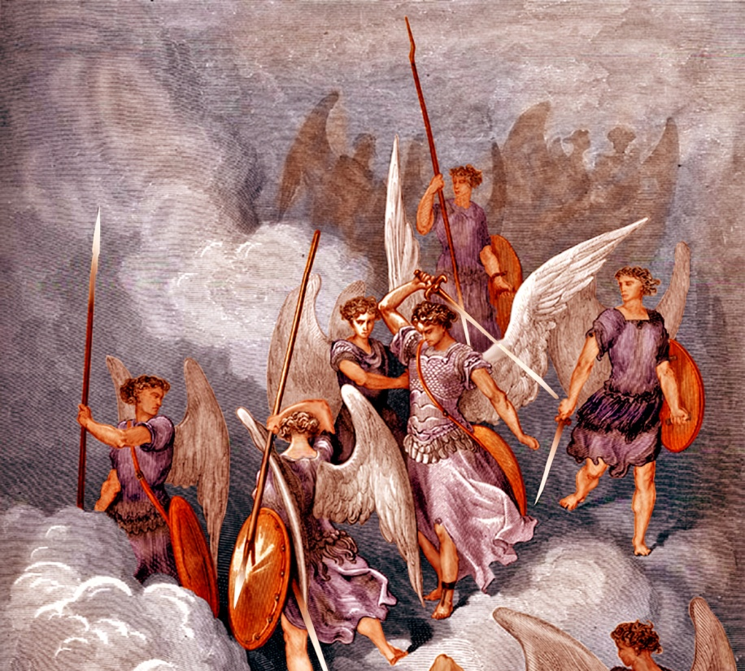
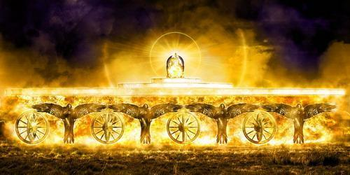
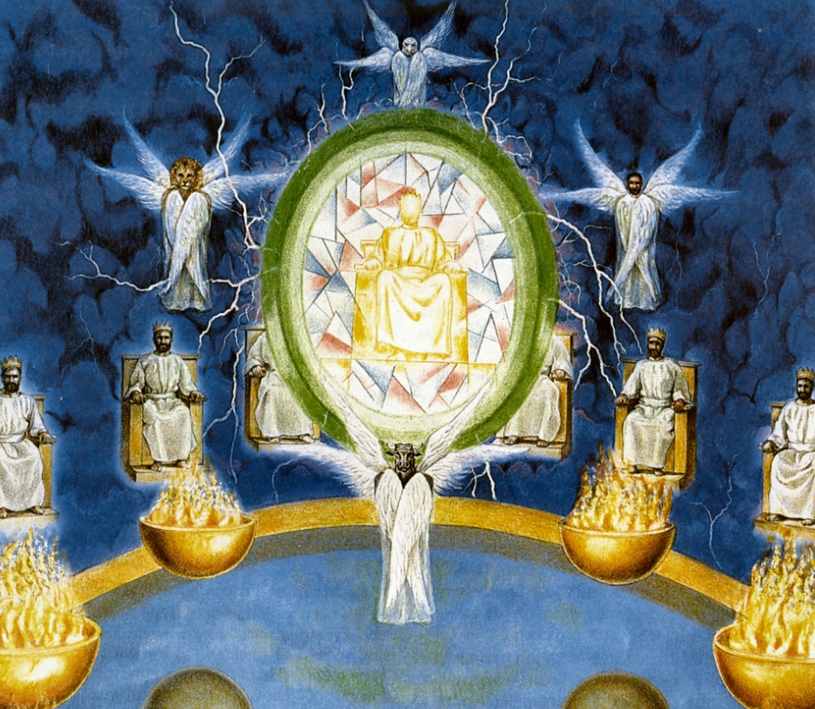
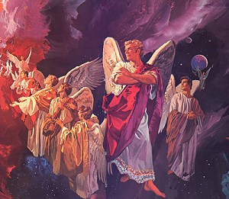
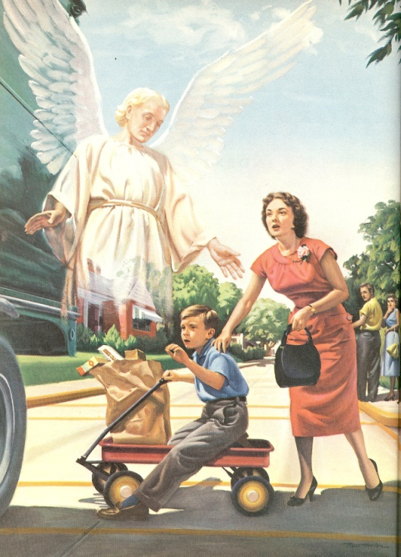
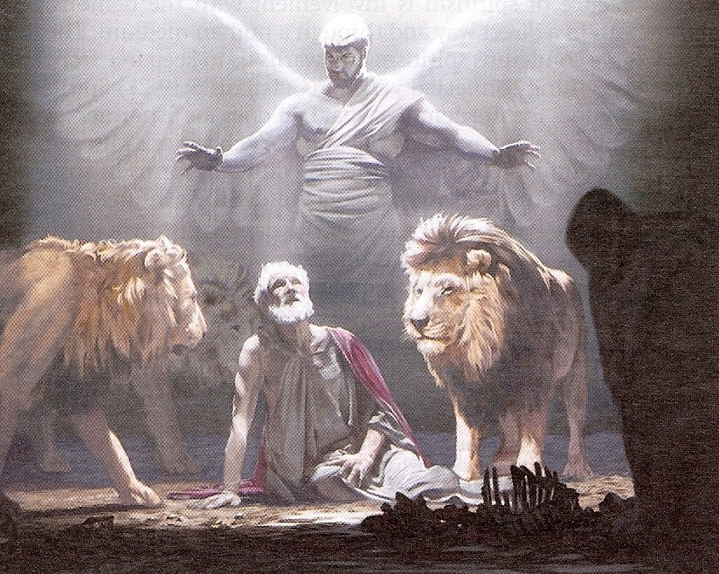
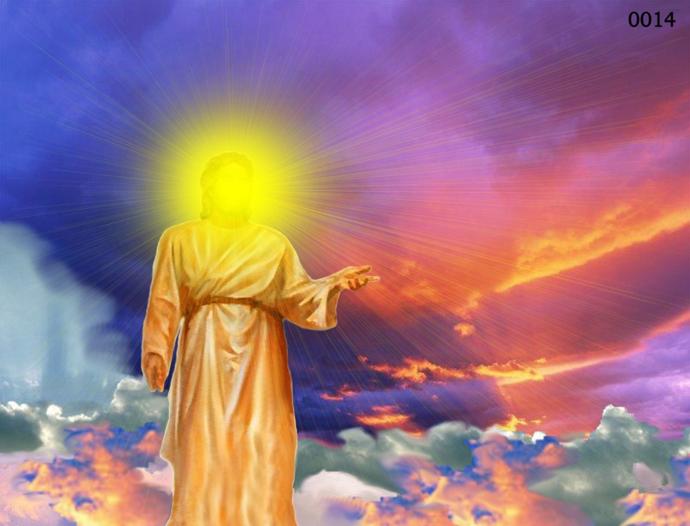
Archangels – Michael and Gabriel
Cherubim's – Ezekiel 1:4-28
Seraphim’s – Isaiah 6:1-7
Ruling angels – I Peter 3:22
Guarding angels – Hebrews 1:14
Angel of the Lord – Zechariah 3:1-10

Slide 7
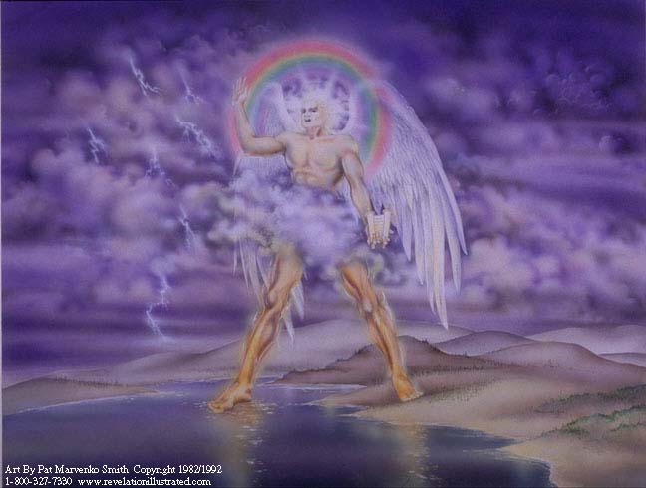
Clothed with a cloud – Holiness (Psalms 104:3)
Rainbow upon his head – Covenant promise of God (Revelation 4:3)
Face shone as the sun – Glory (Revelation 1:16)
Feet as pillars of fire – Judgment (Exodus 13:21)
Right foot upon the sea, and his left foot on the earth – Authority over land and sea (Psalms 2:6-9)

Slide 8
“And cried with a loud voice, as when a lion roareth: and when he had cried, seven thunders uttered their voices. And when the seven thunders had uttered their voices, I was about to write: and I heard a voice from heaven saying unto me, Seal up those things which the seven thunders uttered, and write them not.”

Slide 9
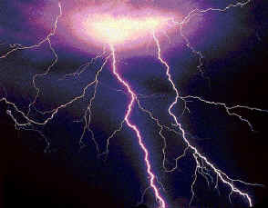
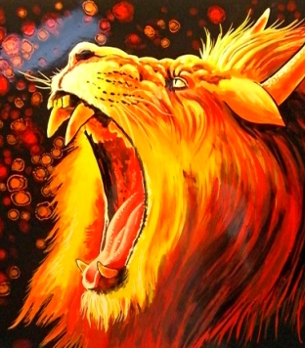
“The Lord also shall roar out of Zion…and the heavens and the earth shall shake.”

Slide 10
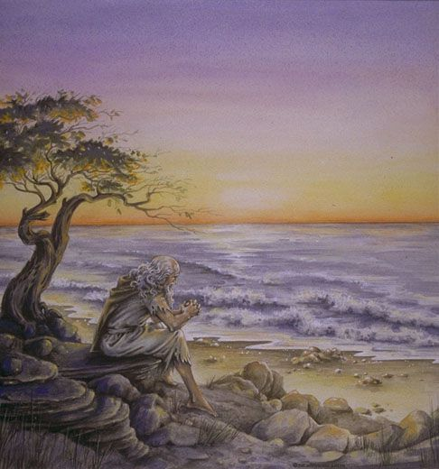
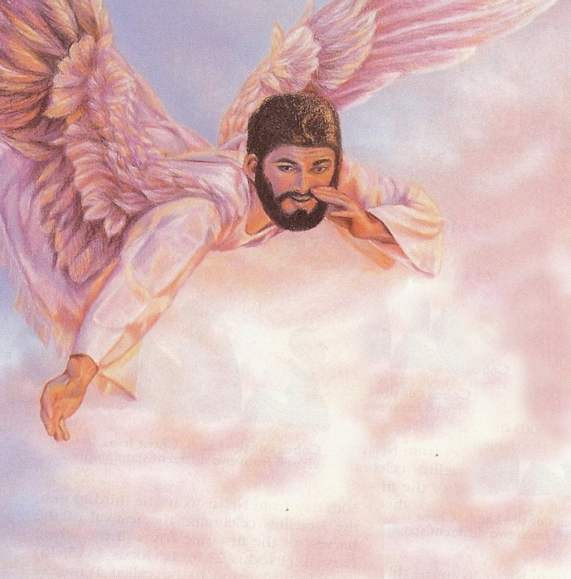
“Seal up those things which the seven thunders uttered, and write them not.”

Slide 11
“The adversaries of the LORD shall be broken to pieces; out of heaven shall he thunder upon them: the LORD shall judge the ends of the earth.”

Slide 12
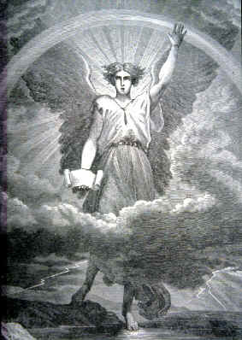
“And the angel which I saw stand upon the sea and upon the earth lifted up his hand to heaven, And sware by him that liveth for ever and ever, who created heaven, and the things that therein are, and the earth, and the things that therein are, and the sea, and the things which are therein, that there should be time no longer.”

Slide 13
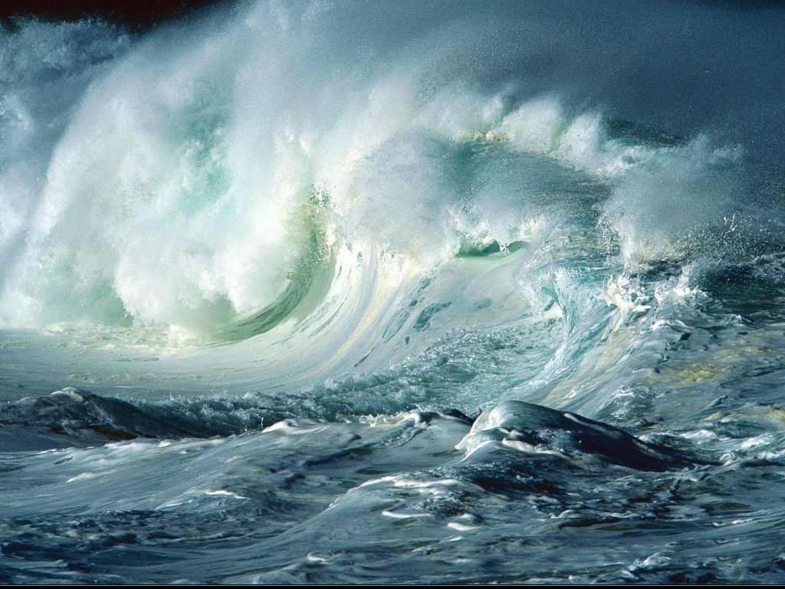
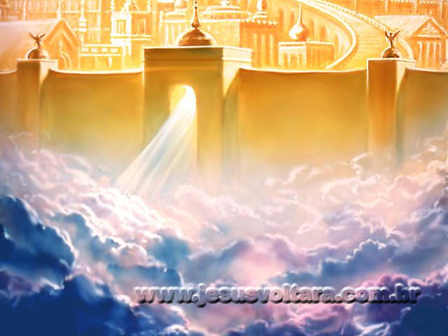
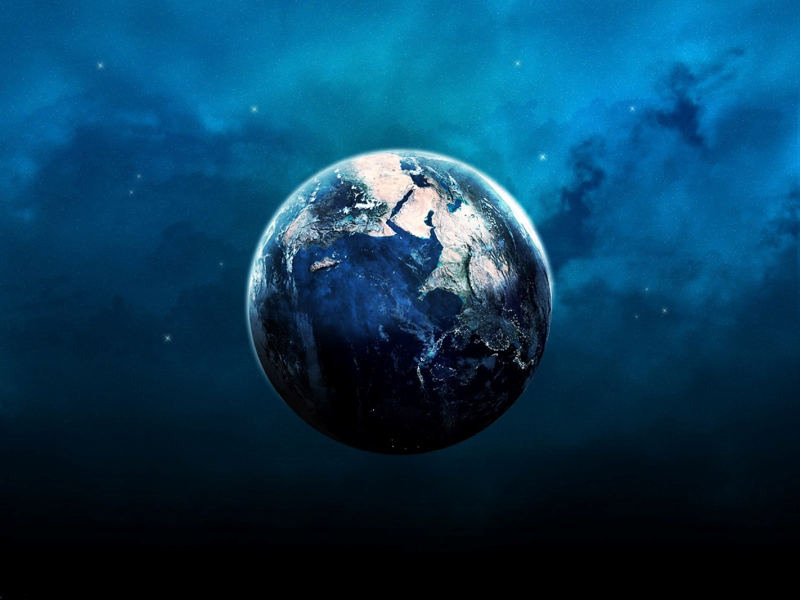
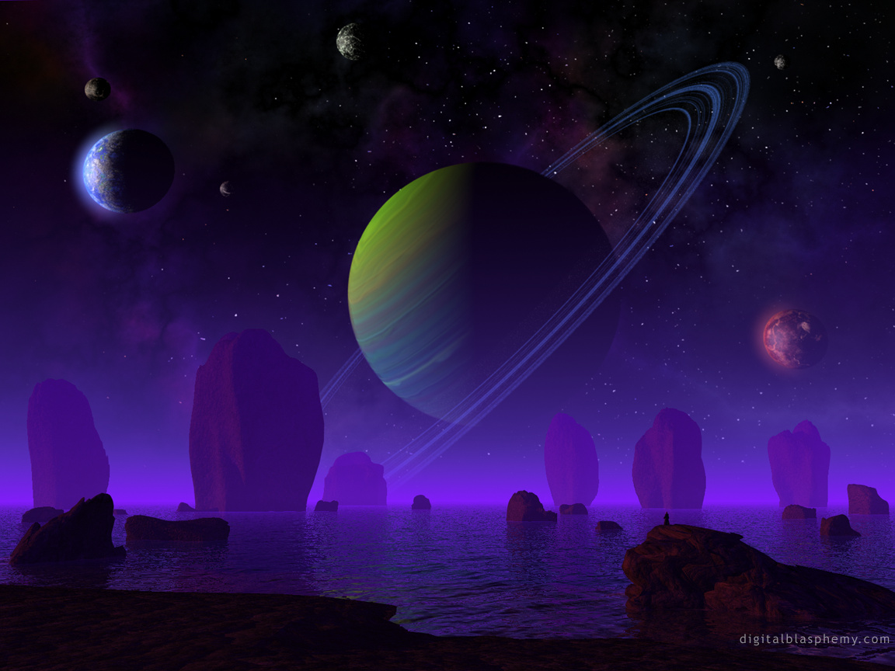

Slide 14
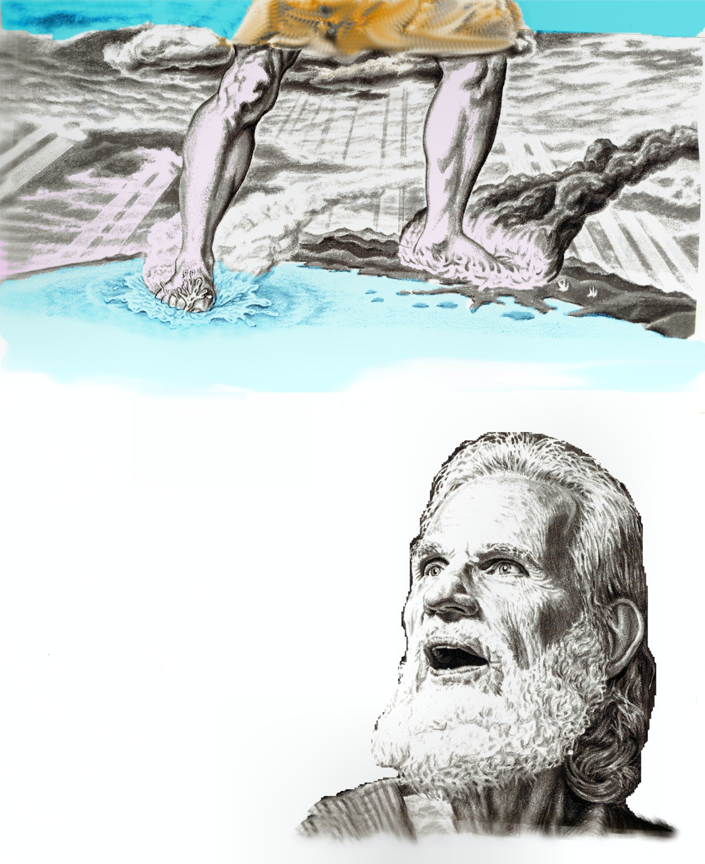
“There should be time no longer.”
“There should be no more delay in the fulfillment of the mystery of God.”

Slide 15
“But in the days of the voice of the seventh angel, when he shall begin to sound, the mystery of God should be finished, as he hath declared to his servants the prophets.”

Slide 16
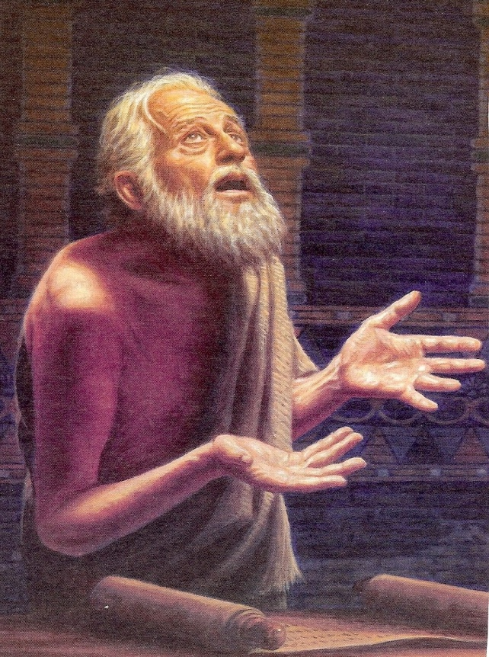
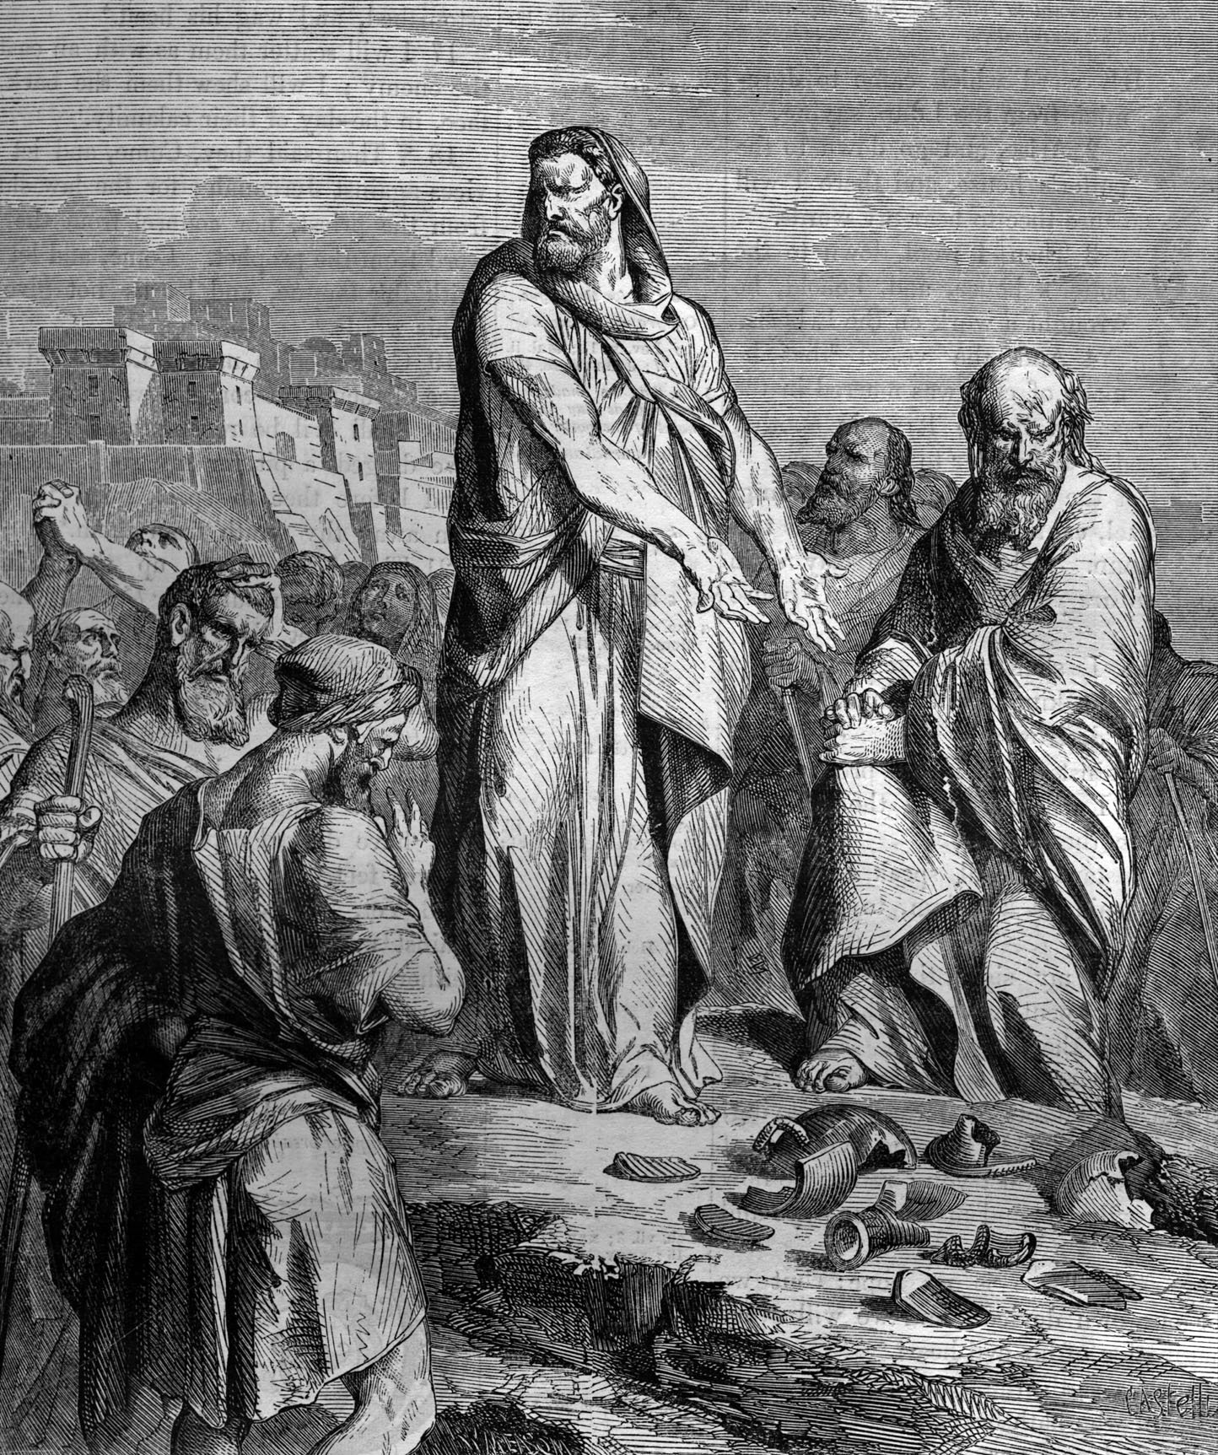
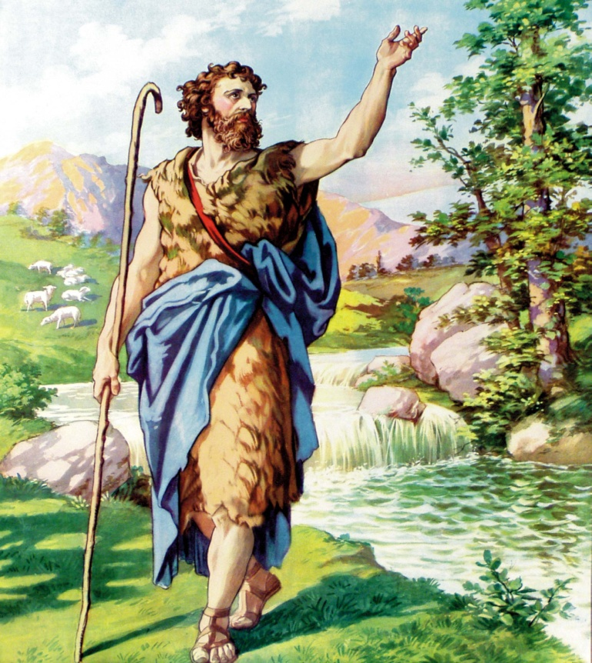
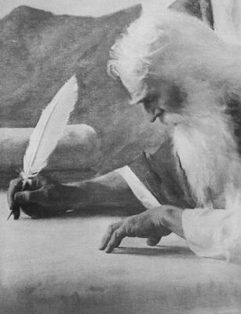
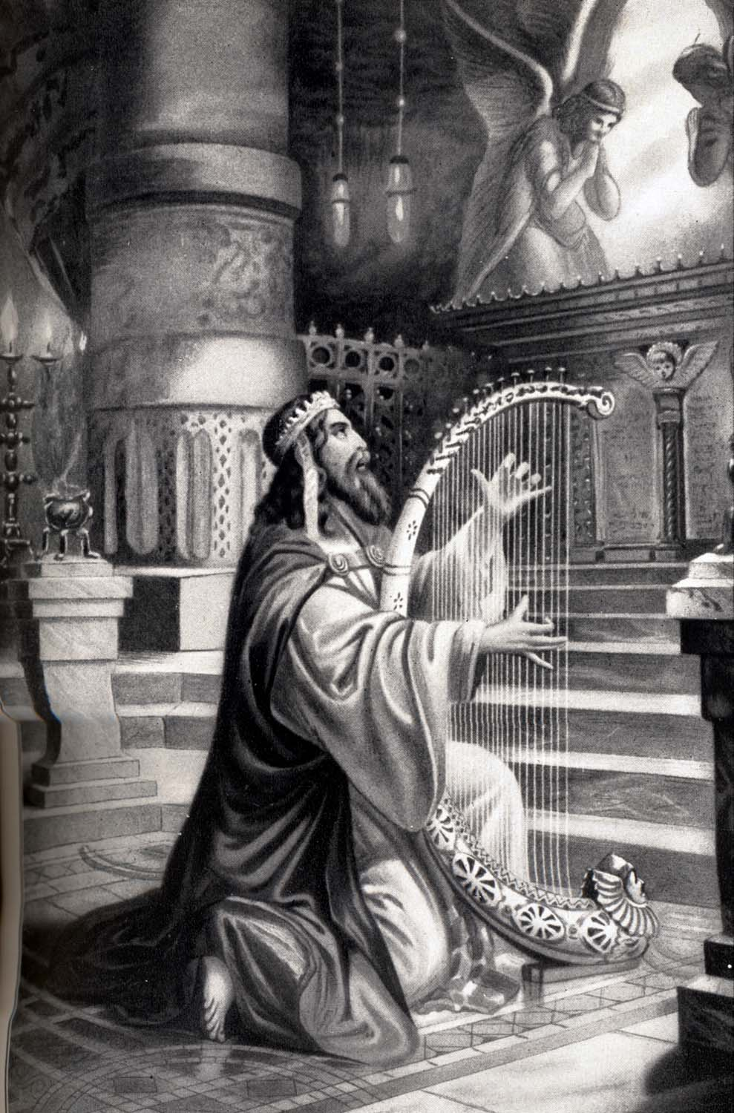
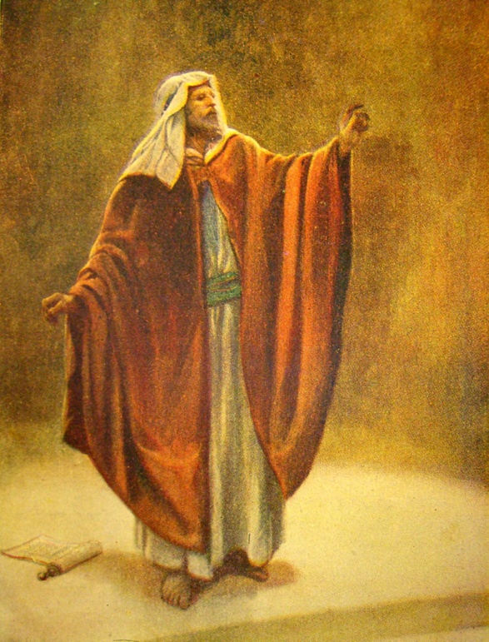
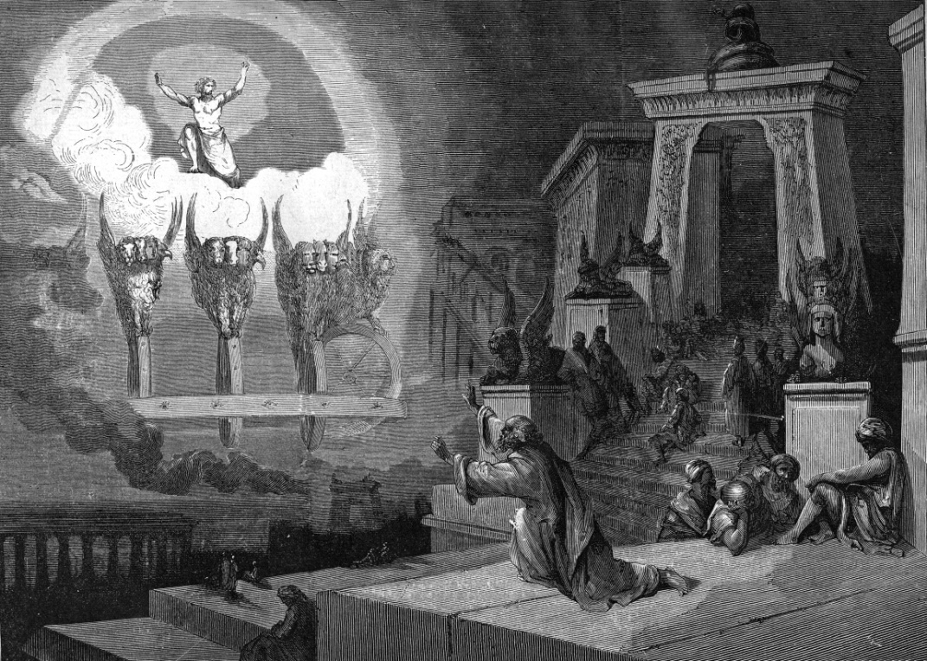

Slide 17
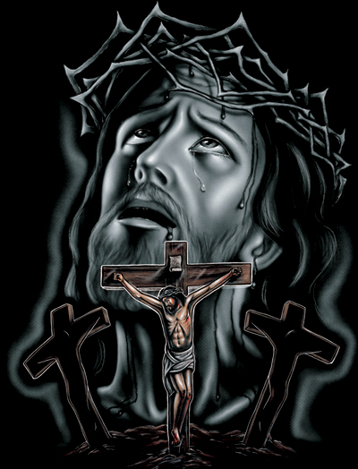
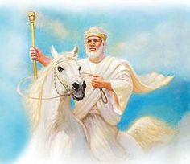
“Searching what, or what manner of time the Spirit of Christ which was in them did signify, when it testified beforehand the sufferings of Christ, and the glory that should follow.” (I Peter 1:11)

Slide 18
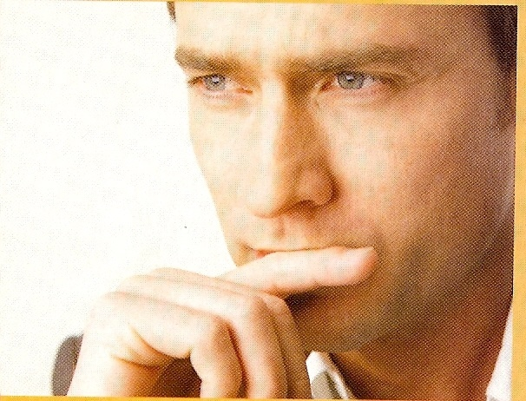
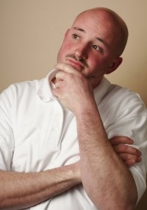
The Mystery of the Ages
“My Lord delayeth His coming.”
“Where is the promise of His coming?”

Slide 19
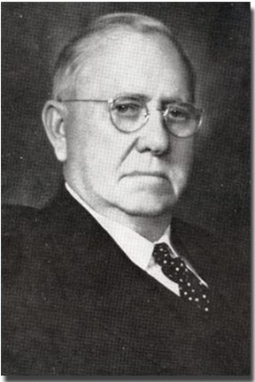
Lehman Strauss
The great mystery of our age has been the so-called silence of God in the face of prevailing wickedness. Sin has stalked around the earth unashamed without much divine intervention. But one day the judgment of the Almighty will be laid upon the world. Then we shall know why He permitted Satan and sin. The mystery of the struggle between light and darkness, good and evil, will be made known in that day.

Slide 20
I confess that at times I have been baffled, and even troubled, by questions in my own mind as to the strange providential ways and dealings of God. But I know that I must wait in patience until that day when the mystery will be made known. That which is now unknown will then be revealed.

Slide 21
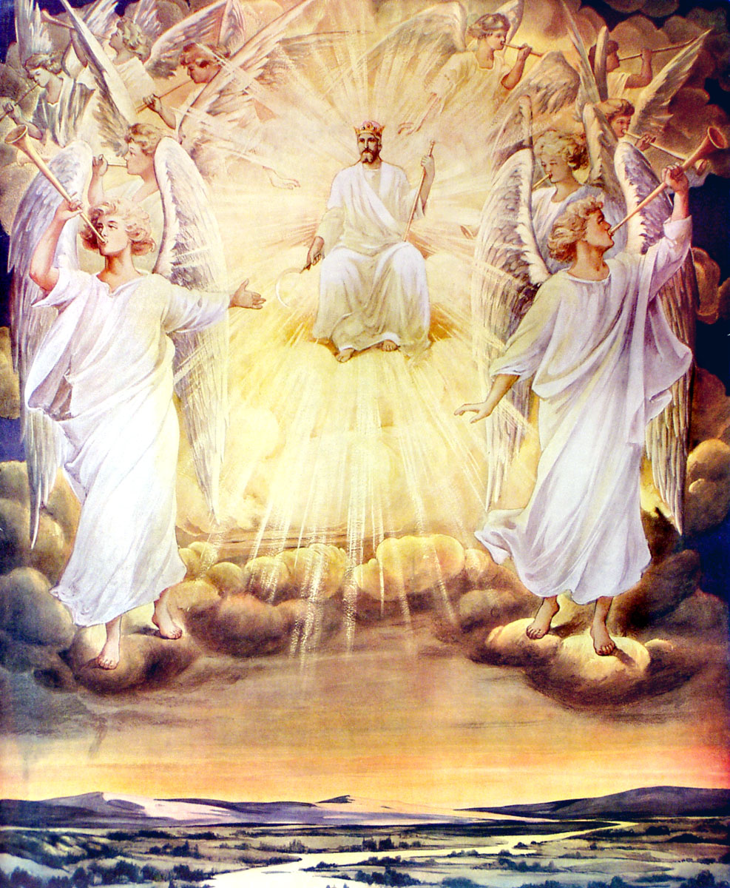
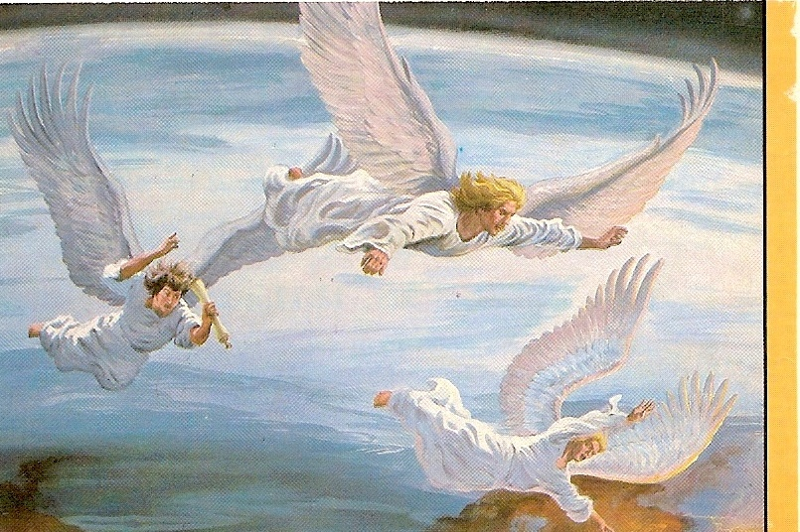
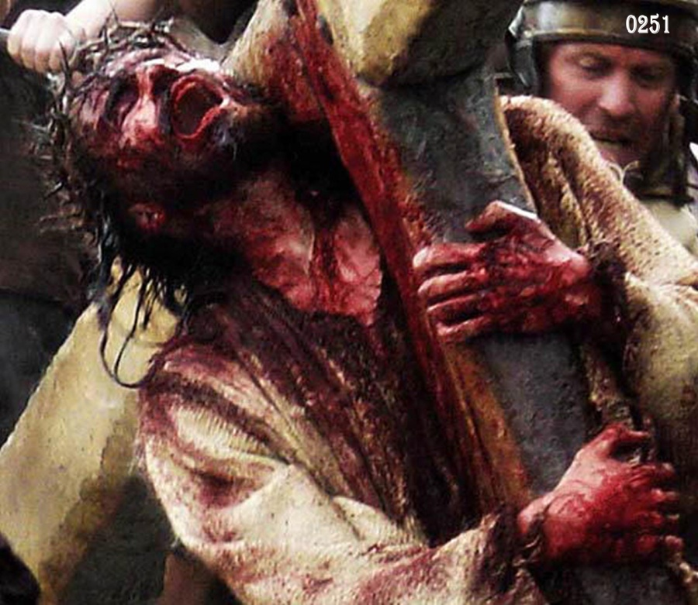
“Of which salvation the prophets have inquired and searched diligently, who prophesied of the grace that should come unto you. Searching what, or what manner of time the Spirit of Christ which was in them did signify, when it testified beforehand of the sufferings of Christ, and the glory that should follow…which things the angels desire to look into.”

Slide 22
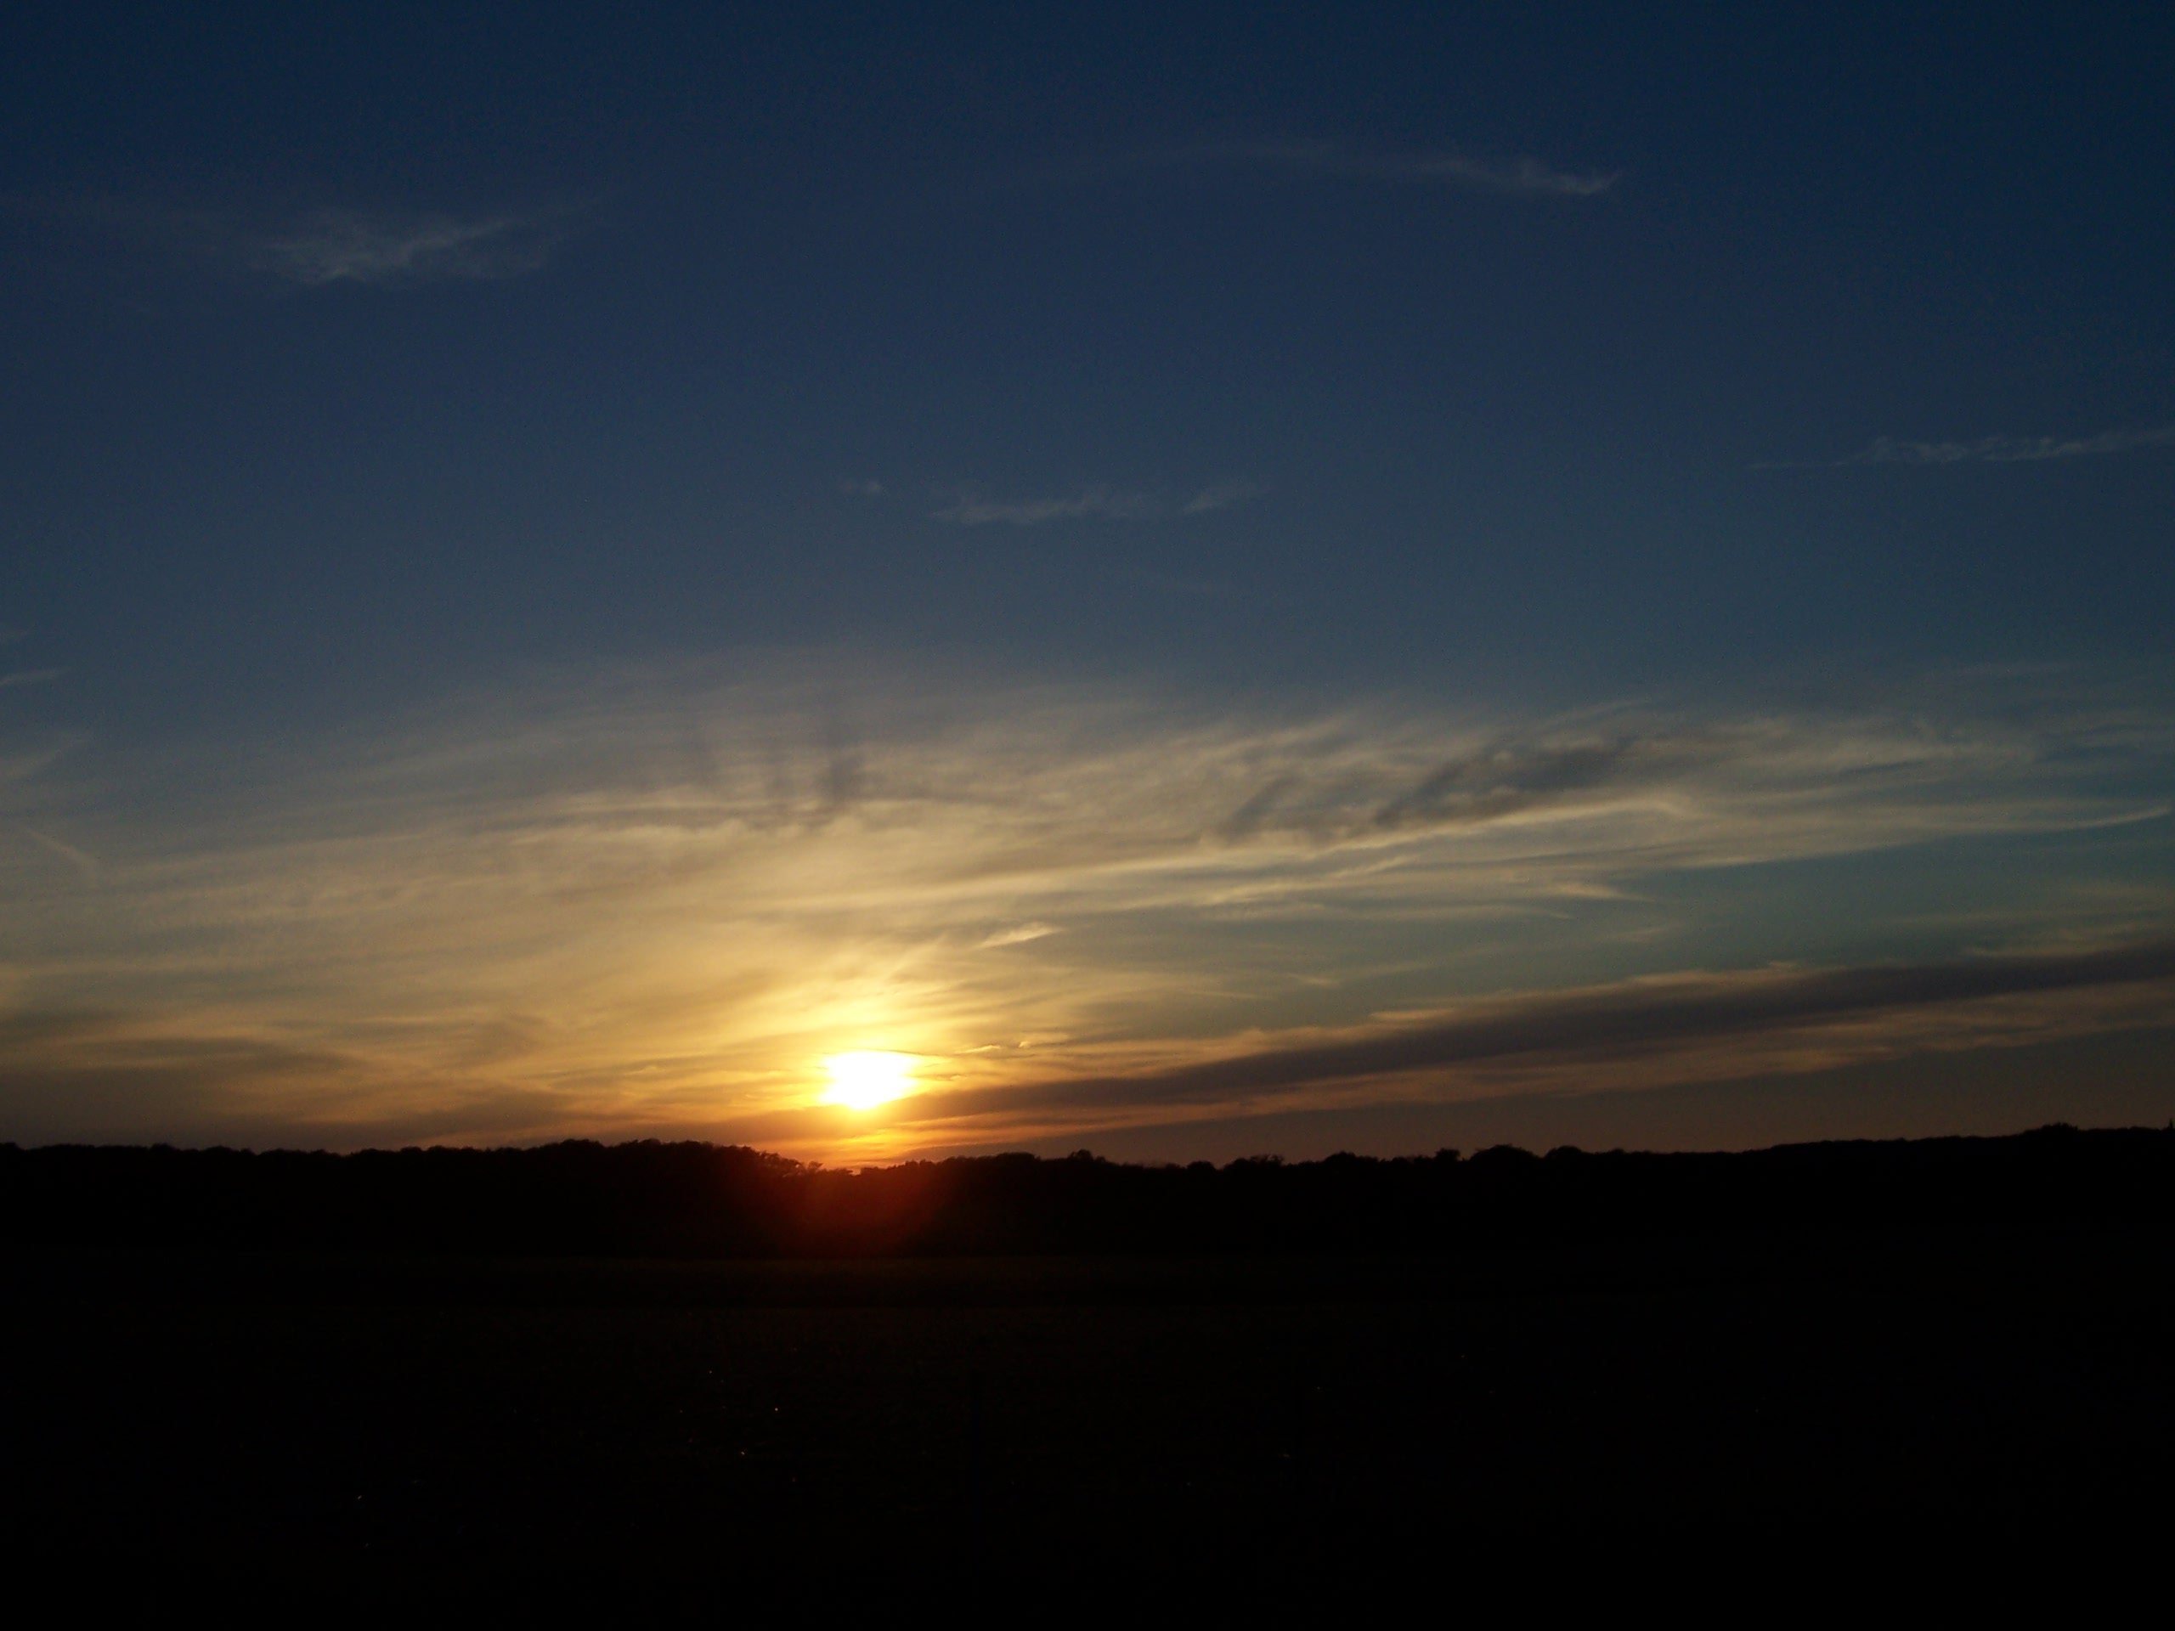
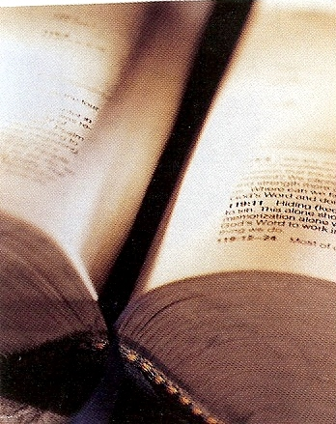
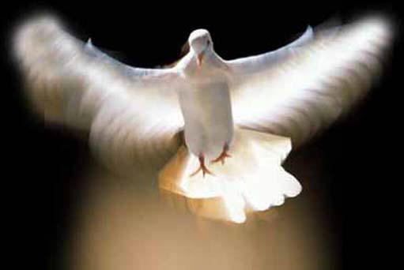
“We have a more sure word of prophecy; whereunto ye do well that ye take heed, as unto a light that shineth in a dark place. Knowing this first, that no prophecy of the Scripture is of any private interpretation. For the prophecy came not in old time by the will of man: but holy men of God spake as they were moved by the Holy Ghost.”

Slide 23
“Go take the little book (divine revelation) which is open in the hand of the angel which standeth upon the sea and upon the earth.”

Slide 24
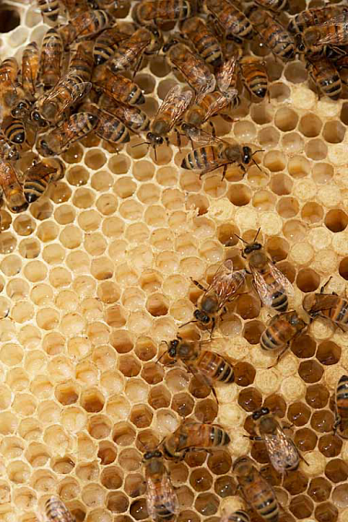
“It shall make thy belly bitter, but it shall be in thy mouth sweet as honey. And I took the little book out of the angel’s hand, and ate it up; and it was in my mouth sweet as honey: and as soon as I had eaten it, my belly was bitter.”

Slide 25
Jesus – “Man shall not live by bread alone, but by every word that proceedeth out of the mouth of God.”
Jeremiah – “Thy words were found, and I did eat them; and Thy word was unto me the joy and rejoicing of mine heart.”
David – “How sweet are Thy words unto my taste! Yea, sweeter than honey to my mouth.”
Peter – “As newborn babes, desire the sincere milk of the word, that ye may grow thereby.”

Slide 27
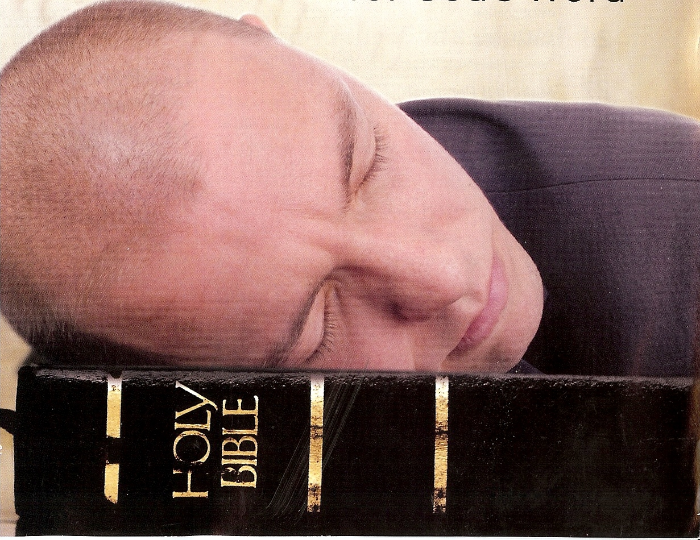

Slide 28
“And he said unto me, Thou must prophesy again before many peoples, and nations, and tongues, and kings.”

