Slide 1
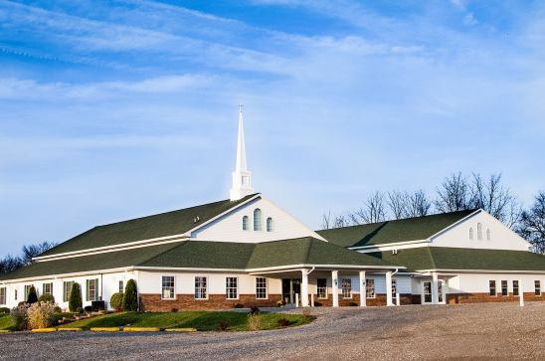
The Doctrine of the Church
The Origin of the Church
“When and where did the church actually begin?”

Slide 2
The Origin of the Church “When and where did the church actually begin?”

Slide 3
Several different views

Slide 4
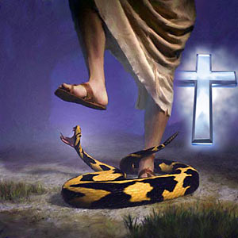
The Church begin with Adam Genesis 3
In this view it is taught that Adam and Eve believed the promise of God that the seed of the serpent would indeed bruise the heel of the woman, but that the woman’s seed would crush the serpent’s head...then it may be asserted that they constituted the first Christian church.

Slide 5
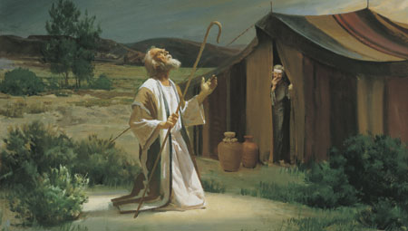
The Church began with Abraham Genesis 12
This is the position is held by covenant theologians. The logic behind this view is the belief that as Israel once functioned as God’s church in the Old Testament, so the church now functions as God’s Israel in the New Testament.
Covenant theology teaches that the church has become God’s elect people, as Israel once was.

Slide 6
What is Covenant Theology?

Slide 7
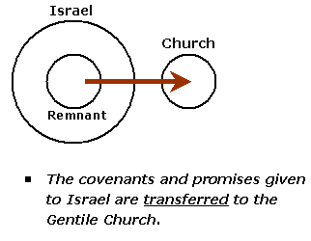

Slide 8
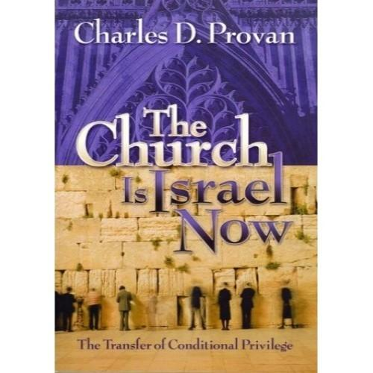

Slide 9
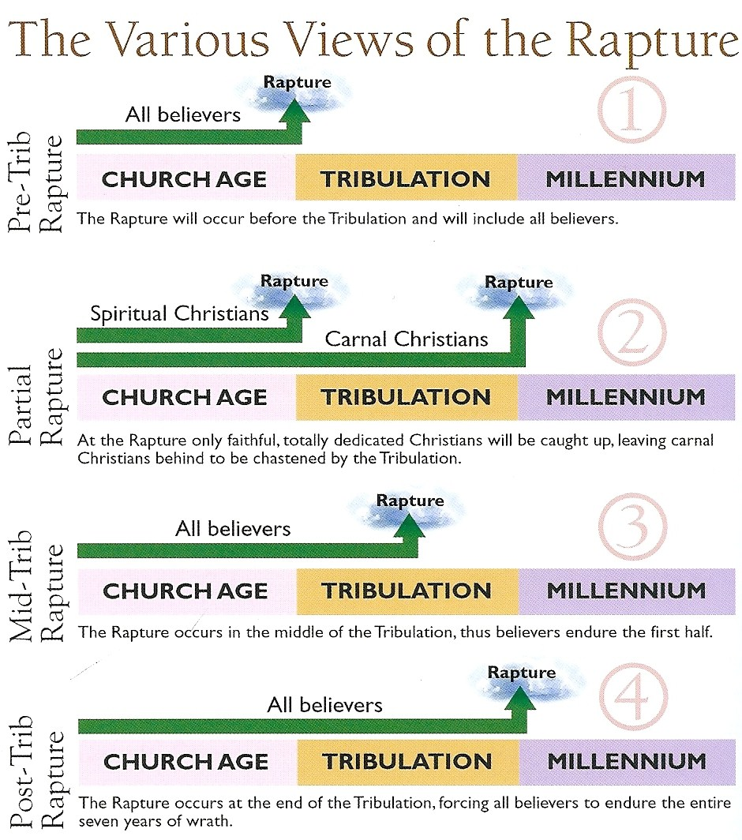

Slide 10
Dispensational Theology
I Cor. 9:17 “A dispensation of the gospel is committed unto me.”
Eph. 1:10 “That in the dispensation of the fulness of times he might gather together in one all things in Christ, both which are in heaven, and which are on earth; even in him.”
Eph. 3:2 “If ye have heard of the dispensation of the grace of God which is given me to you-ward.”
Col. 1:25 “Whereof I am made a minister, according to the dispensation of God which is given to me for you, to fulfil the word of God.”

Slide 11
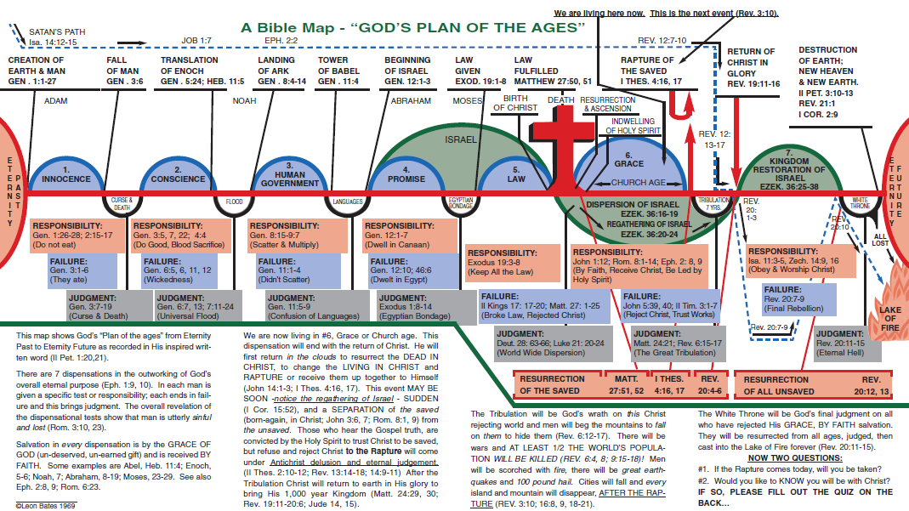

Slide 18
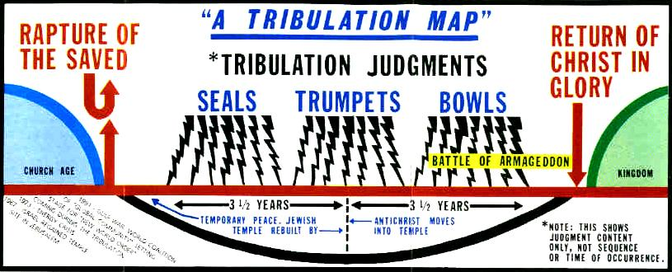

Slide 20
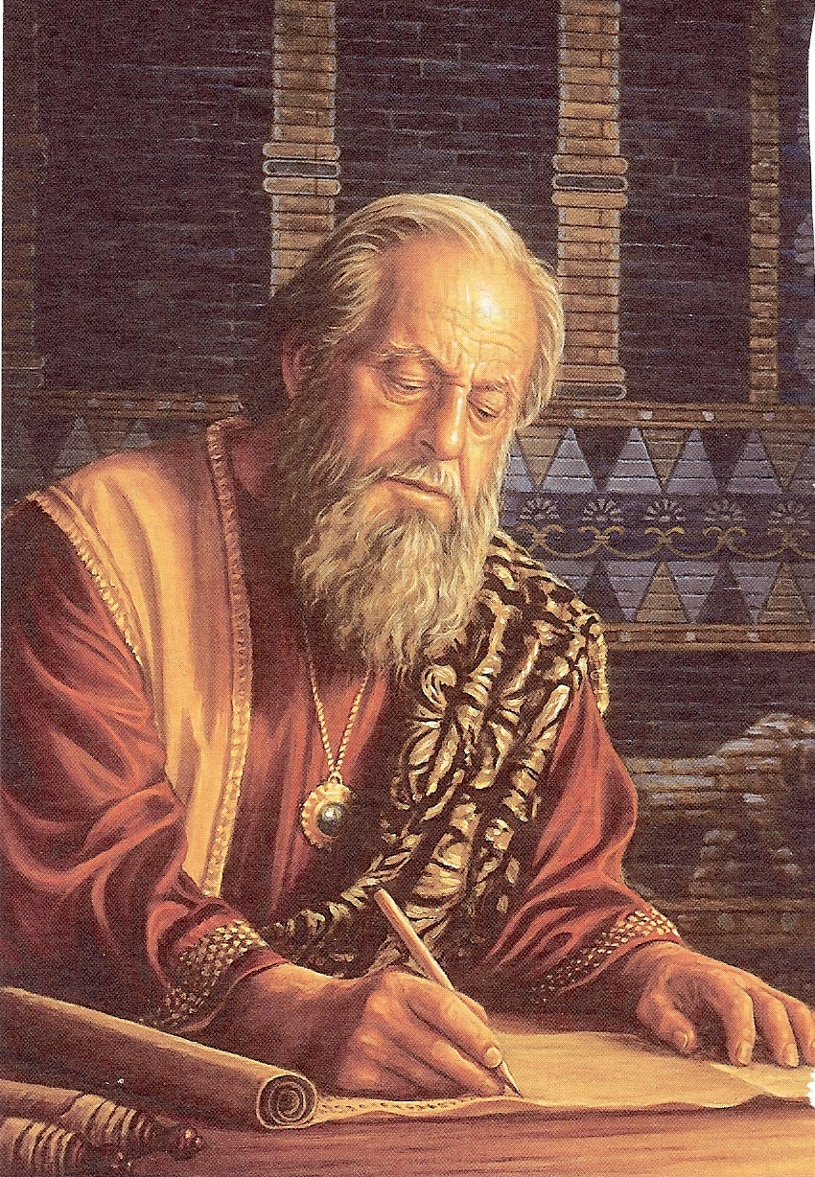
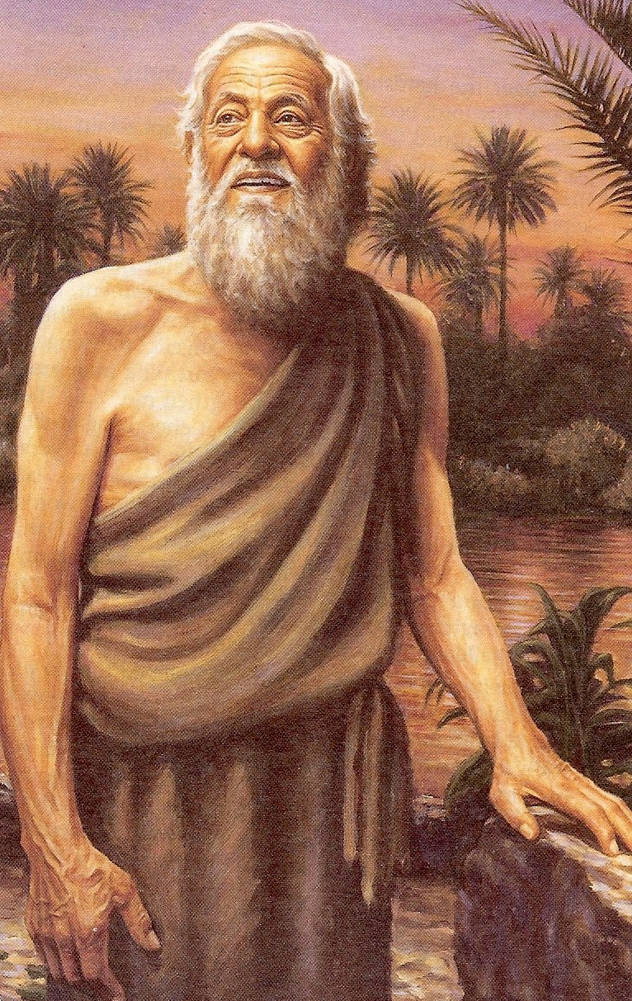
Daniel’s Vision of the 70 Weeks

Slide 21
(Daniel 9:24-27)
“Seventy weeks (490 years) are determined upon thy people (Israel) and upon thy holy city, to finish the transgression, and to make an end of sins, and to make reconciliation for iniquity, and to bring in everlasting righteousness, and to seal up the vision and prophecy, and to anoint the most Holy (Jesus). Know therefore and understand, that from the going forth of the commandment to restore and to build Jerusalem unto the Messiah the Prince shall be seven weeks, and threescore and two weeks: (69 weeks = 483 years) the street shall be built again, and the wall, even in troublous times.

Slide 22
And after threescore and two weeks shall Messiah be cut off, (cross) but not for himself: and the people of the prince that shall come shall destroy the city and the sanctuary; (Titus 70 AD) and the end thereof shall be with a flood, and unto the end of the war desolations are determined. And he (Anti-christ) shall confirm the covenant with many for one week: (seven years) and in the midst of the week (middle of the tribulation) he (Anti-christ) shall cause the sacrifice and the oblation to cease, and for the overspreading of abominations he shall make it desolate, even until the consummation, and that determined shall be poured upon the desolate (second coming of Chrsit).”

Slide 24
Covenant theology is a Calvinist conceptual overview and interpretive framework for understanding the Bible.
Covenant theology views the history of God's dealings with mankind, from Creation to Consummation, under the framework of covenants starting with Adam.
Calvinist believe that the Church is in the unconditional covenant of Grace - Eph 2:8 “For by grace are ye saved through faith; and that not of yourselves: it is the gift of God.”

Slide 25
Thoughts from a Calvinist
Was The Old Covenant A Free Will Covenant or An Unconditional Covenant of Election – Predestination Covenant?
Many Christians regard the new covenant to be based on a free will choice of salvation; that people choose Jesus Christ. I wonder: is there evidence that the old covenant was one of free will? For instance, did Israel choose God, or did God choose Israel? Did God choose the priests (who had to come from the line of Levi) or did the priests choose their occupation? Did God choose the kings (first Saul and then David and his line) or did they take the initiative?

Slide 26
Calvinism is known by an acronym: T.U.L.I.P.
Total Depravity (the total inability “free will” to receive the salvation of God)
Unconditional Election - Covenant
Limited Atonement
Irresistible Grace
Perseverance of the Saints (eternal security / once saved always saved)

Slide 27
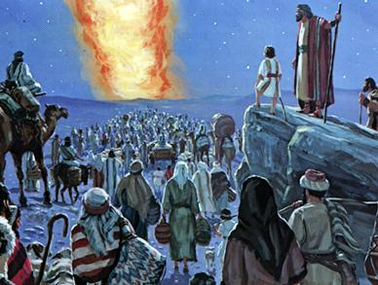
Why was Israel called “The Church in the wilderness?”

Slide 28
(Acts 7:37-38) “This is that Moses, which said unto the children of Israel, A prophet shall the Lord your God raise up unto you of your brethren, like unto me; him shall ye hear. This is he, that was in the church in the wilderness with the angel which spake to him in the mount Sina, and with our fathers: who received the lively oracles to give unto us.”

Slide 29
The church is a called-out assembly because it is called out from the world to assemble. So, it must have been in the world, called out from the world, and formed into a new group in order for them to be a called-out assembly.

Slide 30
Israel was called a church in the wilderness, but Israel was not a church when she was in Egypt because she was not yet a called-out assembly. God called them out from Egypt, and they assembled in the wilderness. They were then a called-out assembly. They were called out of Egypt to assemble and form another group in the wilderness. So, God calls Israel a church in the wilderness. But that does not mean that Israel and the church are one in the same.

Slide 31
Gal. 3:6 “Even as Abraham believed God, and it was accounted to him for righteousness.” Gal. 3:7 “Know ye therefore that they which are of faith, the same are the children of Abraham.” Gal. 3:8 “And the scripture, foreseeing that God would justify the heathen through faith, preached before the gospel unto Abraham, saying, In thee shall all nations be blessed.” Gal. 3:9 “So then they which be of faith are blessed with faithful Abraham.” Gal. 3:14 “That the blessing of Abraham might come on the Gentiles through Jesus Christ; that we might receive the promise of the Spirit through faith.”

Slide 32
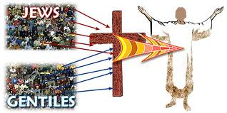
Three Groups of People
(I Corinthians 10:32) “Give none offence, neither to the Jews (Israel), nor to the Gentiles, nor to the church of God.”
Church

Slide 33
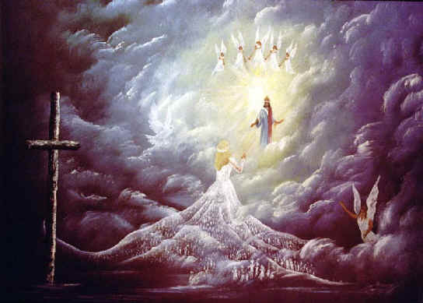
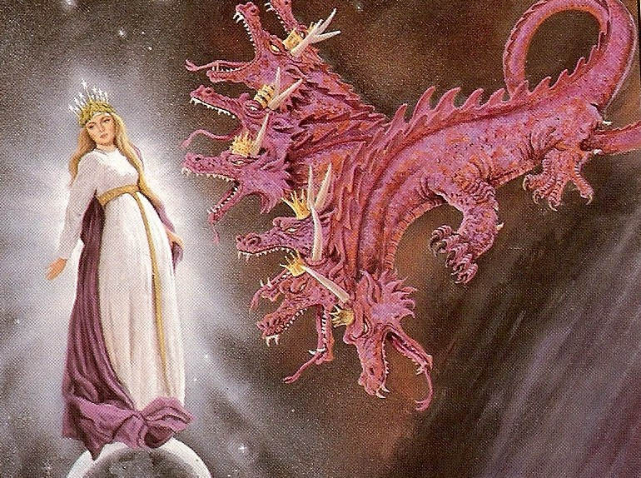
The Church is not Israel.

Slide 34
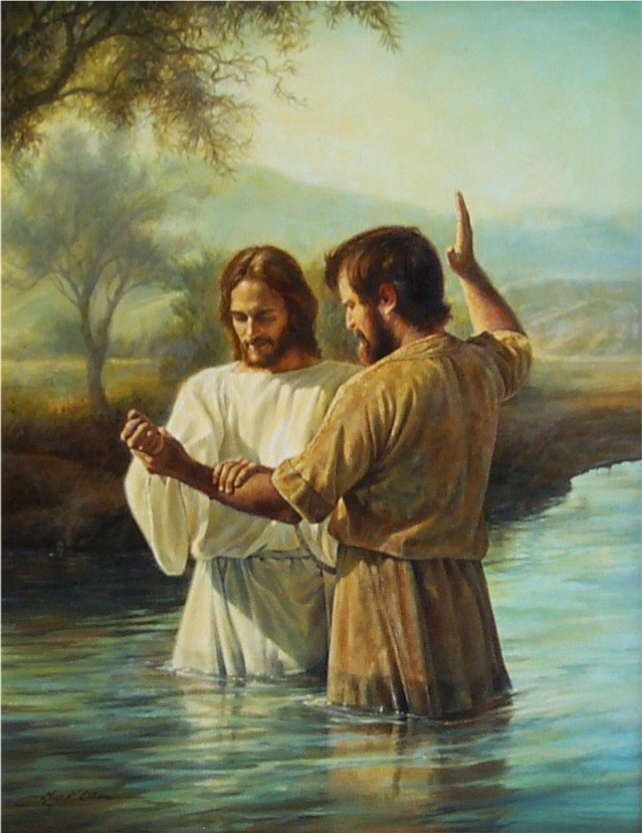
The Church began with John the Baptist Matthew 3

Slide 35
Here the argument is that John was Scripture’s first baptizer, and inasmuch as Christ later commanded his church to practice this worldwide (Matt. 28:19), the conclusion is that the church began with John.

Slide 36
Mark 1:4-9 “John the baptizer appeared in the desert, proclaiming a baptism of repentance for the forgiveness of sins. And people from the whole Judean countryside and all the people of Jerusalem were going out to him, and were baptized by him in the river Jordan, confessing their sins. Now John was clothed with camel's hair, with a leather belt around his waist, and he ate locusts and wild honey. He proclaimed, "The one who is more powerful than I is coming after me; I am not worthy to stoop down and untie the thong of his sandals. I have baptized you with water; but he will baptize you with the
Holy Spirit."

Slide 37
Romans 6:3-6
“Know ye not, that so many of us as were baptized into Jesus Christ were baptized into his death? Therefore we are buried with him by baptism into death: that like as Christ was raised up from the dead by the glory of the Father, even so we also should walk in newness of life. For if we have been planted together in the likeness of his death, we shall be also in the likeness of his resurrection: Knowing this, that our old man is crucified with him, that the body of sin might be destroyed, that henceforth we should not
serve sin.”

Slide 38
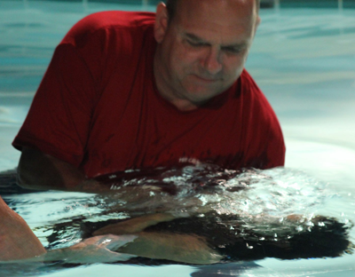
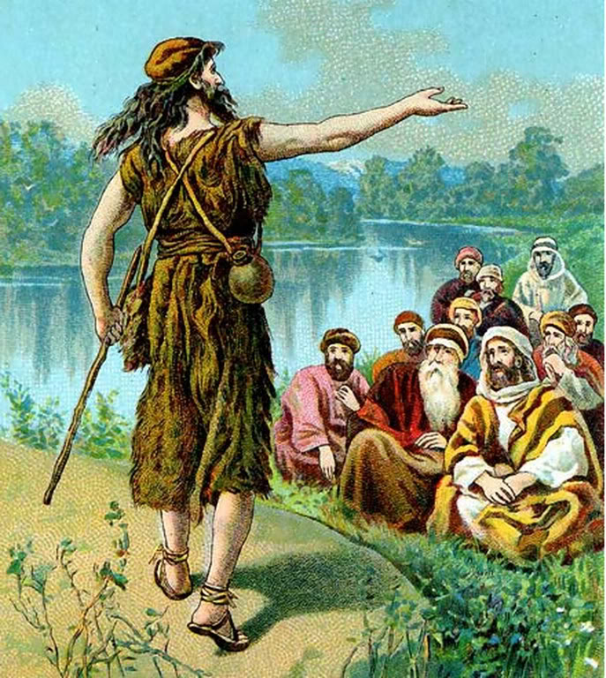

Slide 39
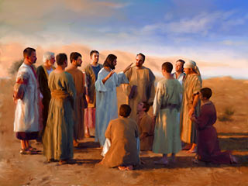
The Church began with Christ
There four different time periods are advocated by those who believe it began with the Savior.

Slide 40
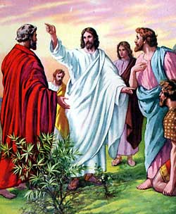
1# At the call of the twelve apostles in Matthew 10
“And are built upon the foundation of the apostles and prophets, Jesus Christ himself being the chief corner stone.” Eph. 2:20

Slide 41
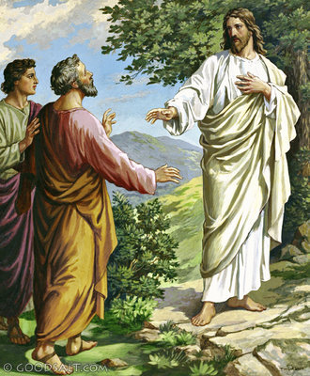
2# At Peter’s confession Matthew 16
Advocates of this position place the church at this point for the simple reason that it is first mentioned by Christ here.
(See Matt. 16:18)

Slide 42
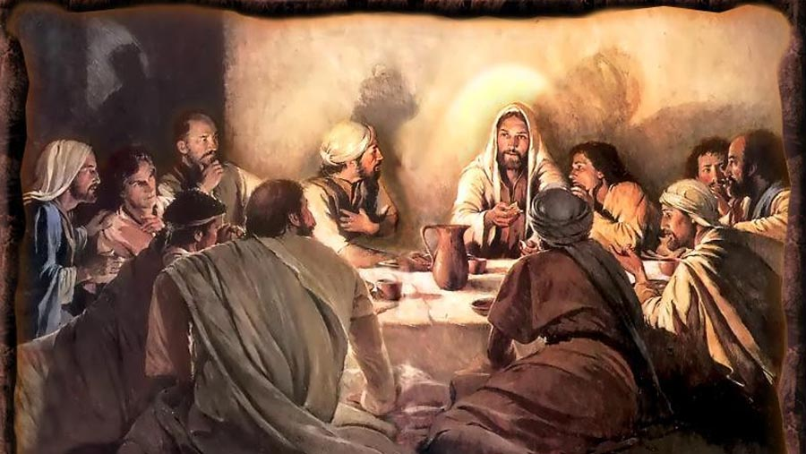
3# At the Last Supper Matthew 26
Those who defend this view point out that it was at this time that Christ instituted the ordinance of the Lord’s Supper, indicating the church now existed.

Slide 43
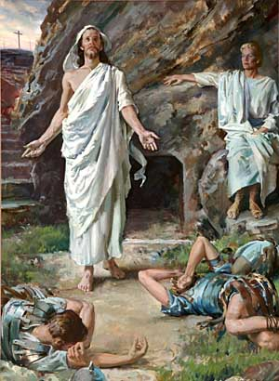
4# At the resurrection of Jesus Christ

Slide 44
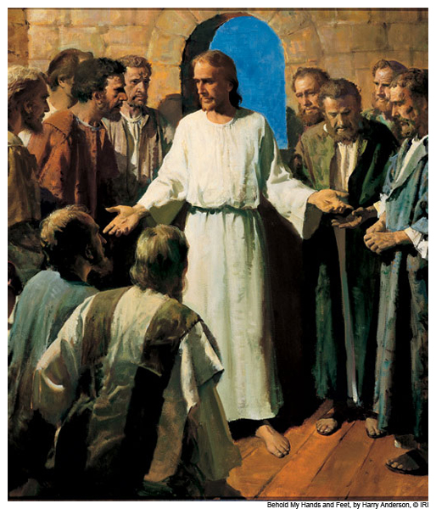
"Then said Jesus to them again, Peace be unto you: as my Father hath sent me, even so send I you. And when he had said this, he breathed on them, and saith unto them, Receive ye the Holy Ghost" (John 20:21-22)
Here it is argued that the final element necessary for the completion of the promised church is now given, namely, the Person and power of the Holy Spirit.

Slide 45
The indwelling of the Holy Spirit did not happen until the day of Pentecost
(Luke 24:48-50)
“And ye are witnesses of these things (resurrection). And, behold, I send the promise of my Father upon you: but tarry ye in the city of Jerusalem, until ye be endued with power from on high. And he led them out as far as to Bethany, and he lifted up his hands, and blessed them.”

Slide 46
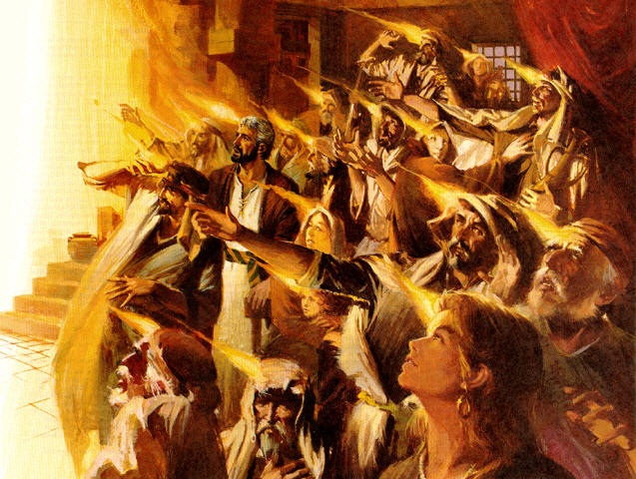
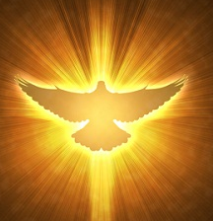
The Promise of the Father

Slide 47
(Acts 1:3-11)
“To whom also he shewed himself alive after his passion by many infallible proofs, being seen of them forty days, and speaking of the things pertaining to the kingdom of God: And, being assembled together with them, commanded them that they should not depart from Jerusalem, but wait for the promise of the Father, which, saith he, ye have heard of me. For John truly baptized with water; but ye shall be baptized with the Holy Ghost not many days hence. When they therefore were come together, they asked of him, saying, Lord, wilt thou at this time restore again the kingdom to Israel? And he said unto them, It is not for you to know the times or the seasons, which the Father hath put in his own power.

Slide 48
But ye shall receive power, after that the Holy Ghost is come upon you: and ye shall be witnesses unto me both in Jerusalem, and in all Judaea, and in Samaria, and unto the uttermost part of the earth. {power...: or, the power of the Holy Ghost coming upon you} And when he had spoken these things, while they beheld, he was taken up; and a cloud received him out of their sight. And while they looked stedfastly toward heaven as he went up, behold, two men stood by them in white apparel; Which also said, Ye men of Galilee, why stand ye gazing up into heaven? this same Jesus, which is taken up from you into heaven, shall so come in like manner as ye have seen him go into heaven.”

Slide 49
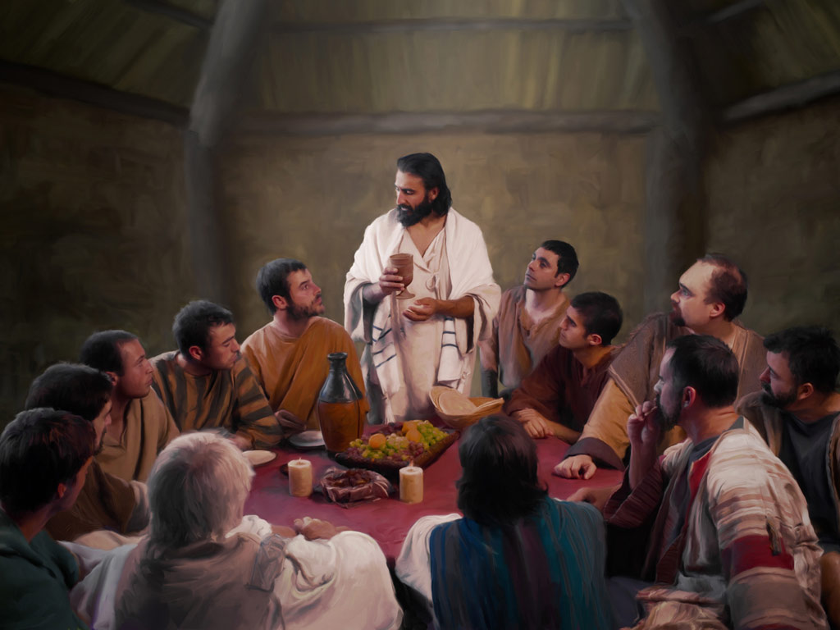
“But when the Comforter is come, whom I will send unto you from the Father, even the Spirit of truth, which proceedeth from the Father, he shall testify of me…Nevertheless I tell you the truth; It is expedient for you that I go away: for if I go not away, the Comforter will not come unto you; but if I depart, I will send him unto you.” (John 15:26, 16:7)

Slide 50
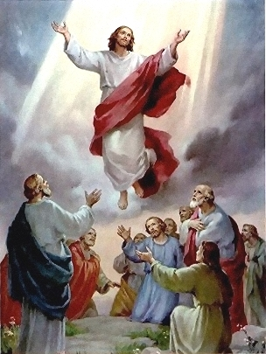
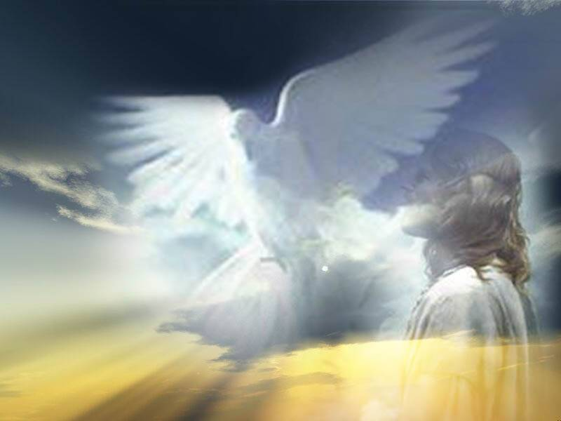

Slide 51
The Church began on the Day of Pentecost
The day of Pentecost marked the beginning of the church for the following reasons.

Slide 52
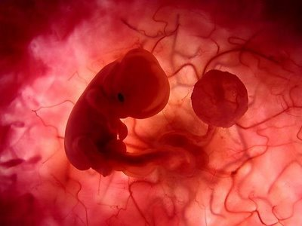
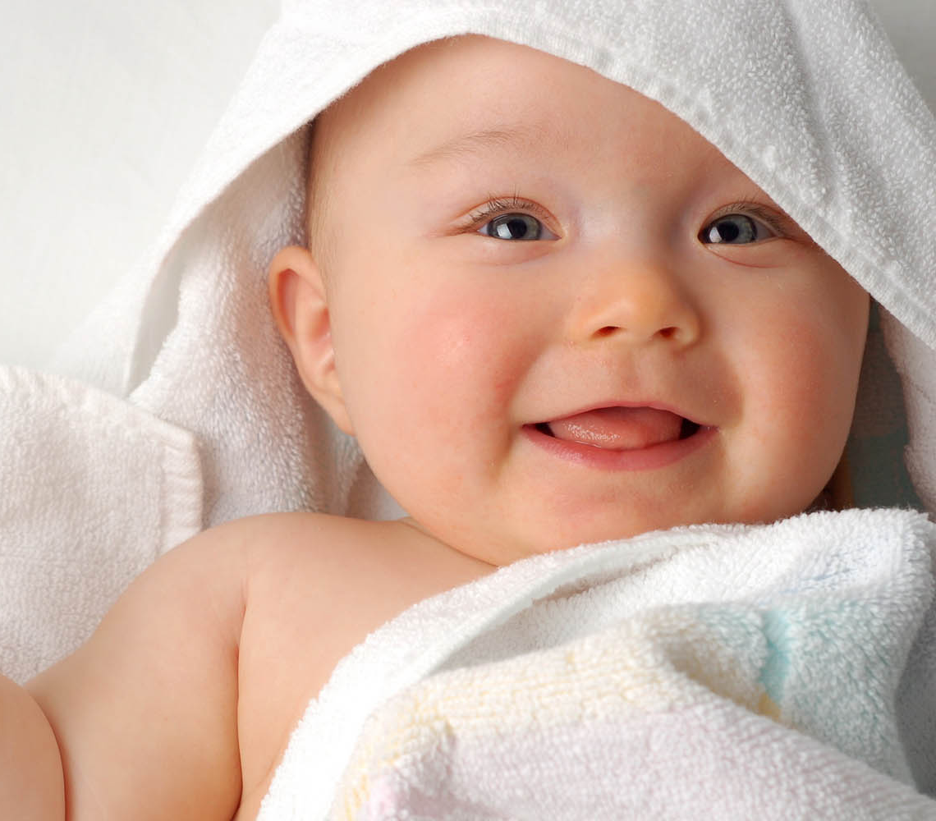
“And when it was day, he called unto him his disciples: and of them he chose twelve, whom also he named apostles.”
(Luke 6:13)
“And when the day of Pentecost was fully come, they were all with one accord in one place. And suddenly there came a sound from heaven as of a rushing mighty wind, and it filled all the house where they were sitting.” (Acts 2:1-2)

Slide 53
The Lord spoke of the Church as being future in Matthew 16:18

Slide 54
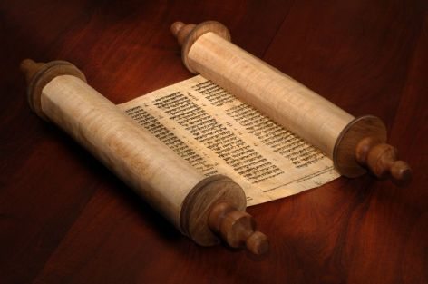
This clearly means that the church did not exist in Old Testament times.

Slide 55
The resurrection and ascension of Christ are essential to the existence and functioning of the church
The church is built on the resurrection of Jesus Christ - (Eph. 1:19-20)
Acts 4:33 “And with great power gave the apostles witness of the resurrection of the Lord Jesus.”
I Cor. 15:14 “And if Christ be not risen, then is our preaching vain, and your faith is also vain.”
Acts 20:7 “And upon the first day of the week, when the disciples came together to break bread, Paul preached unto them.”

Slide 56
The giving of spiritual gifts is required for the churches operation (Rom. 12; I Cor. 12; Eph. 4)

Slide 57
(Ephesians 4:8-12)
“Wherefore he saith, When he ascended up on high, he led captivity captive, and gave gifts unto men. Now that he ascended, what is it but that he also descended first into the lower parts of the earth? He that descended is the same also that ascended up far above all heavens, that he might fill all things. And he gave some, apostles; and some, prophets; and some, evangelists; and some, pastors and teachers; For the perfecting of the saints, for the work of the ministry, for the edifying of the body of Christ.”

Slide 58
The giving of gifts to the church took place after the resurrection and ascension of Christ (Acts 1-2)

Slide 59
“God also bearing them witness, both with signs and wonders, and with divers miracles, and gifts of the Holy Ghost, according to his own will?” (Heb. 2:4; see Acts 2:22, 43)

Slide 60
The principal evidence that the Church began on the day of Pentecost concerns the baptizing work of the Holy Spirit.

Slide 61
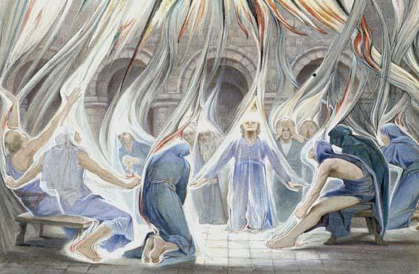
Jesus declared that this particular and distinctive ministry of the Spirit was still future just before his ascension - Acts 1:5
It was on the day of Pentecost that this first occurred - Acts 2; 11:15-16

Slide 62
What is it that Spirit Baptism does?
The answer to this is found in - I Corinthians 12:13
The Baptism of the Holy Spirit places the believer in the body of Christ – I Corinthians 12:27
Since this is the only way to enter the body of Christ and since this work of the Spirit first occurred on the day of Pentecost, then the conclusion is obvious that the Church, the body of Christ, began on the day of Pentecost

Slide 63
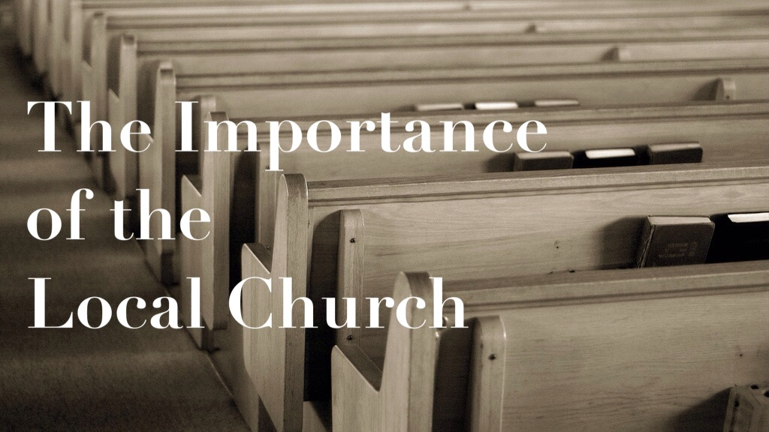
“And he is the head of the body, the church: who is the beginning, the firstborn from the dead; that in all things he might have the preeminence.” Col 1:18

Slide 64
(Eph. 5:25)
“Christ also loved the church, and gave himself for it.”

